Slide 1
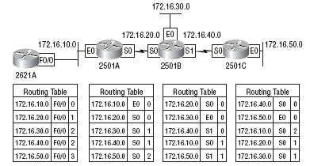
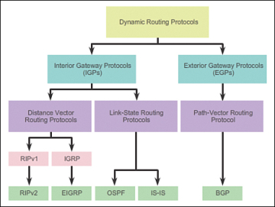
Routing: Key Aspects
Routing table
Routing algorithms

Slide 2
Static Routing

Slide 3
Static Routing Concept
We need to manually add routing information to the routers
Routers do not automatically create/update routing information
Easy but not efficient
Can be used for small networks

Slide 4
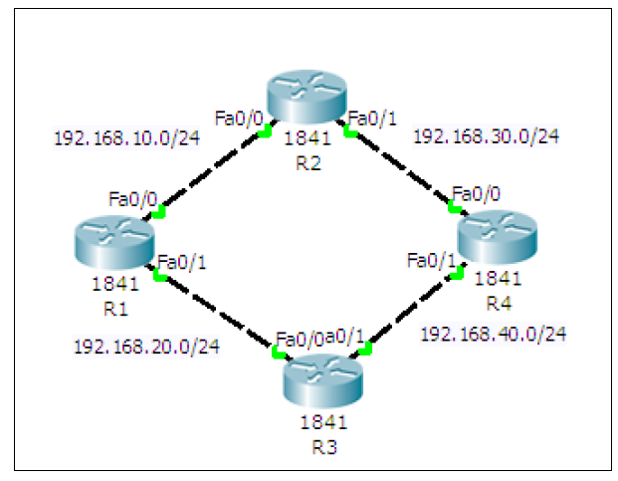
Static Routing Setup
Create a ring topology
(Next slide for details)

Slide 5
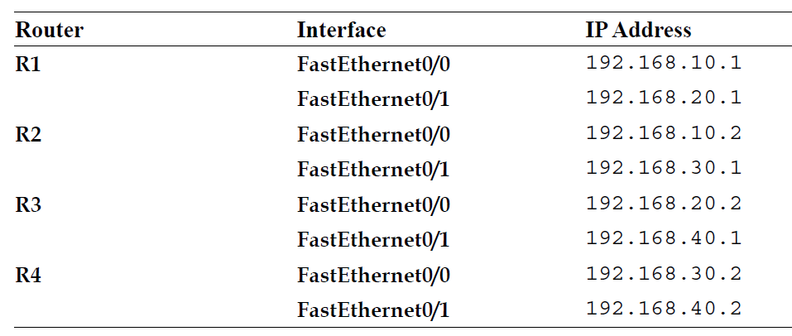
Creating the Ring Topology
Add four routers with the following details – Make sure Port is On

Slide 6
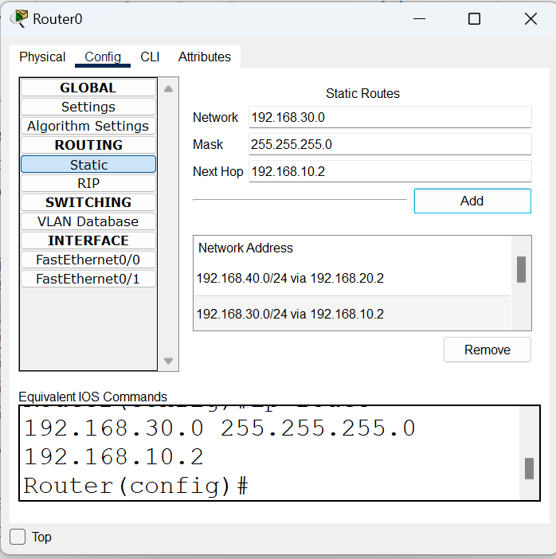
Configuring Routes Statically
Open the first Router (R1) and in Routing, add the routes
Enter the details here and click on Add

Slide 7
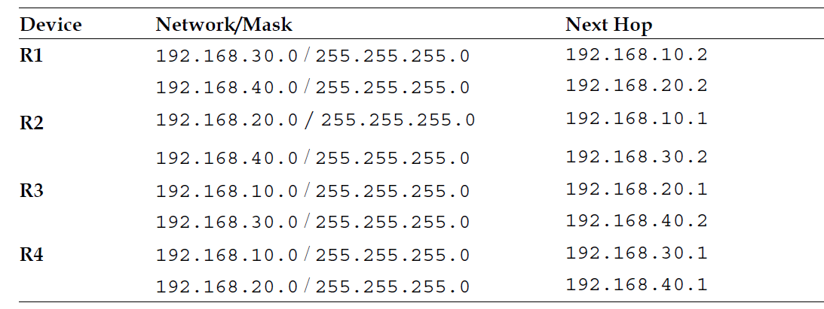
Similarly, for the Others, Add Information as Below

Slide 8

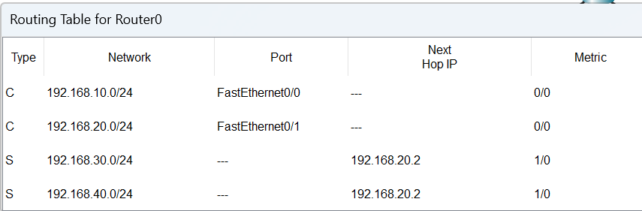
Checking Routing Table
We can examine any router’s routing table by clicking on the search button (called Inspect) on the top left corner of the screen
and then selecting a router

Slide 9
Testing
Add a simple PDU from the menu to any two routers and see if they can route the packet correctly or not

Slide 10
Dynamic Routing

Slide 11
Dynamic Routing
Routing Information Protocol (RIP) is used by routers to exchange information so as to build routing tables
We do not have to add routing information statically now
Routers automatically do this

Slide 12
Configuring RIP
1. Create the same four-router topology we used previously and assign the same IP addresses through the Config tab.

Slide 13
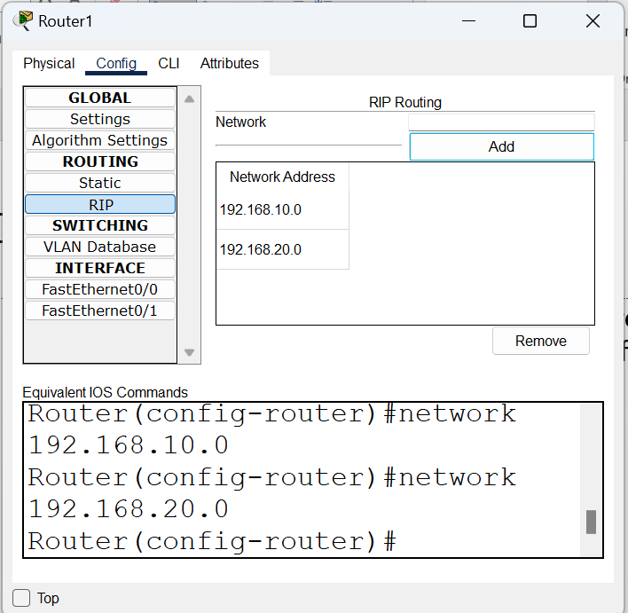
Configuring RIP
2. Click on RIP. This is very easy. Each router now requires only the Network IP of its own interfaces, as shown in the following screenshot:
Full list – next slide

Slide 14
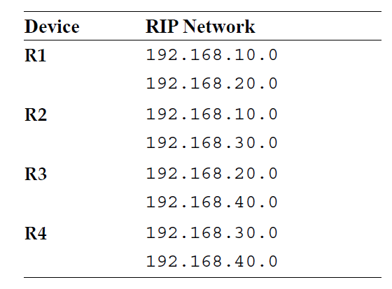
Network Addresses for RIP Configuration

Slide 15
Test using the PDU
Same as before

