Slide 1



MILITARY AIRCRAFT PERFORMANCE
ANALYSIS

Slide 2
ABSTRACT
This project focuses on analyzing and comparing military aircraft based on their performance characteristics. It identifies key trends, differences, and capabilities among aircraft to provide a better understanding of military aviation systems.
01

Slide 3
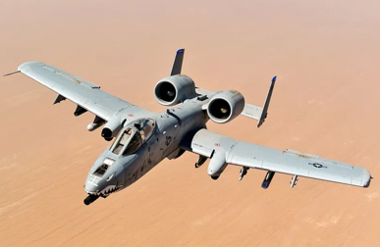
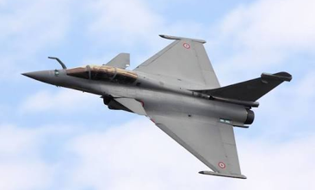
02

Slide 4
INTRODUCTION
•Military aircraft play a vital role in defense, surveillance, and combat operations.
•Different aircraft are designed with unique capabilities and performance characteristics.
•Comparing aircraft performance helps in understanding their strengths and operational efficiency.
•This project analyzes key aircraft parameters such as speed, combat range, generation, and cost.
03

Slide 5
DESCRIPTION
  This project focuses on the analysis of military fighter aircraft performance using a Kaggle dataset.
  The dataset includes aircraft name,country,generation,role,maximum speed etc.
  Data cleaning,sorting,and grouping techniques were used for better analysis.
  The results help identify the fastest,most expensive,and highest combat range aircraft.
04

Slide 6
OBJECTIVES
•Collect and analyze fighter aircraft dataset.
•Compare aircraft based on maximum speed.
• Study combat radius of different aircraft.
•Identify fastest and most expensive aircraft
•Analyze aircraft cost by country.
05

Slide 7
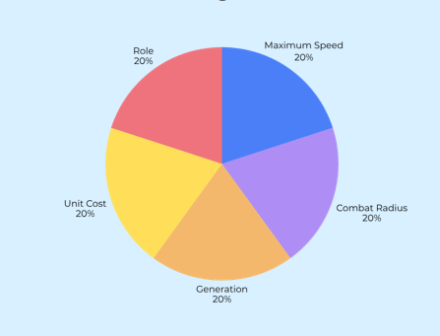
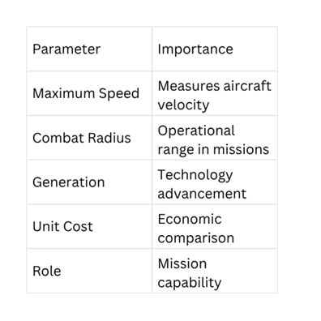
AIRCRAFT PERFORMANCE COMPARISON
06

Slide 8
ADVANTAGES
•Provides data-driven insights for better analysis and decision-making.
•Identifies trends and patterns in aircraft specifications.
•Simplifies complex aircraft data through visualizations.
•Enhances understanding of aviation performance metrics.
Demonstrates the practical application of data analytics techniques
08

Slide 9
SOFTWARE REQUIREMENTS
S.No | Category | Tools / Technologies
1 | Operating System | Windows 10 / Windows 11
2 | Programming Language | Python 3.x
3 | Development Environment | Jupyter Notebook / Google Colab
4 | Python Libraries | Pandas, NumPy, Matplotlib
5 | Dataset Source | Kaggle
6 | Spreadsheet Tool | Microsoft Excel (for data preprocessing)
07

Slide 10
LIBRARIES
Library | Purpose
Pandas | Data cleaning, preprocessing, and analysis
NumPy | Numerical computations and array operations
Matplotlib | Creating charts and data visualizations
Seaborn | Enhanced statistical visualizations
09

Slide 11
METHODOLOGY
Dataset Collection
↓
Data Cleaning
↓
Data Processing
↓
Performance Analysis
↓
Comparison of Aircraft
↓
Visualization
↓
Conclusions
10

Slide 12
RESULTS
  Average speed of aircraft by country was analysed.
  Combat radius was compared based on aircraft generation.
  Unit cost comparison was performed for different countries.
  Fastest and slowest aircraft were identified.
  Most expensive and cheapest aircraft were found.
  Aircraft with highest combat radius was identified.
11

Slide 13
CONCLUSION
THIS PROJECT ANALYZED MILITARY AIRCRAFT PERFORMANCE USING KEY PARAMETERS SUCH AS SPEED, COMBAT RADIUS, AND COST. DIFFERENT AIRCRAFT WERE COMPARED TO IDENTIFY TOP-PERFORMING MODELS AND UNDERSTAND PERFORMANCE TRENDS. DATA VISUALIZATION HELPED SIMPLIFY COMPLEX INFORMATION AND GENERATE MEANINGFUL INSIGHTS. OVERALL, THE PROJECT DEMONSTRATED THE EFFECTIVENESS OF DATA ANALYTICS IN EVALUATING MILITARY AVIATION CAPABILITIES.
11

Slide 14
REFERENCES
  Kaggle Datasets –https://www.kaggle.com
  Python Official Documentation-https://docs.python.org
  NumPy Documentation-https://numpy.org/doc
  Pandas Documentation-https://pandas.pydata.org/docs
  Matplotlib Documentation- https://matplotlib.org/stable/users/index.html
11

Slide 15
THANK YOU
11

