Slide 1
AI-DESK
One framework,
three experiences
How AI-Desk powers Enterprise Search, Bots and the Data Analyst — and how it uses DataHub.
Architecture walkthrough
Notes:
This pack answers one question: what does a client actually get, and who does what behind the seam. Three experiences, one framework, one system of record.

Slide 2
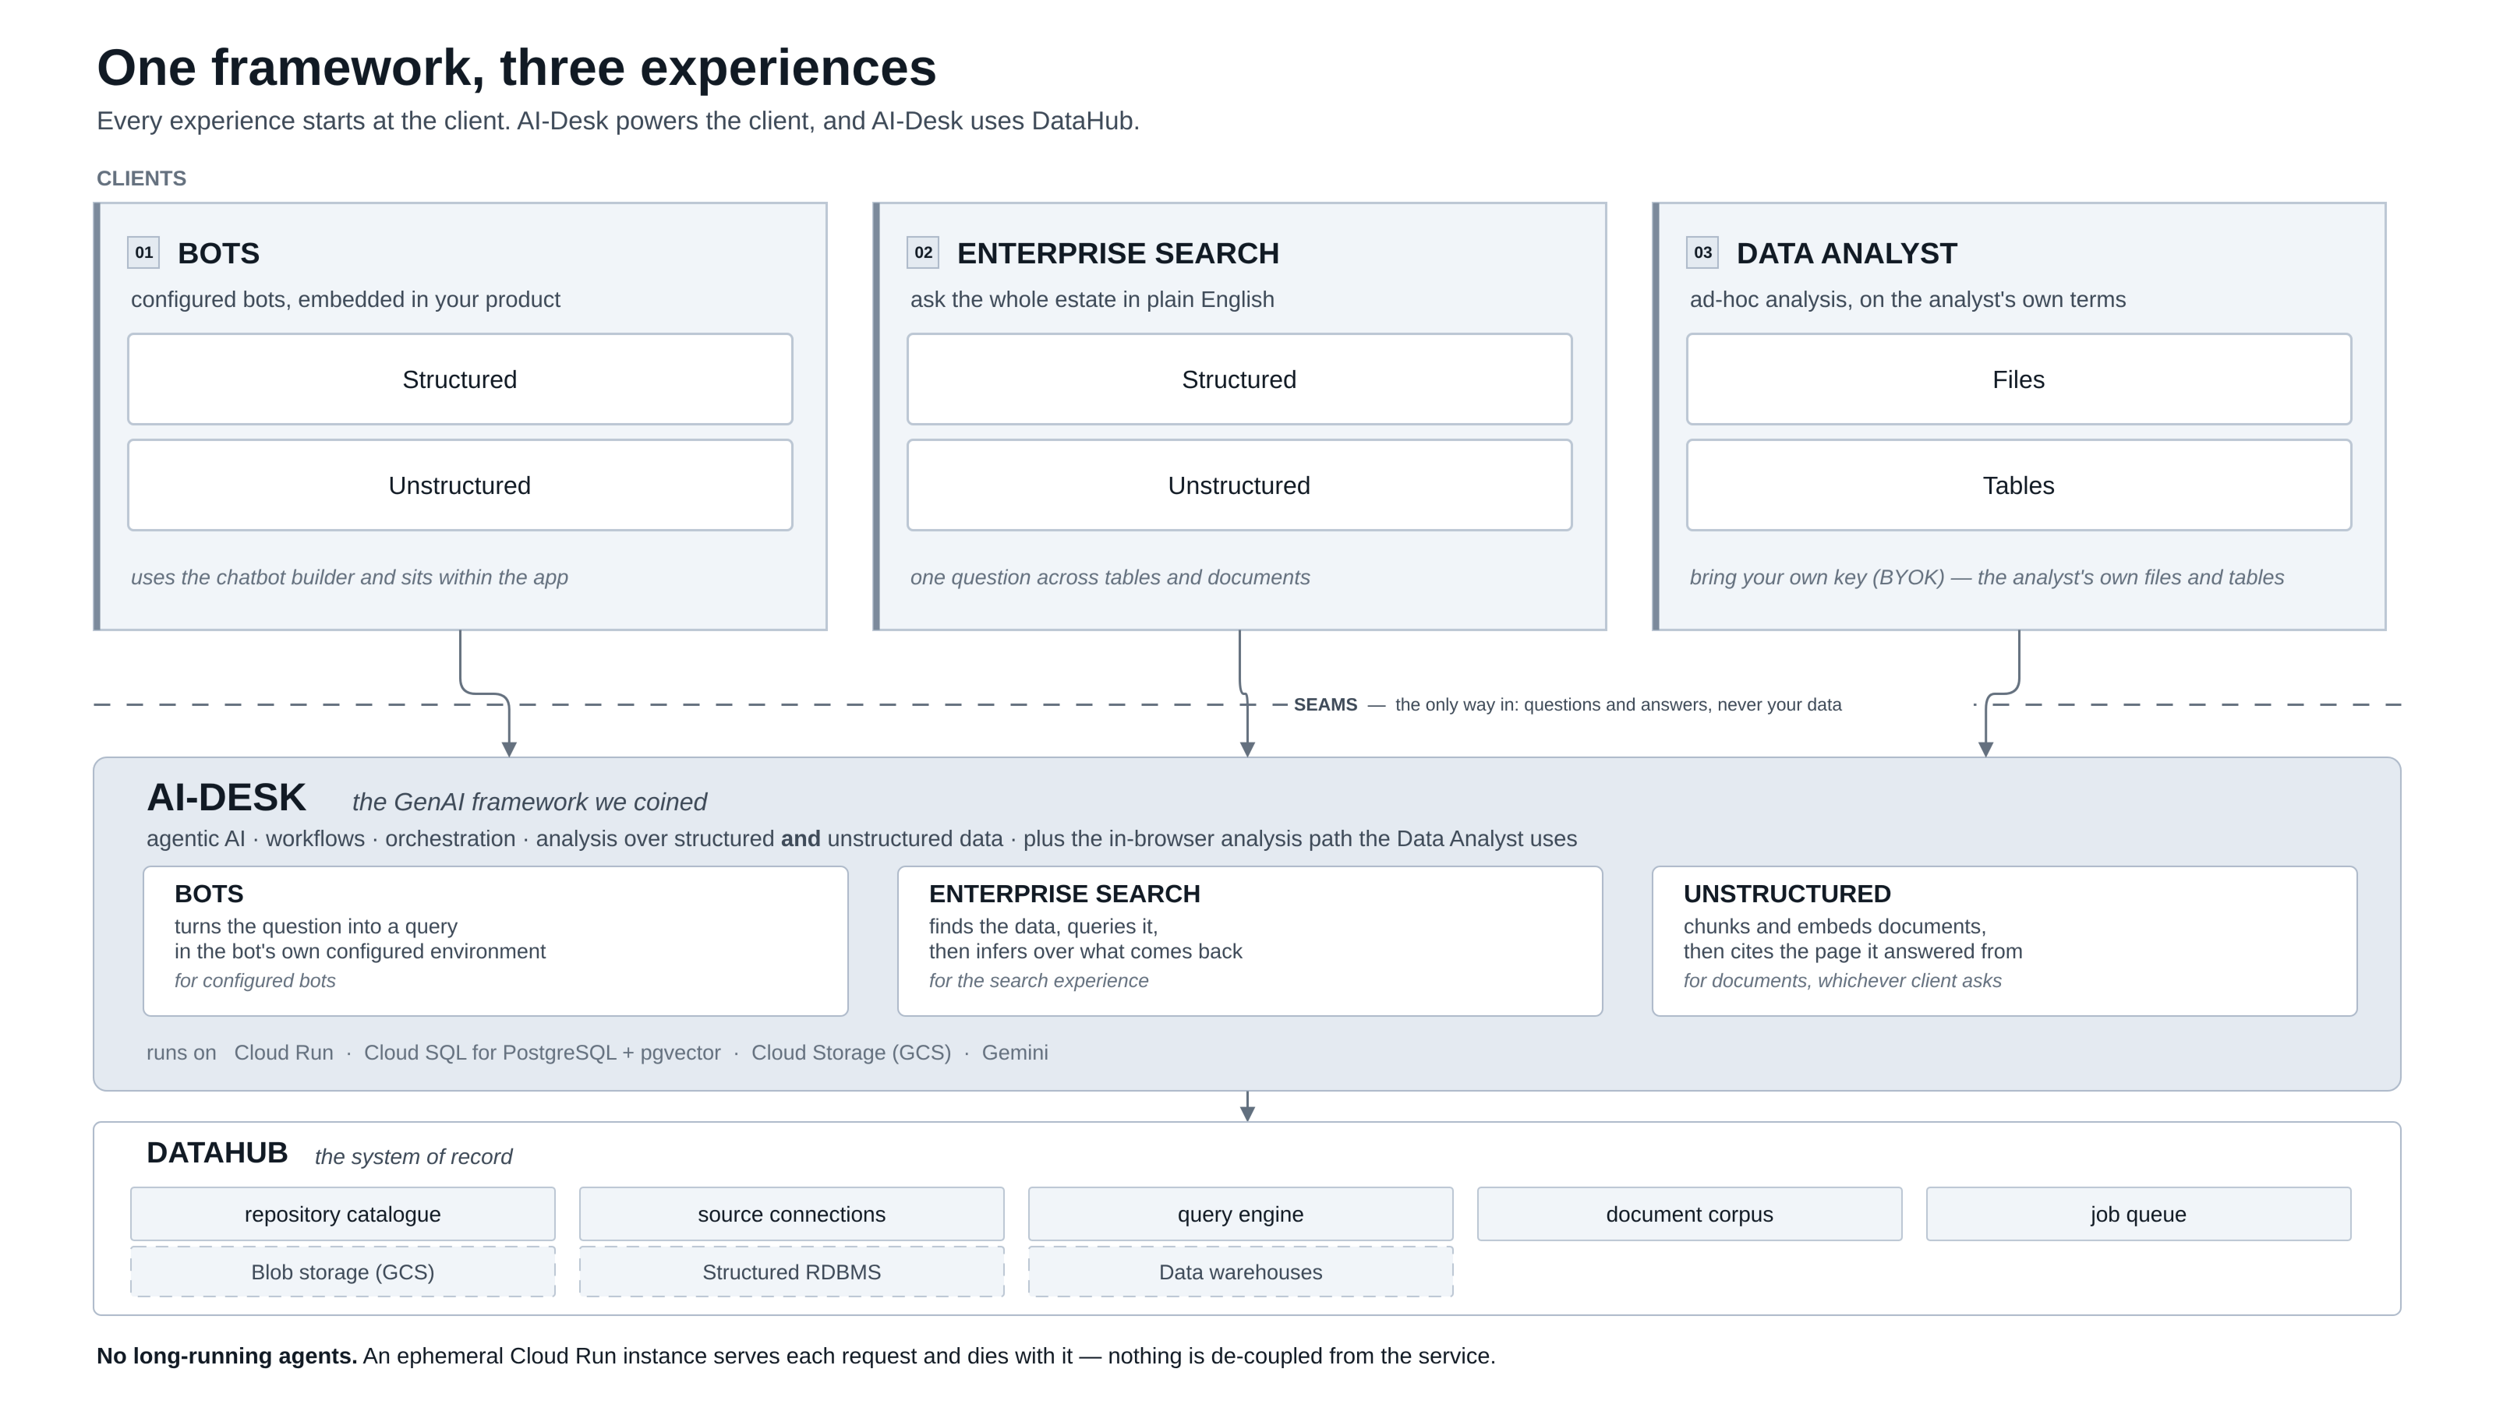
Notes:
The whole picture. Every experience starts at the client; AI-Desk powers the client and AI-Desk uses DataHub. Three client groups sit above the seam, the AI-DESK band holds the three services it hosts, and DataHub is the system of record underneath with the attached sources.
Open here. Point out the seam: questions and answers cross it, data never does. Everything below the dashed line belongs to the platform.

Slide 3
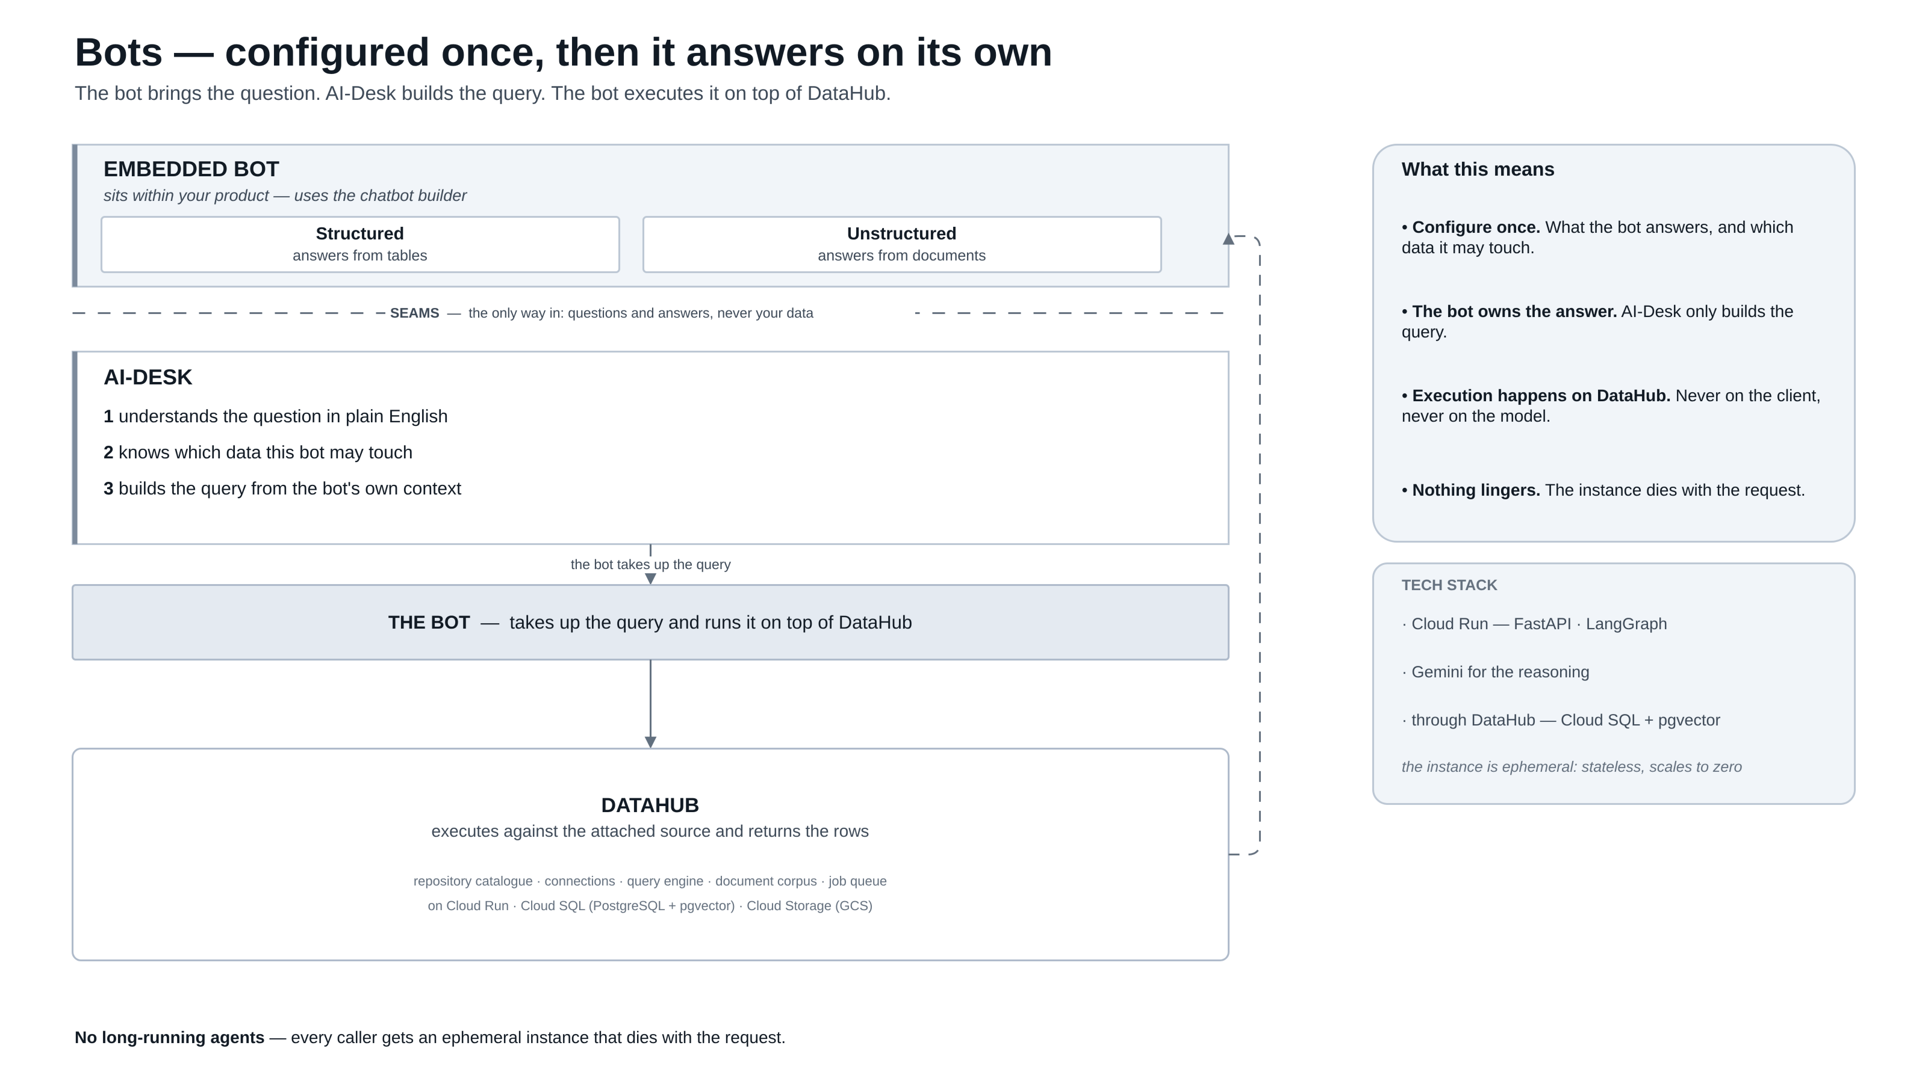
Notes:
A configured bot brings the question. AI-Desk understands it, checks which data the bot may touch, and builds the query. The bot takes the query up and executes it on top of DataHub, which is the only component that touches the source database.
The key line is 'the bot owns the answer' — AI-Desk only builds the query. Emphasise that the instance is ephemeral and nothing lingers between requests.

Slide 4
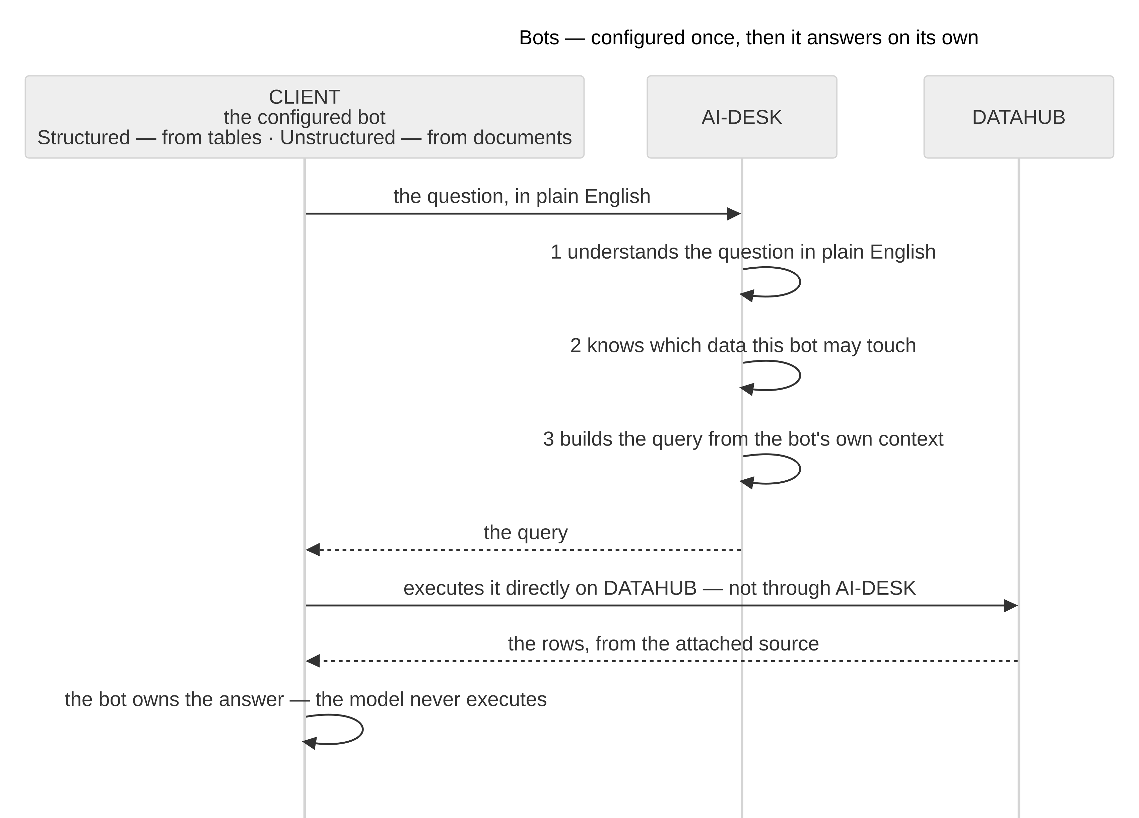
Bots — how a question travels
THE SEQUENCE
A bot is configured once: what it answers, and which data it may touch.
AI-Desk resolves the question into a query — the model never runs it.
AI-Desk hands the query back; the bot executes it directly on DataHub.
Rows return to the bot, and the bot owns the answer. Nothing is cached.
same seam · same DataHub
Notes:
Bots — how a question travels — A bot is configured once: what it answers, and which data it may touch. AI-Desk resolves the question into a query — the model never runs it. AI-Desk hands the query back; the bot executes it directly on DataHub. Rows return to the bot, and the bot owns the answer. Nothing is cached.

Slide 5
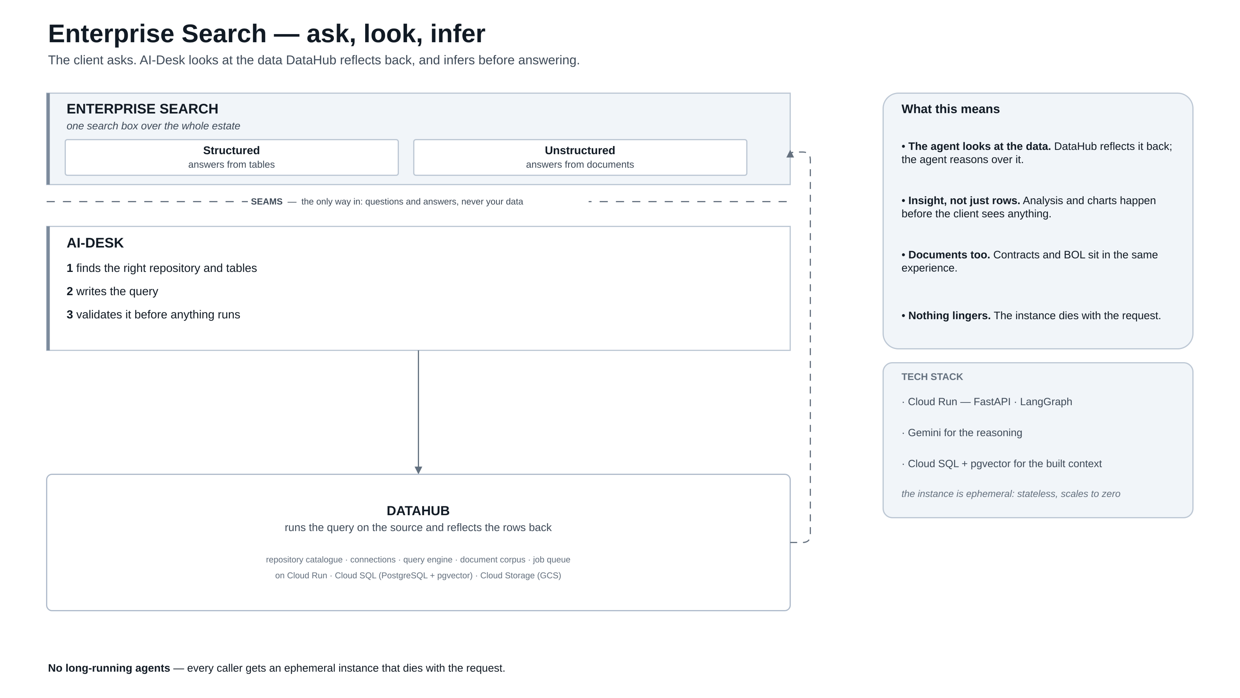
Notes:
The client asks; AI-Desk finds the right repository and tables, writes the query and validates it before anything runs. DataHub runs it on the source and reflects the rows back, so the agent can reason over the data and return insight, not just rows.
This is the experience that shows the framework looking at data rather than only moving it. Documents from the same estate land here too, through the Unstructured service.

Slide 6
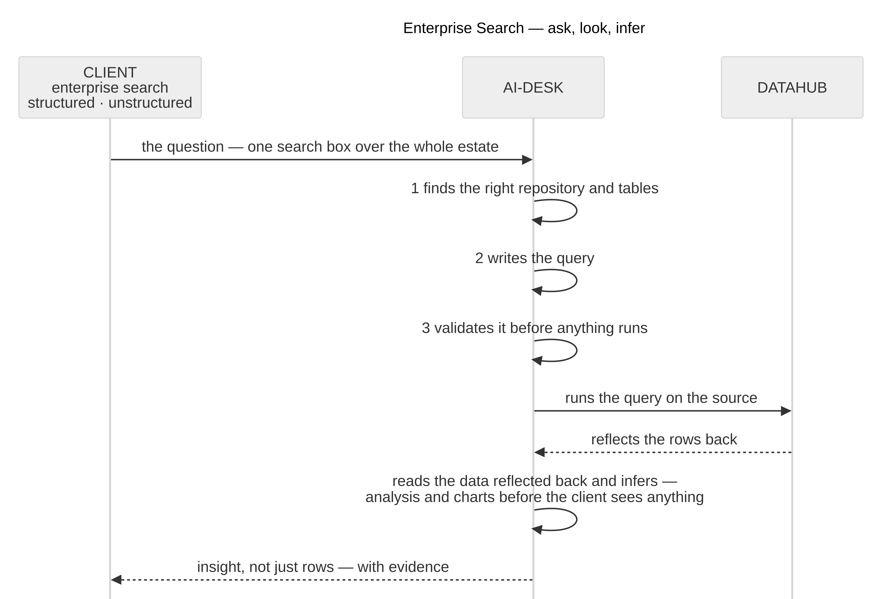
Enterprise Search — behind the seam
THE SEQUENCE
One question across the estate: warehouse tables and documents.
AI-Desk finds the repository, writes the query, validates it.
DataHub runs it on the source and reflects the rows back.
The agent reasons over them, then the client sees insight and charts.
same seam · same DataHub
Notes:
Enterprise Search — behind the seam — One question across the estate: warehouse tables and documents. AI-Desk finds the repository, writes the query, validates it. DataHub runs it on the source and reflects the rows back. The agent reasons over them, then the client sees insight and charts.

Slide 7
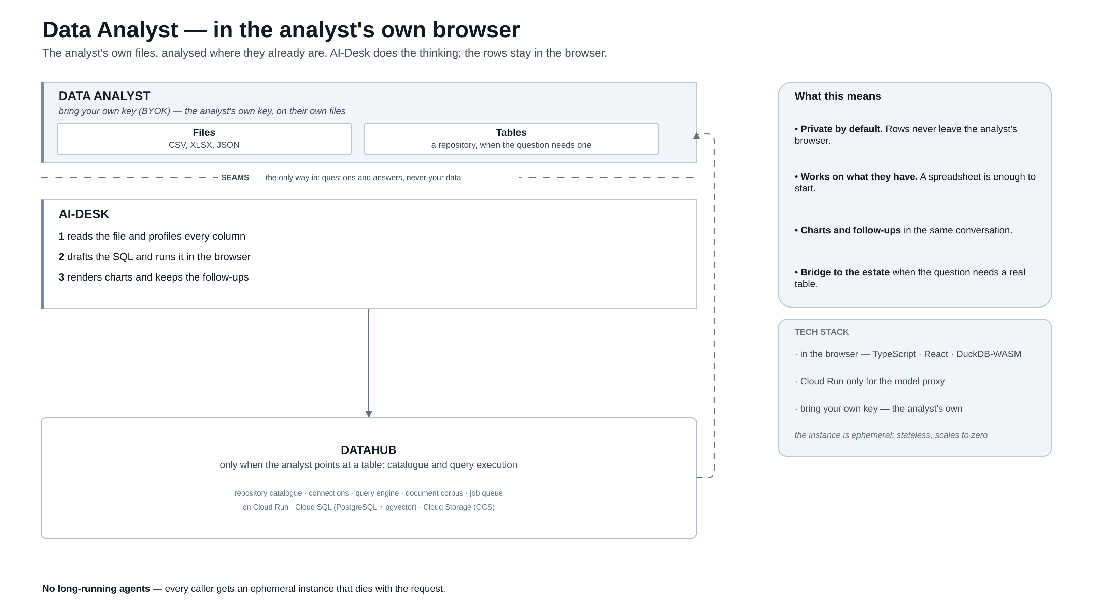
Notes:
The analyst brings their own key and their own files. AI-Desk profiles the file, drafts the SQL and runs it in the browser; DataHub is touched only when the analyst points at a real table. The rows never leave the analyst's browser.
Where the Bots story is embedded and the Search story is enterprise-wide, this one is private by default. It is the on-ramp: a spreadsheet is enough to start.

Slide 8
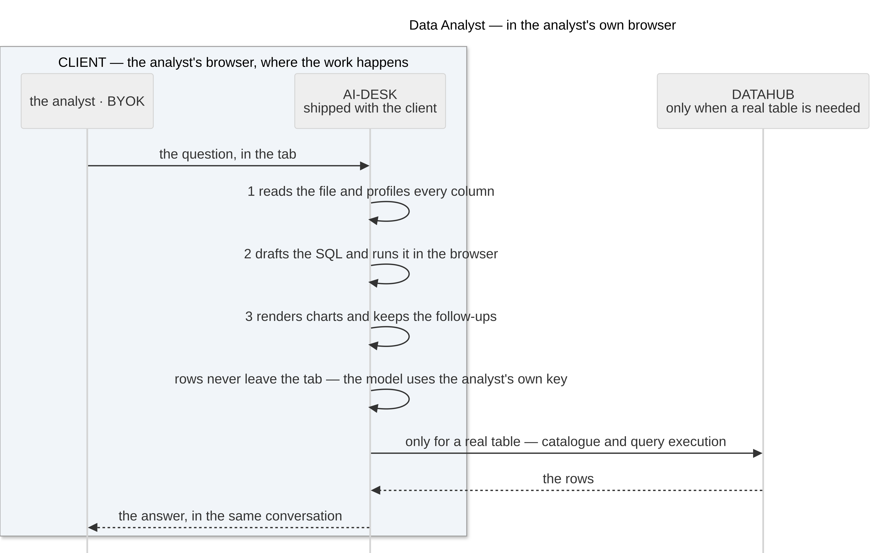
Data Analyst — where the analysis happens
THE SEQUENCE
BYOK: the analyst brings their own key and their own files.
The file is profiled and the SQL drafted inside the browser.
DataHub is the bridge, used only when a real table is needed.
Rows never leave the tab; charts and follow-ups stay in one conversation.
same seam · same DataHub
Notes:
Data Analyst — where the analysis happens — BYOK: the analyst brings their own key and their own files. The file is profiled and the SQL drafted inside the browser. DataHub is the bridge, used only when a real table is needed. Rows never leave the tab; charts and follow-ups stay in one conversation.

Slide 9
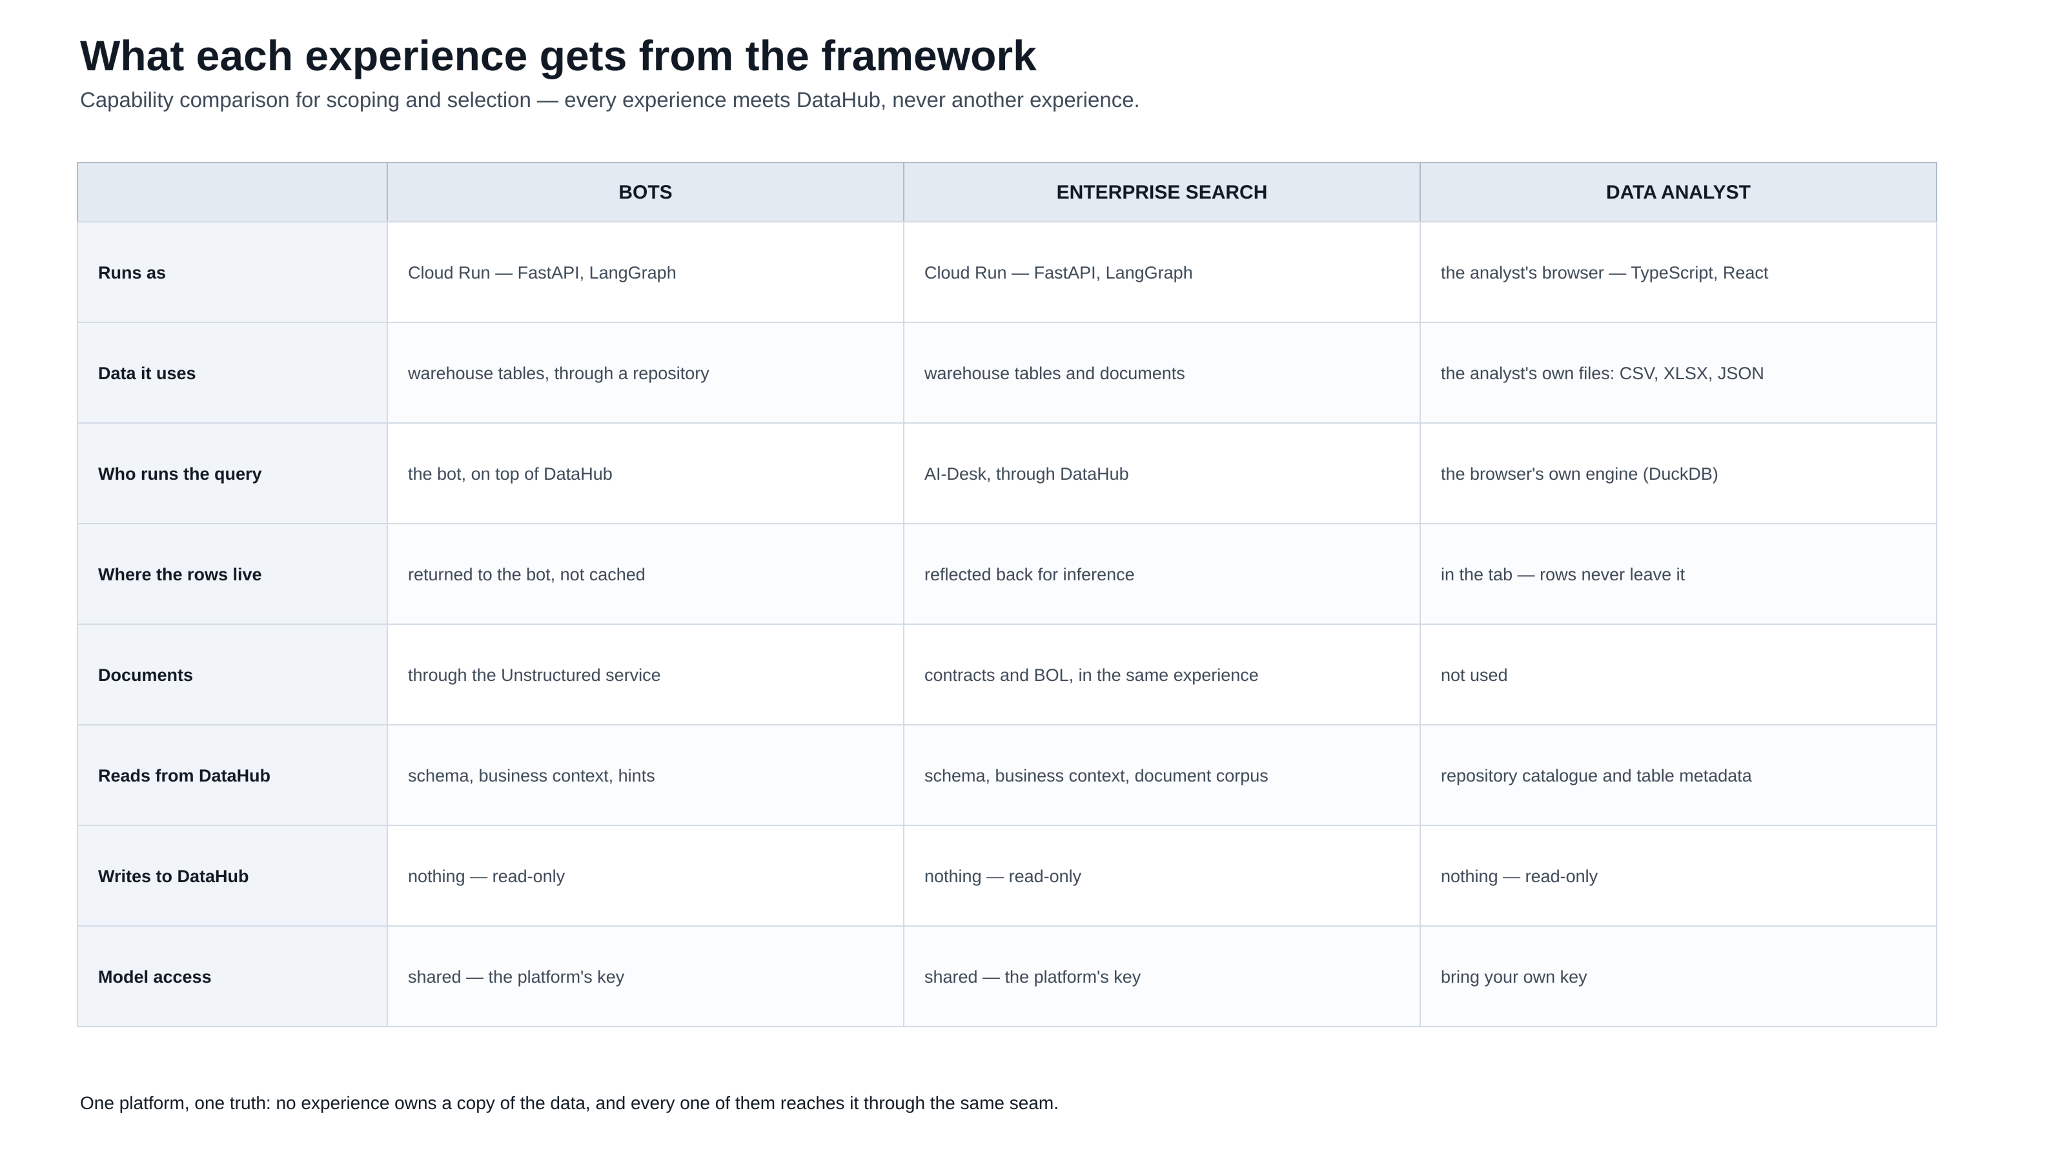
Notes:
Capability comparison for scoping and selection: how each experience runs, what data it uses, who runs the query, where the rows live, whether documents are involved, what it reads from and writes to DataHub, and how it reaches a model.
Leave this up during questions. Three rows answer most of them: who runs the query, where the rows live, and model access — shared for the first two, BYOK for the analyst.

Slide 10
AI-DESK
Thank you
Questions and discussion — on the framework, the three experiences, or what each one needs from DataHub.
Architecture walkthrough
Notes:
Close on the one platform idea: one framework, three experiences, one system of record. The capability matrix on the previous slide is the right thing to leave on screen while questions come in.

