Slide 2
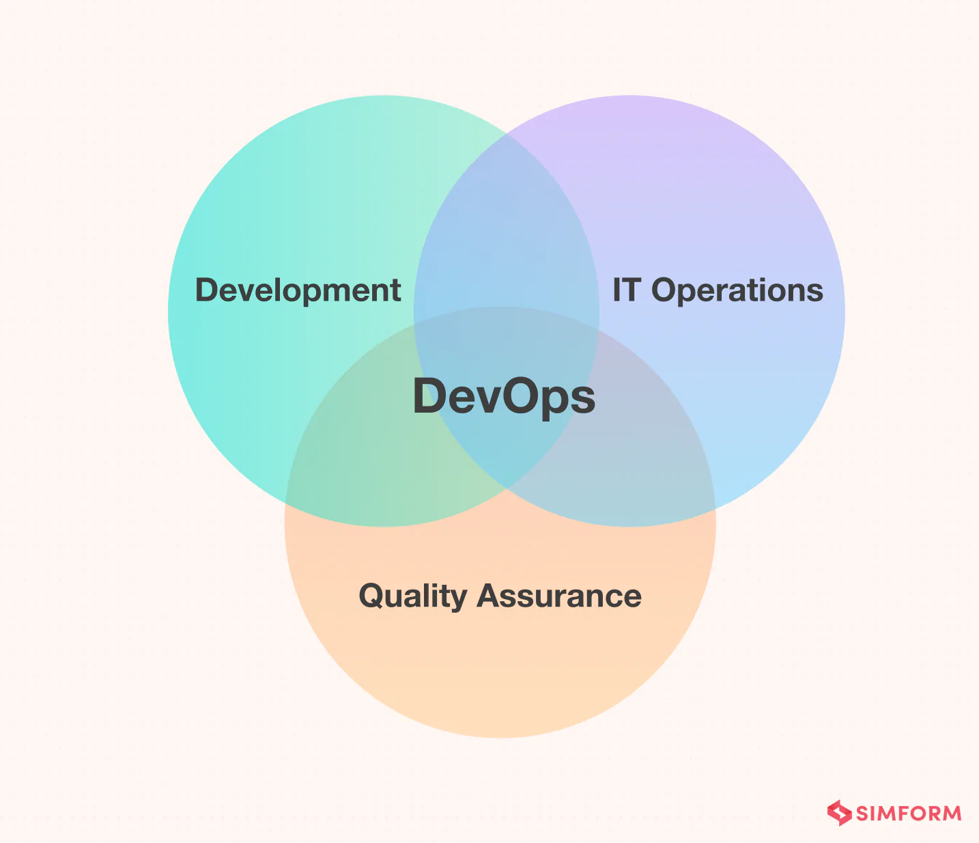
DevOps is a modern way of working in software development in which the development team (who writes the code and builds the software) and the operations team (which sets up, runs, and manages the software) work together as a single team.
Before DevOps, the development and operations teams worked separately. This caused:
Delays in launching software
Miscommunication between teams
Slow fixing of problems

Slide 3
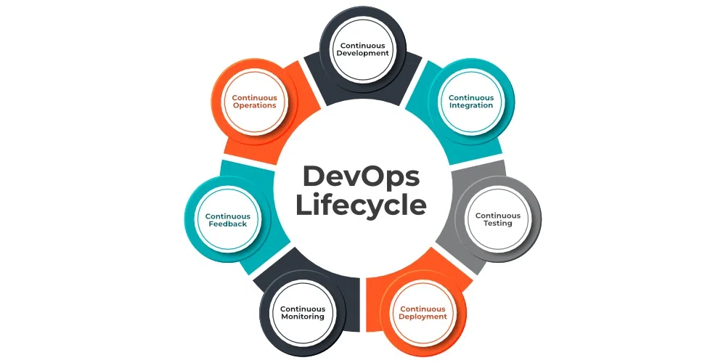
DevOps is a practice that enables a single team to handle the whole application lifecycle, including development, testing, release, deployment, operation, display, and planning. It is a mix of the terms "Dev" (for development) and "Ops" (for operations).

Slide 4
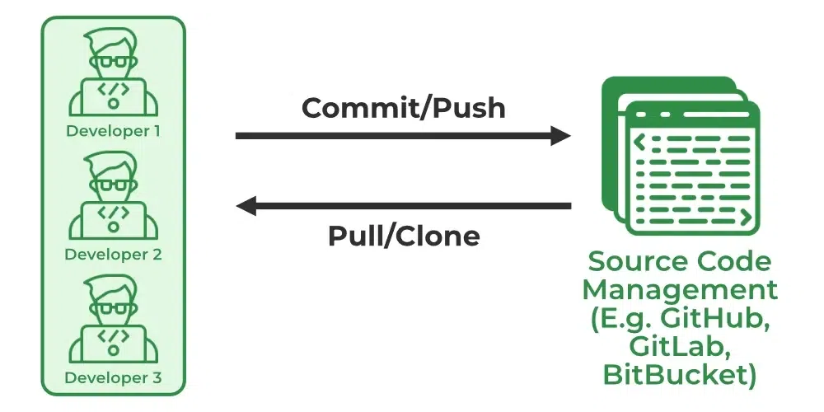
1. Continuous Development
In Continuous Development code is written in small, continuous bits rather than all at once, Continuous Development is important in DevOps because this improves efficiency every time a piece of code is created, it is tested, built, and deployed into production.
Documentation & collaboration: Confluence, Notion
Issue tracking & planning: Jira, Azure Boards, Trello

Slide 5
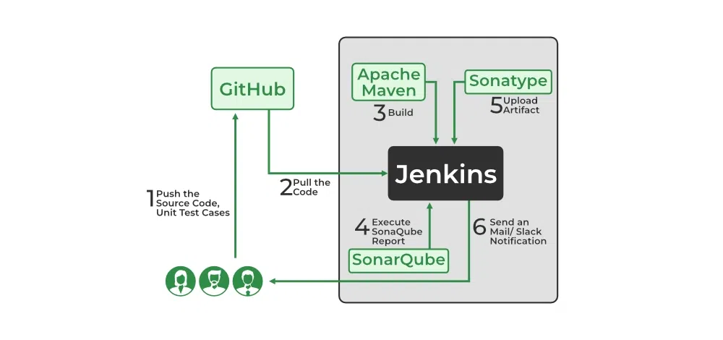
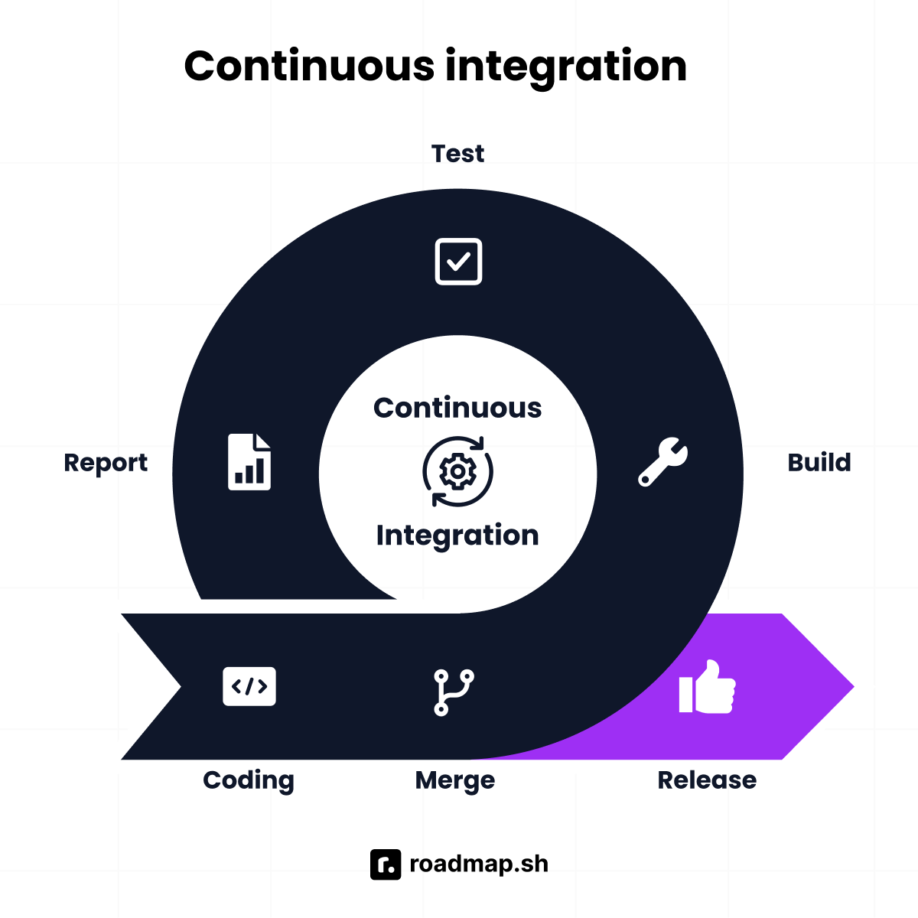
2. Continuous Integration
Continuous Integration can be explained mainly in 4 stages in DevOps. They are as follows:
Getting the SourceCode from SCM
Building the code
Code quality review
Storing the build artifacts
CI servers: Jenkins, GitLab CI, Travis CI, CircleCI
VCS: GitHub, GitLab, Bitbucket

Slide 6
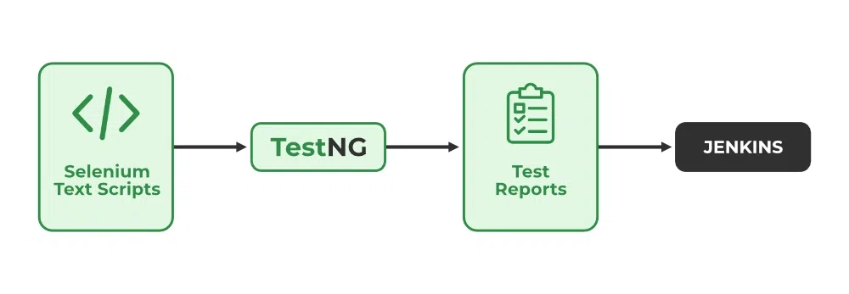
3. Continuous Testing
Any firm can deploy continuous testing with the use of the agile and DevOps methodologies. Depending on our needs, we can perform continuous testing using automation testing tools such as Testsigma, Selenium, LambdaTest, etc. With these tools, we can test our code and prevent problems and code smells, as well as test more quickly and intelligently.
Test frameworks: JUnit, pytest, Selenium, Cypress
Code quality/security: SonarQube, Checkmarx, Fortify

Slide 7
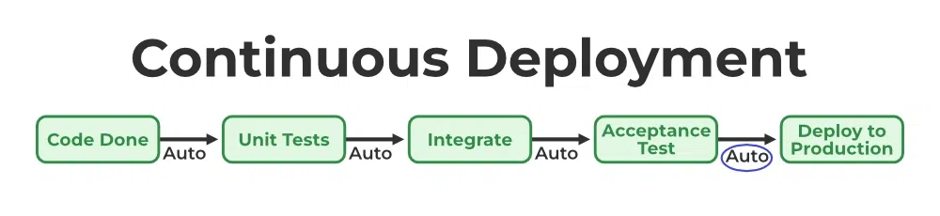
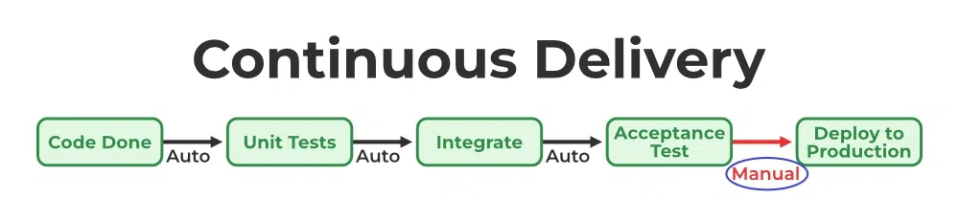
4. Continuous Deployment/ Continuous Delivery
Continuous Deployment: It is the process of automatically deploying an application into the production environment when it has completed testing and the build stages. Here, we'll automate everything from obtaining the application's source code to deploying it.
Continuous Delivery: it is the process of deploying an application into production servers manually when it has completed testing and the build stages. Here, we'll automate the continuous integration processes, however, manual involvement is still required for deploying it to the production environment.

Slide 8
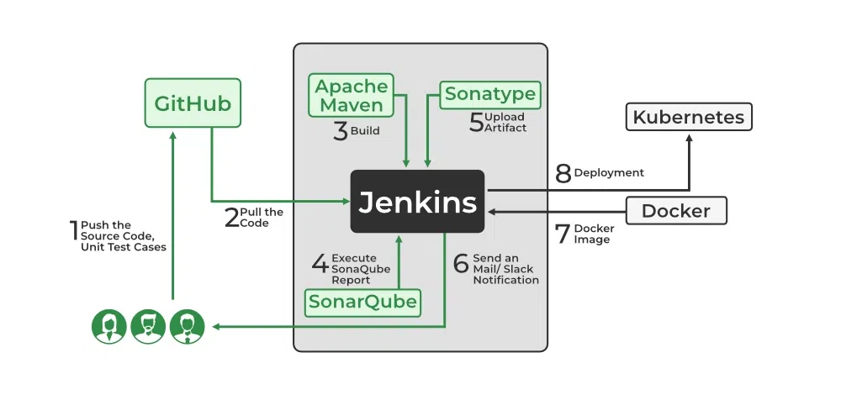
CD platforms: Jenkins Pipelines, Azure DevOps, Spinnaker, Octopus Deploy, AWS CodeDeploy, Google Cloud Build

Slide 9
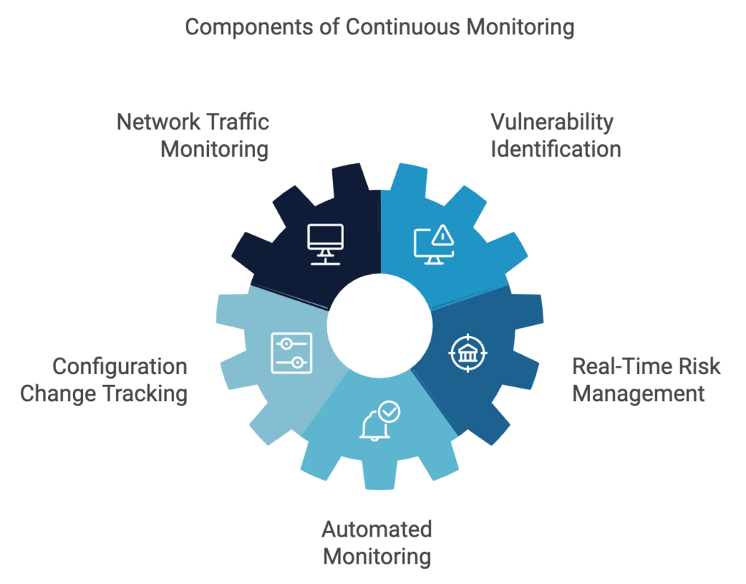
5. Continuous Monitoring
DevOps lifecycle is incomplete if there was no Continuous Monitoring. Continuous Monitoring can be achieved with the help of Prometheus and Grafana we can continuously monitor and can get notified before anything goes wrong with the help of Prometheus we can gather many performance measures, including CPU and memory utilization, network traffic, application response times, error rates, and others. Grafana makes it possible to visually represent and keep track of data from time series, such as CPU and memory utilization.
Logging & analysis: ELK Stack, Splunk
Security/compliance monitoring: HeadSpin CCM tools
Metrics & dashboards: Prometheus, Grafana

Slide 10
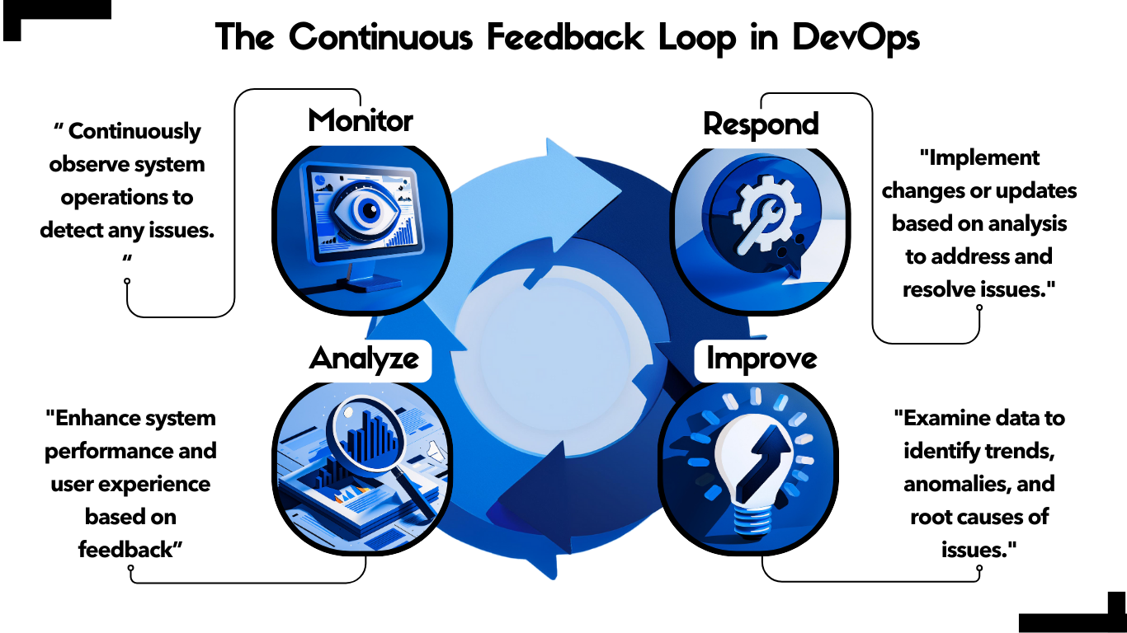
6. Continuous Feedback
Once the application is released into the market the end users will use the application and they will give us feedback about the performance of the application and any glitches affecting the user experience after getting multiple feedback from the end users' the DevOps team will analyze the feedbacks given by end users and they will reach out to the developer team tries to rectify the mistakes they are performed in that piece of code by this we can reduce the errors or bugs that which we are currently developing and can produce much more effective results for the end users also we reduce any unnecessary steps to deploy the application. Continuous Feedback can increase the performance of the application and reduce bugs in the code making it smooth for end users to use the application.
User feedback: Surveys (NPS), bug reports, support tickets, social media
APM & insights: New Relic, Datadog, in-product analytics

Slide 11
7. Continuous Operations
We will sustain the higher application uptime by implementing continuous operation, which will assist us to cut down on the maintenance downtime that will negatively impact end users' experiences. More output, lower manufacturing costs, and better quality control are benefits of continuous operations.
Infrastructure as Code: Terraform, CloudFormation, Ansible
Cloud & orchestration: AWS, Azure, GCP, Kubernetes
Reliability tools: Auto-scaling, backup, and fail-over systems

Slide 12
Phase | Purpose | Core Tools
Continuous Development | Plan & code iteratively | Jira, Confluence
Continuous Integration | Auto-build & test on every commit | Jenkins, GitLab CI
Continuous Testing | Ensure quality via automated test suites | Selenium, SonarQube
Continuous Deployment/Delivery | Automate release pipeline to staging/production | Spinnaker, Octopus Deploy
Continuous Monitoring | Observe performance, logs, security | Prometheus, ELK, Splunk
Continuous Feedback | Use insights to drive improvements | Datadog, NPS surveys, New Relic
Continuous Operations | Maintain always-on, scalable infrastructures | Terraform, Kubernetes, AWS

Slide 13
Phase | Purpose | Recommended Tools
Continuous Development | Plan and code iteratively; backlog grooming, stakeholder alignment | Jira, Redmine, Confluence, Notion (geeksforgeeks.org, medium.com)
Continuous Integration | Merge changes frequently + auto-builds and validation pipelines | Jenkins, GitLab CI, Travis CI, CircleCI, GitHub Actions
Continuous Testing | Automate quality (unit, integration, security, UI) and guardrails | JUnit, pytest, Selenium, Cypress, SonarQube, OWASP ZAP
Continuous Deployment/Delivery | Automatically stage or release builds to environments | Spinnaker, Octopus Deploy, Ansible, Chef, Puppet, Argo CD
Continuous Monitoring | Observe app & infra health, logs, performance in real-time | Prometheus + Grafana, ELK Stack, Datadog
Continuous Feedback | Gather insights from users, telemetry, & support to improve releases | New Relic, Datadog, internal dashboards, ticket systems
Continuous Operations | Ensure uptime, resilience, automated maintenance & infrastructure drift | Terraform, Kubernetes, VMware, Ansible, OpenShift

Slide 14
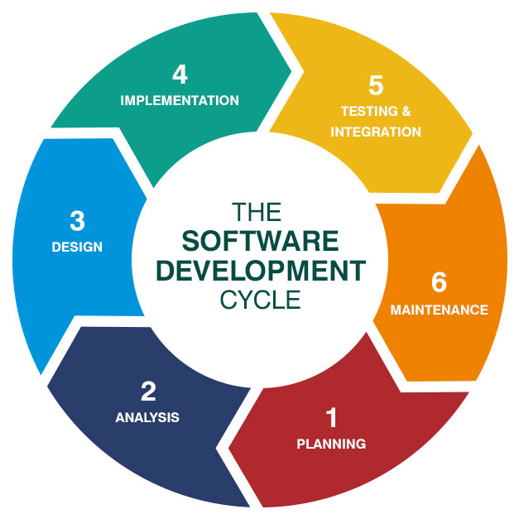

Slide 15
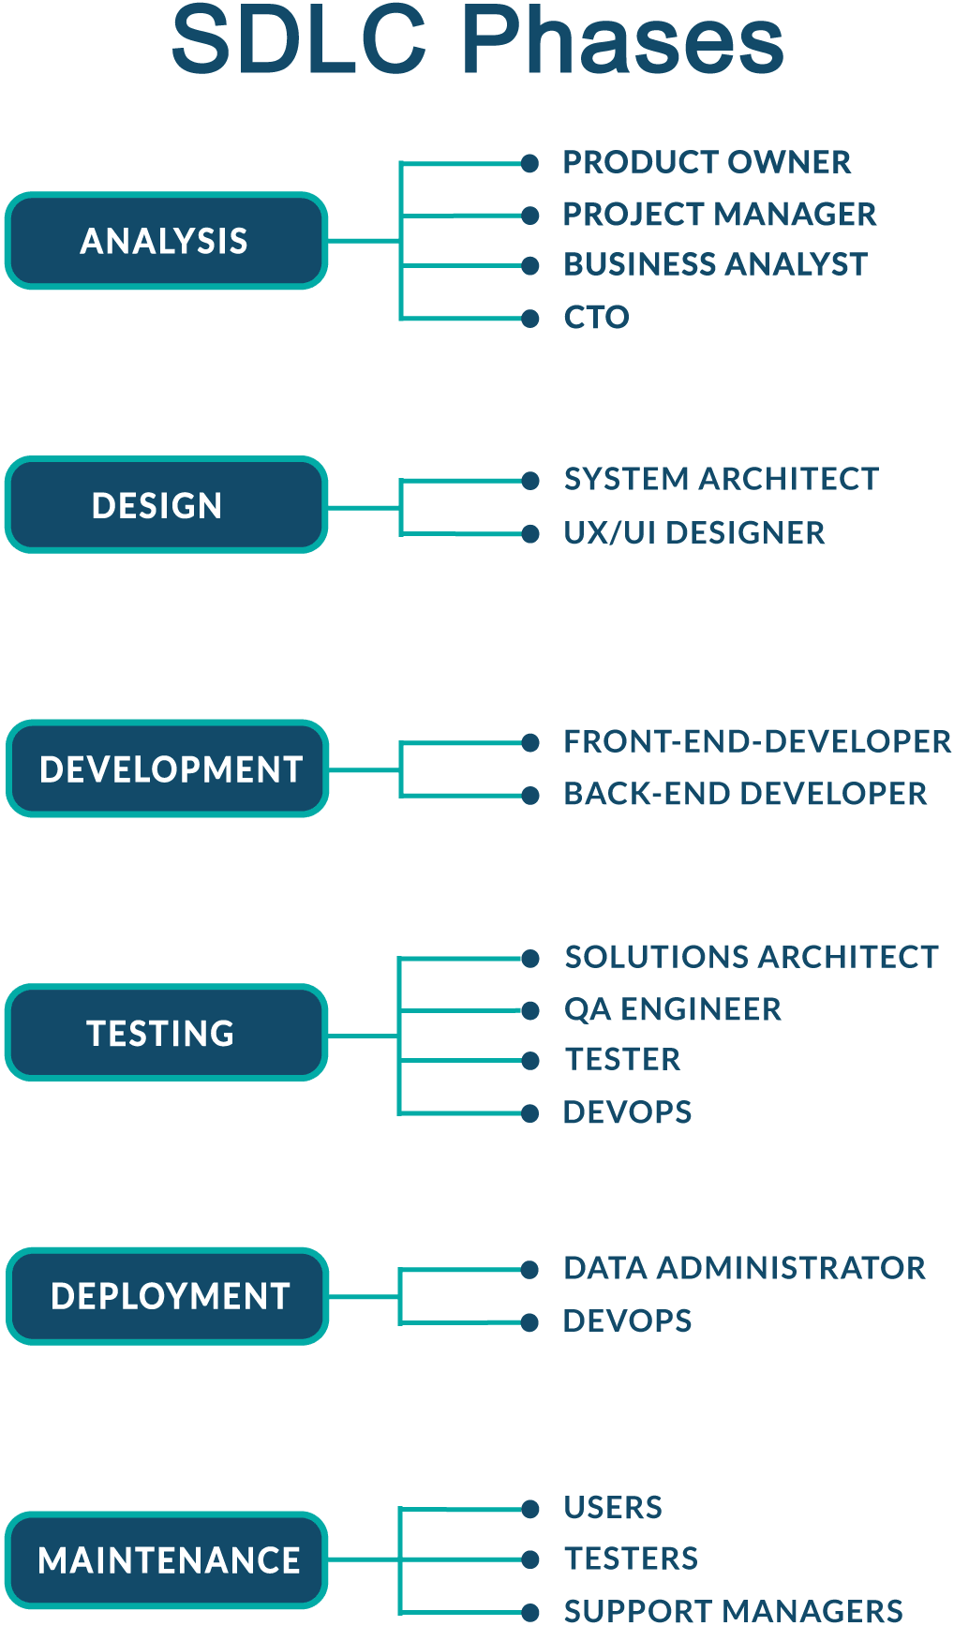

Slide 16
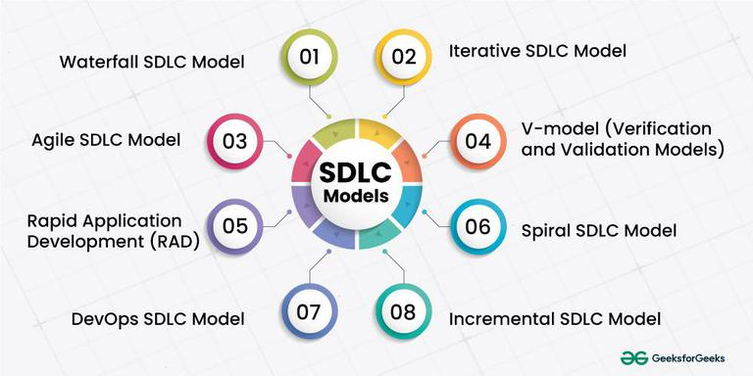

Slide 17
Aspect | Waterfall | Iterative | Spiral | Agile | V-Models | Incremental
Development Approach | Sequential | Iterative | Iterative | Iterative | Iterative | Iterative
Phases | Linear | Planning, Design, Coding, Testing, Evaluation (Repeated Iteratively) | Planning, Risk Analysis, Engineering, Testing (Cyclical) | Planning, Sprint, Review, Retrospective (Iterative Cycles) | Planning, Design, Implementation, Testing, Deployment (Parallel) | Divided into increments, each with Planning, Implementation, Testing
Flexibility | Low | High | High | High | Moderate | High
Risk Management | Late mitigation, Limited adaptability | Proactive risk management, Adaptability to changes | Continuous risk assessment, Proactive mitigation | Continuous risk assessment, Adaptability to changes | Risk management aligned with phases, Moderate adaptability | Proactive risk management, Adaptability to changes
Time-to-Market | Longer | Faster | Variable | Faster | Moderate | Faster
User Involvement | Limited | Continuous | Periodic | Continuous | Periodic | Continuous
Testing | After Implementation | Continuous throughout iterations | Integrated throughout the spiral | Continuous and c | After Implementation | Continuous throughout increments
Adaptability | Low | High | High | High | Moderate | High
Complexity Management | Linear approach, Limited adaptability | Easier to manage, Adaptability to changes | Cyclical approach, Risk-d | Adaptive approach to changes | Traceability helps manage c | Adaptive approach to changes

Slide 18
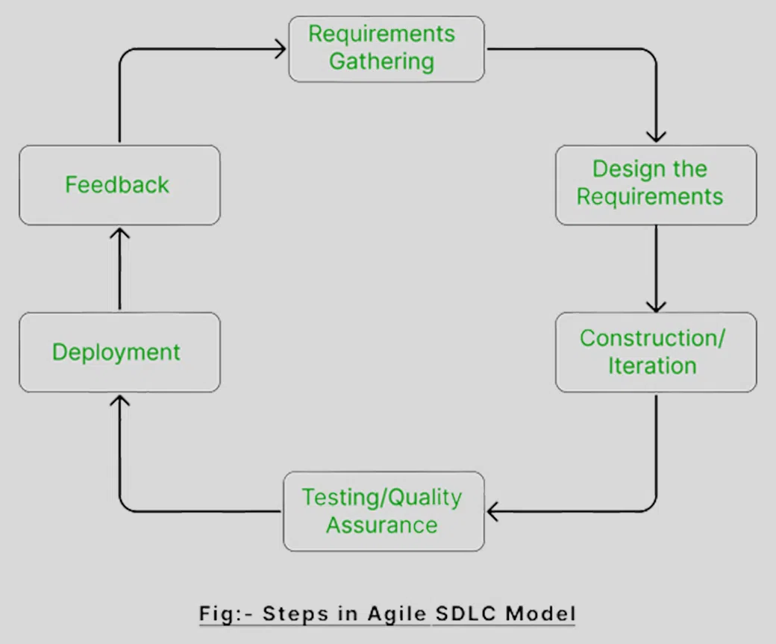
Agile is a way of working where teams build software in small steps, get feedback early, and adjust quickly — to deliver better products faster and smarter.

Slide 19
Factor | DevOps | Agile
Focus | Dev + Ops + QA + Security | Mainly Dev & QA
Speed | Faster with automation | Frequent releases but manual deployment
Automation | High (CI/CD, infra as code) | Limited automation
Risk Handling | Proactive monitoring & issue resolution | Fixes within sprints
Deployment | Automated & continuous | Often manual
Agile helps fast development, but DevOps extends it to deployment and operations, ensuring seamless, automated releases.

Slide 20
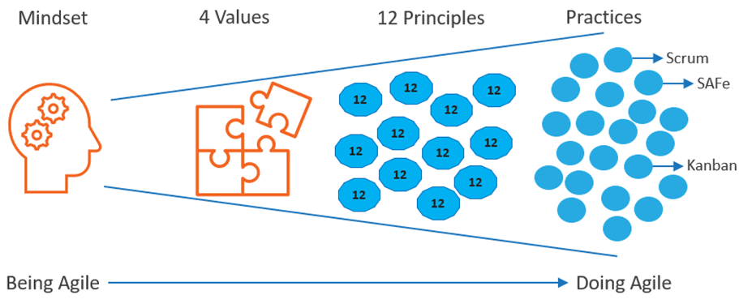

Slide 21
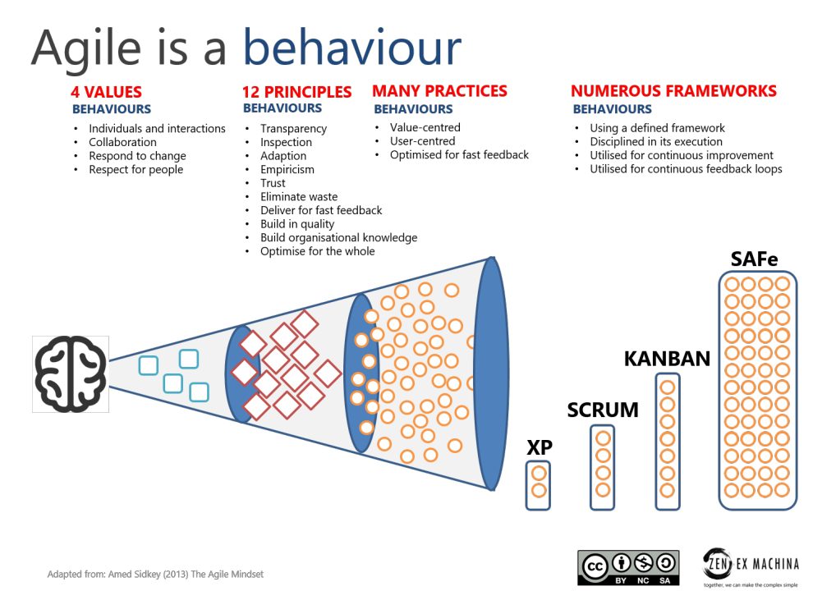

Slide 22
What is Scrum?
Scrum is a way to manage work in small parts (called sprints), allowing a team to deliver better software faster.
Scrum Basic Roles (3 People or Groups)
Role | Description
Product Owner | Decides what to build (features)
Scrum Team | Builds the software
Scrum Master | Guides and removes blockers
Summary: Scrum Setup in 5 Simple Steps
Backlog – Write down all features needed
Sprint Planning – Pick what to do in next 1–2 weeks
Daily Standups – Quick daily updates
Sprint Review – Demo work done
Retrospective – Discuss & improve

Slide 23
Offline DevOps Plan

Slide 24
Offline DevOps Flow
Developer writes code in VS Code / STS .
Pushes to Gitea Git repo (offline server)
Jenkins pulls code → builds with Maven
Jenkins runs SonarQube scan
Jenkins uploads build to Nexus
Jenkins deploys to server or Docker container
Test and monitor logs with basic logging tools

Slide 25
Category | Tool | Description | Offline Capability
Source Code Management | Git | Distributed version control system | Fully offline
 | Gitea | Lightweight self-hosted Git server | Fully offline
 | GitLab CE | Full-featured DevOps platform | Fully offline
Build Tools | Maven | Java build tool; use with Nexus | Fully offline with local repo
Artifact Repository | Nexus OSS | Stores artifacts like JARs, Docker images | Fully offline
 | JFrog Artifactory CE | Advanced artifact manager | Fully offline
CI/CD | Jenkins | Widely-used CI/CD server | Fully offline
 | GitLab CI | Integrated with GitLab | Fully offline
Containerization | Docker | Build and run containers | Fully offline (with saved images)
 | Podman | Rootless container tool | Fully offline
Category | Tool | Description | Offline Capability
Source Code Management | Git | Distributed version control system | Fully offline
 | Gitea | Lightweight self-hosted Git server | Fully offline
 | GitLab CE | Full-featured DevOps platform | Fully offline
Build Tools | Maven | Java build tool; use with Nexus | Fully offline with local repo
 | Gradle | Modern Java build tool | Fully offline with local repo
 | Make | For C/C++ build automation | Fully offline
Artifact Repository | Nexus OSS | Stores artifacts like JARs, Docker images | Fully offline
 | JFrog Artifactory CE | Advanced artifact manager | Fully offline
CI/CD | Jenkins | Widely-used CI/CD server | Fully offline
 | GitLab CI | Integrated with GitLab | Fully offline
Containerization | Docker | Build and run containers | Fully offline (with saved images)
 | Podman | Rootless container tool | Fully offline
Orchestration | Kubernetes | Container orchestration | Offline with kubeadm setup
 | k3s | Lightweight Kubernetes | Fully offline
Code Quality | SonarQube | Static code analysis | Fully offline
Monitoring & Logging | Prometheus | Metrics collection and alerting | Fully offline
 | Grafana | Dashboards and visualization | Fully offline
 | ELK Stack | Elasticsearch, Logstash, Kibana for logging | Fully offline
 | Graylog | Log management | Fully offline
Agile/Scrum Tools | OpenProject | Agile project management with Scrum/Kanban | Fully offline
 | Taiga | Scrum/Kanban boards | Fully offline
 | Redmine | Lightweight project tracking | Fully offline
Secrets Management | Vault (HashiCorp) | Secrets and encryption key management | Fully offline
Authentication | Keycloak | Identity and access management | Fully offline

Slide 26
Orchestration | Kubernetes | Container orchestration | Offline with kubeadm setup
 | k3s | Lightweight Kubernetes | Fully offline
Code Quality | SonarQube | Static code analysis | Fully offline
Monitoring & Logging | Prometheus | Metrics collection and alerting | Fully offline
 | Grafana | Dashboards and visualization | Fully offline
 | ELK Stack | Elasticsearch, Logstash, Kibana for logging | Fully offline
 | Graylog | Log management | Fully offline
Agile/Scrum Tools | OpenProject | Agile project management with Scrum/Kanban | Fully offline
 | Taiga | Scrum/Kanban boards | Fully offline
 | Redmine | Lightweight project tracking | Fully offline

Slide 27
Make It Easy with One Server
You can install:
Jenkins
Gitea
SonarQube
Nexus
All on one powerful system, and access it from LAN (offline network).

Slide 28
Offline DevOps Setup Checklist
[ ] Plan Scrum Process (Backlogs, Sprint Planning)
[ ] Install Git on all developer systems
[ ] Set up Gitea for local Git server
[ ] Install Java (JDK 11 or higher)
[ ] Install Jenkins and configure build jobs
[ ] Install Maven/Gradle for Java builds
[ ] Integrate Jenkins with Git (Gitea)
[ ] Install and configure SonarQube for code quality analysis
[ ] Install and configure Nexus Repository Manager
[ ] Configure Jenkins to deploy builds to Nexus
[ ] (Optional) Install Docker for container deployment
[ ] Run Jenkins jobs to automate CI/CD
[ ] Test end-to-end pipeline offline within LAN
[ ] Use Excel or Wekan for Scrum board tracking

