Slide 1


Optimizing Numerical Weather Prediction Model Performance Using Machine Learning Techniques
This presentation explores the application of machine learning techniques to enhance the accuracy and efficiency of numerical weather prediction models.
M. PAVAN (21R01A05P1)
K. HEMANTH KUMAR (21R01A05m5)
P. RAMU (22R05A0520)
S. DHANUNJAY (22R05A0521)

Slide 2
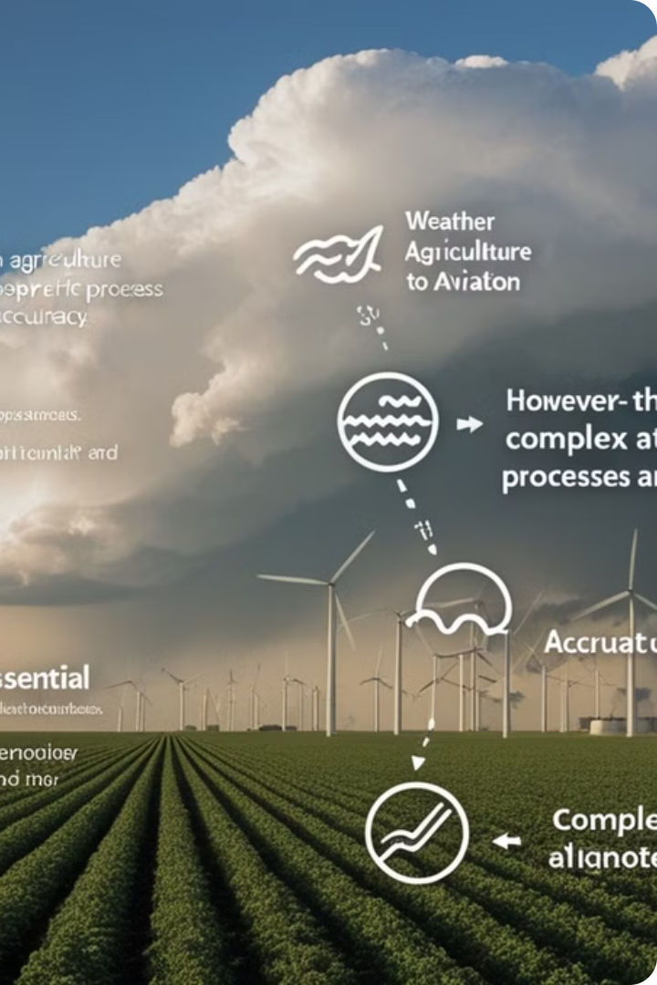
Motivation and Objectives
Weather prediction models are essential for various sectors, from agriculture to aviation. However, their accuracy can be limited by factors such as complex atmospheric processes and data limitations.
1
Improve Model Accuracy
2
Enhance Computational Efficiency
Leveraging machine learning to enhance the prediction of key weather variables such as temperature, wind speed, and precipitation.
Investigating machine learning algorithms that can reduce the computational cost of running weather prediction models.
3
Improve Data Assimilation
Exploring the use of machine learning for better integration of diverse data sources, including satellite observations and ground-based measurements.

Slide 3

Methodology
The research involves a multi-step approach, combining data analysis, model development, and evaluation.
1
2
3
4
Data Acquisition
Feature Engineering
Model Development
Model Evaluation
Gathering historical weather data from various sources, including meteorological stations, satellites, and reanalysis products.
Selecting relevant variables and applying appropriate transformations to improve the predictive performance of the model.
Training and evaluating various machine learning algorithms, including deep learning models, on the prepared dataset.
Assessing the performance of the trained models using metrics such as mean absolute error (MAE), root mean squared error (RMSE), and correlation coefficients.

Slide 4
Data Preprocessing
Data preprocessing is crucial to ensure the quality and consistency of the data used in machine learning models.
Data Cleaning
Data Transformation
Feature Selection
Handling missing values, outliers, and inconsistencies in the data.
Scaling, normalization, or encoding data to ensure consistency across features and improve model stability.
Identifying and selecting the most relevant features that contribute significantly to the predictive performance of the model.
This involves removing or replacing erroneous data points that could adversely affect model performance.
This involves transforming data into a range suitable for specific machine learning algorithms.
This involves using techniques such as feature importance analysis or recursive feature elimination.

Slide 5

Machine Learning Techniques
Various machine learning techniques are being considered for weather prediction model optimization.
Regression Models
Deep Learning Models
Linear Regression, Support Vector Regression, and Random Forest Regression.
Recurrent Neural Networks (RNNs), Long Short-Term Memory (LSTM), and Convolutional Neural Networks (CNNs).
Ensemble Methods
Combining predictions from multiple models to improve overall accuracy and robustness.

Slide 6

Experimental Setup
The research involves running experiments on high-performance computing infrastructure to handle the massive datasets and computationally intensive machine learning algorithms.
Dataset
Historical weather data from various sources(Austin weather)
Machine Learning Libraries
Python Data Analysis Library, Scikit-learn, Numerical Python, Matplotlib,
Hardware
High-performance computing cluster
Software
Python

Slide 7

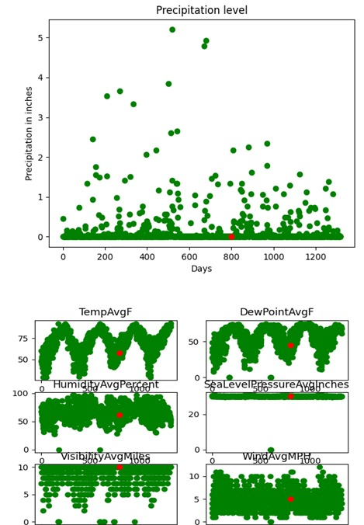



Results and Discussions
The research aims to demonstrate the effectiveness of the selected machine learning techniques in improving the accuracy and efficiency of weather prediction models.
Model Accuracy
Evaluating the performance of the trained models using appropriate metrics.
Computational Efficiency
Analyzing the computational cost of running the machine learning models compared to traditional weather prediction models.
Data Integration
Assessing the ability of the models to integrate diverse data sources and improve prediction accuracy.

Slide 8




Conclusion and Future Work
This research provides valuable insights into the potential of machine learning for enhancing weather prediction model performance.
Future Research
Applications
Embarking on a journey through sophisticated deep learning frameworks and groundbreaking data integration techniques.
Extending the research to real-time weather forecasting and developing user-friendly applications for diverse stakeholders.

