Slide 1
Quantum Geometry Routing
Which road-map should future quantum clouds use?
Bell-state routing across 2016, 2026 and future chip topologies
Track 4: Geometry-Aware Quantum Cloud Challenge | IBM Qiskit Fall Fest 2026

Slide 2
The problem: distant qubits pay a SWAP tax
Cloud QPUs have 100+ qubits, but each qubit talks to only a few neighbors.
Entangling distant qubits needs SWAP detours along the coupling graph.
Each SWAP = more gates = more noise exposure = worse entanglement.
Question: which coupling-graph geometry minimizes this tax?

Slide 3
Our experiment: 9 real simulations + a scaling sweep
Bell state |Phi+> routed between the two farthest qubits of each chip (worst case).
Matrix: T-shape (5q, 2016) x heavy-hex (21q, IBM-style) x hyperbolic {7,3} (20q).
Conditions: ideal, noisy (depolarizing + readout), noisy + ancilla protection.
Scaling sweep: 13 chips, 20 to 127 qubits, 3 families -- how does the worst trip grow?

Slide 4
How it works (and why you can trust it)
H + CNOT makes the Bell state; Qiskit transpile() routes it onto the coupling map.
Fidelity from XX/YY/ZZ correlators: F = (1 + <XX> - <YY> + <ZZ>) / 4.
Protection: an ancilla measures the ZZ then XX stabilizers mid-circuit; we keep only clean-syndrome shots and score the data bits alone.
Selection and scoring use disjoint bits -- random noise cannot fake F=1.

Slide 5
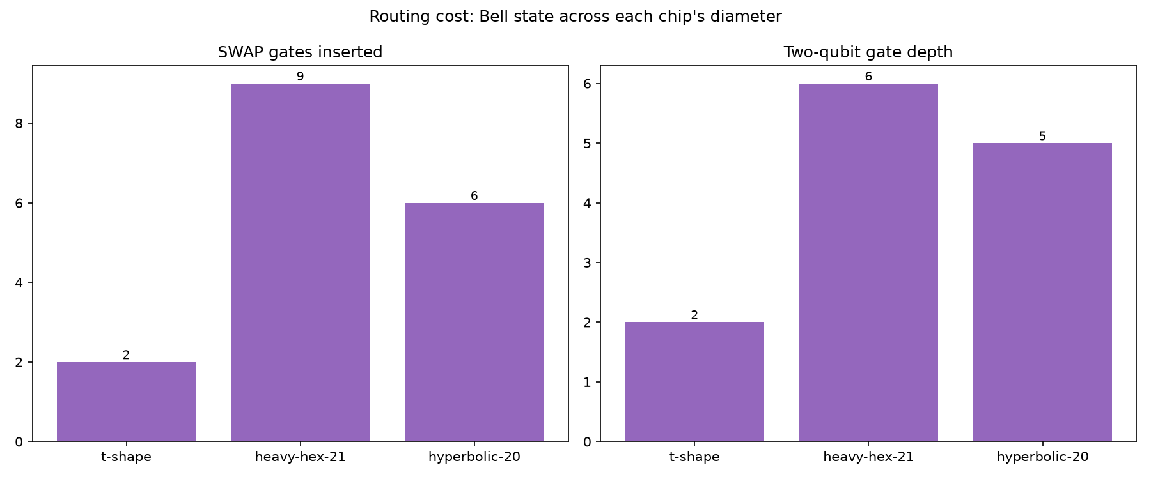
Result 1: the detour depends on the road-map
T-shape (5q, 2016): 2 SWAPs across diameter 3.
heavy-hex (21q, IBM-style): 9 SWAPs across diameter 10.
hyperbolic {7,3} (20q, future): 6 SWAPs across diameter 7.
Every SWAP is noise exposure: routing cost is the whole story.
SWAPs and two-qubit depth per topology (worst-case pair)

Slide 6
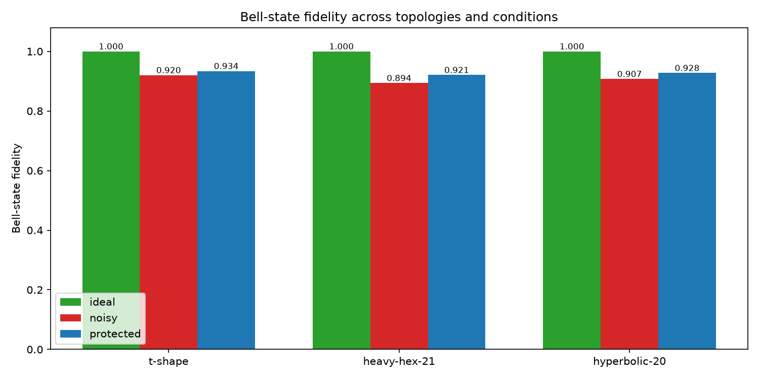
Result 2: protection helps -- honestly
Noisy fidelity: T-shape 0.920, heavy-hex 0.894, hyperbolic {7,3} 0.907.
Protected: T-shape 0.934 (+0.014), heavy-hex 0.921 (+0.027), hyperbolic {7,3} 0.928 (+0.020).
Cost of protection: +1 SWAP, +4 CX, ~12% of shots discarded.
It never reaches 1.0 -- some errors always slip through. That is the honest trade.
Bell-state fidelity across topologies and conditions

Slide 7
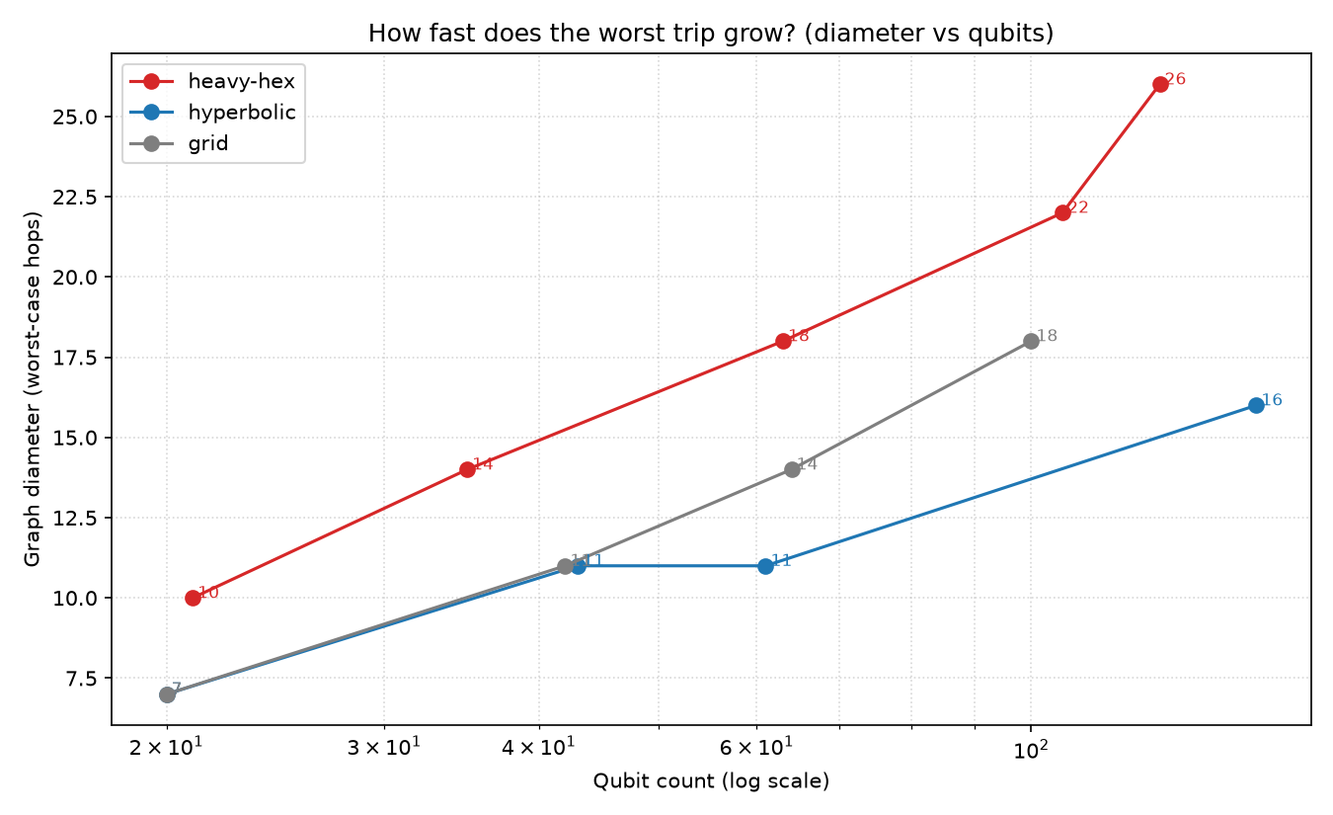
Result 3: scaling decides the future (recommendation)
At 127 qubits, heavy-hex (real IBM Eagle map) has diameter 26; hyperbolic 152q has diameter 16.
Heavy-hex scales ~2.3*sqrt(N) -- worse than a plain grid (~1.8*sqrt(N)).
Recommend: max degree 3, diameter target log(N), no long degree-2 wire chains, small faces (<=8), budget error detection only for the longest routes.
Full evidence: docs/recommendation.md + results/tables/scaling.csv.
Worst-case hops vs qubit count (log-x): hyperbolic grows slowest

Slide 8
System and reproducibility
Modular repo: quantum/ core, algorithms/ matrix+sweep, backend/ FastAPI, frontend/ React.
17 pytest tests, fixed seeds, pinned requirements.
Topologies: T-shape, star, heavy-hex patches (21/35/106), real Eagle-127, {7,3} tiling, grid.
Next: real QPU runs, noise-aware routing, non-planar shortcut couplers.

