Slide 1

Husky Houses
Anusha Talasia
Dhanur Motwani
Manisha Baharani
Parul Vig

Slide 2
Problem Statement
As of 2019, there have been roughly 673,000 houses sold in the US this year (U.S. Census Bureau, 2019) . The average amount of time buyers spent searching for a home in 2018 was 10 weeks. Even after which most of the population is unsatisfied due to the lack of options they could explore in a given time.

Slide 3
Solution
Husky House bridges the gap of communication by providing buyers and sellers, a platform to communicate. Husky House lets a buyer choose from thousands of available houses for the purpose of renting as well as buying, providing you with a way to navigate to those places.
The application lets you search a house according to your requirements and configuration eliminating the overhead of time.

Slide 4
Demonstration

Slide 5
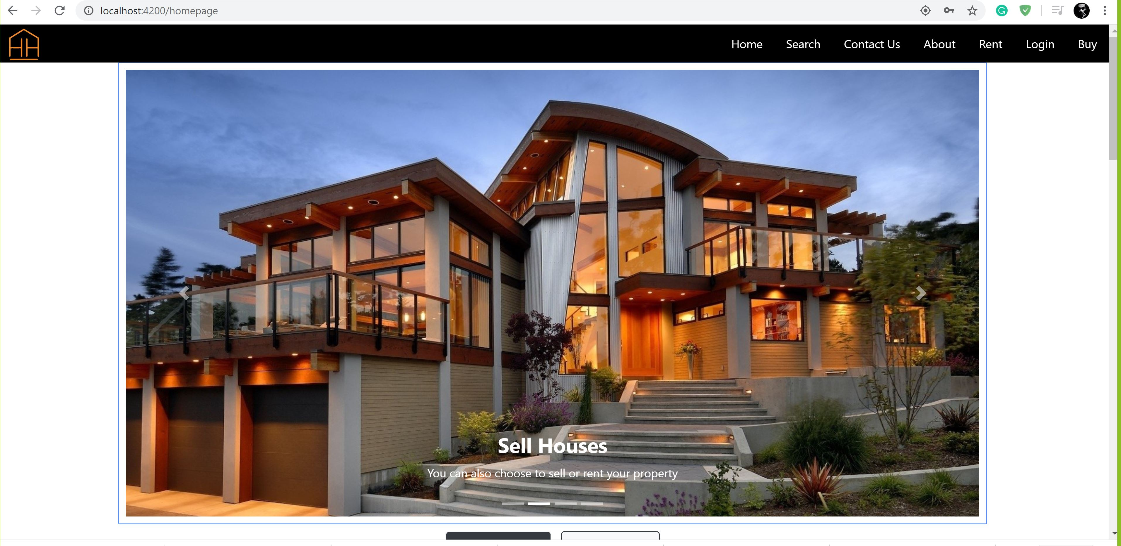
Homepage

Slide 6
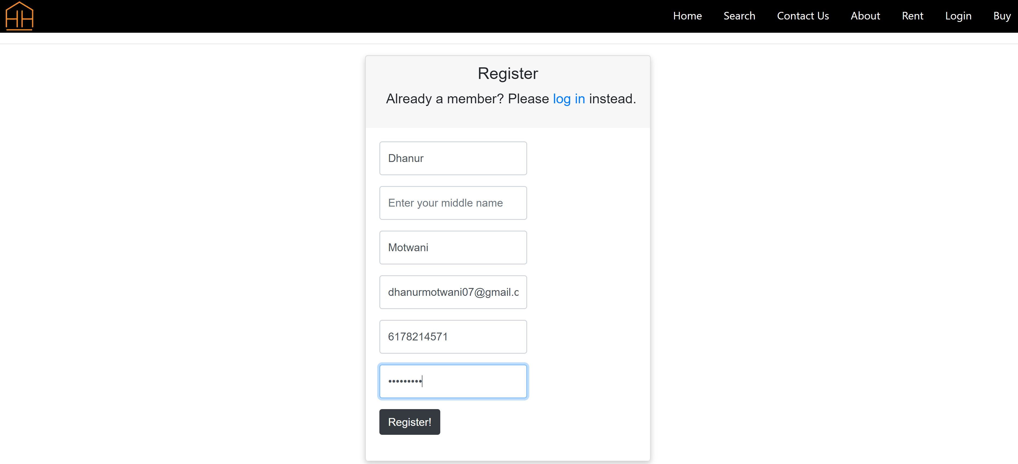
Registration Page

Slide 7
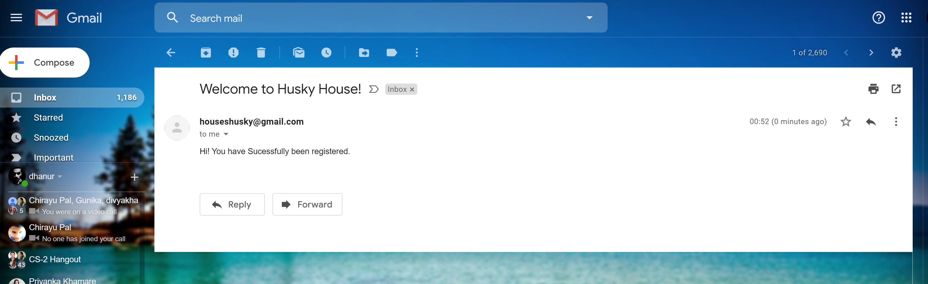
Email Verification

Slide 8
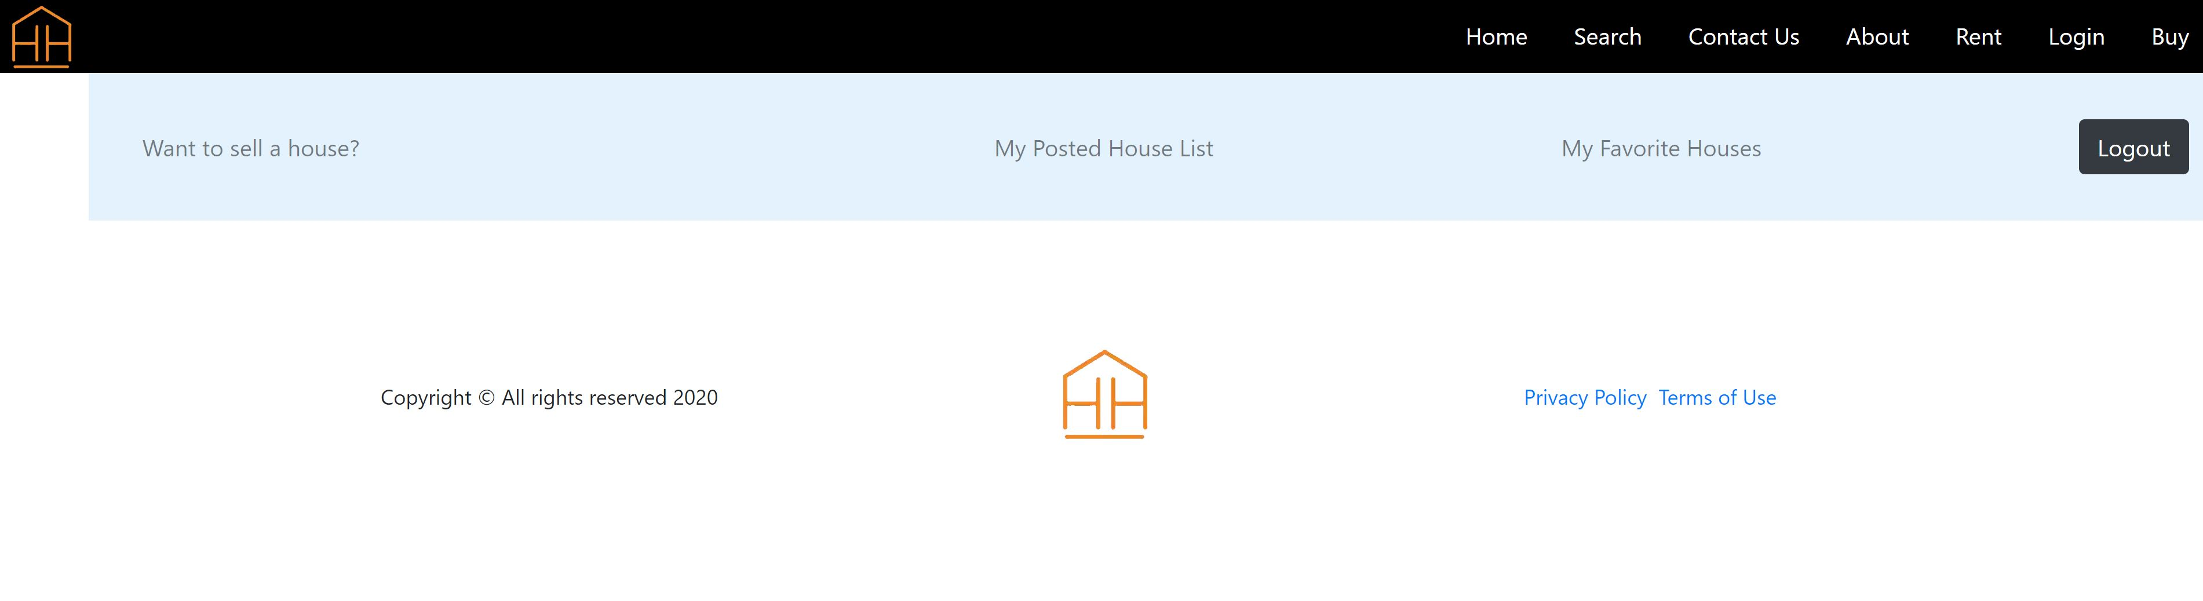
User Homepage

Slide 9
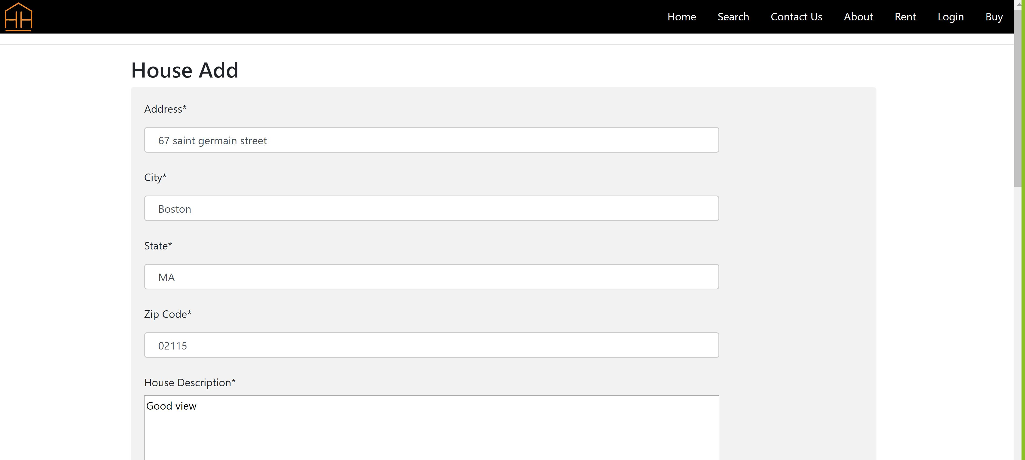
House Add Page

Slide 10
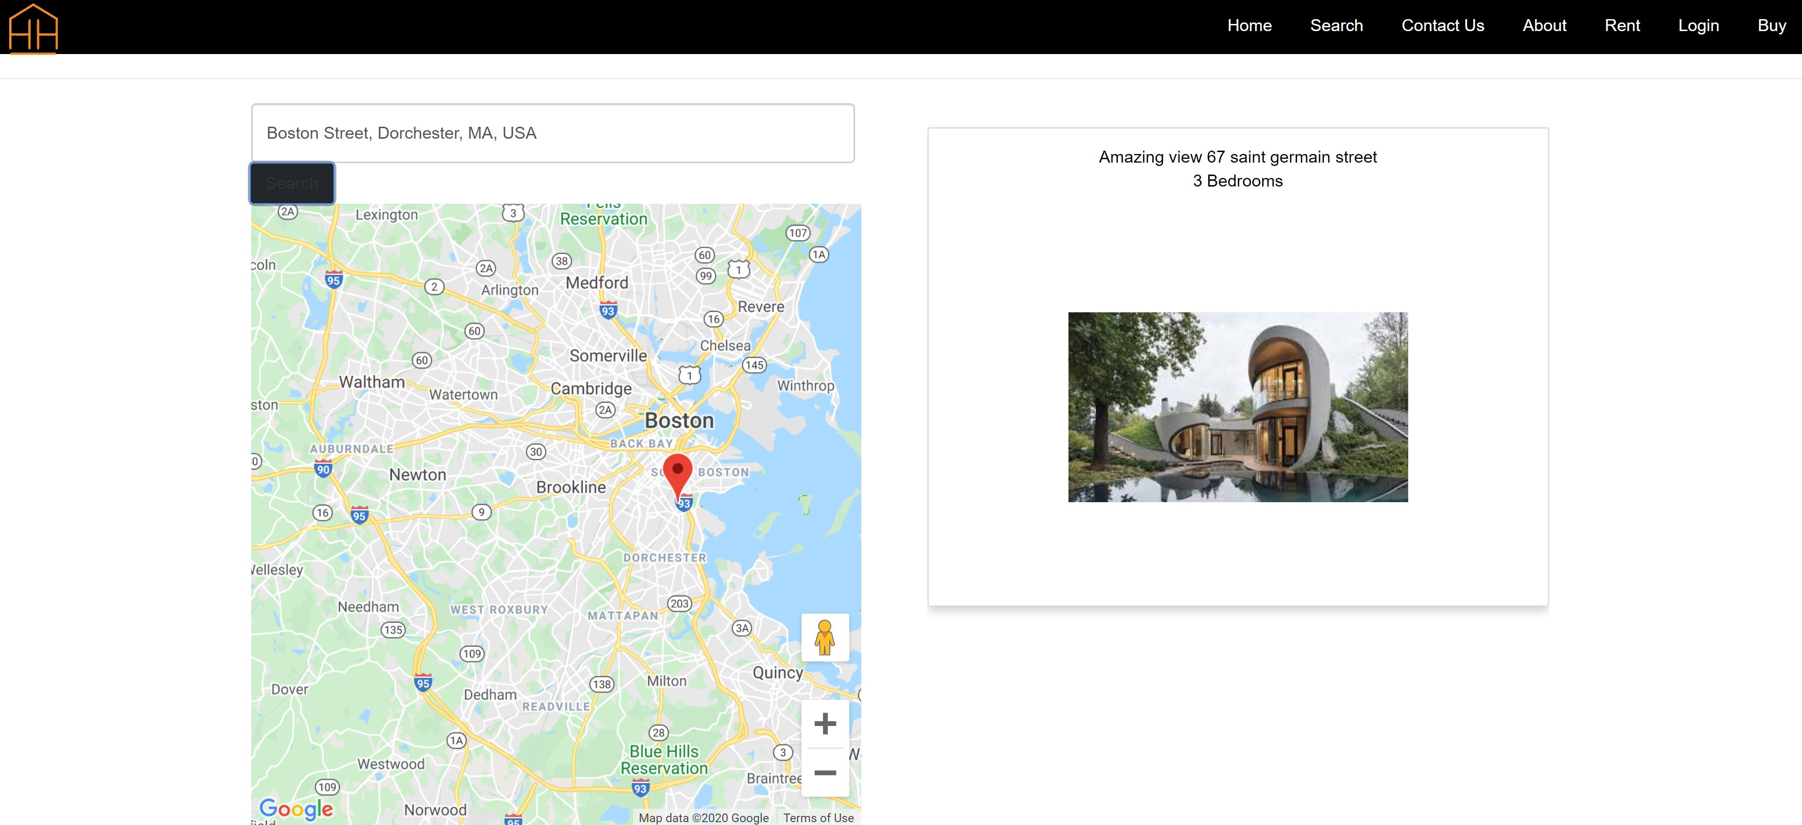
Search Page

Slide 11
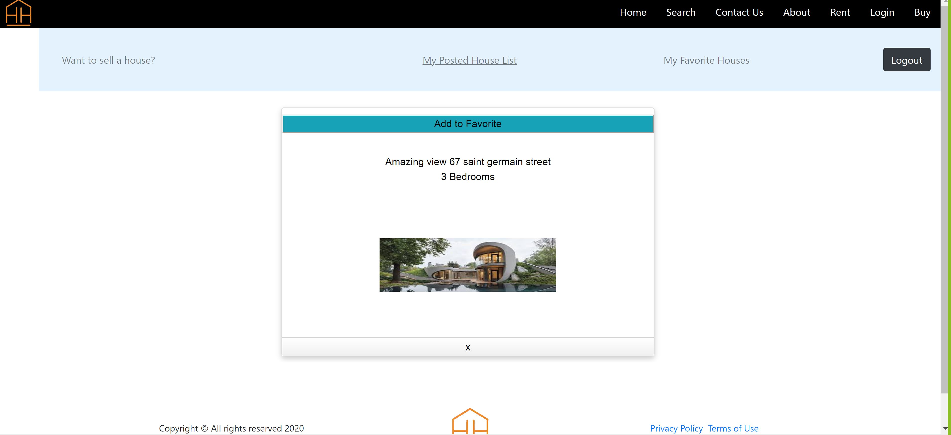
User Posted House list

Slide 12
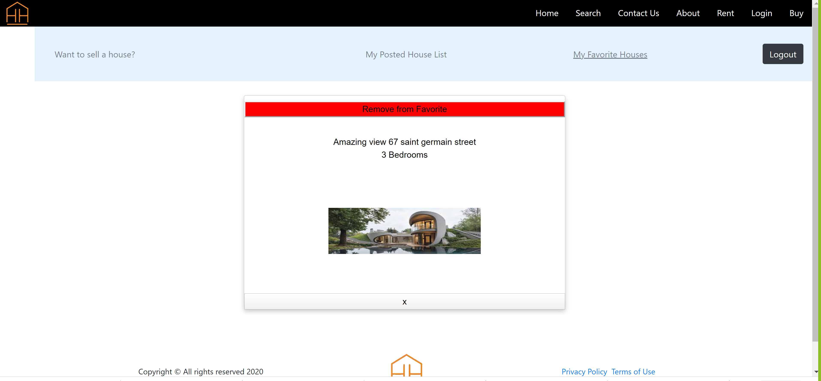
Favorites Page

Slide 13
Functionalities
User Login
Email Confirmation
Google Map (Search by location).
Add to Favorities
House Image upload

Slide 14
Technologies Used
Angular
Html
SCCS
Node JS
Bootstrap
MongoDB
REST API

Slide 15
Thank You

