Slide 1
CLASSIFICATION
FOR EMPLOYEE ATTRITION
Project Presentation By:
1733011 Karthikeyan 1733019 Ragaavi D 1733024 Sanjula K R
1733026 Sri Dhanuja 1733028 Sri Hari KV 1733029 Srinandhini M

Slide 2
Presentation Flow
Problem Statement
Dataset
Program flow
Visualization
Model Development
Model Deployment
Conclusion

Slide 3
Problem Statement
Employee attrition is a major cost to an organization and predicting such attritions is the most important requirement of the Human Resources department in many organizations.
In this study, we predict the attrition rate of employees of an organization.

Slide 4
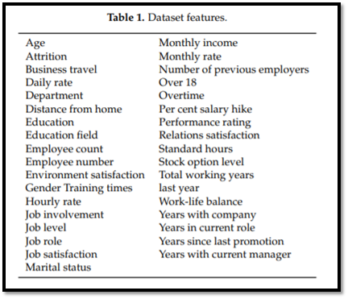
Data Set
This is a fictional data set created by IBM data scientists. Our data set consists of 35 attributes.
Data set link: https://www.kaggle.com/pavansubhasht/ibm-hr-analytics-attrition-dataset

Slide 5
Steps Involved
Data preprocessing
Feature Selection
Feature Engineering
Exploratory Data Analysis using Power BI
Model Development
Model Deployment

Slide 6
FEATURE SELECTION
Process to select those features which contribute most to your prediction variable
Correlation and Variable Inflation Factor(VIF).
EmployeeCount, Employee ID, StandardHours, Over18 has been dropped.

Slide 7
FEATURE ENGINEERING
Feature engineering is about creating new input features from existing ones.
It helps to arrive at accurate results after the model gets fitted.
One-hot encoding spreads the values in a column to multiple flag columns and assigns 0 or 1 to them.

Slide 8
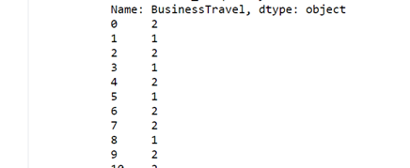
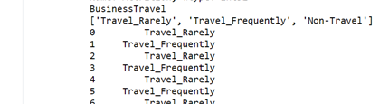
ONE-HOT ENCODING FOR VARIABLES
Before Encoding After Encoding

Slide 9
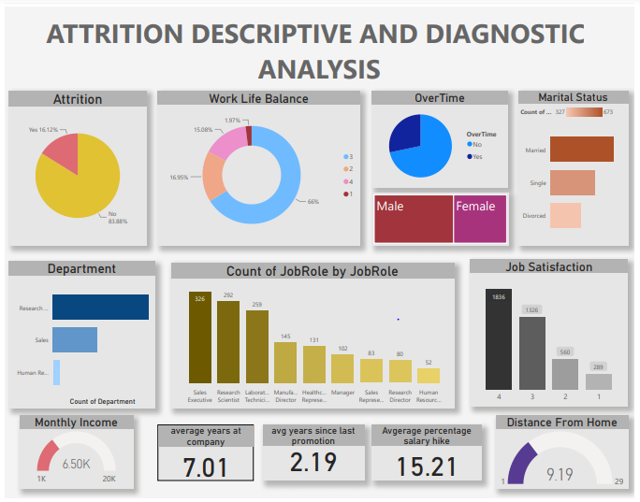
VISUALIZATION
[ POWER BI
ENHANCEMENT ]

Slide 10
MODEL DEVELOPMENT
Boosting algorithm combines multiple simple models (also known as weak learners or base estimators) to generate the final output
Three boosting Algorithm is used. Namely,
Gradient Boosting
XG Boosting
ADA Boosting

Slide 11
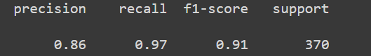
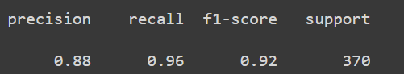
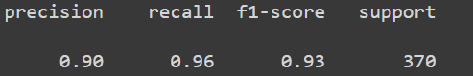
Gradient Boosting
XG Boosting
ADA Boosting
Ensembled the results - MODE

Slide 12
DEPLOYMENT
Saved the models into .pkl files
Developed flask API
Pushed to github
Pulled from github to heroku
Deployed in heroku platform
https://attrition-predic.herokuapp.com/

Slide 13
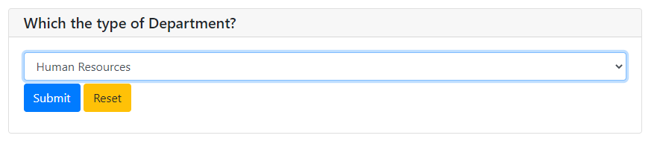
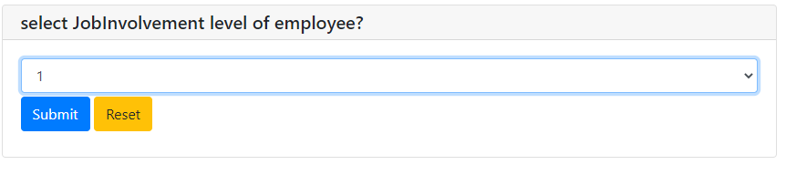
Website Screenshots

Slide 14


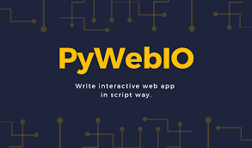



Tools and Technologies

Slide 15
CONCLUSION
All four types of analytics have been implemented in our project. For prescriptive analytics we have prescribed a business strategy.

