Slide 1
Fake news classification
- Sri Dhanuja

Slide 2
Problem Statement
Main objective is to build a model to accurately classify a piece of news as REAL or FAKE.
A type of yellow journalism, fake news encapsulates pieces of news that may be hoaxes and is generally spread through social media and other online media.
news items may contain false and/or exaggerated claims, and may end up being viralized by algorithms, and users may end up in a filter bubble.
This advanced python project of detecting fake news deals with fake and real news.
Using sklearn, built a TfidfVectorizer on dataset.
Initialized a PassiveAggressive Classifier and fit the model
Built MultinomialNB , LSTM and Google Bert model

Slide 3
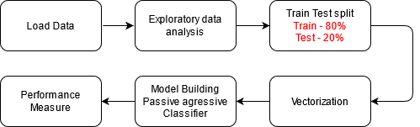
Flow Chart
*In Model Building, you can add LSTM,MNB and Google Bert

Slide 4
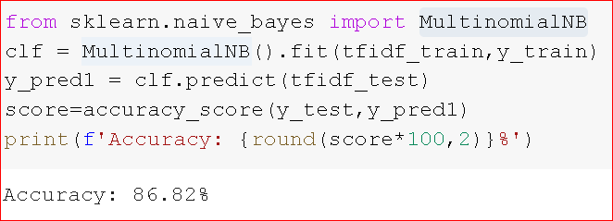
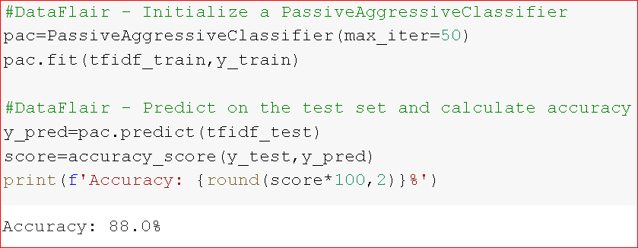
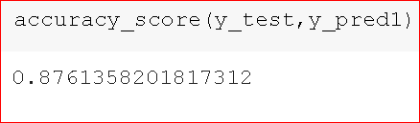
Result
MNB Model
Passive Aggressive Classifier
LSTM

Slide 5
Thank you

