Slide 1
Number of upvotes prediction
-Sri Dhanuja

Slide 2
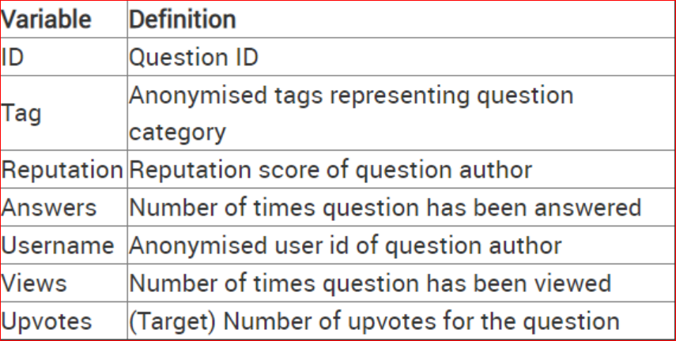
Problem Statement
A XYZ online content platforms have a constant need to identify the best content in time to appropriately promote and thereby improve the engagement at the website.
This challenge involves a similar problem of predicting the upvote count for a queries.
Need to predict the upvote count that the question will receive using the regression models With the tag of the question, number of views received, number of answers, username and reputation of the question author
With the below available data the prediction can be done using the regression models with better accuracy. The count of upvotes will be predicted for each user and for their each post (each post Id)

Slide 3
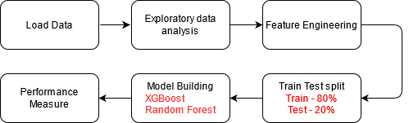
Flow Chart

Slide 4
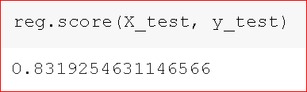
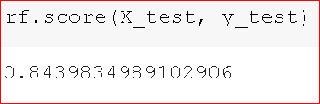
Result
XGBoost – eXtreme Gradient Boosting
Accuracy – 83%
2. Random Forest
Accuracy – 84%

