Slide 1
Satellite image classification
Sri Dhanuja R

Slide 2

Agenda
Problem statement
Data Description
Data Visualization
Pre-Processing
Model Building
Comparison
Conclusion

Slide 3
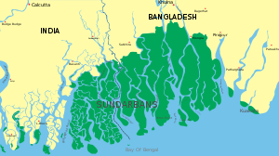
Problem statement
Sundarbans - largest mangrove areas in the delta
Sundarbans forest - 10,000 sq km across India and Bangladesh
use a part of the Sundarbans satellite - the Sentinel-2 Satellite on 27 January 2020.
how people are using the land.
coastal managers can document land use trends and changes.

Slide 4
Data description
Sundarbans data have multiple numbers of bands that contain the data ranging from visible to infrared.
12 bands.
To classify a landcover – need 12 band images of that place
Read Data
read the 12 bands - rasterio
stack them into an n-dimensional array - numpy.stack()
Resultant data - shape (12, 954, 298)
ground truth - loadmat method from the scipy.io
ground truth has 6 classes - water, plants, trees, bare land, e.t.c.

Slide 5
Data Visualization
it is hard to visualize the data ranging from visible to infrared for humans
creating an RGB Composite - easier to understand the data effectively
plot RGB composite images - red, green, and blue bands (bands 4, 3, and 2)
Python uses a zero-based index system - index for the red band is 3, green is 2, and blue is 1.
visualize the ground truth - plot_bands method from eathpy.plot
the composite image and the ground truth of the Sundarbans satellite data
the data contains 12 bands
visualize each band - EarhPy package

Slide 6
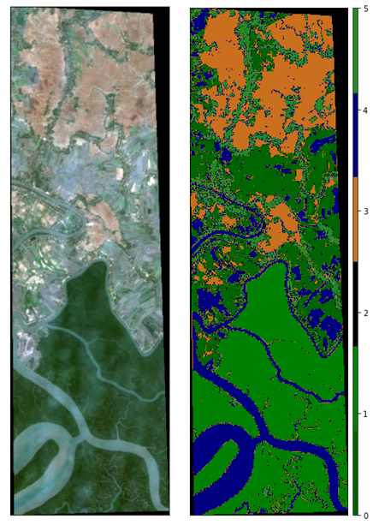
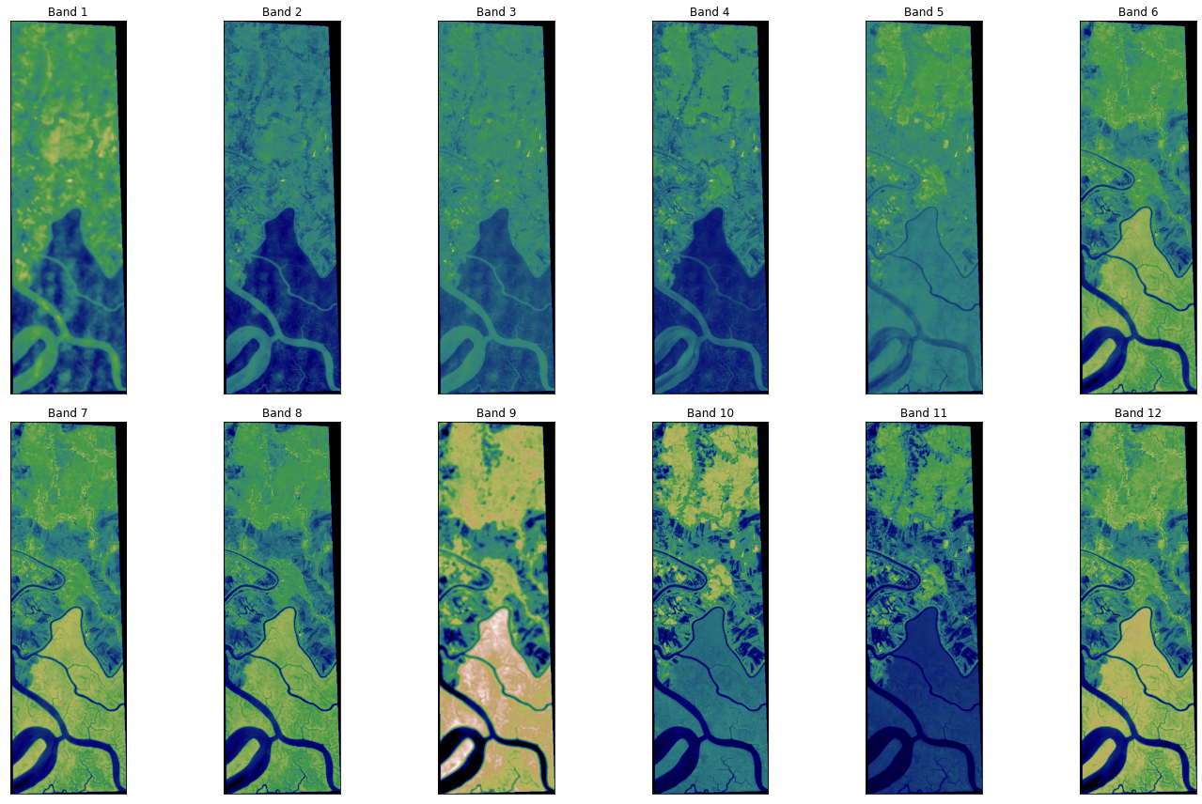
Data Visualization results

Slide 7
Preprocessing
Composite images - can sometimes be dark if the pixel brightness values are skewed toward the value of zero
solved by stretching the pixel brightness values in an image - stretch=True
str_clip - how much of the tails of the data to clip off.
larger the number, the more the data will be stretched or brightened
Principal Component Analysis (PCA) (only for clustering)
(284292, 12) to (284292, 4)
array([0.55778198,0.37521242,0.0484222,0.00637526]) = 0.9877
Standardization -scaling technique
values are centred around the mean with a unit standard deviation and mean = 0
scaled data - train and test data in the ratio of 70:30

Slide 8
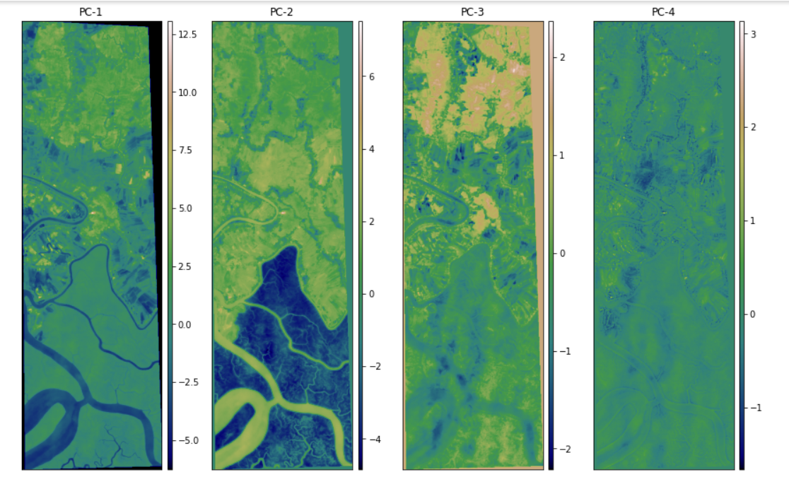
Preprocessing results

Slide 9
KNNC – k nearest neighbor classifier
k-Nearest neighbor classifier is one of the widely used classifiers in machine learning.
The data instances of the same class should be closer in the feature space
k-NNC - scikit learn package
K-NNC instance with n_neighbors as 6
predicts the labels of the test data
The K-NNC has shown 98.94% accuracy over the test data

Slide 10
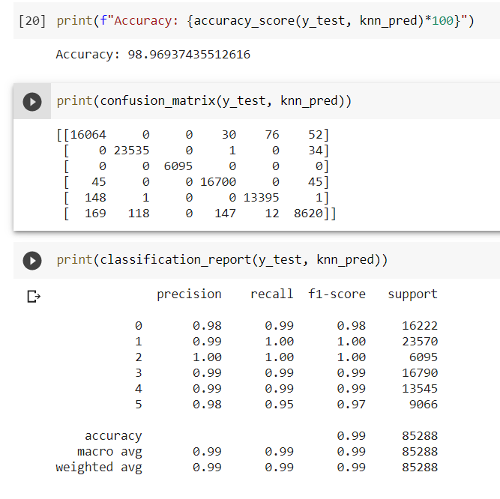
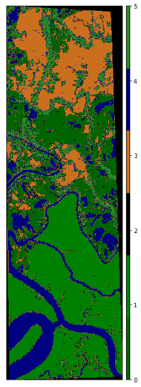
KNN results

Slide 11
Support vector machine
supervised learning method - input-output mapping functions.
The mapping function can be either a classification function or a regression function.
For classification, nonlinear kernel functions are used
Here we use Radial Basis Function(RBF) ,c=3(regularisation parameter)
Support Vector Machine (SVM) algorithm has shown 99.88% accuracy on the test data

Slide 12
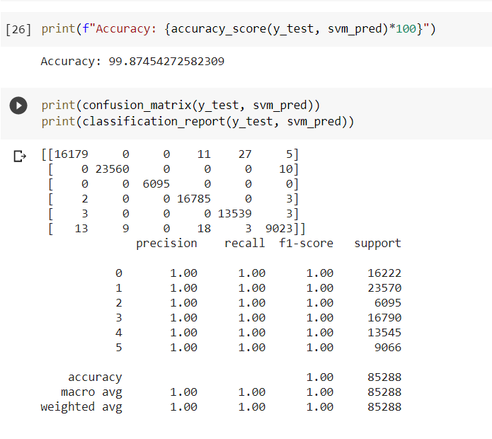
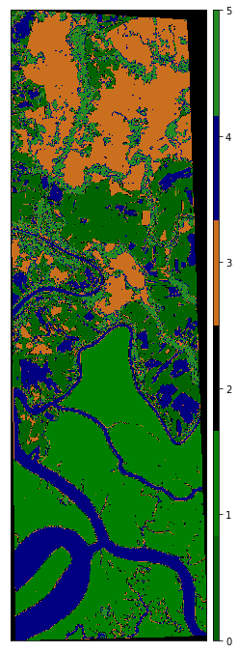
SVM results

Slide 13
Gradient Boosting classifier
Good prediction speed and accuracy - especially with large and complex data
the best possible next model - combined with previous models, minimizes the overall prediction error.
lightGBM - framework that makes use of tree-based learning algorithms
classifier has shown 98.55% accuracy over the test data

Slide 14
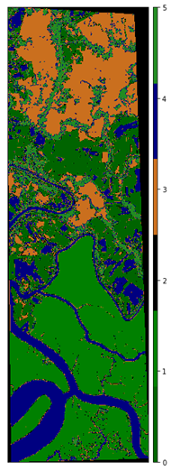
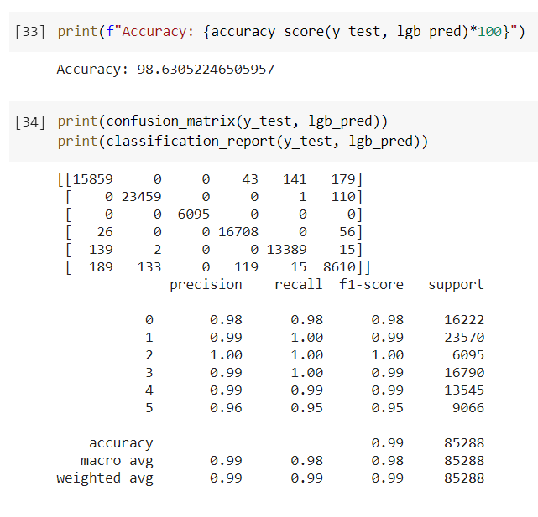
LightGBM results

Slide 15

K-means clustering
Clustering is the assignment of objects into groups called clusters so that objects from the same cluster are more similar to each other than objects from different clusters
K-means is one of the simplest unsupervised learning algorithms in which each point is assigned to only one particular cluster
K = 6 clusters

Slide 16
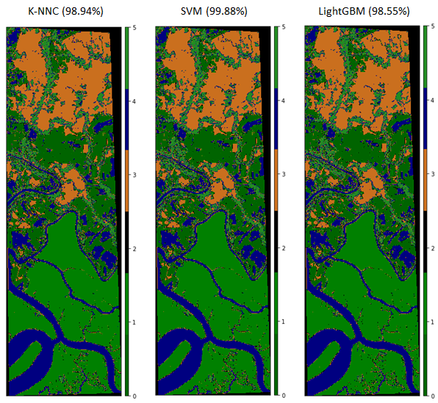
comparison

Slide 17

Conclusion
Satellite image classification dependent upon the classifiers
SVM, K-nearest neighbor, Light BGM and K-means are defined that are considered as best
The comparison is done by performing classification based on combined RGB features for six object classes.
Future lies - dataset of satellite image to achieve better accuracy

Slide 18
Thank you

