Slide 1
Understanding the Role of Version Control in Software Build and Testing
Dhanush Dharmaretnam and Kamel Alrashedy

Slide 2
Research Questions
1) What Git actions does developers do at the beginning and end of an IDE session?
2) Do developers commit their code after a successful build or test?
3) Do developers follow any trends regarding the time of the day to perform version control activities?

Slide 3
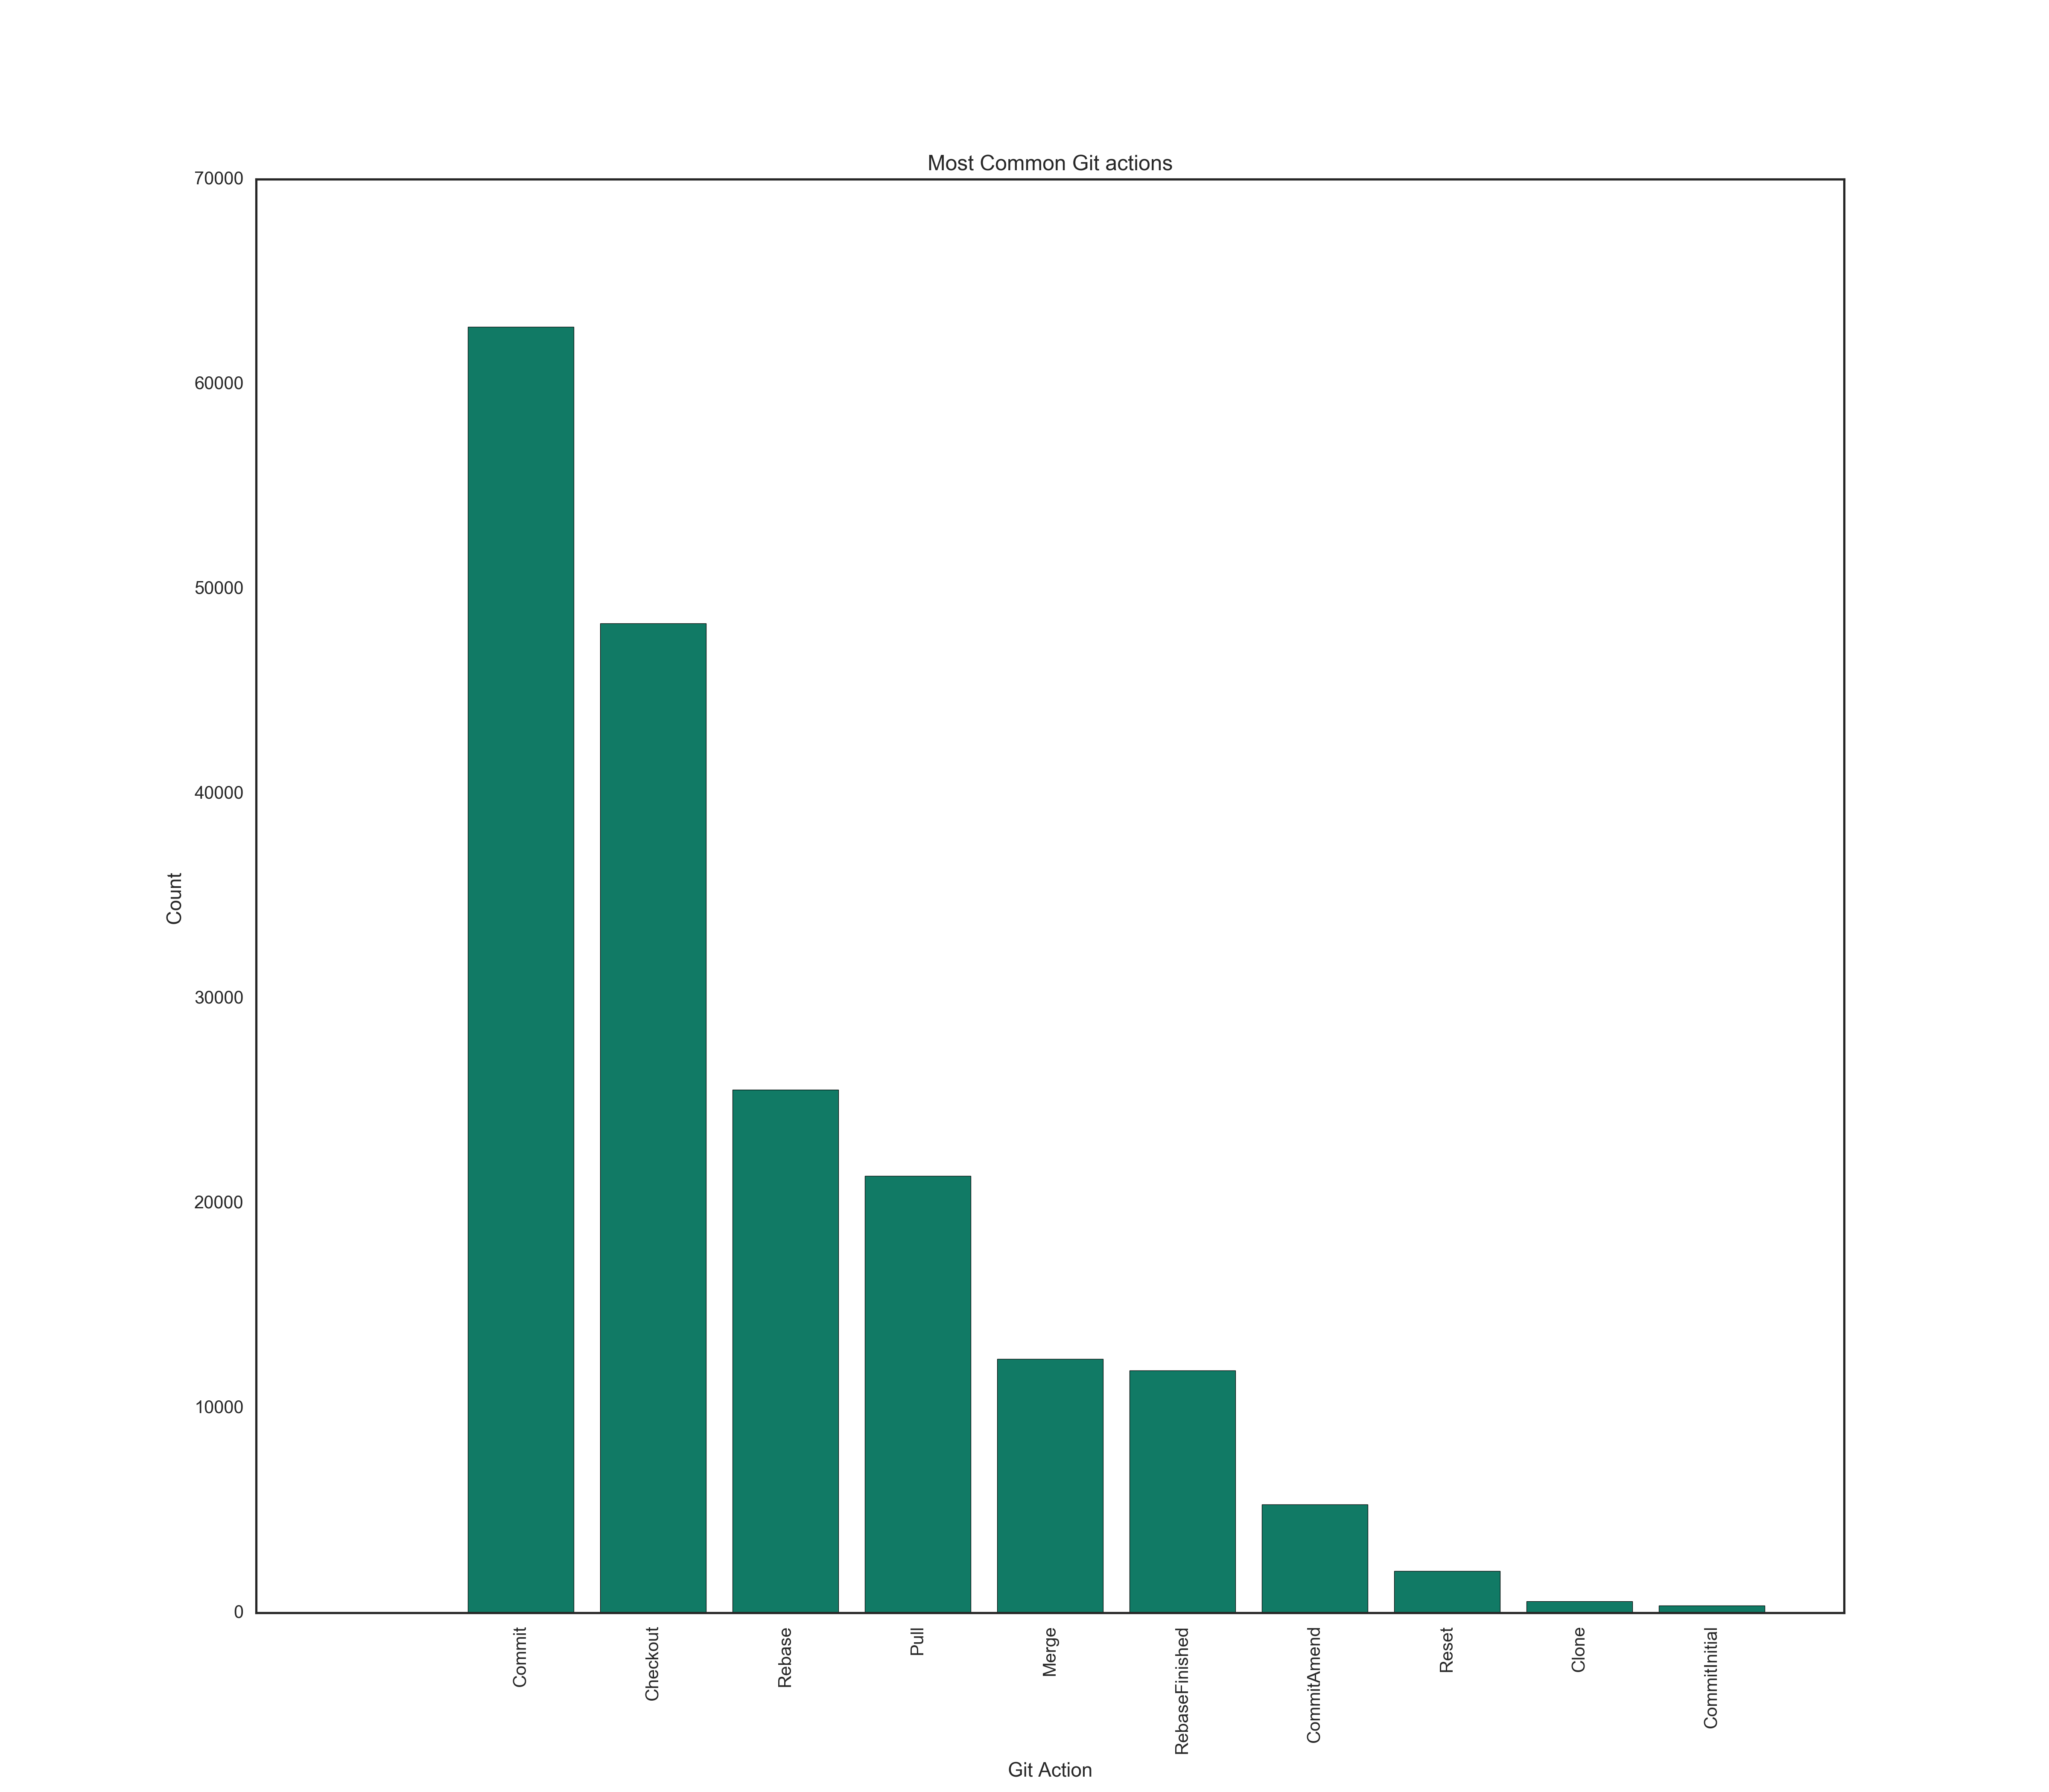
About the dataset – VC table, Build Table and Test cases Table=> Bad Dataset, Less variability.
Build Table
"vsBuildActionBuild" -12662 are built events
"vsBuildActionRebuildAll" -639
"vsBuildActionClean" -263
"vsBuildActionDeploy" -9
Success:75358, failed 3278
Debug': 75450, Release: 2025, CodeAnalysis: 785,
Local.Debug: 163
Test table: 336113 test cases
Success: 289747 (1)
Rest all error, ignored, failed

Slide 4
RQ 1. What Git actions does developers do at the beginning and end of an IDE session?
We looked for Unique IDE Sessions with has a Git activity in the Version Control Table. We found 825 Sessions
We looked to find the first action after an IDE Session started and Last action before ending IDE session. (executedAt field)
We also studied first four and last 3 sequence of git activities in a session.

Slide 5
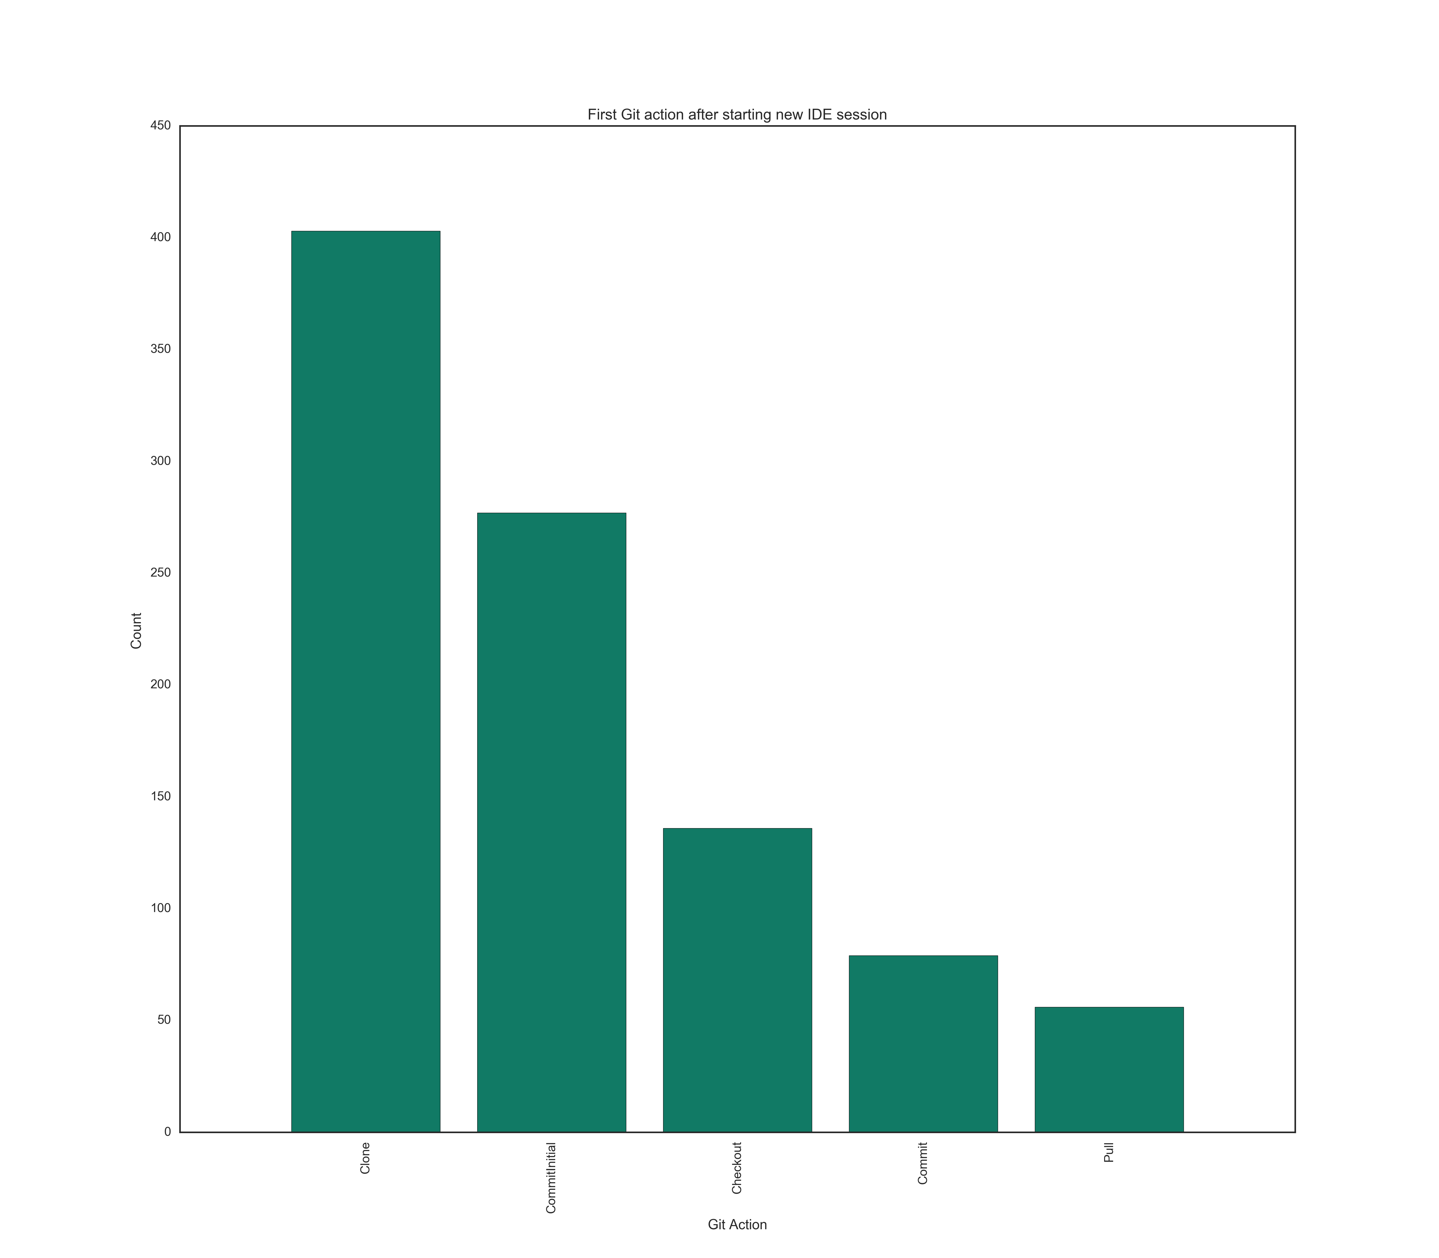

Slide 6
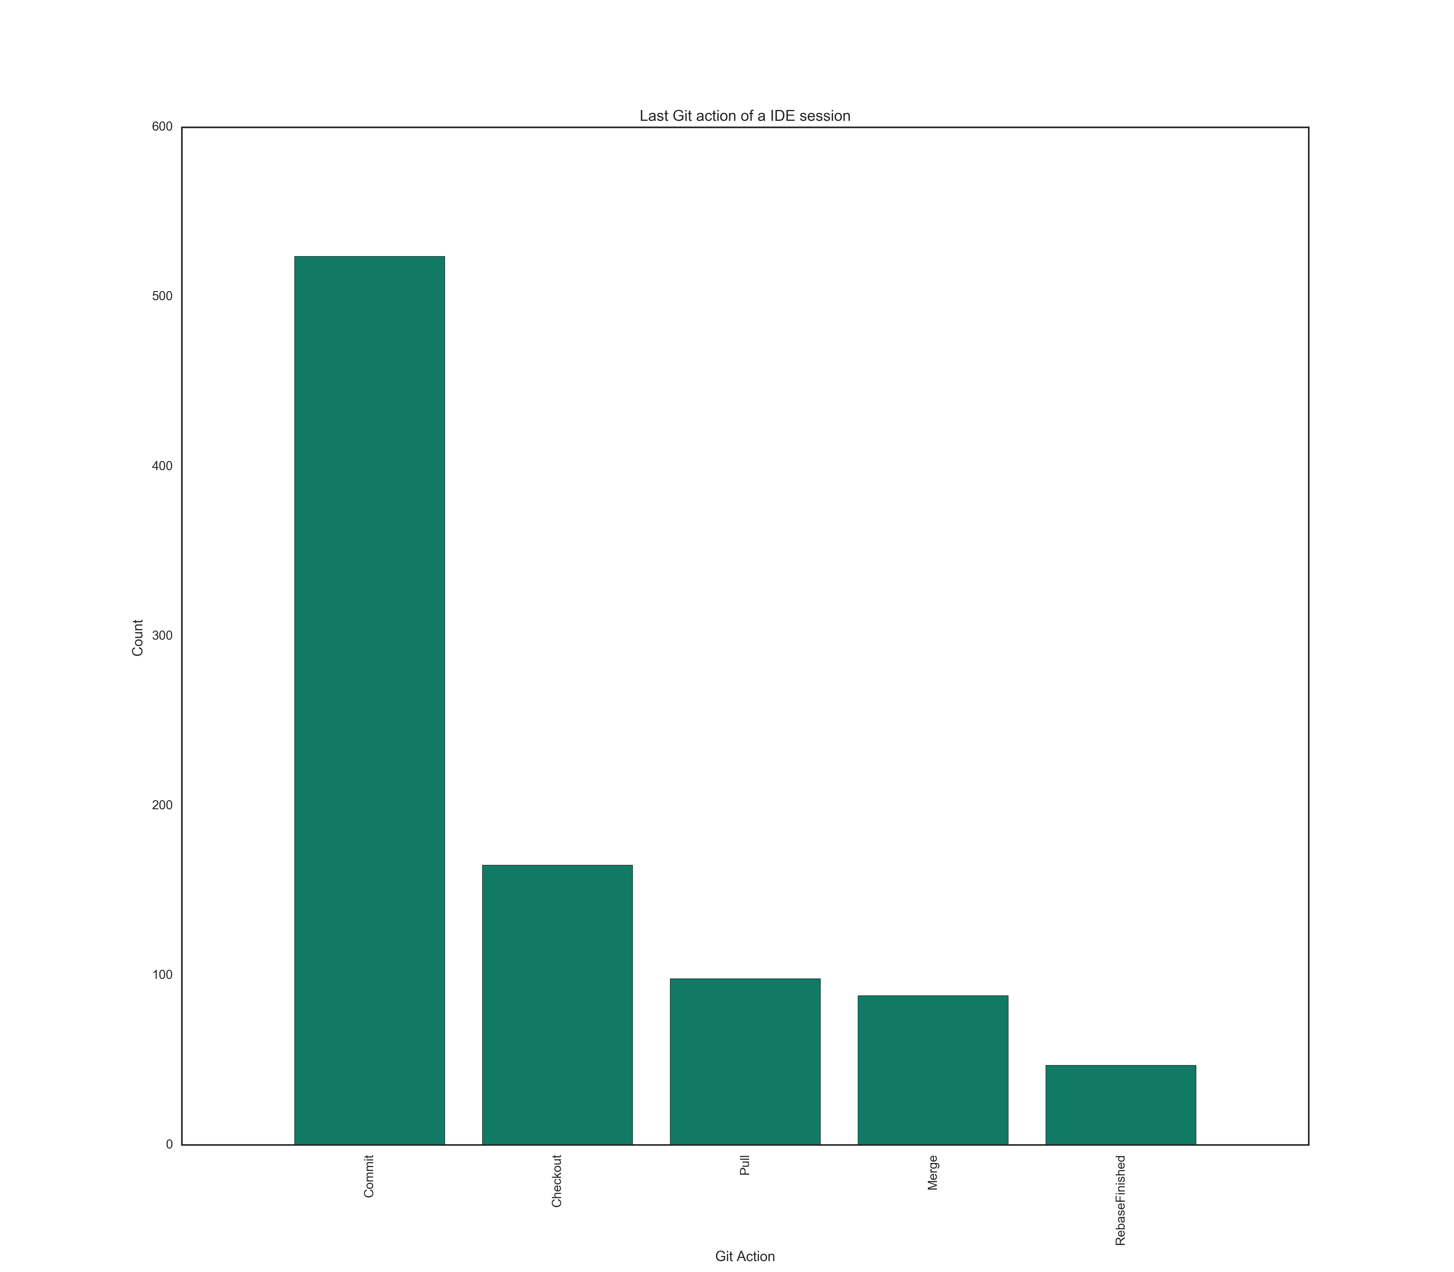

Slide 7
Sequence First Four
➢ CommitInitial->Commit->Commit->Commit 76
➢ Clone->Checkout->Commit->Commit 71
➢ Checkout->Checkout->Commit->Checkout 57
➢ Clone->Commit->Commit->Commit 55
➢ CommitInitial->Commit->Checkout->Commit 42
➢ Clone 40
➢ CommitInitial->Commit 38
➢ Pull->Pull->Pull->Pull 37
➢ Clone->Checkout->Checkout->Checkout 34
➢ Checkout->Pull->Checkout->Checkout 32

Slide 8
Last three Sequence
➢ Commit->Commit->Commit, 204
➢ Commit->Checkout->Commit 48
➢ Clone 40
➢ CommitInitial->Commit 38
➢ Checkout->Pull->Checkout 32

Slide 9
Do developers commit their code after a successful build or test? SuccessFul Build:
We found 459 IDE sessions which had both a Git activity and a build activity and these sessions were selected for analysis.
This resulted in 87755 Git actions and 41898 build actions. In 27037 cases there was a Git action followed by a build.

Slide 10
Results
In 27037 cases there was a Git action followed by a build. We found that 1581 out of 26280 successful builds, there was a Git action performed within a minute (6%).
16546 times a Git action was performed within an hour after a successful test (61%).
The average time for a Git action after a successful build is 4.44 hours.

Slide 11
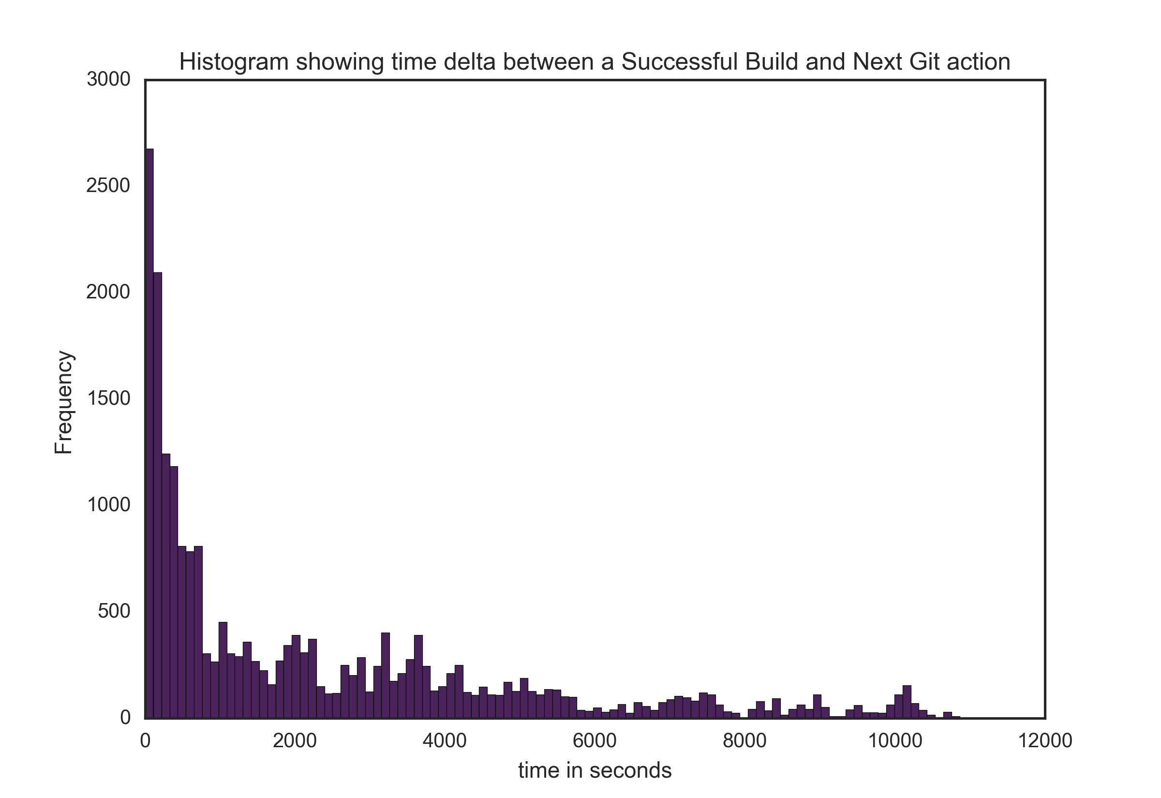

Slide 12
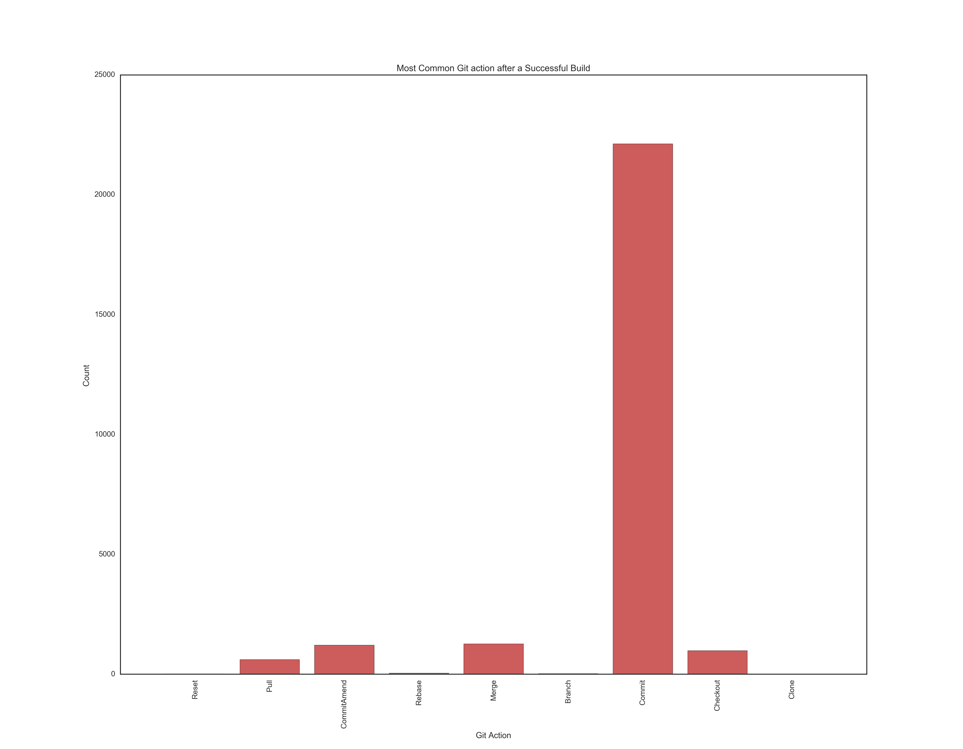
When Build Success- Git action
The most common Git action followed by a successful build is commit (88%), followed by Commit-Amend (5%), Merge (4%), checkout (2%) and Pull (1%).

Slide 13
When Build fails:
we found only 757 unsuccessful build which was followed by a Git action. We found that among the 757 unsuccessful build, 222 were followed by a successful build.
The average time for commit after an unsuccessful build is 6.7 hours. This is because the developers spend additional time fixing their build errors and then running a successful build before committing their code.
Even though the most common developer actions after an unsuccessful build is commit (82%), actions such as Pull (8%) and Commit-Amend (5%) closely

Slide 14
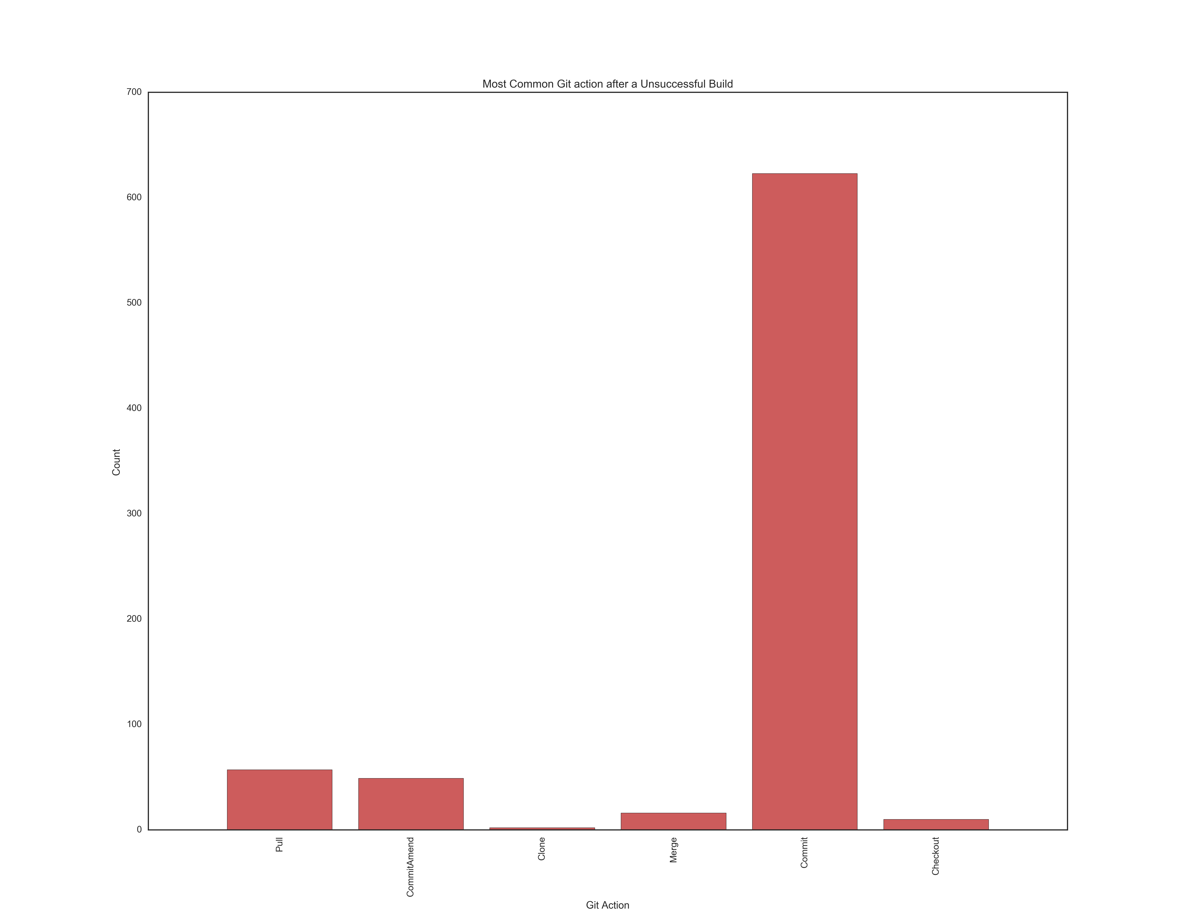

Slide 15
Successful Build after an UnSuccessful one
number of times git followed by Successful build:222
under_one_minute
9
under_one_hour
124
average time for git action in hours
4.52583458458

Slide 16
For Successful tests
We selected those IDE sessions which has both test execution and Git actions.
We found 157 such sessions which consisted of 72029 Git actions and 327463 test cases.
We found that there were 250304 successful Test cases (76% of total test cases) and all of them were followed by a Git activity
There were 7260 out of 250304 instances where a Git action as performed within one minute of a successful test case.
This number changed to 201028 out of 250304 (80.31%) for actions within an hour.
For an Unsuccessful test case, this number changed to 0.8% for under a minute and 73% for under an hour.
It must be noted that only 63% of the failed Test case had a Git action performed.

Slide 17
Do developers follow any trends regarding the time of the day to perform development activities.
Early morning-> 06:00-08:59Hrs,
Morning->09:00-11:59Hrs,
Afternoon->12:00-15:59Hrs,
Evening-> 16:00-18:59Hrs,
Night->19:00-21:59Hrs,
Late Night: 22:00-05:59Hrs.

Slide 18
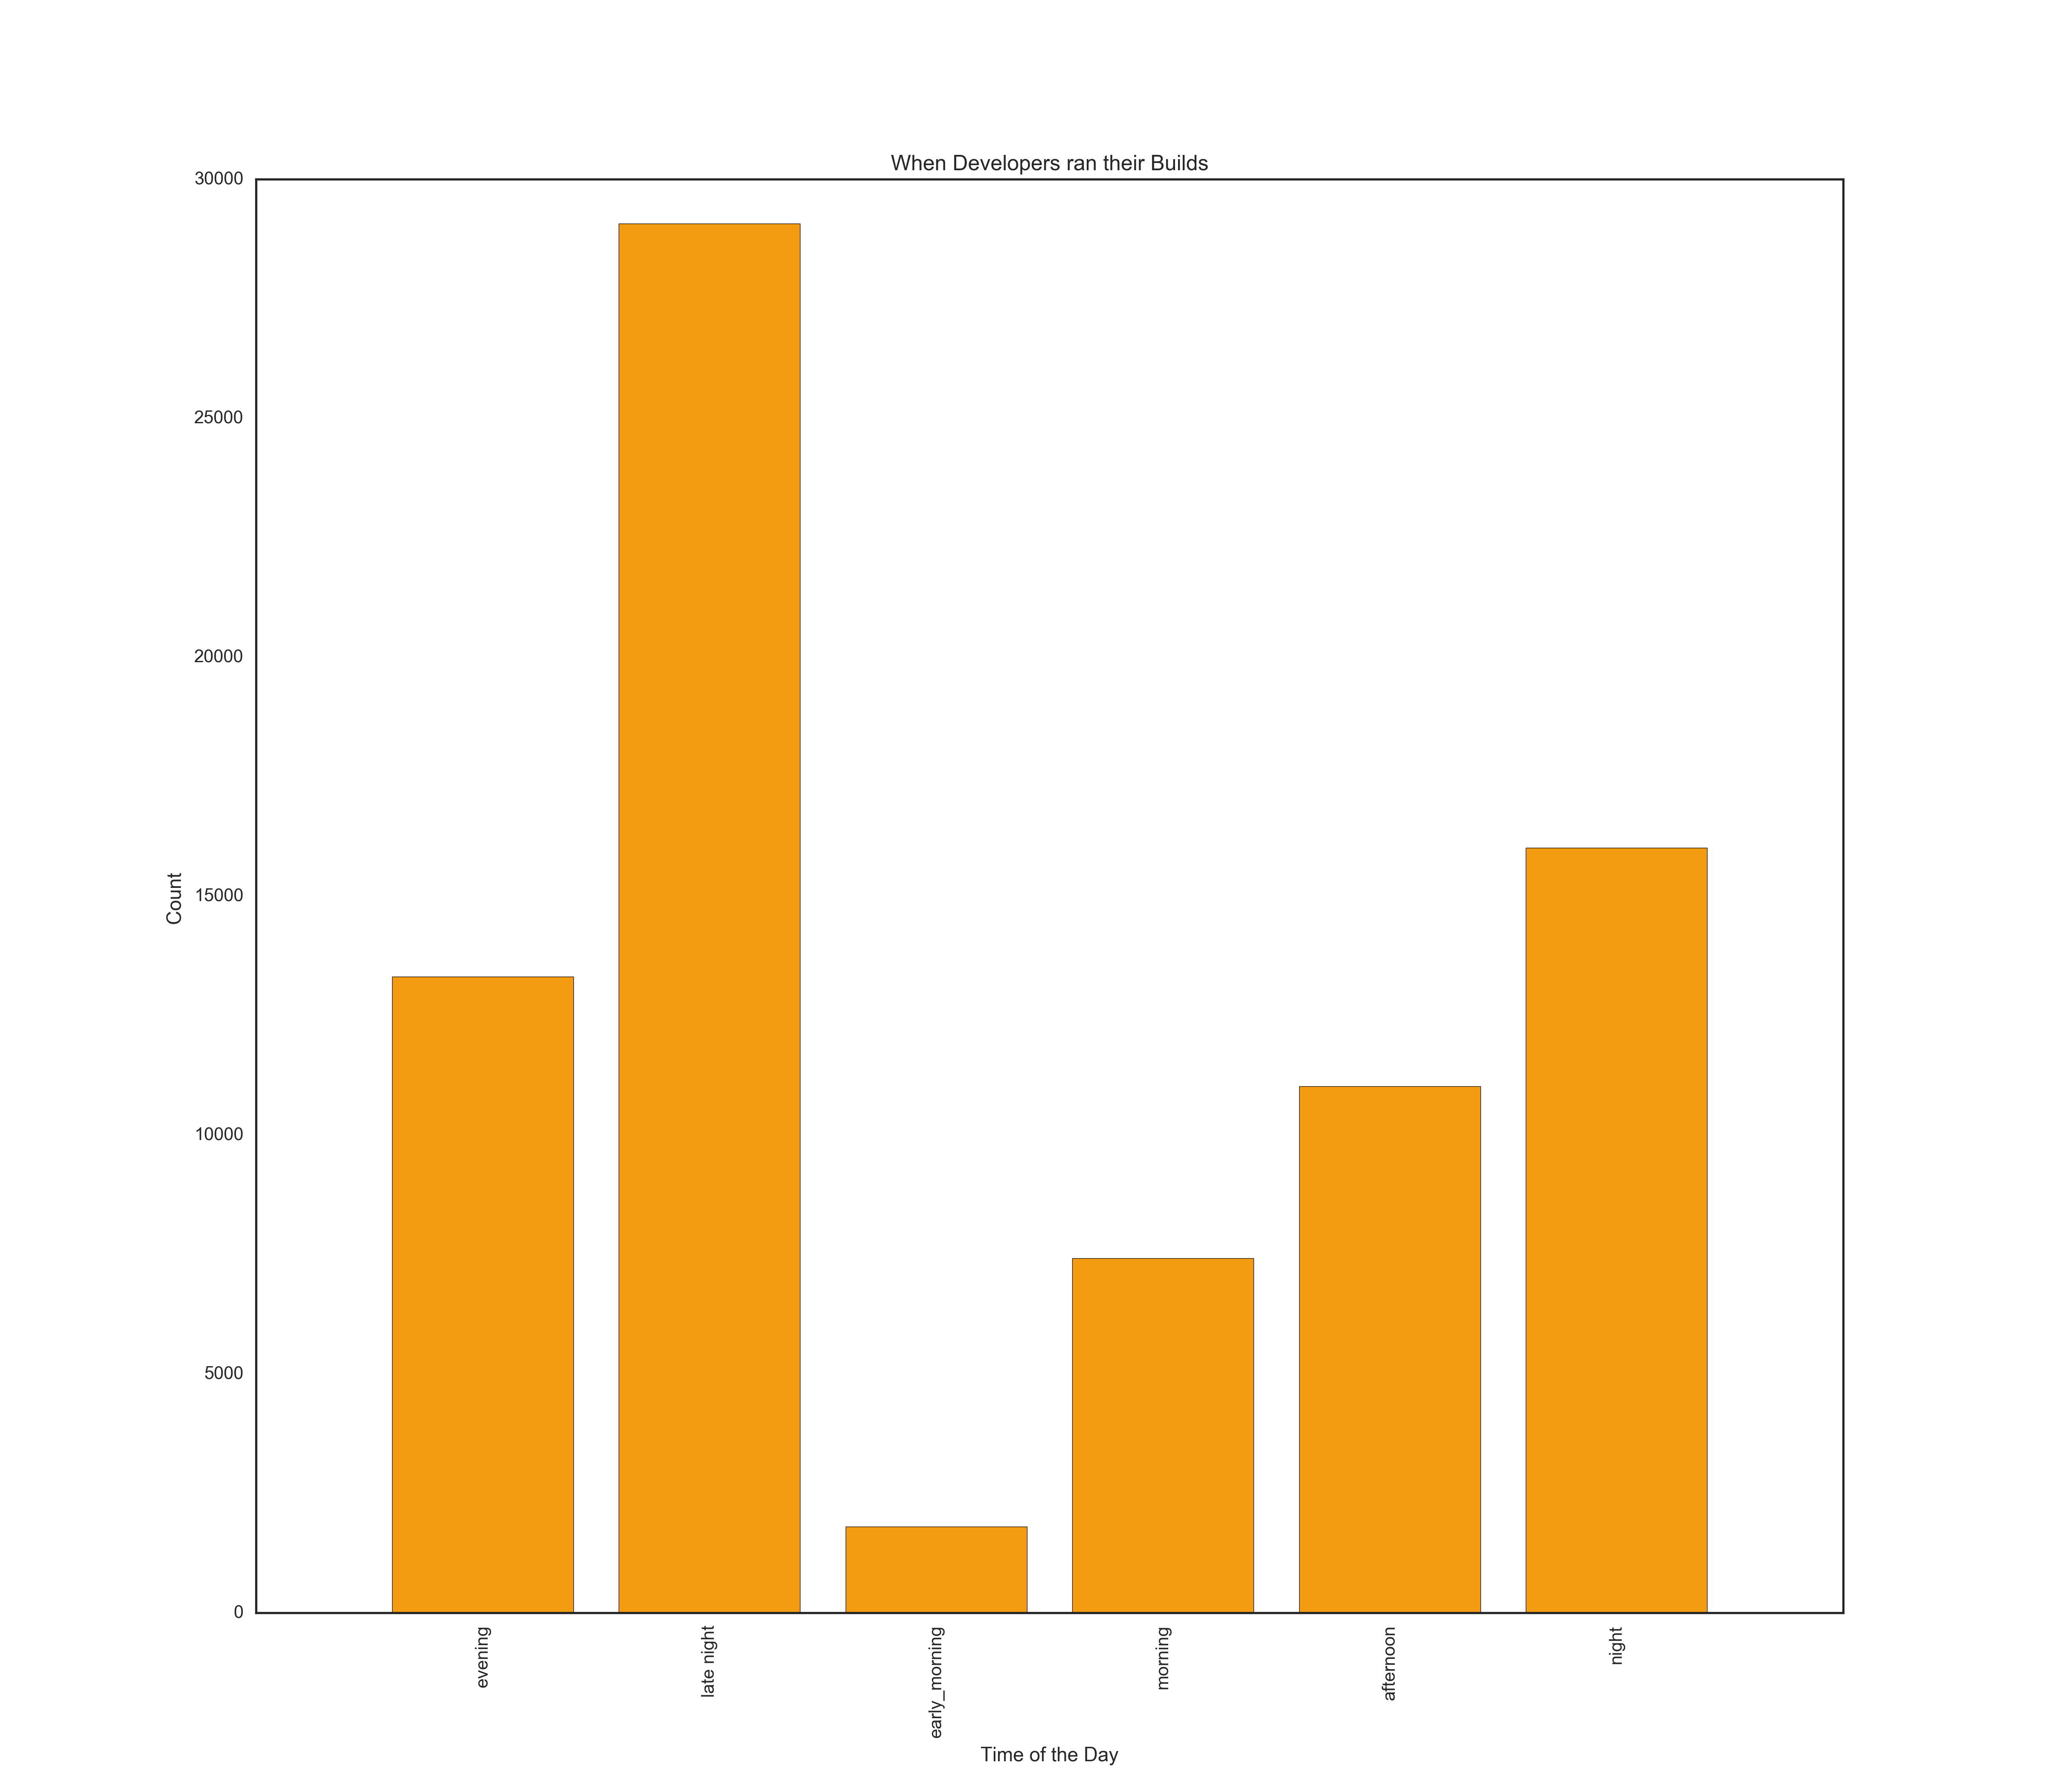
Build

Slide 19
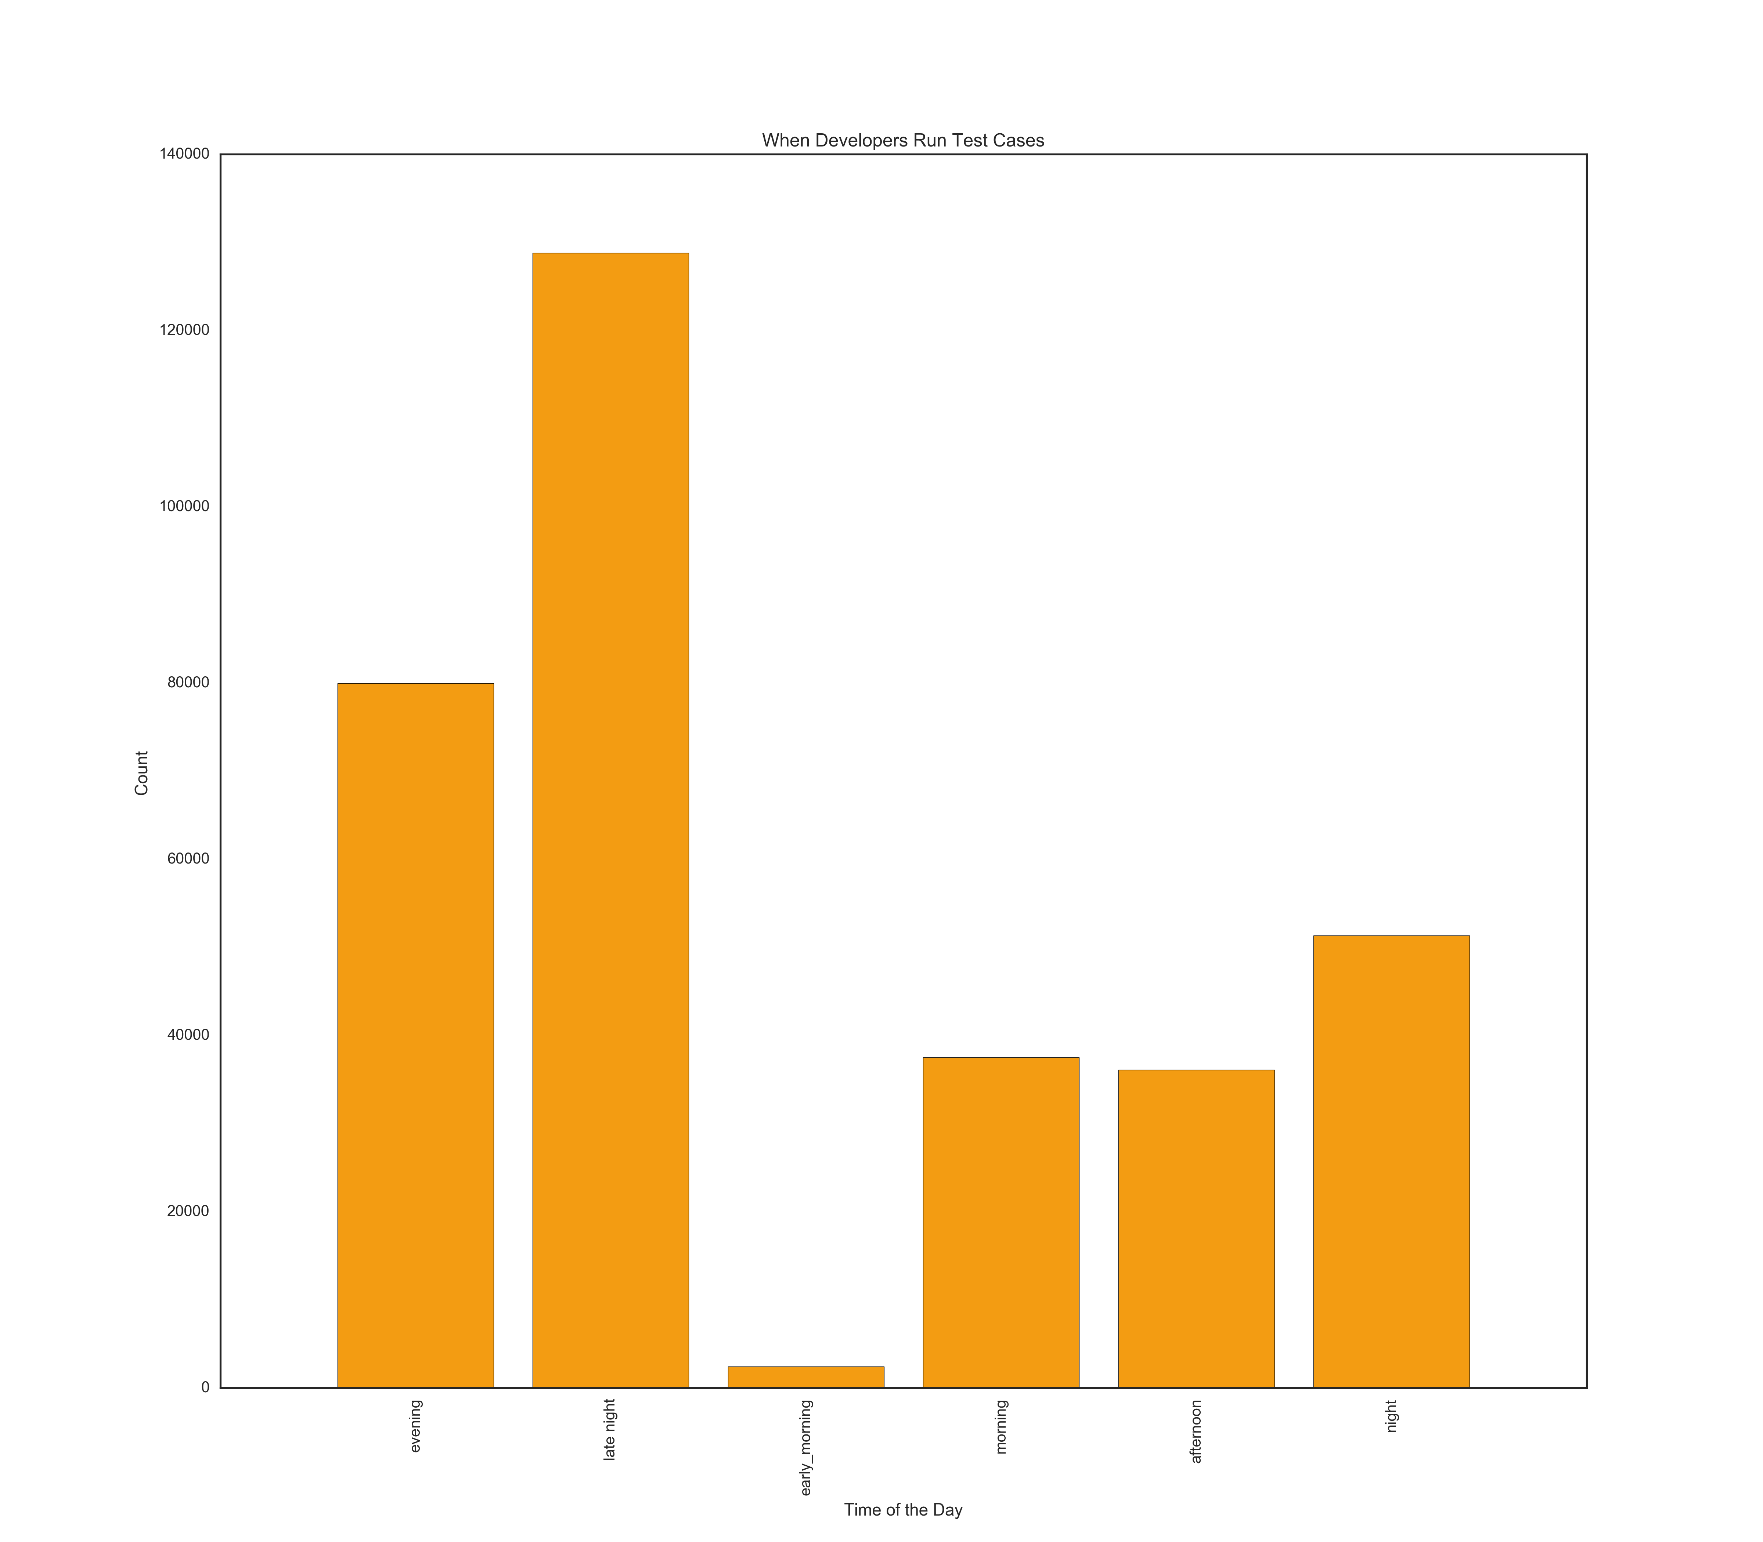
Tests

Slide 20
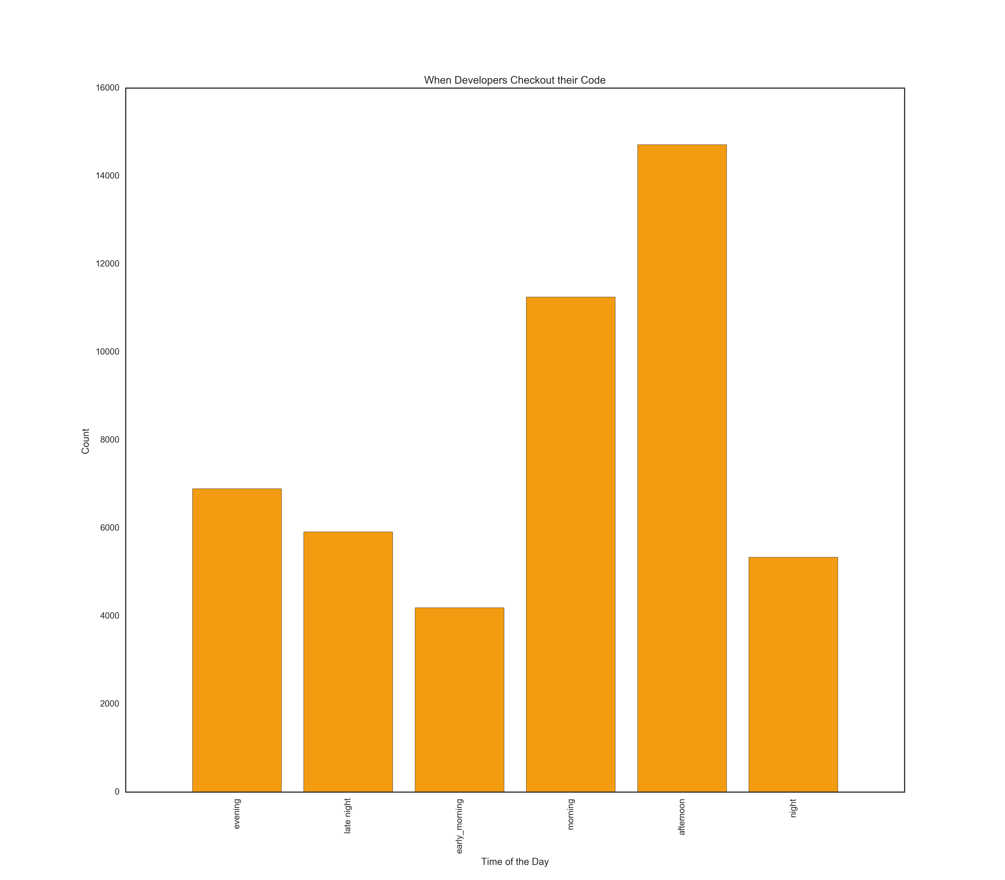
Checkout

Slide 21
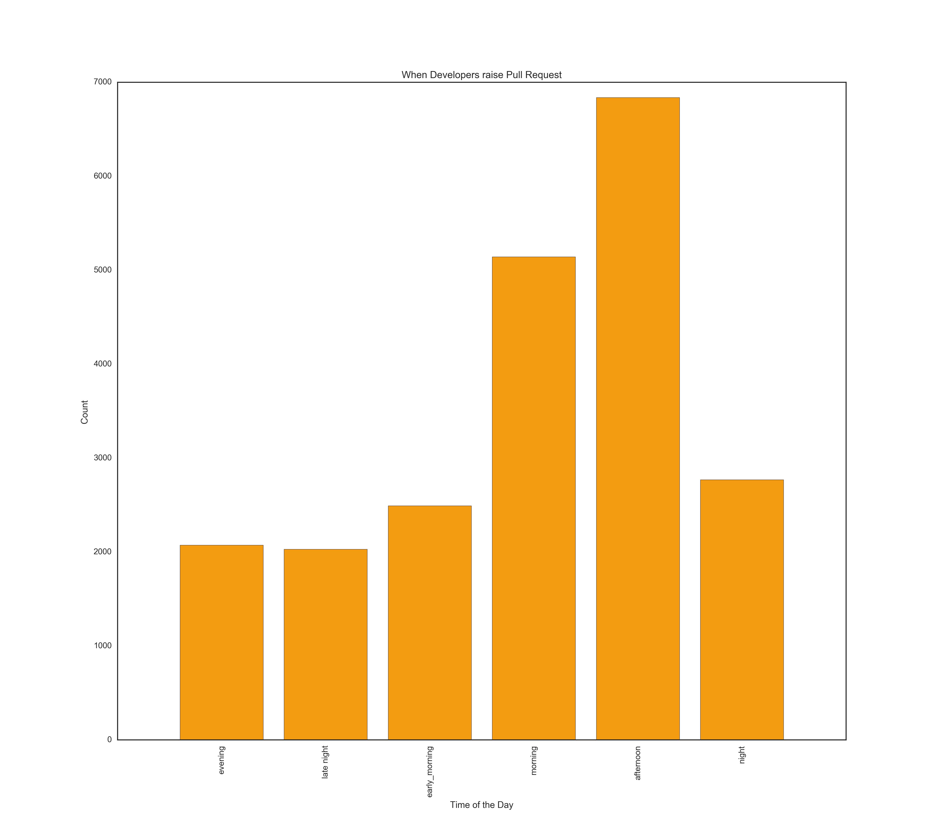

Slide 22
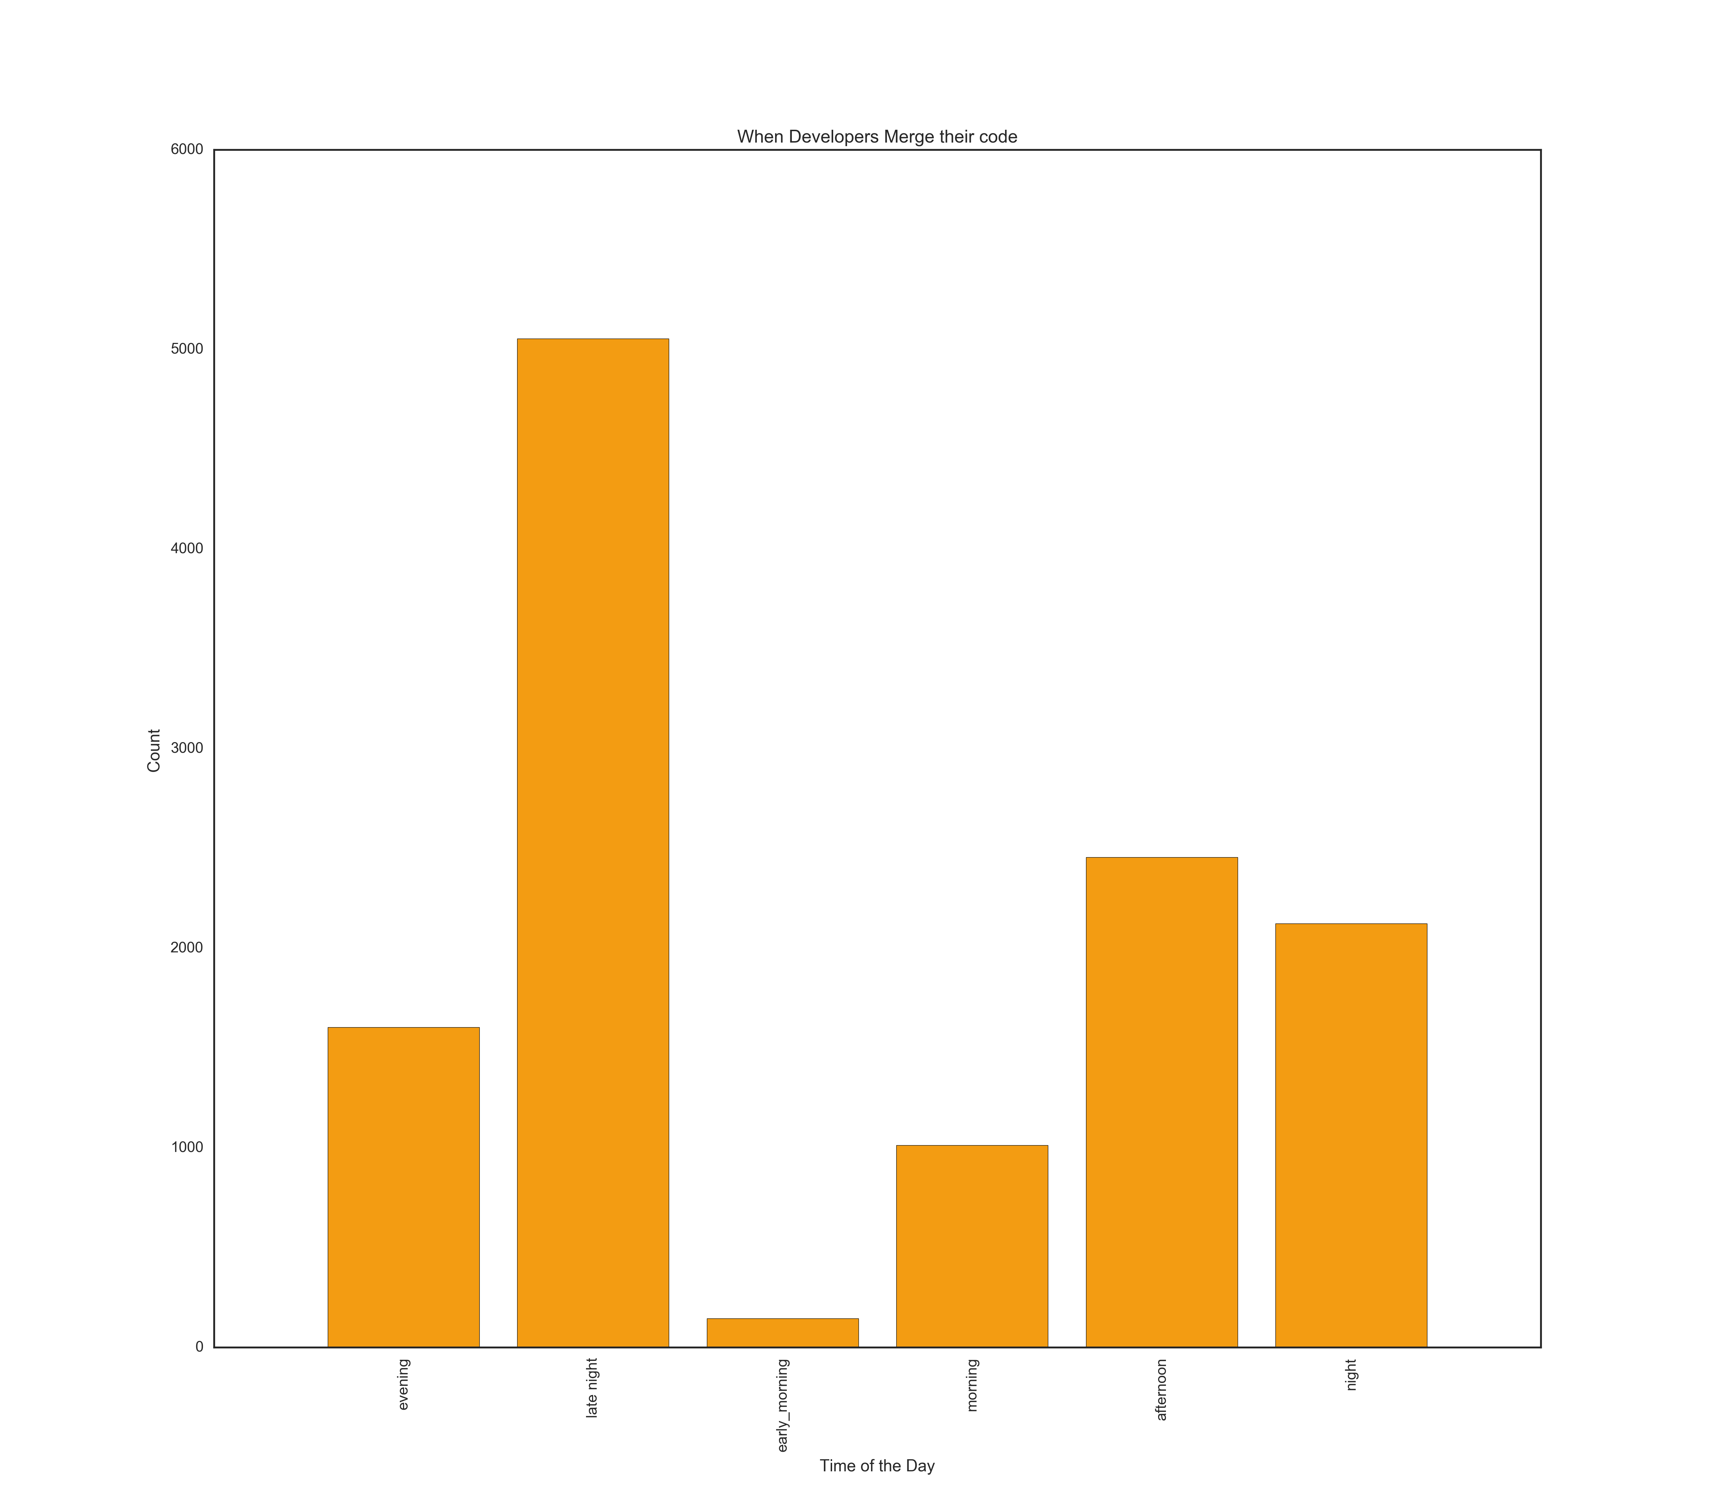

Slide 23
Conclusion
We explored what Git actions does developers do at the beginning and end of an IDE session – Beginning -> Clone, Ending -> Commit

