Slide 1


Food and Beverage Industry
#challenge 6

Slide 2
Agenda
Tools used ( SQL , MS Excel ).
Primary Insights.
Secondary Insights (Recommendations for improving CodeX).

Slide 3
Agenda
MS Excel-Charts , Visualizations .
SQL-Analyzing the data and posting output.
Power Point – presentation.

Slide 4
Primary insights

Slide 5

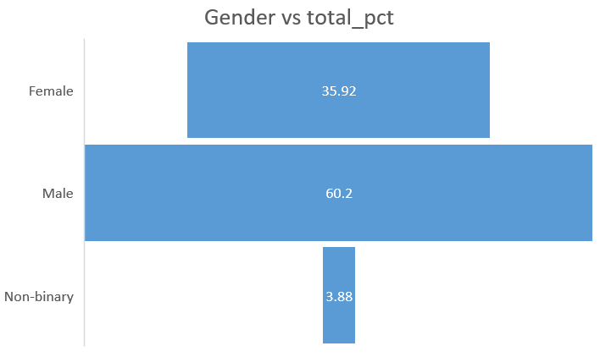
1. Demographic Insights a. Who prefers energy drink more? (male/female/non-binary?)
Male prefer Energy Drink more than other two categories .
Around 60% of the total is contributed by males
and major age group is between (19-30).

Slide 6
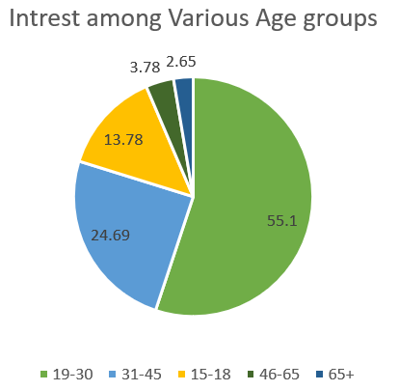
1. Demographic Insights b. Which age group prefers energy drinks more?
Those people who come under the age category of 19-30 prefer more energy drink .
This category covers the 55% of the total responses.
The minimum audience for the energy drink belongs to the age group of age 65+

Slide 7
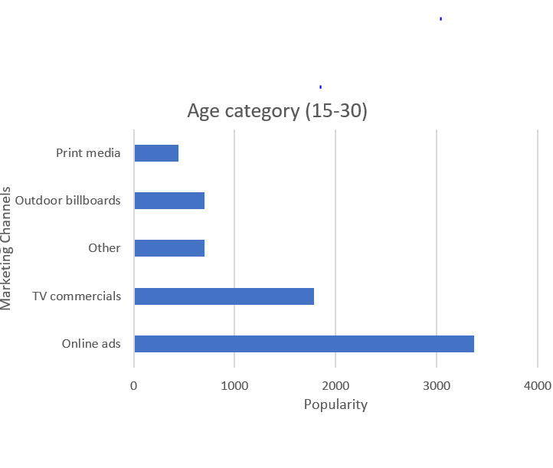
1. Demographic Insights c. Which type of marketing reaches the most Youth (15-30).
If the target audience is in between the age of 15 to 30 then online ads and Social Media Marketing helps to reach out more.
This would give the best result for the above mentioned age category.
For the age category 65+ TV ads would give better results.

Slide 8
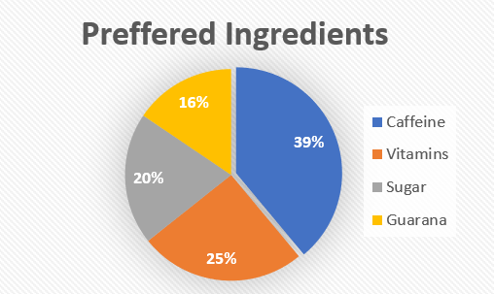
2. Consumer Preferences: a. What are the preferred ingredients of energy drinks among respondents?
Respondents preferred 4 ingredients ( Caffeine , Vitamins , Sugar , Guarana ).
Out of these Caffeine was the most preferred Ingredients around 40% of the respondents preferred caffeine and least preferred is Guarana.

Slide 9
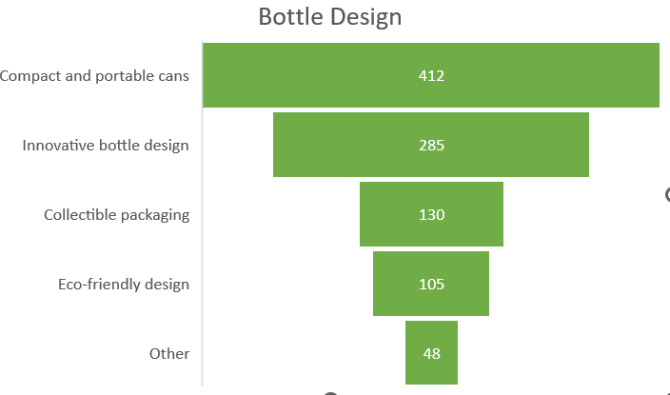
2. Consumer Preferences: b. What packaging preferences do respondents have for energy drinks?
This funnel chart shows that most of the Respondents want a simple and portable package with an innovative bottle design
This shows that they are least interested in Eco - Friendly design and other.

Slide 10
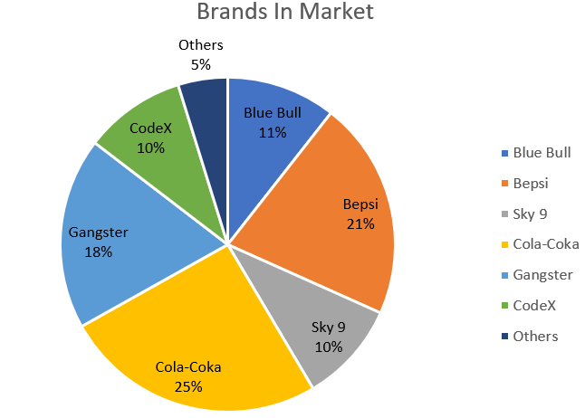
3. Competition Analysis: a. Who are the current market leaders?
A market leader is a company with the largest market share in an industry that can often use its dominance to affect the competitive landscape and direction the market takes. A market leader typically enjoys the largest market share or the largest percentage of total sales in a given market.
From the pie chart we can find that 25% of the Total is contributed by cola-coka and Bepsi so these 2 brands are the current marketing leaders in our case.

Slide 11
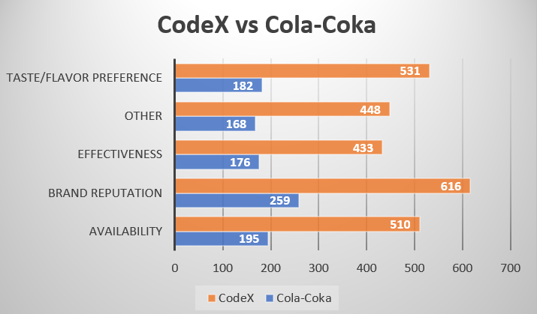
3. Competition Analysis: b. What are the primary reasons consumers prefer those brands over ours?
When we are comparing Codex with cola-coka which is the current market leader we come to know that most of the people are unaware of the brand “CodeX” and CodeX brand availability is less compared to other brands.
Taste/Flavour experience doesn’t come into role because the average taste experience rating is same for both the brands.
CodeX must focus on Brand Awareness and increase the Availability for increasing the sales.

Slide 12
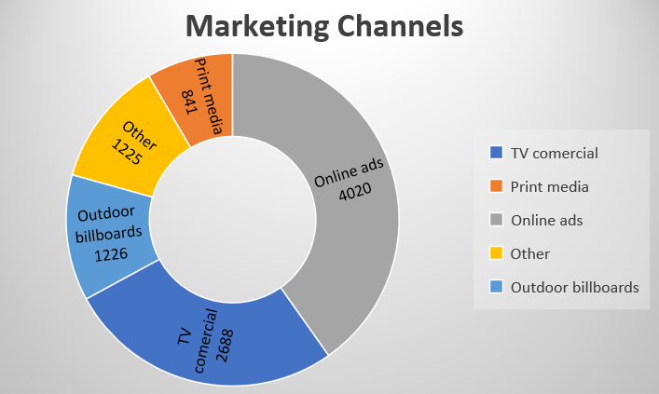

4. Marketing Channels and Brand Awareness: a. Which marketing channel can be used to reach more customers?
Online ads and Social Media is the best way to achieve massive amount of people this helps to cover most of the youth whose age between (15-30) to be specific because they contribute 50% of the total number.
Digital media marketing costs less and it is more efficient than any other type of marketing .It can cover more audience easily and effectively.

Slide 13
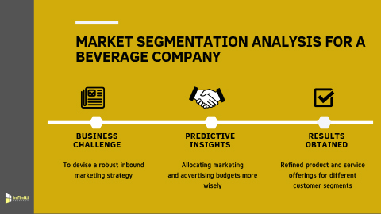
4. Marketing Channels and Brand Awareness: b. How effective are different marketing strategies and channels in reaching our customers?
An effective marketing strategy underlines business growth and from the existence it would be decided the ideal price of the product ,needs and helping you build brand loyalty to determining the right prices for your products and services , this would maximize the sale quantity.
Here are some best strategies to cover maximum target audience.
Having a social media presence.
Going behind the scenes.
Having a trendy packaging style.
Omnichannel presence.

Slide 14
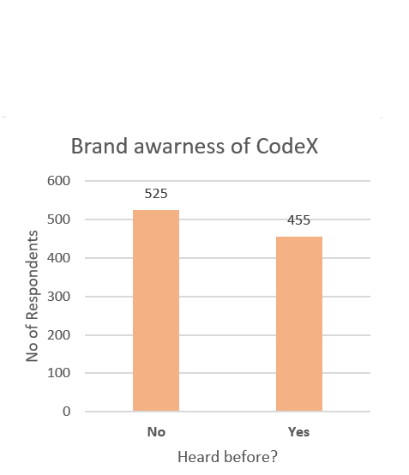
5. Brand Penetration: a. What do people think about our brand? (overall rating)
The overall rating depends upon many factors such as :
Taste Experience.
Availability , opinion about the brand.
Brand awareness etc.
When this applies to CodeX most of the people are unaware of the product (They doesn’t know that there is a product existing in the market)
The average Taste experience for CodeX is 3.3 and taking
all these into action on overall CodeX gets a
rating of 3.2 (Average).

Slide 15
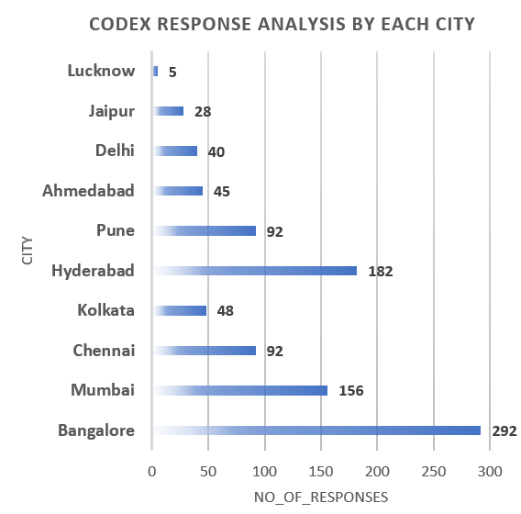

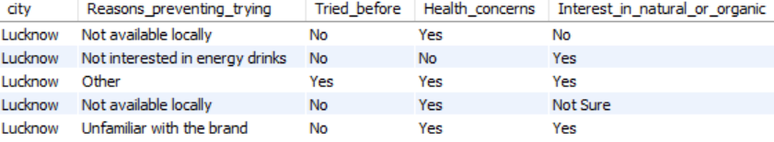
5. Brand Penetration: b. Which cities do we need to focus more on?
We can find that minimum amount of responses or preference is from Lucknow we must focus more on Lucknow to increase sales.
Not only CodeX all the brands have minimal responses from Lucknow.
Here we can find that most of the people are prevented from trying due to their Health concern ,least availability of the product and most of them are interested in organic.

Slide 16
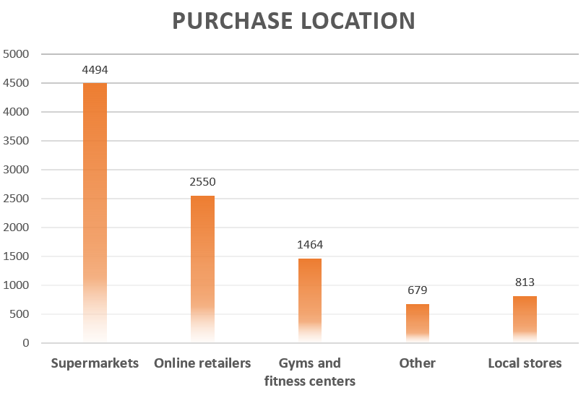
6. Purchase Behavior: a. Where do respondents prefer to purchase energy drinks?
Although Energy drinks are available in multiple places most of them are heading to the Supermarkets to buy it.
Supermarkets are becoming increasingly popular these days. Many people choose multi-commodity stores over the traditional shops for purchasing energy drinks.
Consequently, it has an adverse effect on the business of the local stores.
This may be fixed by giving an offer or any sale at local stores because it has the least preference or purchases compared to other locations.

Slide 17
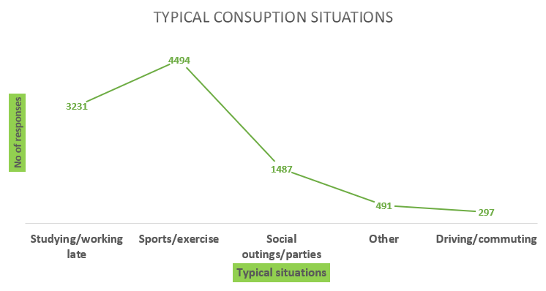
6. Purchase Behavior: b. What are the typical consumption situations for energy drinks among respondents?
There were 4 major typical consumption situations out of which most of them responded that they consume energy drinks during Sports/Exercise.
Energy drinks during exercise in hot/humid environments can help prevent dehydration and improve endurance exercise capacity. In fact, research has shown that carbohydrate intake during endurance activities can increase exercise performance.
45% of the respondents responded that their typical situation as “sports/exercise” and around 30% of the respondents responded as they consume during “studying/working late”.
These were the 2 situations which were familiar with most of them.

Slide 18
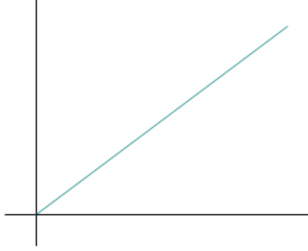
6. Purchase Behavior: c. What factors influence respondents' purchase decisions, such as price range and limited edition packaging?
Features that influence purchase decision:
Product prices significantly correlate with consumer buying behavior.
The product information available on packaging influences the consumer’s buying behavior.
Satisfaction plays a mediating role in consumer buying behavior.
Pricing of the product plays an essential role in customer satisfaction.
Product information available on labels play a significant role in customer satisfaction.
Price Range (PR)
Package Quality (PQ)
Most of the people in our brand are not sure about limited edition package and around 40% of people are interested in limited edition packaging.
Price range ∝ Package Quality
As a customer everyone would prefer to purchase a good quality product at a cheap price so we must mediate between these two factors to become a successful brand in the market.
As package quality and product quality increase price increases.

Slide 19
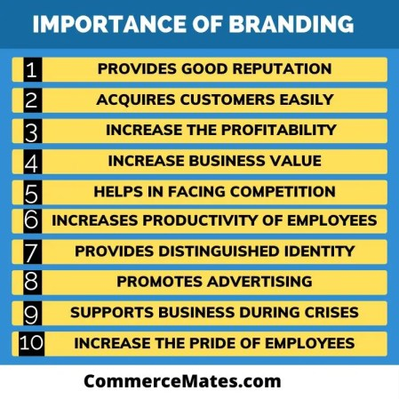

7. Product Development a. Which area of business should we focus more on our product development? (Branding/taste/availability)
Branding, taste, availability these 3 are important but in our case taste experience seems to be (Average-good) , but Branding and availability are the cases where CodeX lags behind
Here is the best case shown by cola-coka (current marketing leader). In Lucknow most of them are concerned about their health and availability is also less but here comes the power of branding Cola – Coka has 10x more preference in Lucknow compared to CodeX. Areas of Business to focus on (Branding , Availability)
Branding can establish trust and credibility with customers. A well-crafted brand can communicate a company's values, mission, and reputation, which can help build a positive image and foster long-term customer relationships.

Slide 20
secondary insights

Slide 21
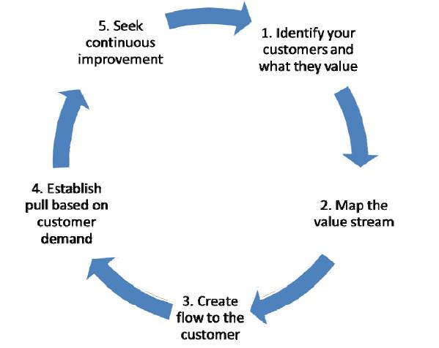
Recommendations for CodeX: ● What immediate improvements can we bring to the product?
Use word of mouth advertisement .
Increasing the availability (this is the core thing) if product is not available then the people cant buy it.
Create a social media page and start uploading the updates and new features.
Bringing organic ingredients so that this will improve the sales in Lucknow.
Advertising through multiple means.
Change the bottle design and label (increased portability and innovative) suggestions from respondents.
Follow 80/20 Principle invest 20% in improving and get sales increased by 80%.

Slide 22
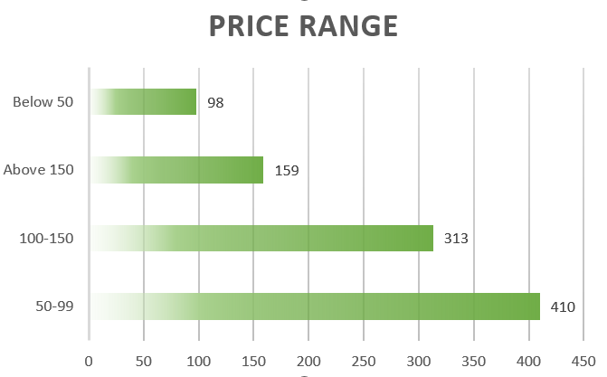
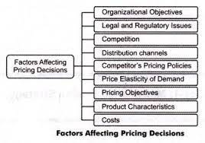
Recommendations for CodeX: ● What should be the ideal price of our product?
While pricing we must do psychological pricing if we follow this method they will think that product costs less and the probability of purchasing increases.
For increasing sales rapidly and taking (psychological pricing and customer preference) on account we can determine that the ideal price of the product would be ₹99.

Slide 23

Recommendations for CodeX: ● What kind of marketing campaigns, offers, and discounts we can run?
Offers & Discounts
Same discounts and offers must not run in all the cities.
Discounts and offers must be run in the places where our brand awareness and brand perception is less.
If we want to run discount we can offer a profitable discount of 10% because if the discount% increases profit will decrease.
We can run offers like 10% Extra or 10% bigger to attract more customers.
Running both discount and offer at the same period could affect the brand impression.
Marketing Campaign ideas:
Listen and Respond , Go to Events .
Collab With Influencers , Get Your Social Media
Game On Point.
For now we can run discount in Lucknow and offer in Jaipur as these 2 cities are lagging behind.

Slide 24
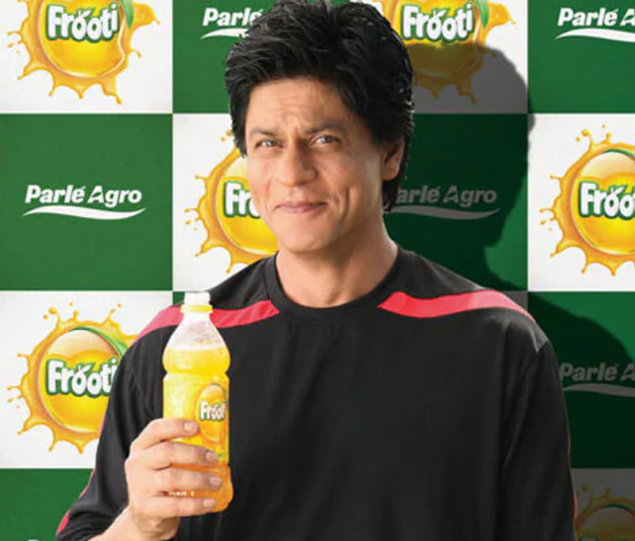
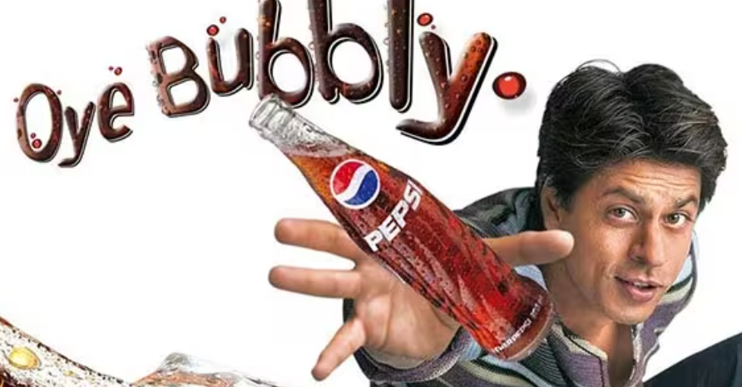
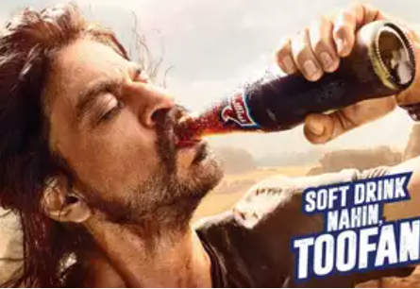
Recommendations for CodeX: ● Who can be a brand ambassador, and why?
A person, especially a celebrity, who is paid to endorse or promote a particular company's products or services.
Shah Rukh Khan is one of the best ambassador he made multiple energy drink brands widespread globally.
He is very popular in the Northern part of India.
He has experience with many such brands.
He made many brands successful and he is a social media influencer.

Slide 25
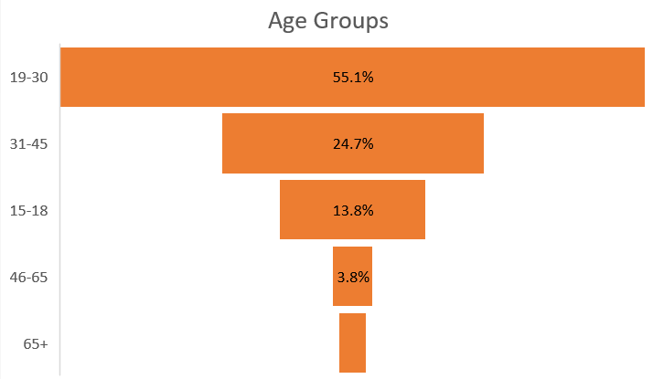
Recommendations for CodeX: ● Who should be our target audience, and why?
Our target audience is in between the age category( 15 – 65) because it has 90% of the total.
We cant advertise our product to age group of 65+ because at that age people are concerned about their health and they are not interested.

Slide 26
I would like to thank Mr. Dhaval Patel and Mr. Hemanand Vadivel for building this community and giving me this opportunity and thanks to codebasics team ☺ .

Slide 27
Thank you

