Slide 1
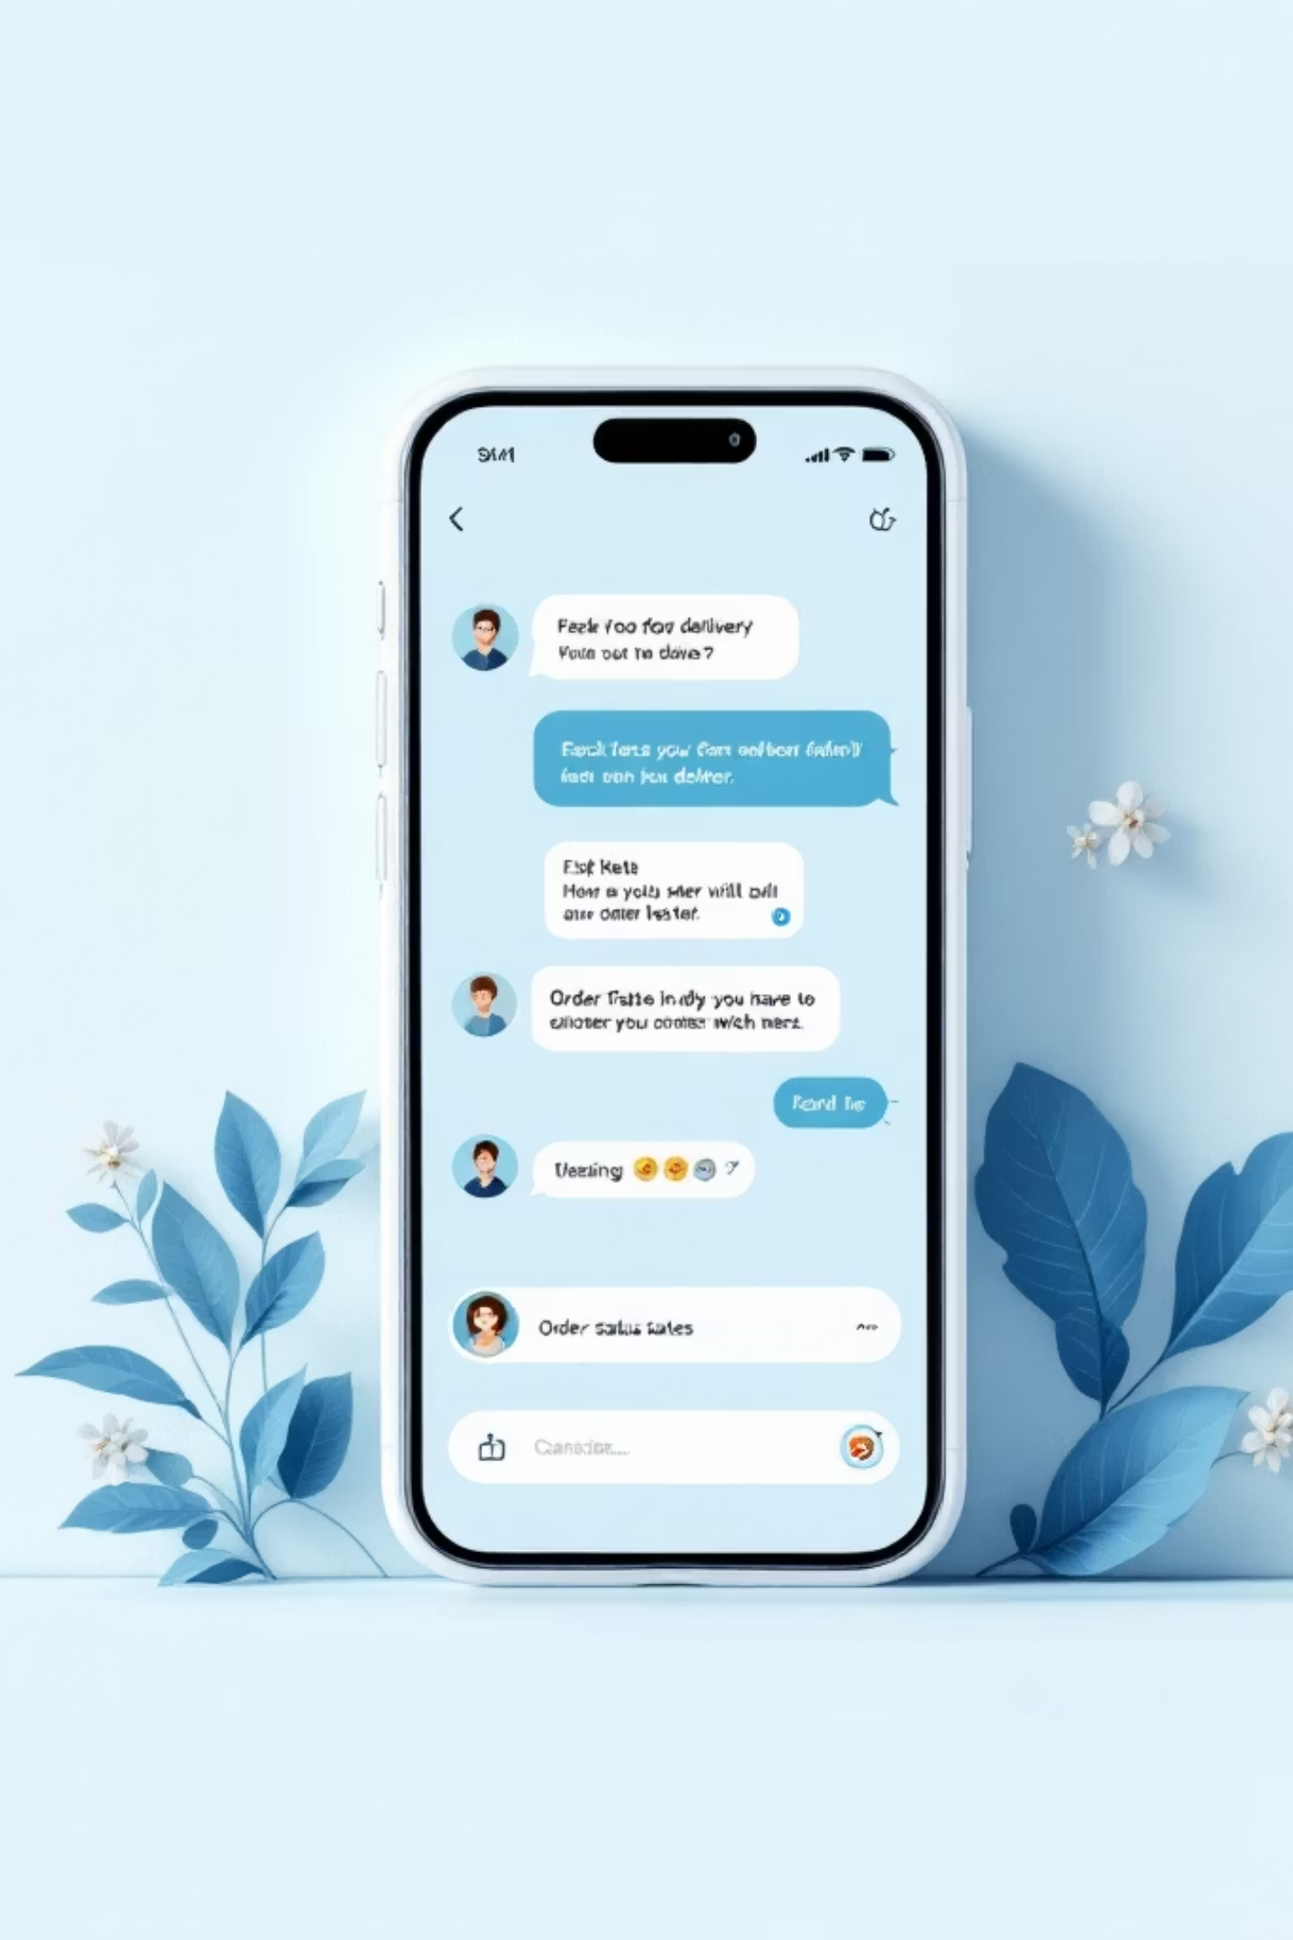
FoodFlow Support Bot
Smart Customer Support for Food Delivery Platforms
Hackathon Project | Mysuru Royal Institute of Technology

Slide 2

Problem & Vision
The Challenge
Our Vision
Users frequently ask repetitive support queries
Existing support systems are slow or inefficient
High operational costs for customer support teams
Build a fast, reliable chatbot for food delivery platforms
Combine FAQ database with real-time data
Implement intelligent AI fallback for complex queries

Slide 3


Hybrid 3-Layer Architecture
User Query Received
Customer sends a question
Response Delivered
Hybrid 3-Layer Routing
Order Query Detection
Final answer returned to user
Fetches order status from Firestore
AI Fallback (Gemini)
FAQ Engine
Matches against 100+ predefined queries
Handles unknown or complex queries
Order Query Detection
FAQ Engine
AI Fallback
Fetch real-time order status, ETA, and rider details from Firebase Firestore
100+ predefined support queries for instant responses on refunds, cancellations, and payments
Gemini API handles unknown or complex queries with intelligent understanding

Slide 4
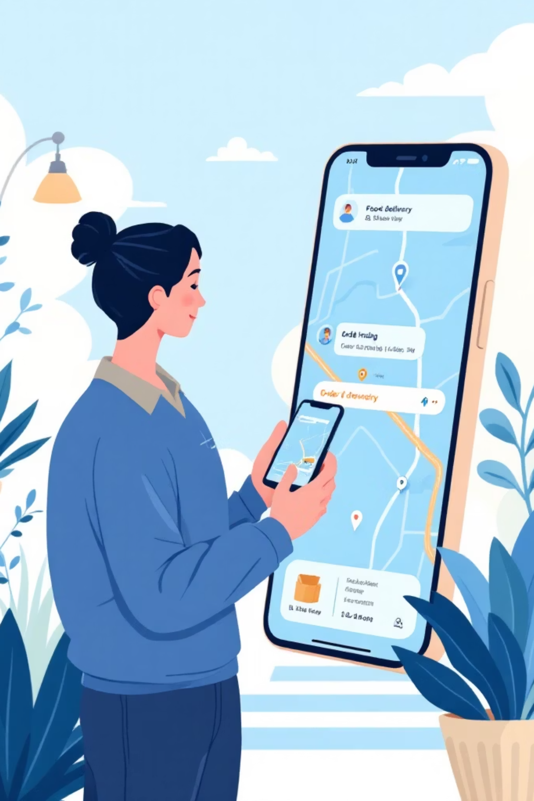
Key Features & Demo Flow
01
Real-Time Order Status
Instant access to ETA, delivery stage, and rider information
02
Order History Retrieval
Quick access to past orders and transaction details
03
Instant FAQ Responses
Predefined answers for refunds, cancellations, and payments
04
Smart Fallback System
Gemini API handles complex queries that aren't in the FAQ database
Inspired by Swiggy and Zomato's seamless customer experience

Slide 5
Impact & Innovation
Lightning Fast
Cost-Efficient
Accuracy First
Faster than AI-only chatbots by using targeted database queries first
Reduces reliance on expensive AI calls, making it scalable for production
Minimizes hallucination risk through structured data before AI fallback
Future Roadmap
NLP improvements for better query understanding
Voice-based chatbot for hands-free support
Personalization using customer order history

