Slide 1
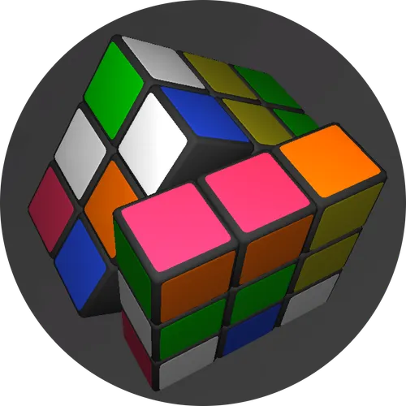
AeroHack’25 | Smart Rubik’s Cube Solver
An Interactive Python-Based Visual Solver
Presented by: Dhanush Salian
Notes:
1

Slide 2
Understanding the Problem Statement
The task: Design an algorithm that can solve a standard 3x3 Rubik’s Cube from any scrambled state. The solution must produce a valid sequence of moves — like a human solving the cube step-by-step.
The solution must:
Mimic how the cube is solved in real life (with real moves like R, U', F2, etc.)
Track how each move affects the cube's state
Be able to solve any valid scrambled input
Preferably show the solving steps visually, for a better experience
Notes:
2

Slide 3
How Our System Works
We built a desktop application with:
Frontend: main_ui.py using Pygame for the cube’s 2D interface and buttons.
Backend: cube.py models the cube logic; Kociemba library solves the cube.
Interactive GUI
Button-triggered
Clean Backend-Frontend
with real-time cube animations.
"Shuffle" and "Solve" operations.
Separation.
Notes:
3

Slide 4
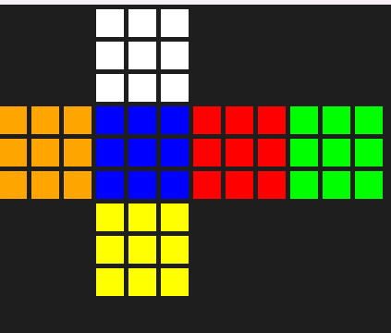
Representing the Cube Internally
To represent the 3x3 Rubik’s Cube in code, we created a class called RubiksCube in cube.py.
Each of the six faces of the cube — Up, Down, Left, Right, Front, and Back — is modeled using a 3x3 grid of colors.
Each face holds a 3x3 grid of stickers (colors: W, Y, R, O, G, B).
Easy to visualize and manipulate like a real cube.
Enables fast state access and clean face rotations.
Notes:
4

Slide 5
Simulating Cube Rotations
Each move (like R or U') affects:
Each move rotates one face
For example, the move R means rotate the Right face 90° clockwise.
ThisAdjacent stickers also change
Rotating one face also affects the stickers on four other faces next to it.
For example, R affects parts of Up, Front, Down, and Back faces.
is done using a helper function called _rotate_face_clockwise().
We swap stickers between faces
The method for each move (like R(), U(), F_prime(), etc.) carefully swaps the right rows or columns between affected faces.
This keeps the cube in a valid state after every move.
Prime moves are just repeated
Moves like R' (R prime) mean rotate the face counter-clockwise.
We simulate this by rotating the same face three times clockwise.
All moves are mapped
We use a dictionary called move_map to link move names to their functions.
This makes it easy to apply a sequence of moves like:
"U R' F2" just by reading the string.
Notes:
5

Slide 6
Choosing the Right Algorithm for Efficiency
To ensure the highest possible efficiency, we chose Herbert Kociemba's Two-Phase Algorithm.
Why Kociemba?
How It Works (High-Level):
Speed: It finds solutions in milliseconds. It uses pre-calculated data and advanced group theory to drastically reduce the search space.
Phase 1: The algorithm uses a specific set of moves to get the cube into a state where all edge pieces are correctly oriented.
Optimality: It is designed to find very short solutions, often close to or at the theoretical minimum (God's Number), which is around 20 moves. This far exceeds the efficiency of simpler, layer-by-layer methods.
Phase 2: From that state, it uses a different, more restricted set of moves to solve the rest of the cube.

Slide 7



How We Solve the Cube
We use the well-known Kociemba Two-Phase Algorithm via the kociemba Python package.
cube.py Converts State
Send to Kociemba
Receive & Animate
Converts current cube state to a 54-char solver string (URFDLB order).
main_ui.py sends this string to kociemba.solve().
Receives a move sequence (e.g., "U R' F2...") and animates it visually using Pygame.
Result: Fast, optimal, and real-time cube solving.
Notes:
6

Slide 8




Final Outcomes and Key Features
Achievements:
Accurate Modeling
Efficient Solver
Reliable move engine in cube.py.
Kociemba integration ensures optimal paths.
Interactive UI
Scalable Design
Built with Pygame, supports shuffle/solve with animation.
Easy to extend to other cube sizes like 2x2 or 4x4.
Notes:
7

Slide 9
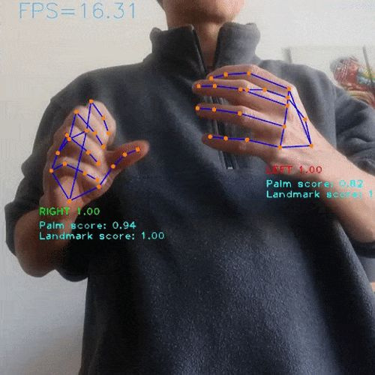
Future Ideas
Click-to-edit custom input
Multiple cube Integration
User can input the shuffling and the algorithm will give the output to it.
The algorithm will be fast and efficient to solve even 10×10 cube in fastest way possible.
Camera based tracker to solve real rubik's cube
Support for real-world cube input.
Notes:
8

Slide 10
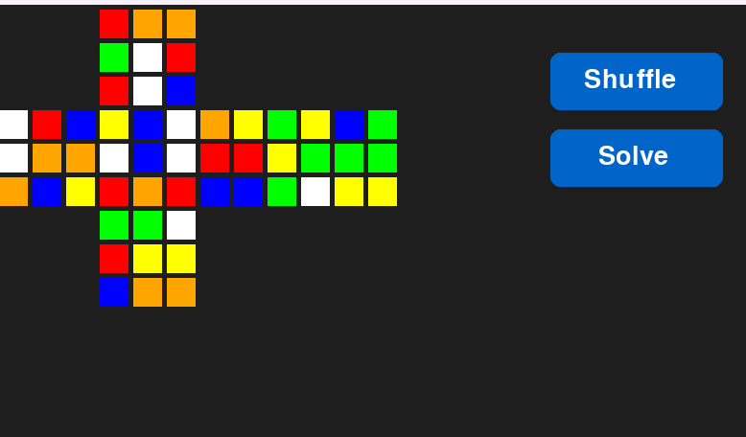
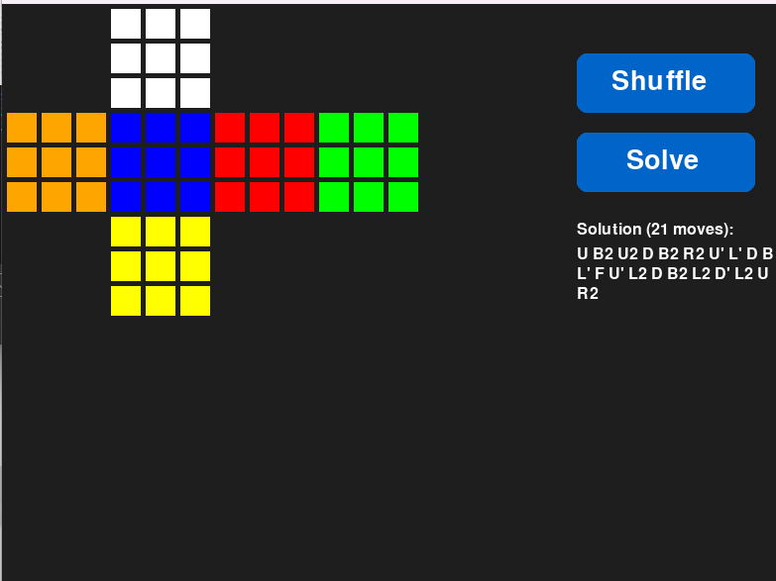
Demo Screenshots
These screenshots illustrate the interactive GUI of our Smart Rubik's Cube Solver, showcasing both a scrambled and a solved cube state within the Pygame interface.
Notes:
9

