Slide 1


Automating GitHub Repo Containerization with LLMs
Revolutionize your DevOps workflow with our new LLM-powered tool. It automates GitHub repository analysis and containerization, streamlining development and onboarding processes.
Team name : Creative Sparks

Slide 2



Cloning Public GitHub Repositories
Seamless Cloning
Robust Handling
Preparation for Analysis
Utilize the Git CLI or GitHub API to efficiently clone repositories to your local environment.
Address complexities like large repository sizes, submodules, and authentication requirements.
Ensure the cloned repository is optimally prepared for subsequent static analysis by the LLM.

Slide 3



Tech Stack and Project Type Detection
Stack Extraction
Runtime Inference
Tool Identification
Automatically extract the full tech stack by analyzing package managers like npm, pip, and Maven.
Infer the optimal runtime environment, including Node.js, Python, Java, and Go, for seamless deployment.
Identify essential build tools, testing frameworks, and configuration files for precise containerization.

Slide 4
Unified JSON/YAML Configuration File
Generate a comprehensive configuration file in JSON or YAML format, containing all necessary parameters for your containerized application.
{ "applicationName": "my-web-app", "projectType": "web_application", "techStack": ["Node.js", "Express", "MongoDB"], "dockerfilePath": "./Dockerfile", "containerConfig": { "ports": [3000, 80], "environmentVariables": { "NODE_ENV": "production", "DB_HOST": "localhost", "DB_PORT": "27017" }, "startupCommands": [ "npm install", "npm start" ] }}
Parameters are extracted from existing repository configurations or inferred through intelligent defaults provided by the LLM.

Slide 5
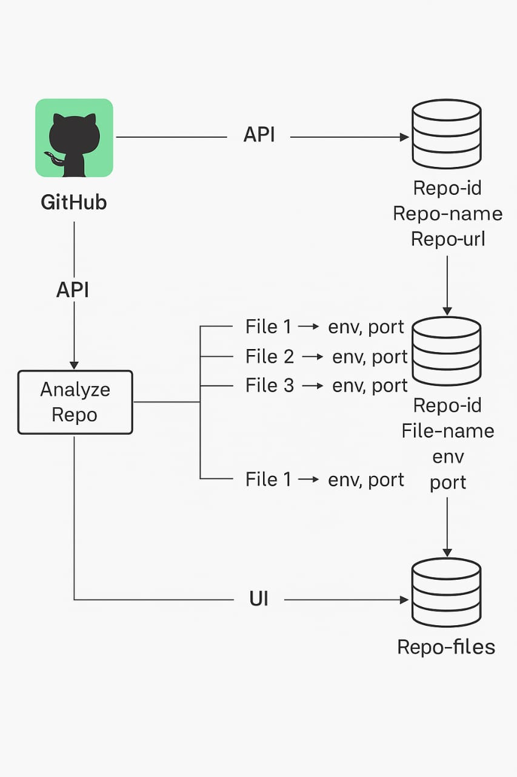
Architecture

Slide 6

STAKEHOLDERS
QA engineer
Project Managers
Security Teams
Software engineers

Slide 7
THANK YOU

