Slide 2
ABSTRACT
Blockchain technology is becoming increasingly attractive to the next generation, as it is uniquely suited to the information era. Blockchain technology can also be applied to the Internet of Things (IoT). The advancement of IoT technology in various domains has led to substantial progress in distributed systems. Blockchain concept requires a decentralized data management system for storing and sharing the data and transactions in the network. This paper discusses the blockchain concept and relevant factors that provide a detailed analysis of potential security attacks and presents existing solutions that can be deployed as countermeasures to such attacks. This paper also includes blockchain security enhancement solutions by summarizing key points that can be exploited to develop various blockchain systems and security tools that counter security vulnerabilities. Finally, the paper discusses open issues relating to and future research directions of blockchain-IoT systems.

Slide 3
INTRODUCTION
Blockchain can be defined as a chain of blocks that contains information.
The technique is intended to record transactions and track assets within a network of businesses. It is a form of storing information that prevents anyone from changing, hacking, or cheating it.
The most important and unique factor of the blockchain concept is that the stored information is secured entirely within the blocks of the blockchain’s transactions.
The three main criteria related to blockchain identity and accessibility are public or less authorized, private or authorized, and consortium.

Slide 4
BLOCKCHAIN IN IOT
Blockchain technology has been successfully applied in a wide variety of areas. When blockchain technology is implemented in the Internet of Things (IoT) domain to exchange and share network data, records, validation, and security service, there are a few relevant issues.
The technology brings transparency, reliability, and proper governance to the IoT information system
Blockchain technology is at the center of many current developments in the IoT industry. One reason for this is that many IoT services are vulnerable to attacks and challenges. Using blockchain technology can solve many of the issues with cyber-physical systems in the IoT sector.

Slide 5
The Blockchain Model
Blockchain is a database that maintains a continuously growing set of data records. It is distributed in nature, meaning that there is no master computer holding the entire chain. Rather, the participating nodes have a copy of the chain. It’s also ever-growing — data records are only added to the chain.

Slide 6
When someone wants to add a transaction to the chain, all the participants in the network will validate it. They do this by applying an algorithm to the transaction to verify its validity.
What exactly is understood by “valid” is defined by the Blockchain system and can differ between systems. Then it is up to a majority of the participants to agree that the transaction is valid.

Slide 7
A set of approved transactions is then bundled in a block, which gets sent to all the nodes in the network. They, in turn, validate the new block. Each successive block contains a hash, which is a unique fingerprint, of the previous block.

Slide 8
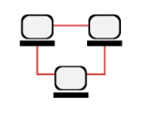
Principles of Blockchain Technology
Here are five basic principles underlying the technology.
Distributed Database
Each party on a blockchain has access to the entire database and its complete history. No single party controls the data or the information. Every party can verify the records of its transaction partners directly, without an intermediary.

Slide 9
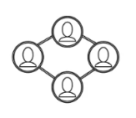
2. Peer-to-Peer Transmission
Communication occurs directly between peers instead of through a central node. Each node stores and forwards information to all other nodes.

Slide 10

3. Transparency
Every transaction and its associated value are visible to anyone with access to the system. Each node, or user, on a blockchain has a unique 30-plus-character alphanumeric address that identifies it. Users can choose to remain anonymous or provide proof of their identity to others. Transactions occur between blockchain addresses.

Slide 11
4. Irreversibility of Records
Once a transaction is entered in the database and the accounts are updated, the records cannot be altered, because they’re linked to every transaction record that came before them (hence the term “chain”). Various computational algorithms and approaches are deployed to ensure that the recording on the database is permanent, chronologically ordered, and available to all others on the network.

Slide 12
5. Computational Logic
The digital nature of the ledger means that blockchain transactions can be tied to computational logic and in essence programmed. So users can set up algorithms and rules that automatically trigger transactions between nodes.

Slide 13
Public vs. Private Blockchain
Blockchain technology implementation can be public or private with clear differences, for example the benefits offered by a private blockchain are: faster transaction verification and network communication, the ability to fix errors and reverse transactions, and the ability to restrict access and reduce the likelihood of outsider attacks.

Slide 14
While developers who work to maintain public blockchain systems like bitcoin still rely on individual users to adopt any changes they propose, which serves to ensure that changes are only adopted if they are in the interest of the entire system.

Slide 15
Just as a business will decide which of its systems are better hosted on a more secure private intranet or on the internet, but will likely use both, systems requiring fast transactions, the possibility of transaction reversal, and central control over transaction verification will be better suited for private blockchains, while those that benefit from widespread participation, transparency, and third-party verification will flourish on a public blockchain.

Slide 16
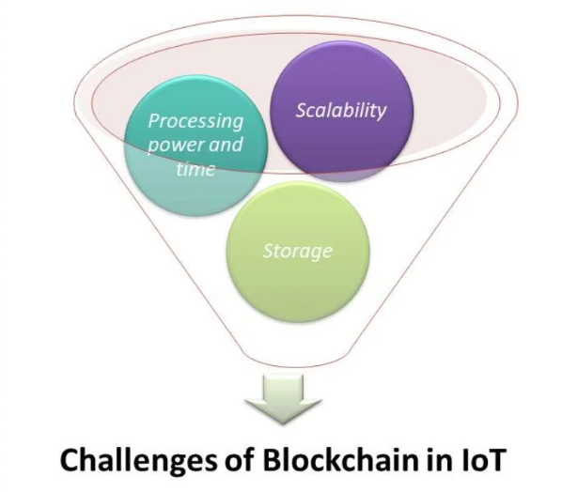

Slide 17
Challenges of Blockchain in IoT
In spite of all its benefits, the Blockchain model is not without its flaws and shortcomings:
• Scalability issues:
Relating to the size of Blockchain ledger that might lead to centralization as it's grown over time and required some kind of record management which is casting a shadow over the future of the Blockchain technology.

Slide 18
Processing power and time:
Required to perform encryption algorithms for all the objects involved in Blockchain -based IoT ecosystem given the fact that IoT ecosystems are very diverse and comprised of devices that have very different computing capabilities, and not all of them will be capable of running the same encryption algorithms at the desired speed.

Slide 19
Storage will be a hurdle:
Blockchain eliminates the need for a central server to store transactions and device IDs, but the ledger must be stored on the nodes themselves, and the ledger will increase in size as time passes. That is beyond the capabilities of a wide range of smart devices such as sensors, which have very low storage capacity.

Slide 20
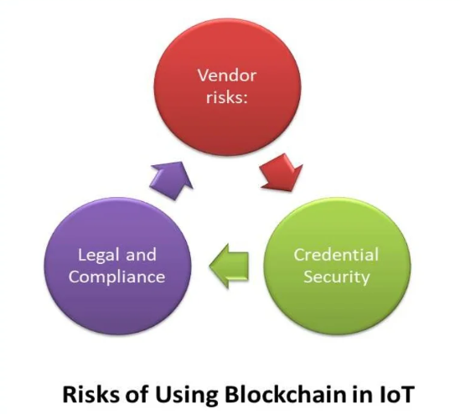

Slide 21
Risks of Using Blockchain in IoT
It goes without saying that any new technology comes with new risks. An organization’s risk management team should analyze, assess and design mitigation plans for risks expected to emerge from implementation of blockchain based frameworks.

Slide 22
Vendor Risks:
Practically speaking, most present organizations, looking to deploy blockchain based applications, lack the required technical skills and expertise to design and deploy a blockchain based system and implement smart contracts completely in- house, i.e. without reaching out for vendors of blockchain applications.

Slide 23
The value of these applications is only as strong as the credibility of the vendors providing them. Given the fact that the Blockchain-as-a-Service (BaaS) market is still a developing market, a business should meticulously select a vendor that can perfectly sculpture applications that appropriately address the risks that are associated with the blockchain.

Slide 24
Credential Security:
Even though the blockchain is known for its high security levels, a blockchain based system is only as secure as the system’s access point. When considering a public blockchain based system, any individual has access to the private key of a given user, which enables him/her to “sign” transactions on the public ledger, will effectively become that user, because most current systems do not provide multi-factor authentication.

Slide 25
Legal and Compliance:
It’s a new territory in all aspects without any legal or compliance precedents to follow, which poses a serious problem for IoT manufacturers and services providers. This challenge alone will scare off many businesses from using Blockchain technology

Slide 26
The Optimum Secure IoT Model
For us to achieve that optimal secure model of IoT, security needs to be built-in as the foundation of IoT ecosystem, with rigorous validity checks, authentication, data verification, and all the data needs to be encrypted at all levels, without a solid bottom- top structure we will create more threats with every device added to the IoT.

Slide 27
What we need is a secure and safe IoT with privacy protected. That’s a tough trade-off but possible with Blockchain technology if we can overcome its drawbacks.

Slide 28
References

Slide 29
BLOCKCHAIN FACTORS and ISSUES
DECENTRALIZATION
In blockchain technology, decentralization entails dispersing functions throughout a system rather than having all units connected with and controlled by a central authority;
In other words, there is no central point of control, and this absence of centralized authority in a blockchain is what makes it more secure than other technologies.
Each blockchain user, called a miner, is assigned a unique transaction account, and blocks are added once the miners are validated.
blockchain networks use consensus protocols to secure nodes. In this way, transactions are validated and data cannot be destroyed.
While the decentralized nature of networks allows for peer-to-peer operations [16], it also poses major challenges to personal data privacy

Slide 30
CONSENSUS MODEL
Consensus refers to agreement among entities
Consensus models help decentralized networks make unanimous decisions. This allows for all records to be tracked from a single authority.
Blockchain technology requires consensus algorithms to ensure that each next block is the only true version; that is, the algorithms ensure that all nodes agree that each new block added to the blockchain carries the same message
Consensus models guarantee against ‘‘fork attacks’’ and can even protect against malicious attacks
The three main features of consensus models are as follows:
Consistency-
Aliveness
Fault tolerance

Slide 31
TRANSPARENCY AND PRIVACY
The most appealing aspect of blockchain technology is the degree of privacy it offers
Blockchain networks periodically (i.e., every 10 minutes) self-audit the digital value ecosystems that coordinate transactions; one set of these transactions is called a block, and this process results in two properties: transparency and impossibility of corruption
In a blockchain, the identity of the user is hidden behind a strong cipher, making it particularly difficult to link public addresses to individual users.

Slide 32
IDENTITY AND ACCESS
The three main criteria related to blockchain identity and accessibility are public or less authorized, private or authorized, and consortium
the main distinction between public and private blockchain technologies and discussed the foundations and disruptive nature of blockchain technology.
Public blockchains are completely open and allow anyone to join the network; they are designed to reduce intermediaries so that more participants can join.
By contrast, private blockchains restrict network privileges; participants need permission to join and the access control mechanism can change

