Slide 1
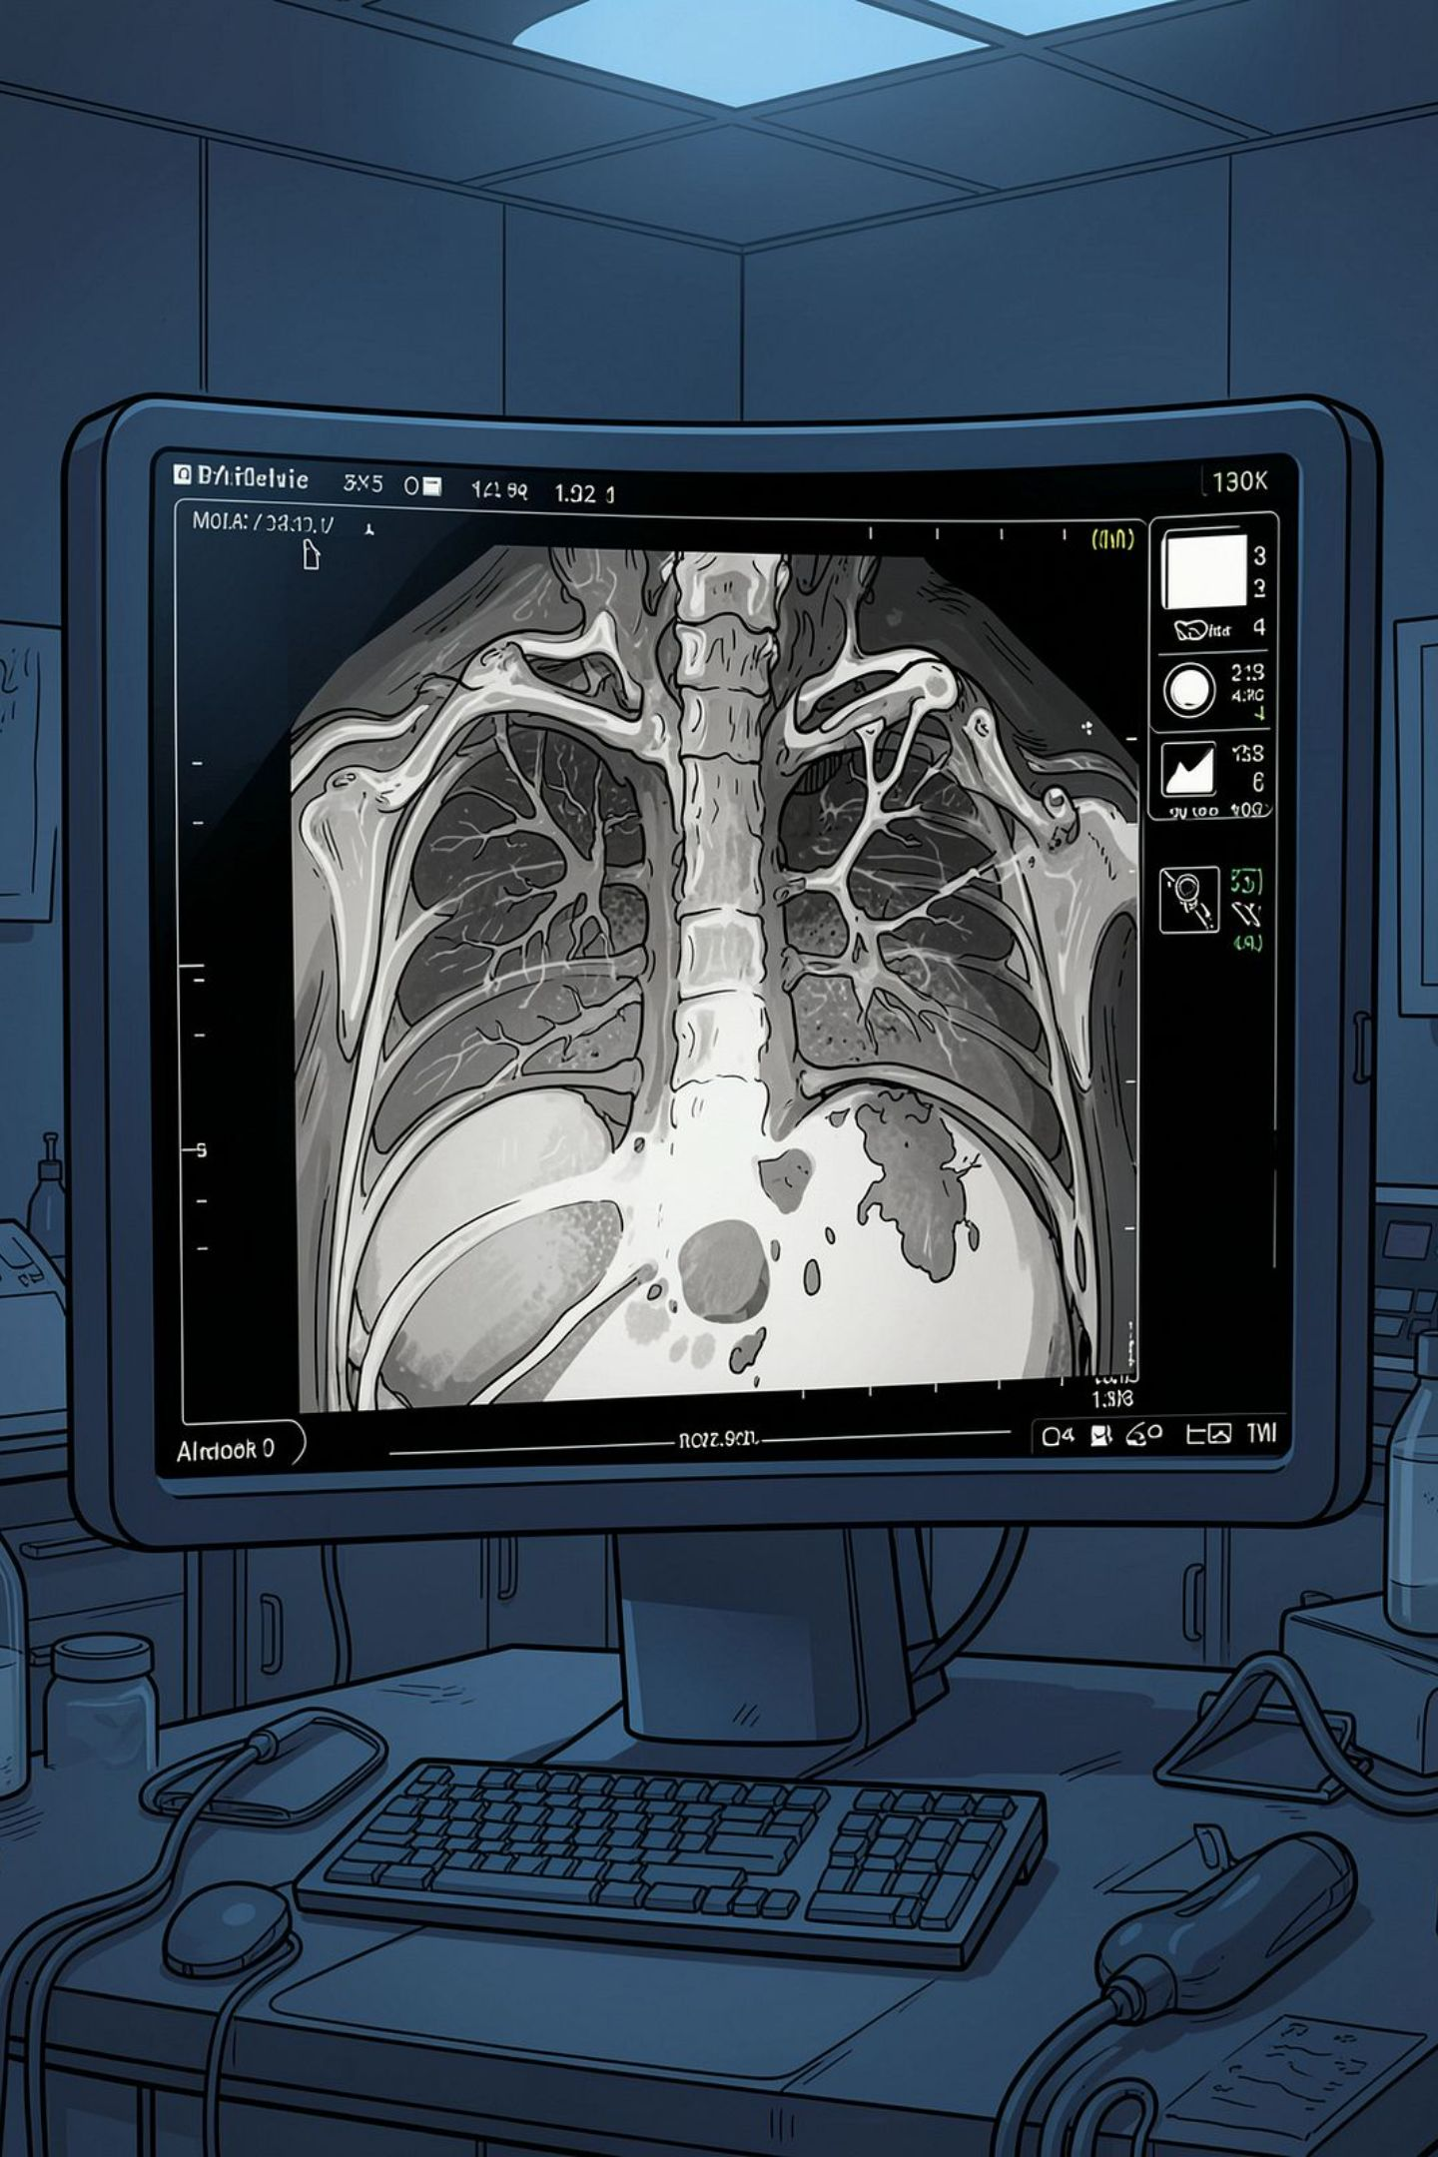

Digital Grayscale
Principles, Challenges, and Precision
Presented by:
G.Dhanusha Sree(192325012)
U.Udhayashree(192521448)
T.S.Sai Lahari(192325137)
Kondeti Sai Teertha (192325131)

Slide 2
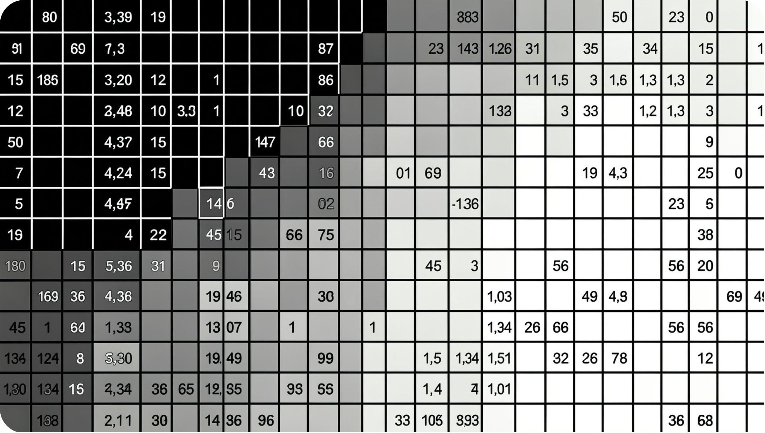
Defining the Monochrome Image
The Mathematical Model
Every grayscale image is a 2D function: f(x,y) = illumination × reflectance. Each pixel holds an intensity value from 0 (black) to 255 (white) in standard 8-bit images.
*No Blur and Better Contrast
Digitization in Two Steps
Sampling — spatial grid placement of pixels
Quantization — assigning amplitude levels
Black velvet reflects ~0.01; snow reflects ~0.93 — yet both must be faithfully represented.

Slide 3
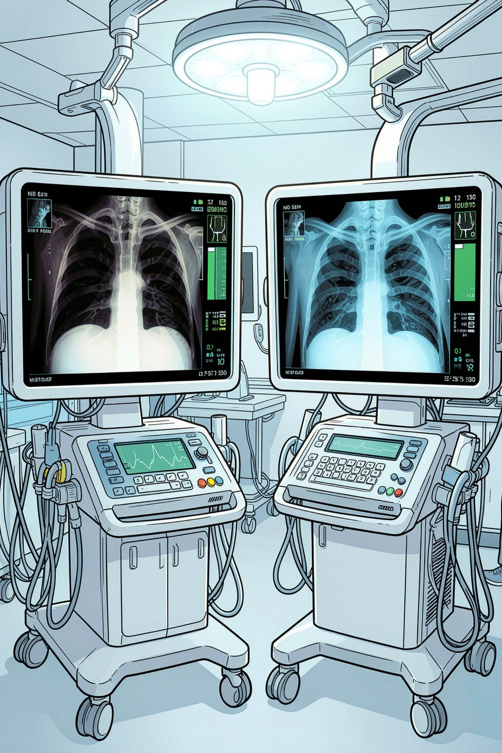

Practical Limitations and Distortions
Device Inconsistency
Displays vary in maximum luminance and respond differently to ambient light, causing the same image to appear different across monitors.
Hardcopy vs. Softcopy
Printed film and digital monitors often yield conflicting visual results, complicating cross-referencing in clinical workflows.
Dynamic Range Issues
Human perception is non-linear — not all intensity levels are equally visible, especially at the extremes of the grayscale.
Diagnostic Stakes
Inconsistent rendering can obscure clinical masses or critical features, directly impacting patient outcomes.

Slide 4
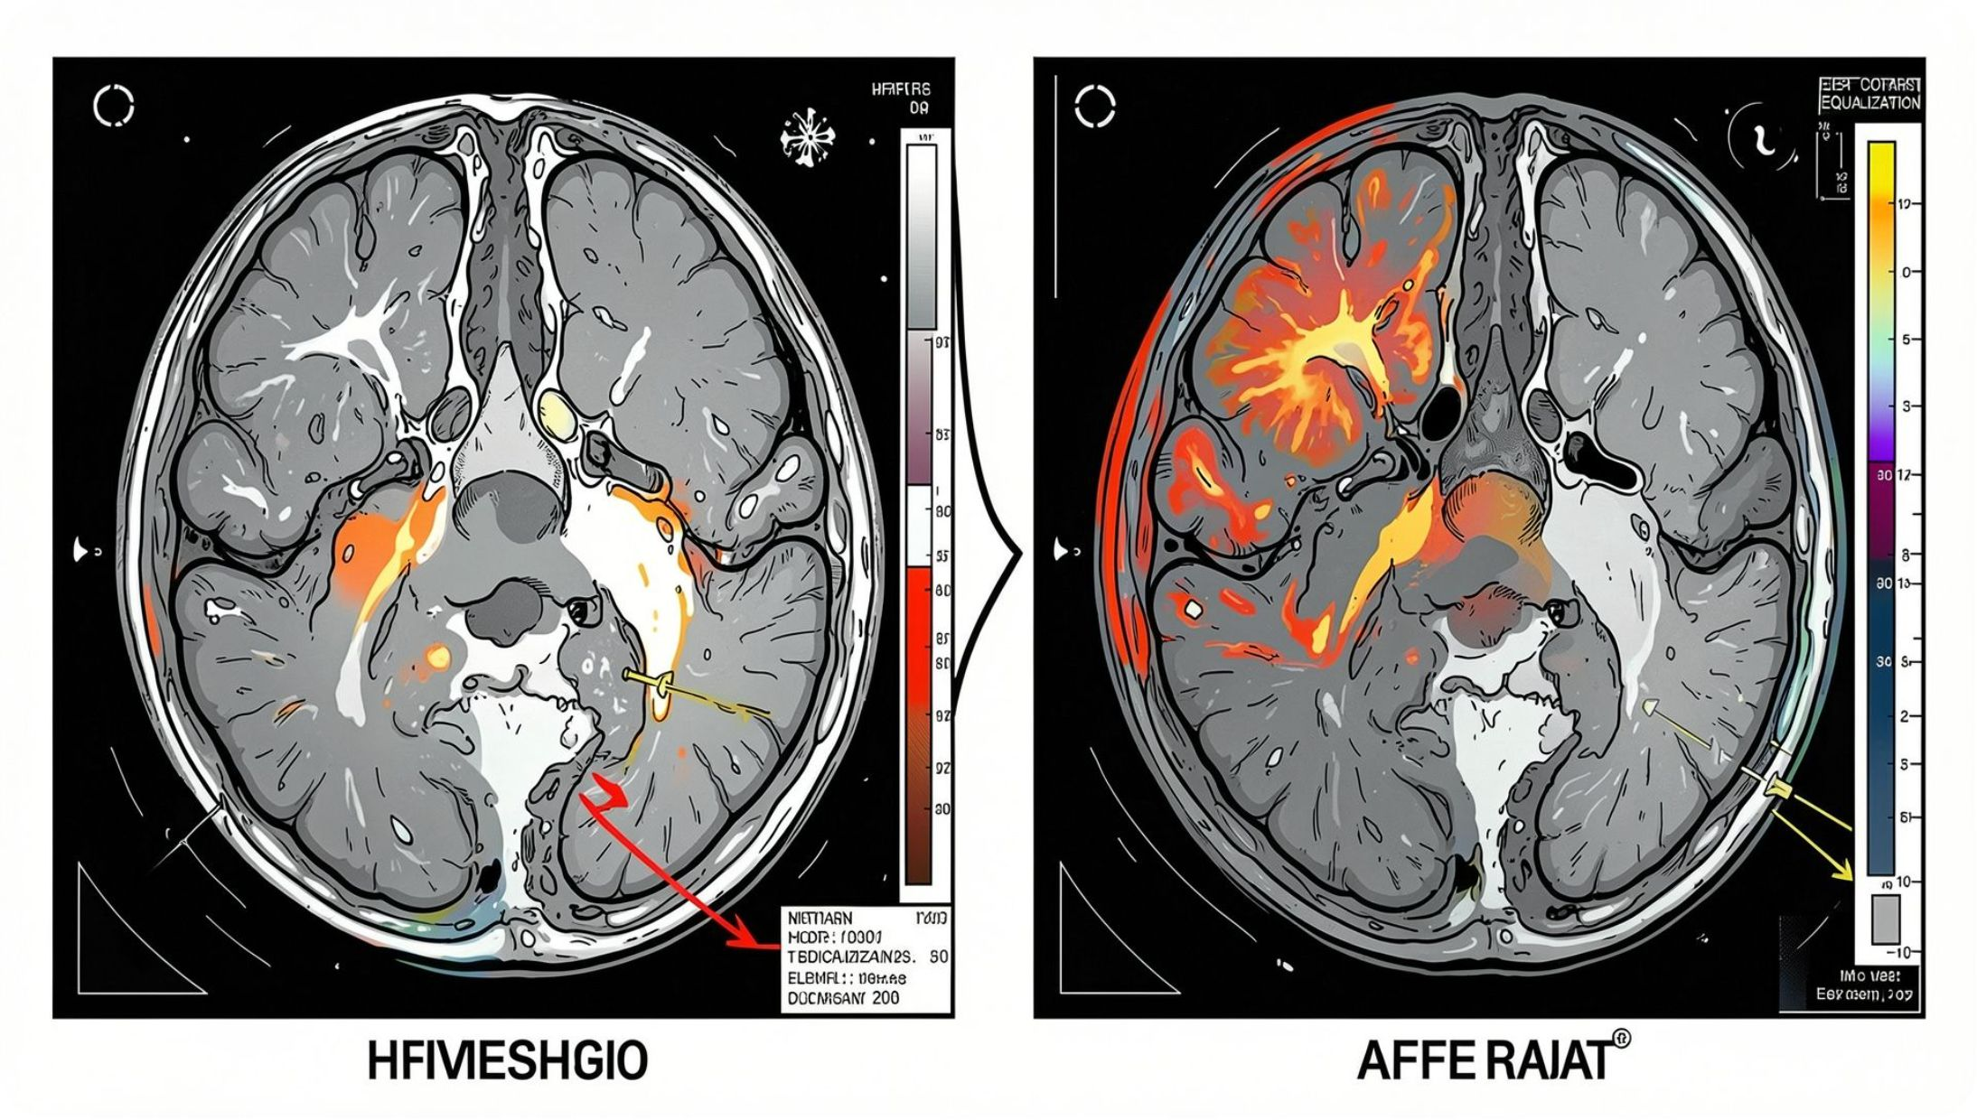
Analytical Tools and Enhancements
Contrast Manipulation
Functions like imadjust remap intensity ranges to improve visibility.
Histogram Techniques
Stretching or equalizing distributions flattens contrast and reveals hidden detail.
Logarithmic Transforms
Compresses wide dynamic ranges into a viewable spectrum.
Spatial Processing
Local operators modify pixels based on their surrounding neighbourhood.
These tools transform raw grayscale data into diagnostically useful images by correcting for capture limitations and display constraints.

Slide 5
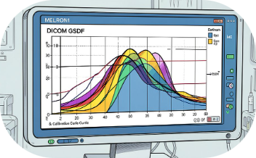
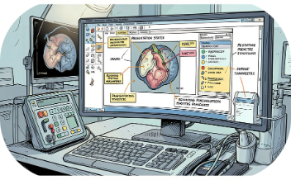
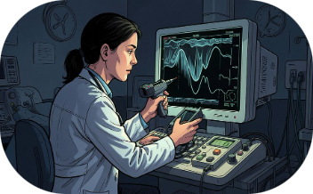
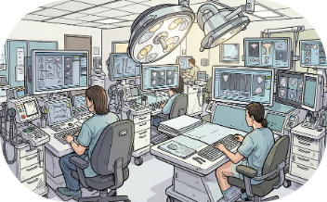
Standardization: The Modern Era
DICOM GSDF
Presentation States (GSPS)
Calibration
Hanging Protocols
The Grayscale Standard Display Function creates a perceptually linear curve, ensuring uniform output regardless of hardware.
Mandatory hardware adjustment to the GSDF curve ensures vendor-neutral consistency across all displays.
Automated instructions enforce consistent layout and orientation across every workstation in the network.
Objects that store rendering parameters, annotations, and spatial transforms separately from the image itself.

Slide 6
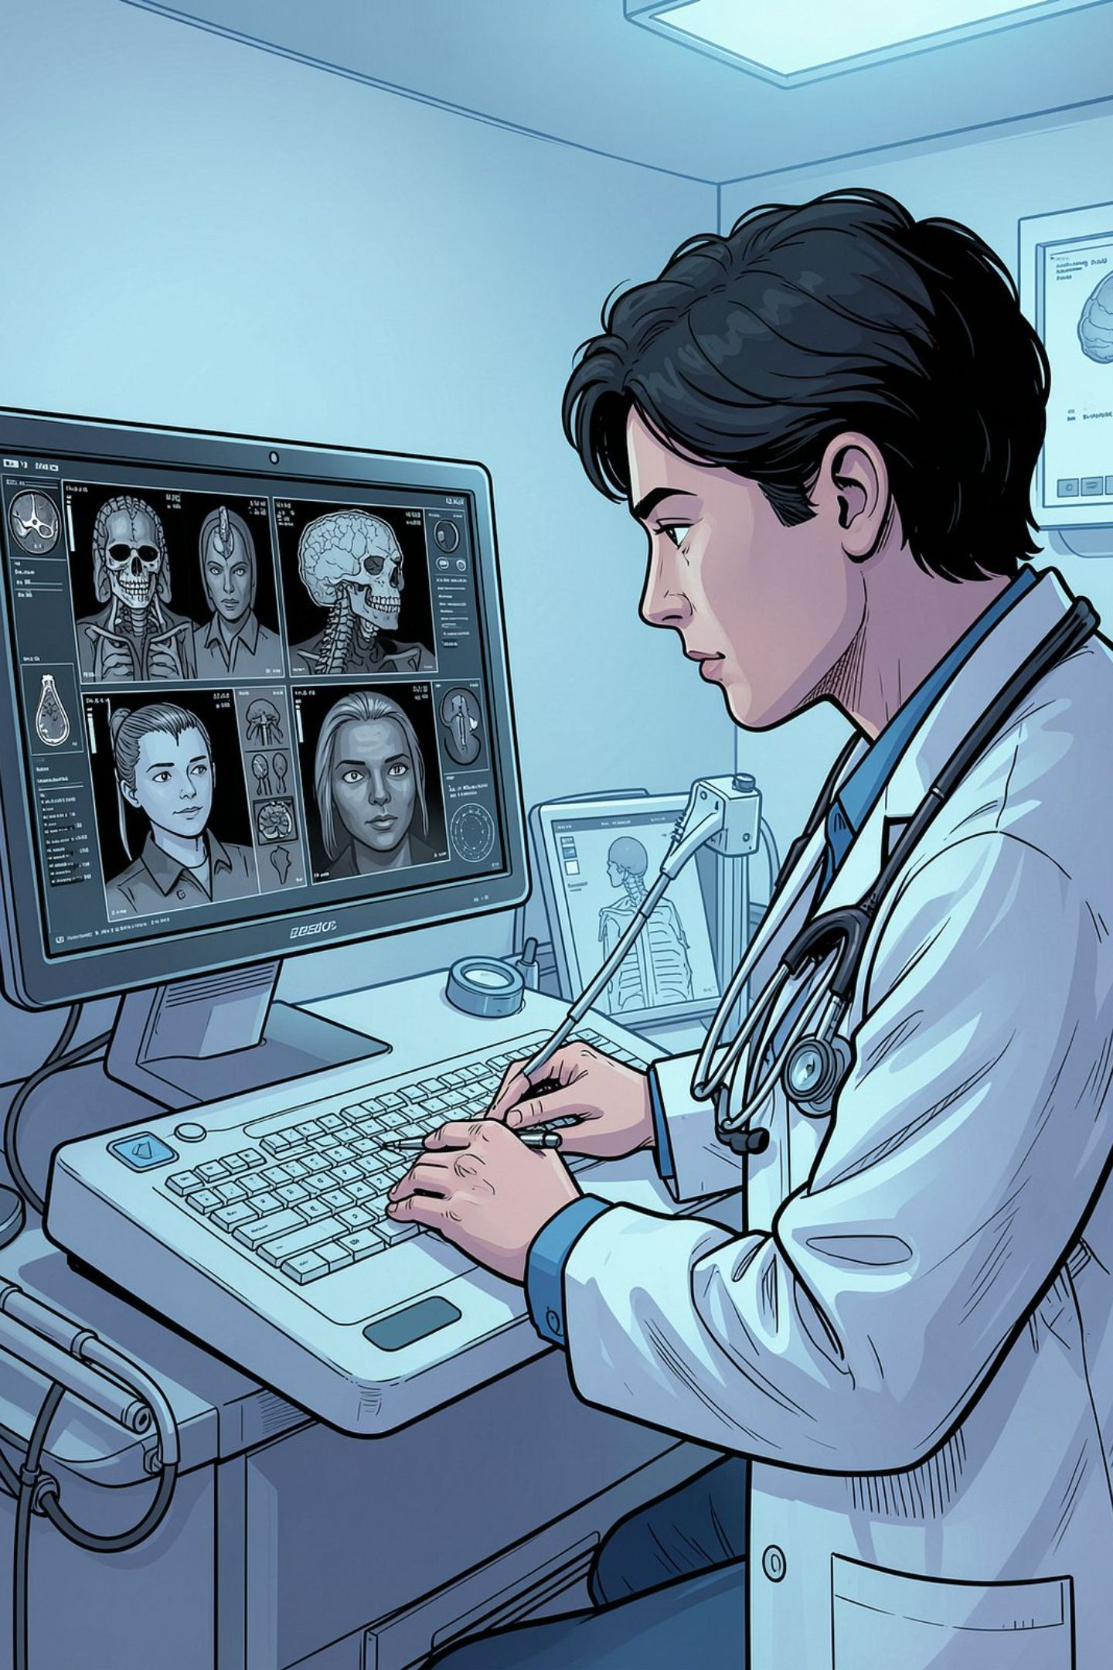


Precision as the Clinical Standard
Consistency is not automatic
Digital reliability demands strict calibration and standardized metadata at every stage of the imaging chain.
Rethink the image
Shift from viewing images as static files to treating them as calibrated, reproducible data states.
Next-generation focus
Managing color-blended and fusion imaging alongside grayscale diagnostics is the emerging frontier.
Call to Action: Audit your display workflows against GSDF standards to ensure absolute diagnostic reliability.

