Slide 1


SIMATS ENGINEERIN Saveetha Institute of Medical and Technical Sciences Chennai-602105
Department of Computer Science And Engineering
NLP-Based Job-Adaptive Resume and Portfolio Generation with Skill Gap Analysis
Presentation By:
G.Dhanusha Sree(192325012)
Deepka V(192325008)
Sushma(192325135)
C.Praveena(192324272)
Supervisor:
Dr. K. Anbazhagan
Professor.

Slide 2
OVERVIEW
ABSTRACT
INTRODUCTION
LITERATURE SURVEY
EXISTING SYSTEM
PROBLEM IDENTIFICATION
PROPOSED SYSTEM
SYSTEM CONFIGURATION
ARCHITECTURE DIAGRAM
ALGORITHM
FLOW CHART
METHODOLODY - 1.1 LIST OF MODULES
BRIEF EXPLANATION OF MODULES
CODING & SCREENSHOT
CONCLUSION & FUTURE ENHANCEMENT
REFERENCES

Slide 3
ABSTRACT
Job seekers waste time manually tailoring resumes for each job; most use generic templates that don't highlight role-specific strengths
Proposes an NLP-based system that auto-customizes resume & portfolio to match a target job description
Uses NLP techniques: tokenization, Named Entity Recognition (NER), keyword extraction, semantic embeddings.
Computes similarity score between candidate profile and job description
Skill Gap Analysis module identifies missing/weak skills and recommends upskilling resources
Output: ATS-friendly resume + dynamic portfolio generated automatically per application

Slide 4
INTRODUCTION
75%+ of resumes are first screened by Applicant Tracking Systems (ATS), not humans
Resumes not aligned with job keywords/skills get rejected at this first stage
Candidates lack time/skill to rewrite resumes for every application
Candidates often don't know which skills they're missing for a target role
Project builds an NLP pipeline: reads profile + job description → generates adaptive resume/portfolio
Goes beyond keyword matching using semantic similarity + entity extraction
Performs structured Skill Gap Analysis with learning resource suggestions
Goal: increase interview call rate, save time, guide upskilling

Slide 5
LITERATURE SURVEY
Paper 1: Automated Resume Screening using NLP and ML — Roy, Chowdhary, Bhatia (2020)
Parses resumes into structured fields using NLP
Classifies candidates using Random Forest, KNN
Focus: screening, not generation or gap analysis
Paper 2: Resume Classification using TF-IDF and Cosine Similarity — Kopparapu (2019)
Baseline text-matching using TF-IDF vectors + cosine similarity
Limitation: keyword-only matching, misses synonyms/context

Slide 6
LITERATURE SURVEY
Paper 3: SKILL — Skill Identification and Normalization — Zhao, Javed, Jacob, McNair (2015)
Identifies and normalizes skill entities from job postings/resumes
Uses NER + taxonomy matching
Basis for skill-gap comparison logic
Paper 4: BERT-Based Resume-JD Matching — Bhatia, Rawat, Kumar, Shah (2019)
Uses BERT contextual embeddings for semantic similarity
Improves match relevance beyond keyword overlap
Forms the semantic-matching basis of this project

Slide 7
EXISTING SYSTEM
Static resume builders: only formatting templates, no market intelligence
ATS checkers: score resume vs. JD but leave tailoring to the user
Rely on simple keyword matching — misses synonyms (e.g., "ML" vs "Machine Learning")
No system combines resume + portfolio generation + skill-gap recommendations together
Candidates must use multiple disconnected tools

Slide 8
PROBLEM IDENTIFICATION
Generic resumes get rejected by ATS before reaching recruiters
No time/expertise to manually tailor resumes per application
Keyword-only tools ignore semantic meaning
No proper coordination between resume content and job requirements
No clear, quantified skill gap feedback for candidates
Portfolios are static, not re-targeted per application
No actionable path to close skill gaps — only scoring, no guidance

Slide 9
PROPOSED SYSTEM
End-to-end NLP pipeline: candidate profile + job description → adaptive resume + portfolio + skill gap report
Preprocessing: tokenization, stop-word removal, lemmatization, NER
Semantic embeddings (Sentence-BERT) compute similarity score
Reorders/rewords resume bullets to emphasize relevant experience
Skill Gap module: compares candidate skills vs. required/preferred skills
Computes gap score, recommends courses to close each gap
Renders ATS-friendly resume via template engine
Auto-populates matching portfolio page for consistency

Slide 10
SYSTEM CONFIGURATION
Software:
OS: Windows 10/11, Linux, or macOS
Language: Python 3.9+
NLP Libraries: spaCy, NLTK, Hugging Face Transformers, Sentence-Transformers
ML: scikit-learn, PyTorch/TensorFlow
Backend: Flask/FastAPI/Django
Frontend: React.js / HTML5, CSS3, JS
Database: MySQL/MongoDB
IDE: VS Code/PyCharm/Jupyter
Document Gen: python-docx, ReportLab/WeasyPrint
Hardware:
Processor: Intel Core i5 (10th Gen) or higher
RAM: 8 GB min (16 GB recommended)
Hard Disk: 256 GB SSD or higher
GPU: Optional NVIDIA CUDA-enabled (faster inference)
Keyboard/Mouse: Standard

Slide 11
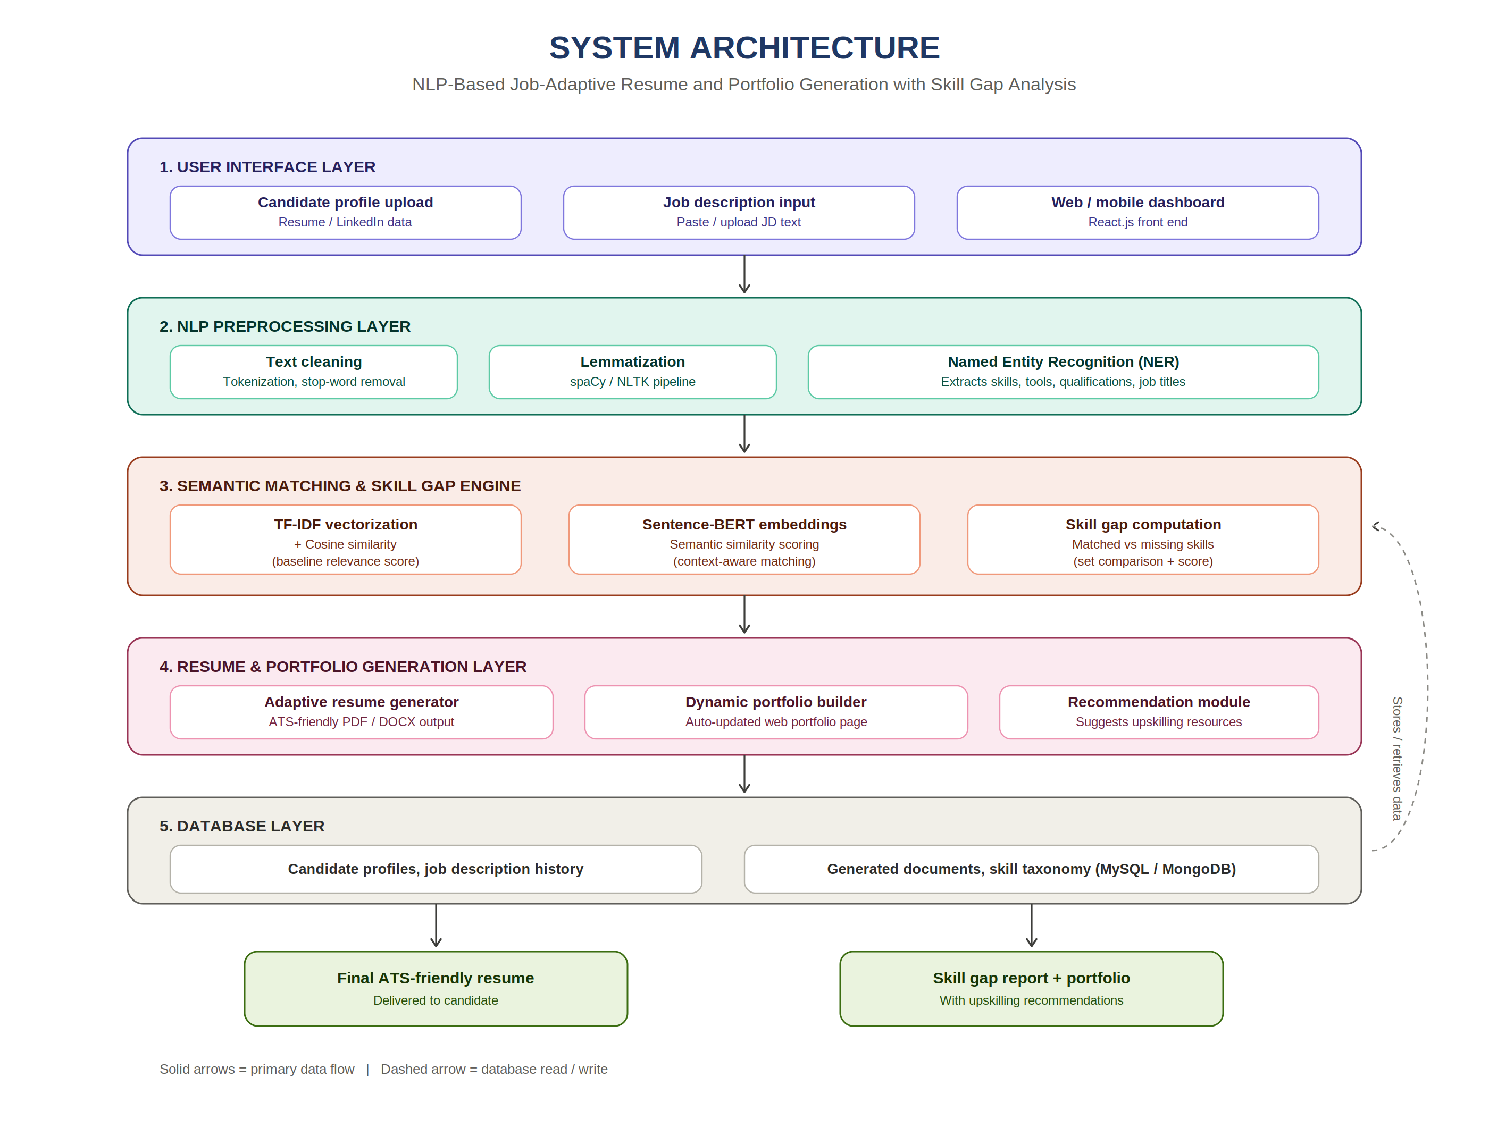

Slide 12
ALGORITHM
1. TF-IDF + Cosine Similarity
Converts resume/JD into weighted term vectors
Cosine similarity gives fast baseline relevance score
2. Named Entity Recognition (NER)
Extracts SKILL, TOOL, DEGREE, ORGANIZATION entities
Basis for Skill Gap Analysis
3. Sentence-BERT Semantic Similarity
Encodes resume bullets & JD requirements as dense vectors
Captures contextual meaning (e.g., "built REST APIs" ≈ "API development")

Slide 13
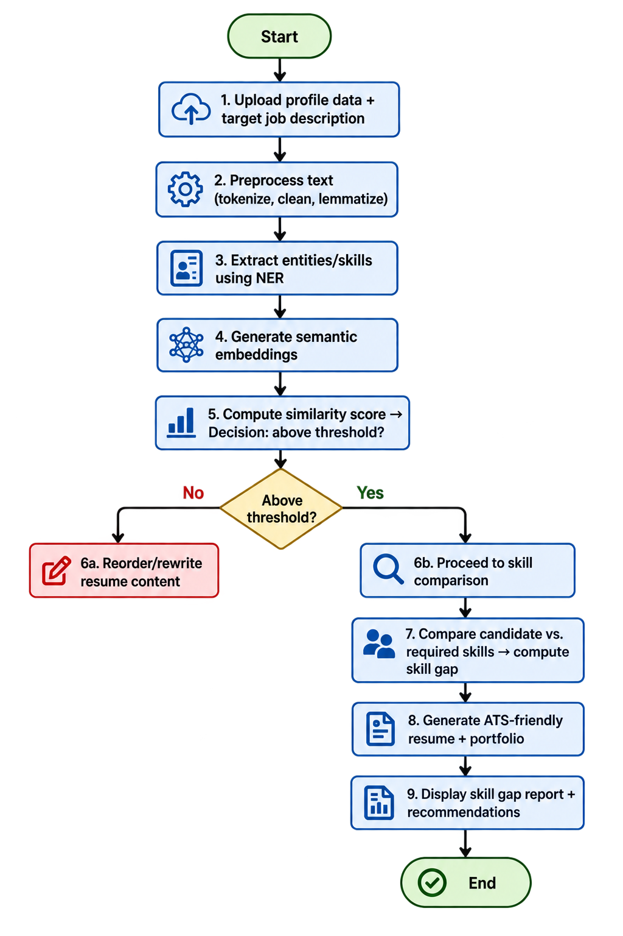
FLOW CHART

Slide 14
LIST OF MODULES
1. User Profile & Job Description Input
2. NLP Preprocessing and Entity Extraction
3. Resume–Job Semantic Matching Engine
4. Skill Gap Analysis and Recommendation

Slide 15
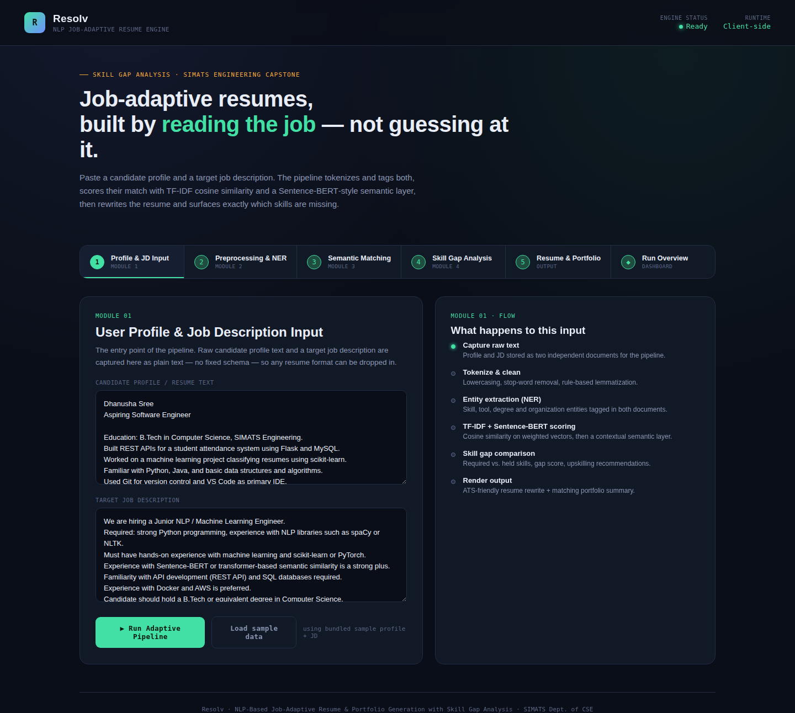
MODULE 1 – USER PROFILE & JOB DESCRIPTION INPUT
What it does: Collects the candidate’s resume/profile and the target job description.
Why it is used: Provides the required data for resume–job matching.
Process: Extracts and stores the candidate and job information as text.
Output: Candidate Profile + Target Job Description.

Slide 16
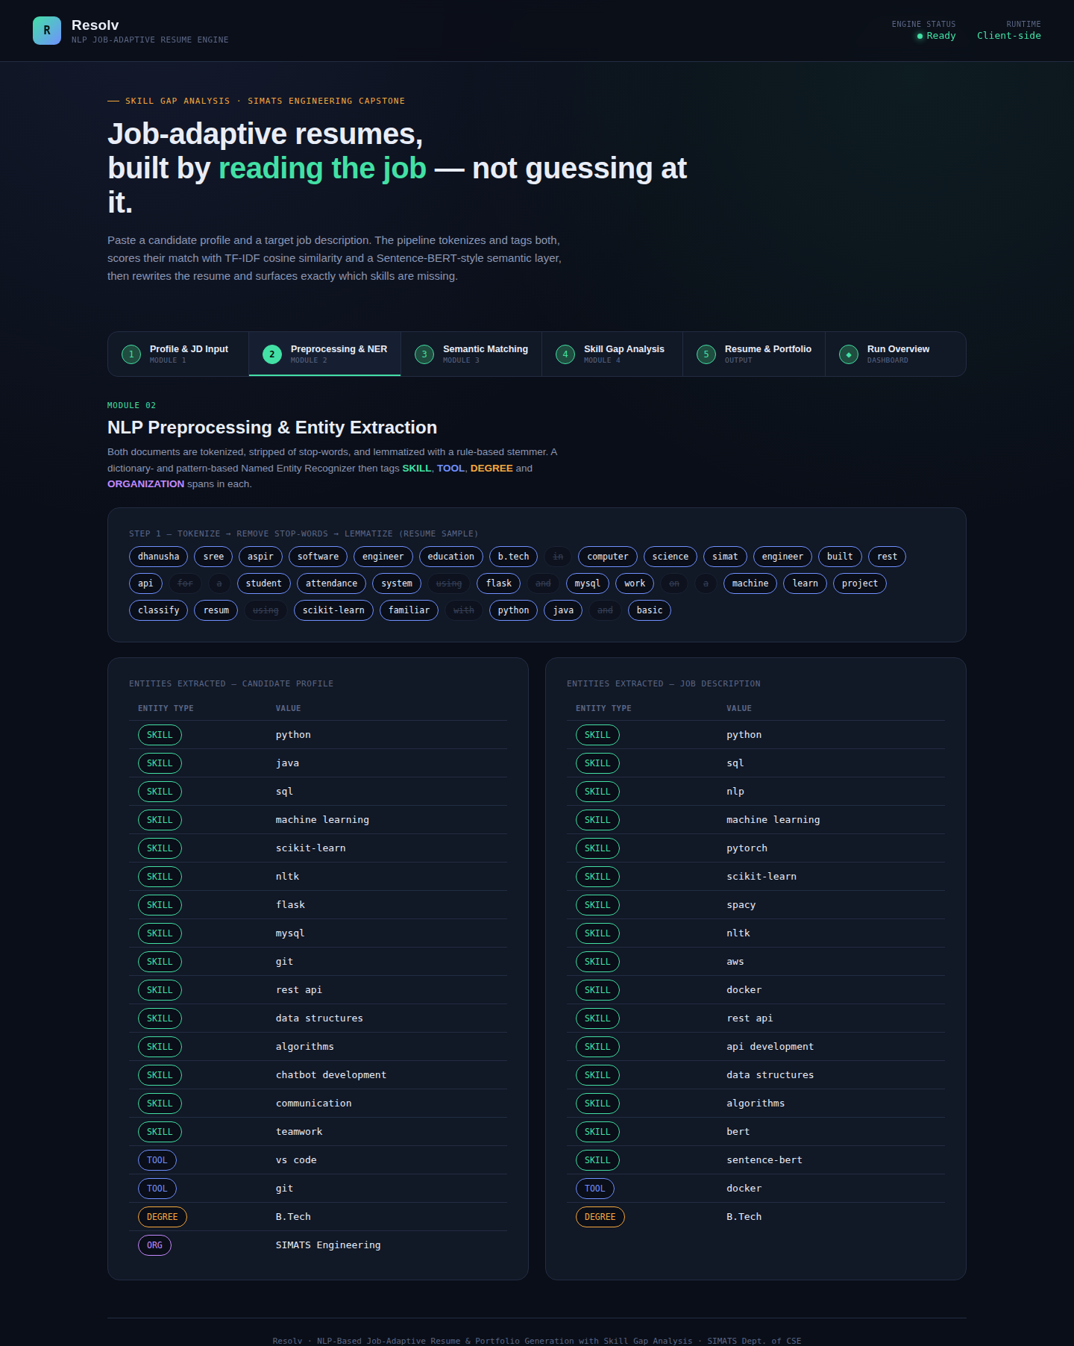
MODULE 2 – NLP PREPROCESSING & ENTITY EXTRACTION
What it does: Cleans and processes the collected text.
Why it is used: Removes unnecessary words and prepares text for NLP analysis.
Process: Tokenization, cleaning, lemmatization, and Named Entity Recognition.
Output: Cleaned text + Extracted skills, tools, degrees, and entities.

Slide 17
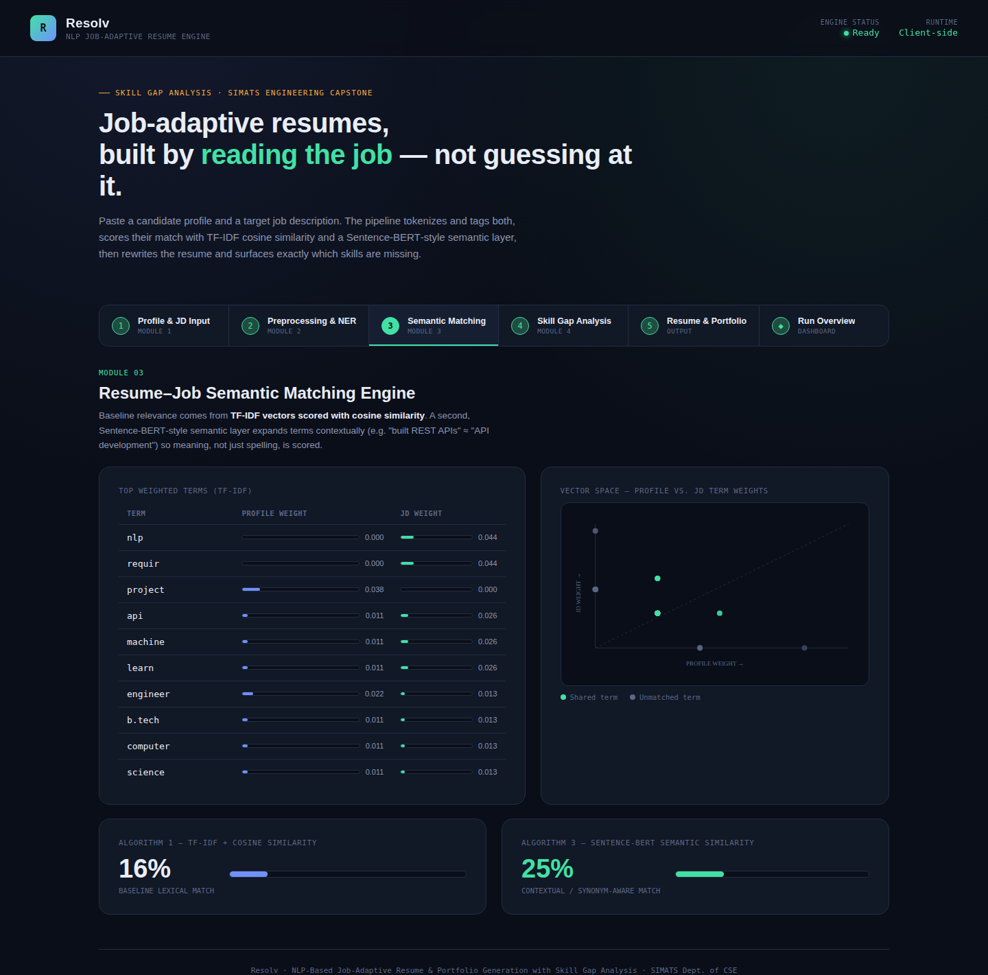
MODULE 3 – RESUME–JOB SEMANTIC MATCHING
What it does: Compares the candidate profile with the target job description.
Why it is used: Determines how relevant the candidate is for the selected job.
Process: Uses TF-IDF, Cosine Similarity, and Sentence-BERT embeddings.
Output: Similarity score + Match/No-Match decision.

Slide 18
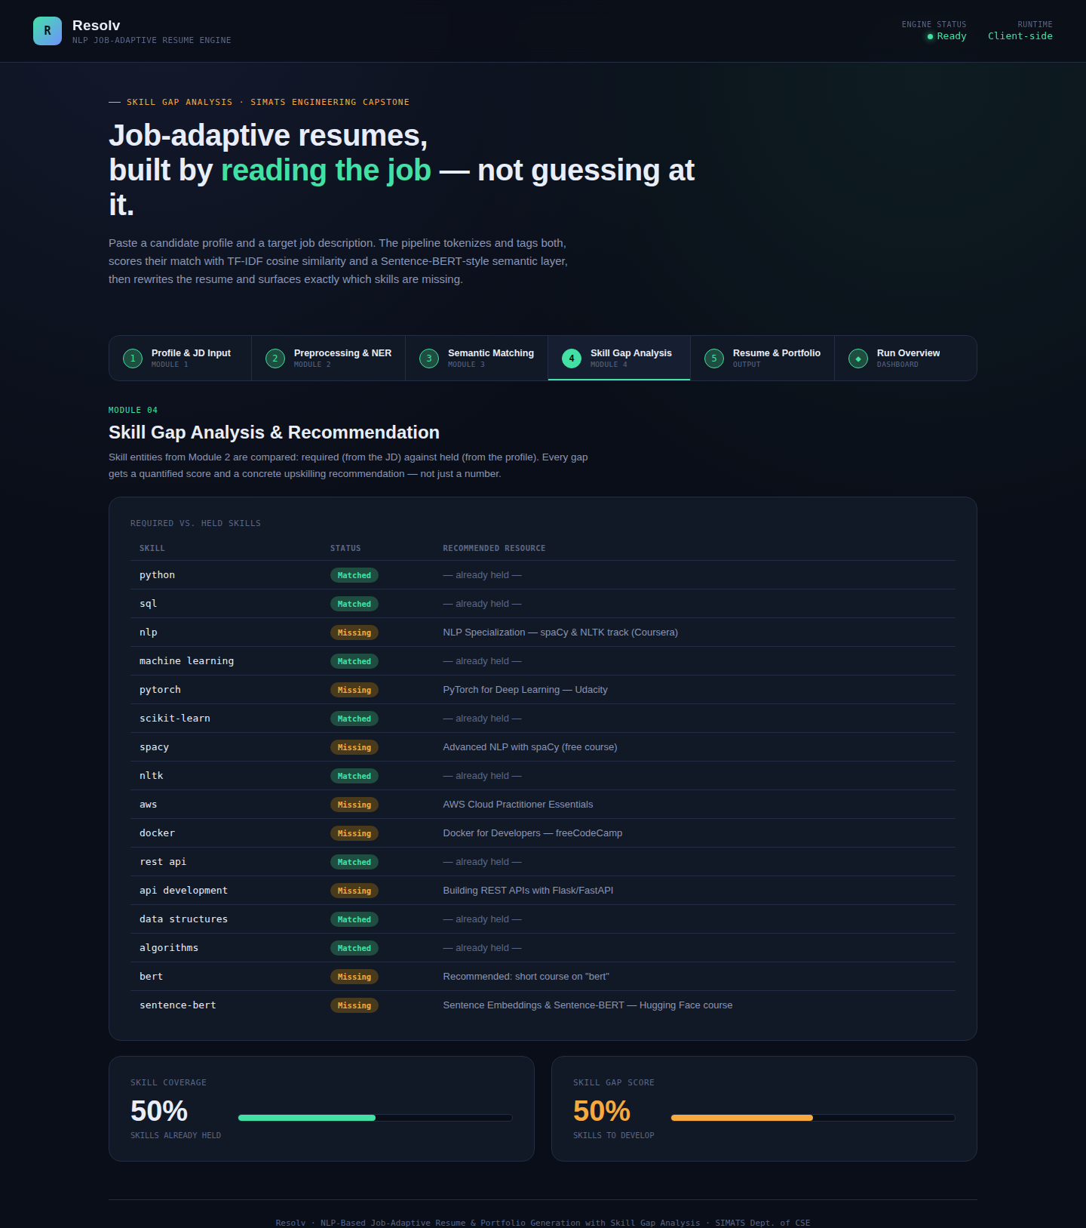
MODULE 4 – SKILL GAP ANALYSIS & RECOMMENDATION
What it does: Identifies the difference between candidate skills and job requirements.
Why it is used: Helps candidates understand and improve their missing skills.
Process: Compares skills, calculates skill gaps, and generates recommendations.
Output: Skill Gap Report + Recommendations + ATS-Friendly Resume & Portfolio.

Slide 19
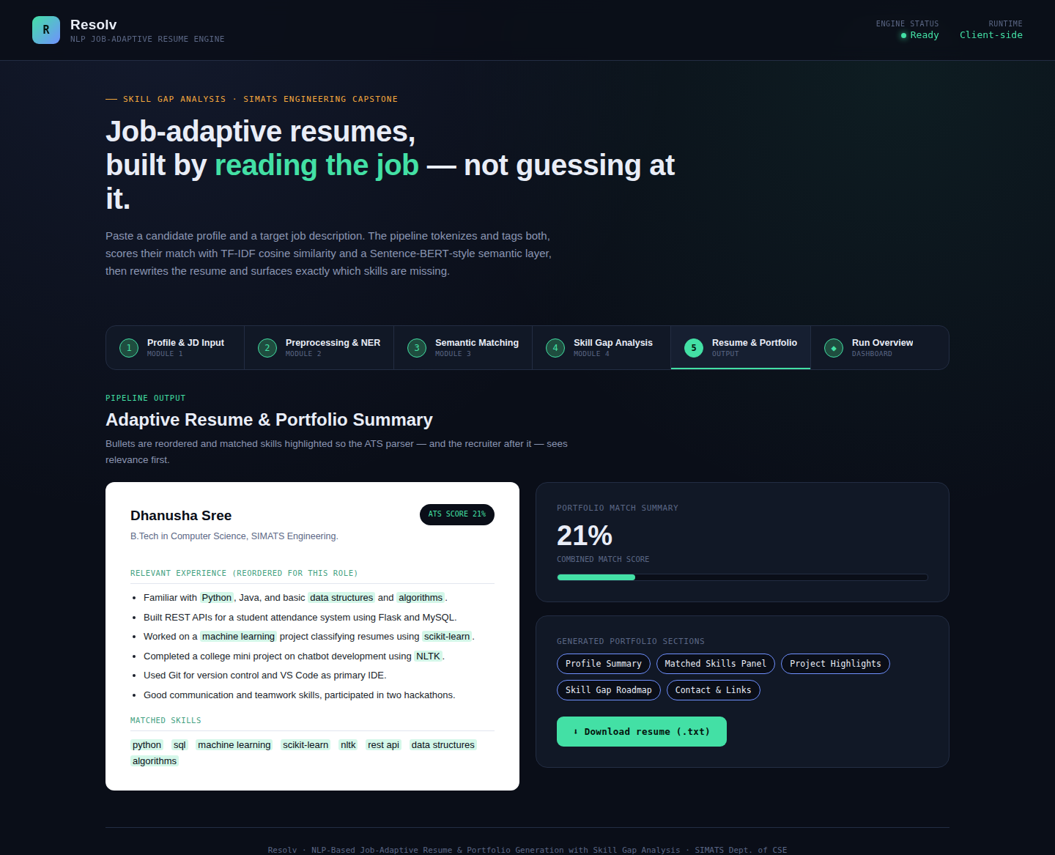
RESULT
Successfully processes candidate resumes and target job descriptions.
Extracts relevant skills, tools, qualifications, and entities using NLP.
Calculates resume–job similarity using TF-IDF and Sentence-BERT.
Identifies matched and missing skills from the job requirements.
Generates a skill-gap report with personalized recommendations.
Produces an ATS-friendly resume and portfolio tailored to the target job.

Slide 20
CONCLUSION
The proposed system provides an automated and intelligent solution for resume–job matching. By combining NLP, semantic similarity, and skill-gap analysis, it helps candidates understand their strengths and missing skills. The system also improves resume relevance and ATS compatibility, making the overall job application process more effective and efficient.

Slide 21
FUTURE ENHANCEMENT
Integrate real-time job market data via job-portal APIs
Fine-tuned LLMs for more natural resume rewriting
Multi-language support
Mobile app version
Interview-question generation based on skill gaps
Browser extension for auto-detection + instant adaptation

Slide 22
REFERENCES
C. Xu, J. Lu, J. Liu, and X. Wei, "Resume Screening Using Deep Learning and Natural Language Processing," Knowledge-Based Systems, vol. 215, 2021.
R. Elakkiya and S. Muthurajkumar, "Automated Resume Screening System Using Semantic Similarity," Proc. Int. Conf. Computing, Electronics & Communications Engineering (ICCECE), 2021.
M. de Groot, J. Schutte, and D. Graus, "Job Posting-Enriched Knowledge Graph for Skills-Based Matching," arXiv preprint arXiv:2109.02554, 2021.
L. Hofeditz, S. Clausen, A. Rieß, et al., "Applying XAI to an AI-Based System for Candidate Management to Mitigate Bias and Discrimination in Hiring," Electronic Markets, vol. 32, pp. 2207–2233, 2022.
X. Sun, Y. Meng, X. Ao, F. Wu, T. Zhang, J. Li, and C. Fan, "Sentence Similarity Based on Contexts," Transactions of the Association for Computational Linguistics (TACL), vol. 10, pp. 573–588, 2022.

Slide 23
THANK YOU

