Slide 1

DEPARTMENT OF INFORMATION SCIENCE & ENGINEERING
“SPAM CLASSIFIER”
Presentation by,
NAME:Dhanush Biligiri N H
USN: 1NH18IS030
Under the Guidance of ,
Guide Name: Dr. Arvind Shivappa Kapse
Designation: Professor

Slide 2
Agenda
Introduction
Problem Definition
Objectives
Proposed system
System Design
Methodology
Expected Outcome
Conclusion

Slide 3
Introduction(1 slide)
Spam classifier using Naive Bayes algo is an effecient way of classifying mails whose accuracy is proven to be 98% effecient. As email has become an effective, faster and cheap way of communication, it is better to have an effecient way to classify spam and ham.
Spam filtering is is the process of classifying and organizing emails based on a pre-defined criteria.
The trivial method of manually going through mails is next to impossible in a world of spammers and marketers that looks to flood the Inbox.
This process, with the advancement and development of machine learning and natural language processing it's possible to classify them in no time.

Slide 4
Problem Definition
In the present technical world,emails have become one of the most effective ways of communication.
As the usage of emails is increasing, it is highly necessary to ensure the protection of emails.
According to a survey it is known that a person receives more spam than ham as a result people are moe prone to lose their credentials.
In order to deal with the situation, it is important to come up with a robust algorithm that will help in classifying the mails as ham and spam.

Slide 5
Objectives(1 slide)
The objective of this project is to fetch raw data and train it using Naive Bayes algo and finally testing the accuracy of the algorithm, and to successfully segregate the spam and ham emails.

Slide 6
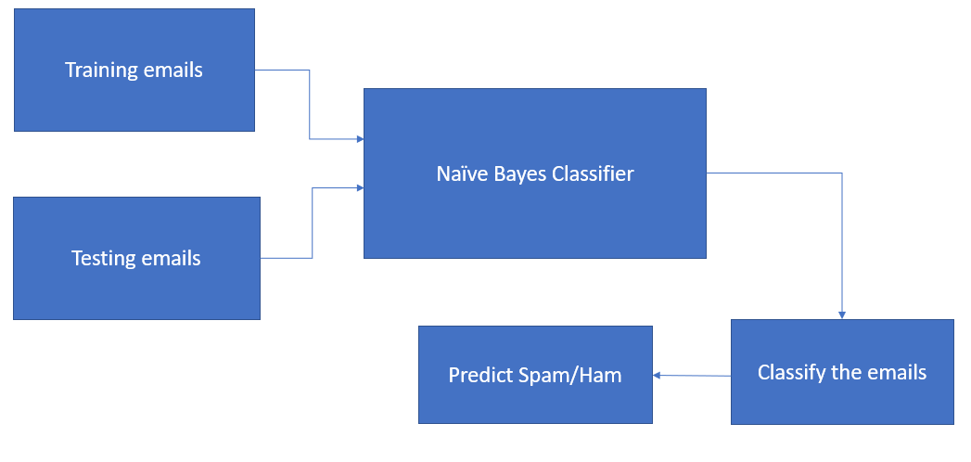
Proposed System-Architectural Design of the System

Slide 7
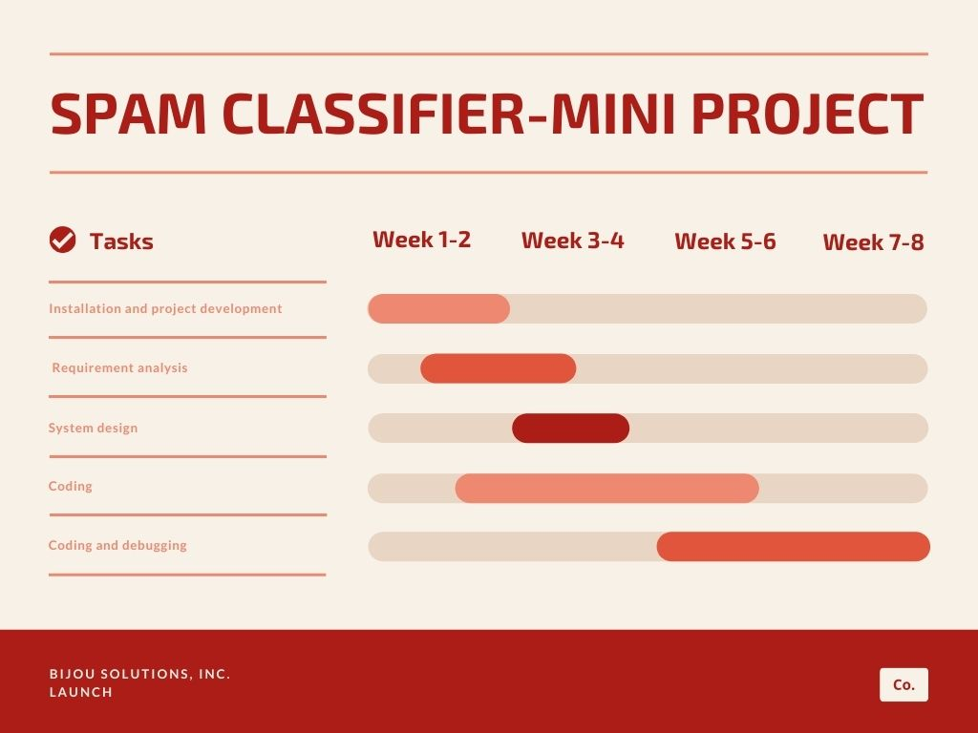

Slide 8
Proposed System-Methodology
A dataset consists of n emails which is split into 2 datasets (train dataset and test dataset).
System requirements: Python.
The train dataset consists of X which denotes messages and Y which denotes label (ham
or spam). X and Y are converted into binary. The train data is fed into the Naïve bayes
classifier which helps in training the model. And then the test dataset is fed into the naïve
bayes classifier which classifies the emails and predicts whether they are ham or spam.

Slide 9
Expected Outcome
The model classifyes the mails to ham and spam with an accuracy of 98%. The accuracy is determined using confusion matrix and the output will be in a tabular form.

Slide 10
Conclusion
As emails are one of the most effective ways of communication, it is mandatory to come up with an algorithm that will help in segregating the emails as ham and spam.
Ensuring that the algorithm works accurately will be our utmost concern.

Slide 11
References
[1] https://www.javatpoint.com/python-features
[2] https://towardsdatascience.com/spam-classifier-in-python-from-scratch-
27a98ddd8e73

Slide 12
Thank you
Queries ?

