Slide 1



Slide 2
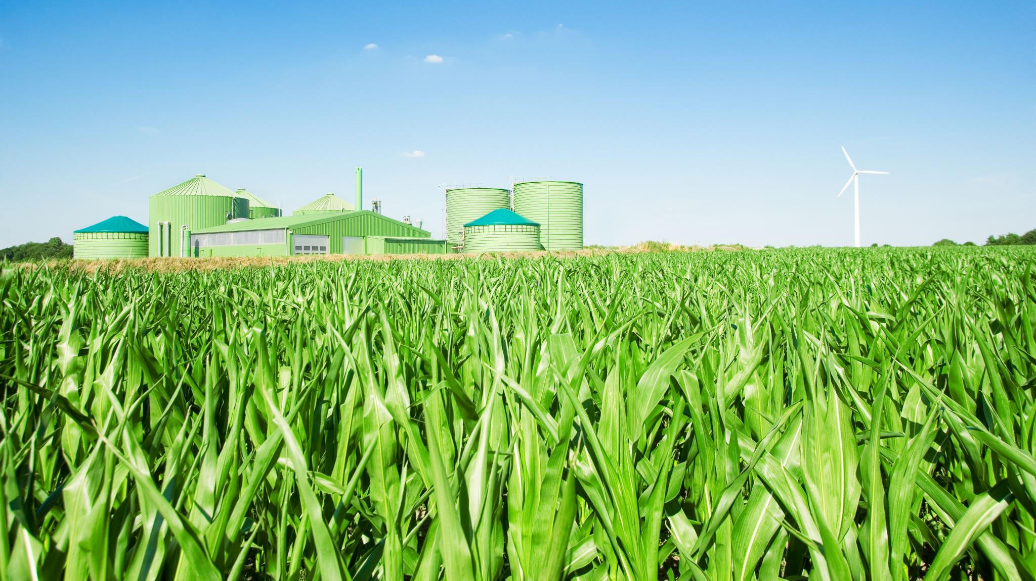
INTRODUCTION
The Agriculture Products Rural Entrepreneurship Management System is a comprehensive platform aimed at fostering rural entrepreneurship in agriculture. This system is tailored to efficiently manage and promote a wide array of agricultural products, empowering farmers in their business endeavors. It integrates tools for inventory management, market analysis, and financial planning, facilitating informed decision-making.

Slide 3
CONTEXT:
The Agriculture Products Rural Entrepreneurship Management System is developed against the backdrop of the challenges faced by rural communities in the agricultural sector. In many regions, farmers encounter difficulties in effectively managing their products, accessing markets, and making informed business decisions.
This system is a response to these challenges, aiming to empower rural entrepreneurs by providing them with a user-friendly and integrated platform.
By addressing issues related to inventory, market information, and financial planning, it strives to uplift rural economies, promote sustainable agricultural practices, and bridge the gap between farmers and market opportunities. The context underscores the system's role in fostering positive change in rural communities.

Slide 4
SYSTEM ARCHITECTURE:
Inventory Management
Market Analysis
Financial Planning
Supplier and Buyer Management
Crop Management
Weather Integration
Mobile App Interface
Reporting and Analytics
Training and Support
Collaboration and Communication

Slide 5
Inventory Management Module: Tracks and manages the agricultural product inventory, providing real-time information on stock levels.
Market Analysis Module: Analyzes market trends and demands, offering insights to farmers for informed decision-making.
Financial Planning Module: Assists farmers in budgeting, financial planning, and investment decisions.
Supplier and Buyer Management Module: Manages relationships with suppliers and buyers, facilitating efficient transactions.
Crop Management Module: Monitors and provides guidance on crop-related activities, including planting, harvesting, and crop rotation.
Weather Integration Module: Integrates weather data to help farmers plan activities based on weather conditions.
Mobile App Interface: Allows users to access and manage the system through mobile devices, enhancing accessibility.
Reporting and Analytics Module: Generates reports and provides analytics based on system data for better decision-making.
Training and Support Module: Offers training resources and support to users for effective utilization of the system.
Collaboration and Communication Module: Facilitates communication and collaboration among farmers, suppliers, and other stakeholders.

Slide 6
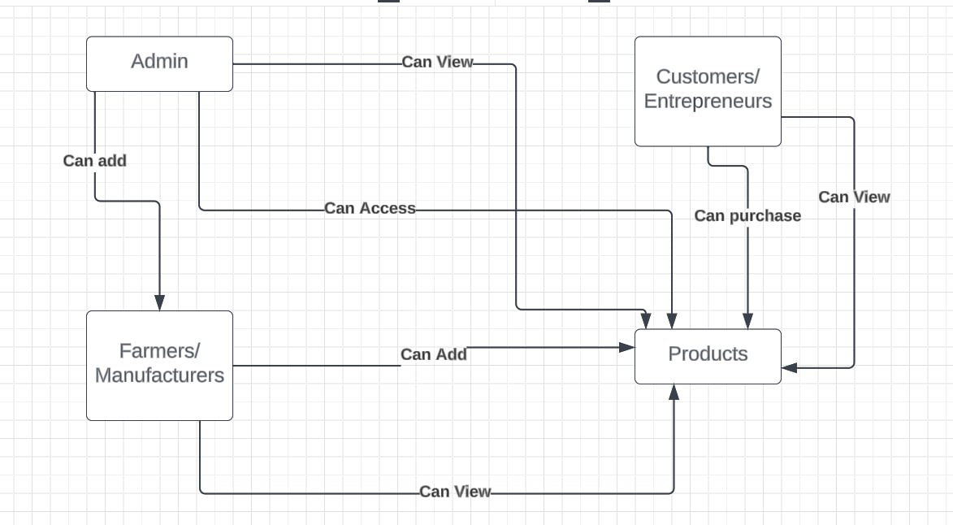
PROTOTYPE:

Slide 7
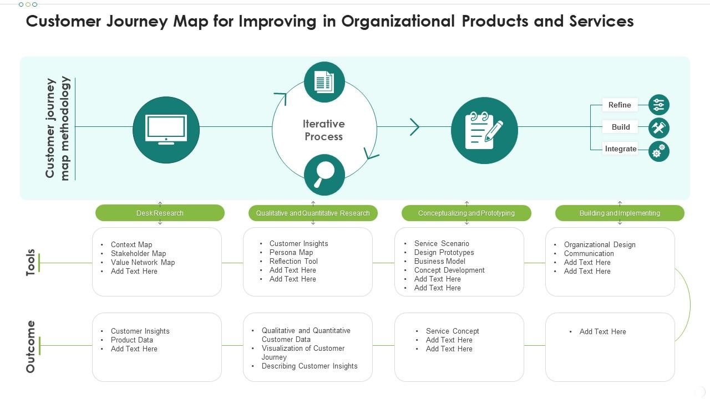
CUSTOMER JOURNEY MAP:

Slide 8

Advantages😊
Improved Efficiency
Informed Decision-Making
Financial Stability
Market Access
Resource Optimization
Risk Mitigation
Enhanced Collaboration
Compliance Management

Slide 9
Disadvantage's 😒
Technological Barriers
Cost of Implementation
Data Security Concerns
Dependency on Connectivity
Resistance to Change

Slide 10
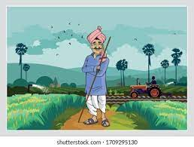
USERS STORY:
"As a rural farmer, I need an Agriculture Products Rural Entrepreneurship Management System to streamline inventory, analyze markets, and facilitate financial planning, empowering me for sustainable and profitable agricultural entrepreneurship."

Slide 11

CONCLUSION:
The Agriculture Products Rural Entrepreneurship Management System stands as a pivotal tool in revolutionizing agricultural practices. By integrating innovative modules, it empowers farmers, fosters economic growth, and contributes to sustainable rural development, ushering in a new era of efficiency and prosperity in the agricultural landscape.

