Slide 1


Slide 2
Agenda
Problem Statement 03
Data Mining - 01 04
Data Mining - 02 05
Exploratory Data Analysis (EDA) 06
Data Visualization 07
Algorithms Used 08
Analysis of Results 09
Conclusion & Future Work 10

Slide 3
Problem Statement
The body signal smoking data science project aims to analyze and interpret the effects of smoking on various physiological signals collected from individuals.
The project seeks to explore the correlation between smoking habits and the changes in body signals, such as heart rate, blood pressure, respiratory rate, and other relevant metrics.

Slide 4
Data Mining - 01
Only object,int, float data types are found in dataset.
Object data types are converted into int using label encoder.
Null values are not found in the dataset.
Duplicates are not found in the dataset.

Slide 5
Data Mining - 02
Identify the proportion of target variable (balance or imbalance)
Check the duplicate values
Drop duplicates if any
Dropping of columns which not effect the target variable
Identify the dependent and independent variables in the data set

Slide 6
Exploratory Data Analysis (EDA)
Importing required libraries
Spliting the data ->x_train,x_test>
->y_train,y_test
Scaling the features by using minmax
ScalerBuilding the algorithm

Slide 7
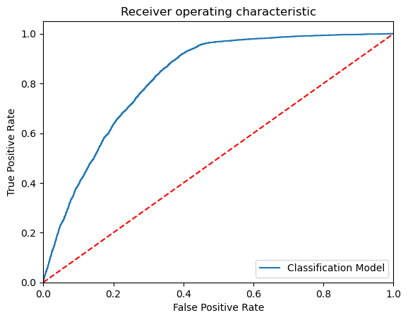
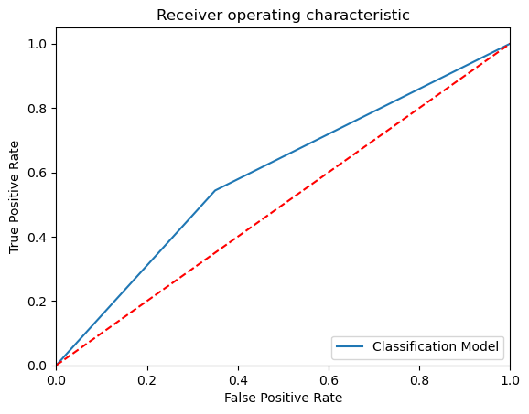
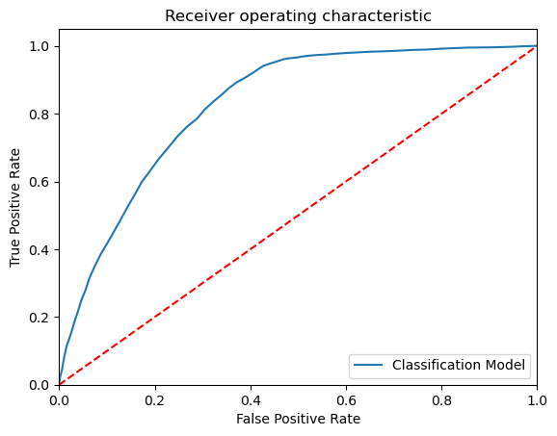
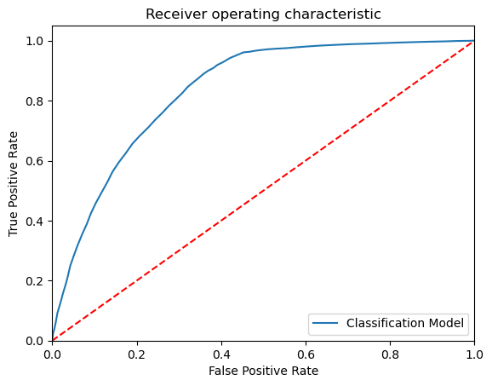
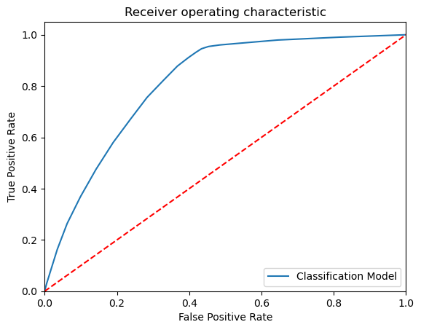
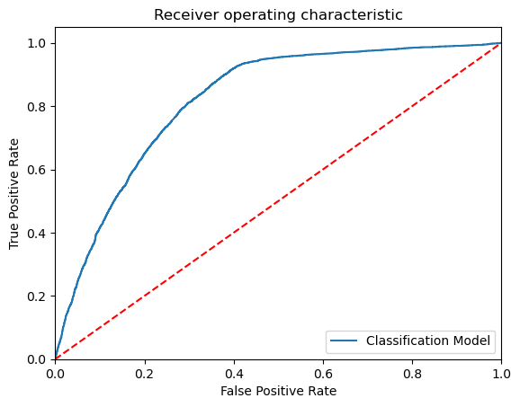
Data Visualization

Slide 8
Algorithms Used
Multi-label classification
Mutlinomial logistic regression
Multinomial Decision tree classifier
Multinomial Random forest classifier
Multinomial Extra trees classifier
Multinomial KNeighbors classifier
Multinomial GaussianNB

Slide 9
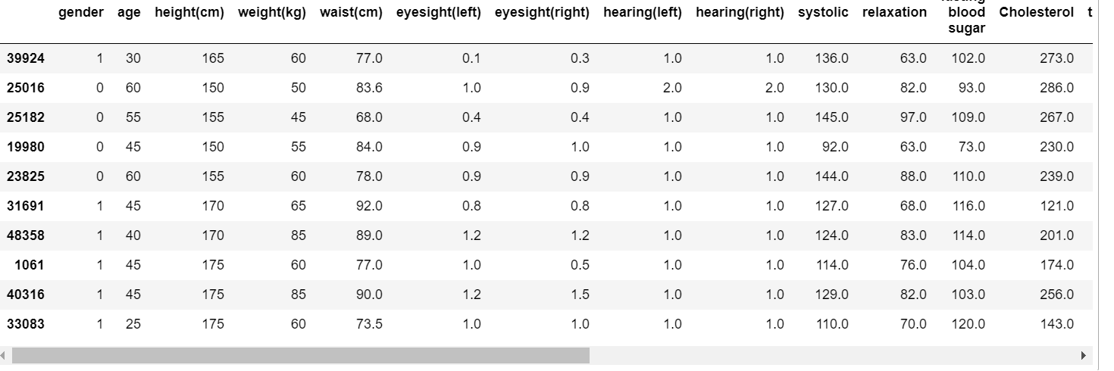
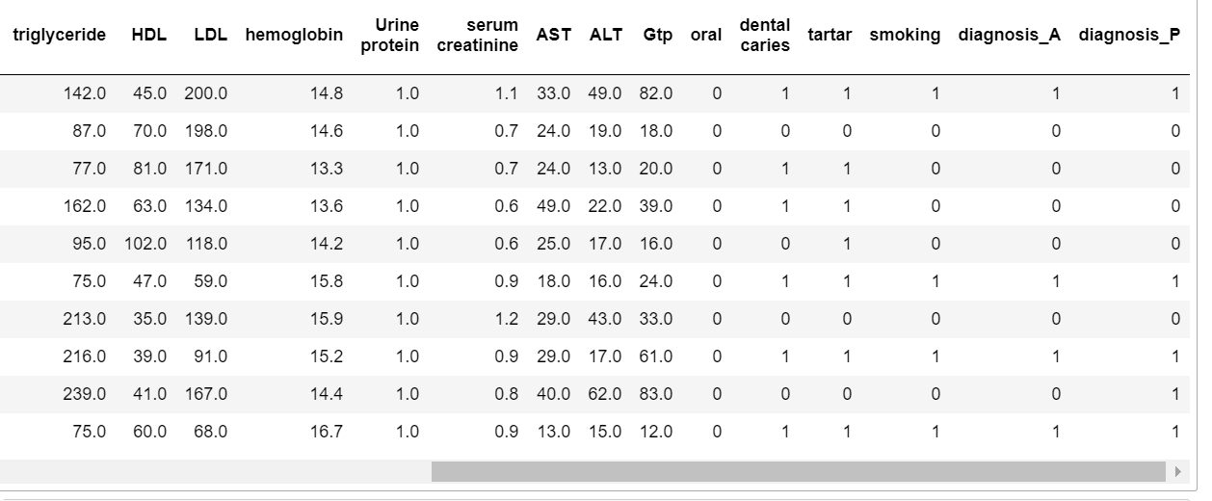
Analysis of Results

Slide 10
Conclusion and Future Work
Conclusion:
Significant correlations identified between body signals and smoking behavior, indicating potential health implications.
Causation should be interpreted cautiously; further research needed to establish direct links.
Future Work:
Conduct longitudinal studies to track body signals over time for a deeper understanding of long-term effects.
Employ causal inference methods to establish causation between smoking and specific body signal changes.

Slide 11
Thank You
Q & A
Student Name : Botcha Dhanush
Roll Number : 21B91A0425
SRKR Engineering College
Mobile: +91 7093822145
Email: 21B91A0425@srkrec.ac.in
Bhimavaram - India

