Slide 1
MINI PROJECT
Reg No | Name | Branch
261100610001 | B. Nitin Sri Karthikeya | CSE
261100610017 | E. Dhanush Rajkumar | CSE
261100610019 | M. B. Usha | CSE
Project Title | AI - Based Intrusion Detection System for IoT Networks Using Machine Learning and Deep Learning
Panel Members | Dr.Raghudathesh G P & Mr. Satyanarayan P Shenoy

Slide 2
CONTENTS
Introduction
Objective
Literature Review
Operational Flow
Functional Requirements
Implementation
Work Done
Conclusion
References

Slide 3
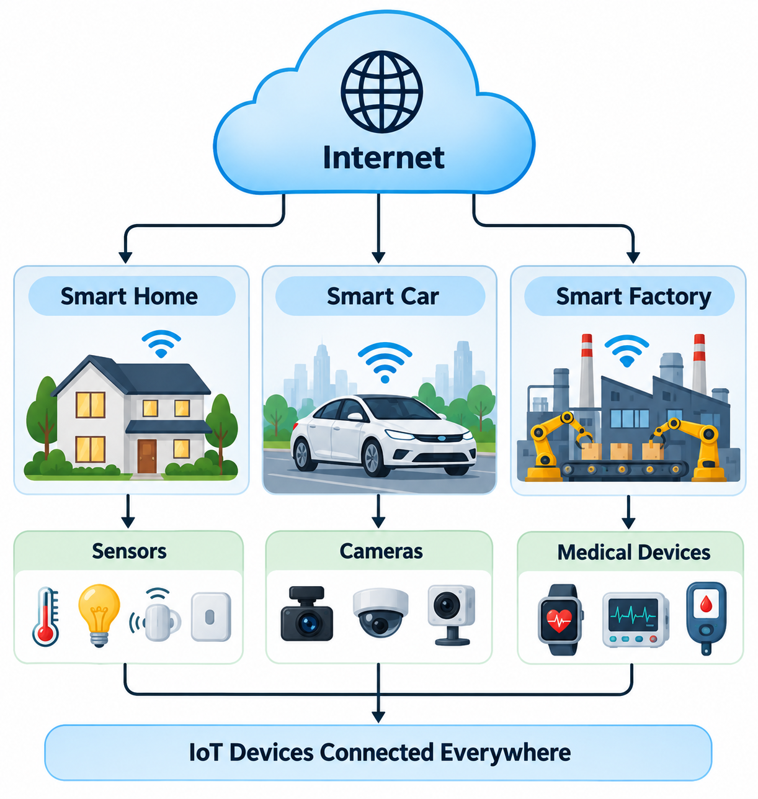
INTRODUCTION
The Internet of Things (IoT) is a network of interconnected physical devices embedded with sensors, software, and communication technologies that enable them to collect, exchange, and process data over the Internet with minimal human intervention.
IoT has become an integral part of modern applications such as:
  Smart Homes
  Smart Cities
  Healthcare
  Industrial Automation
  Agriculture
  Transportation
As the number of connected devices continues to grow, securing IoT networks has become increasingly important due to the large attack surface exposed to cyber threats.

Slide 4
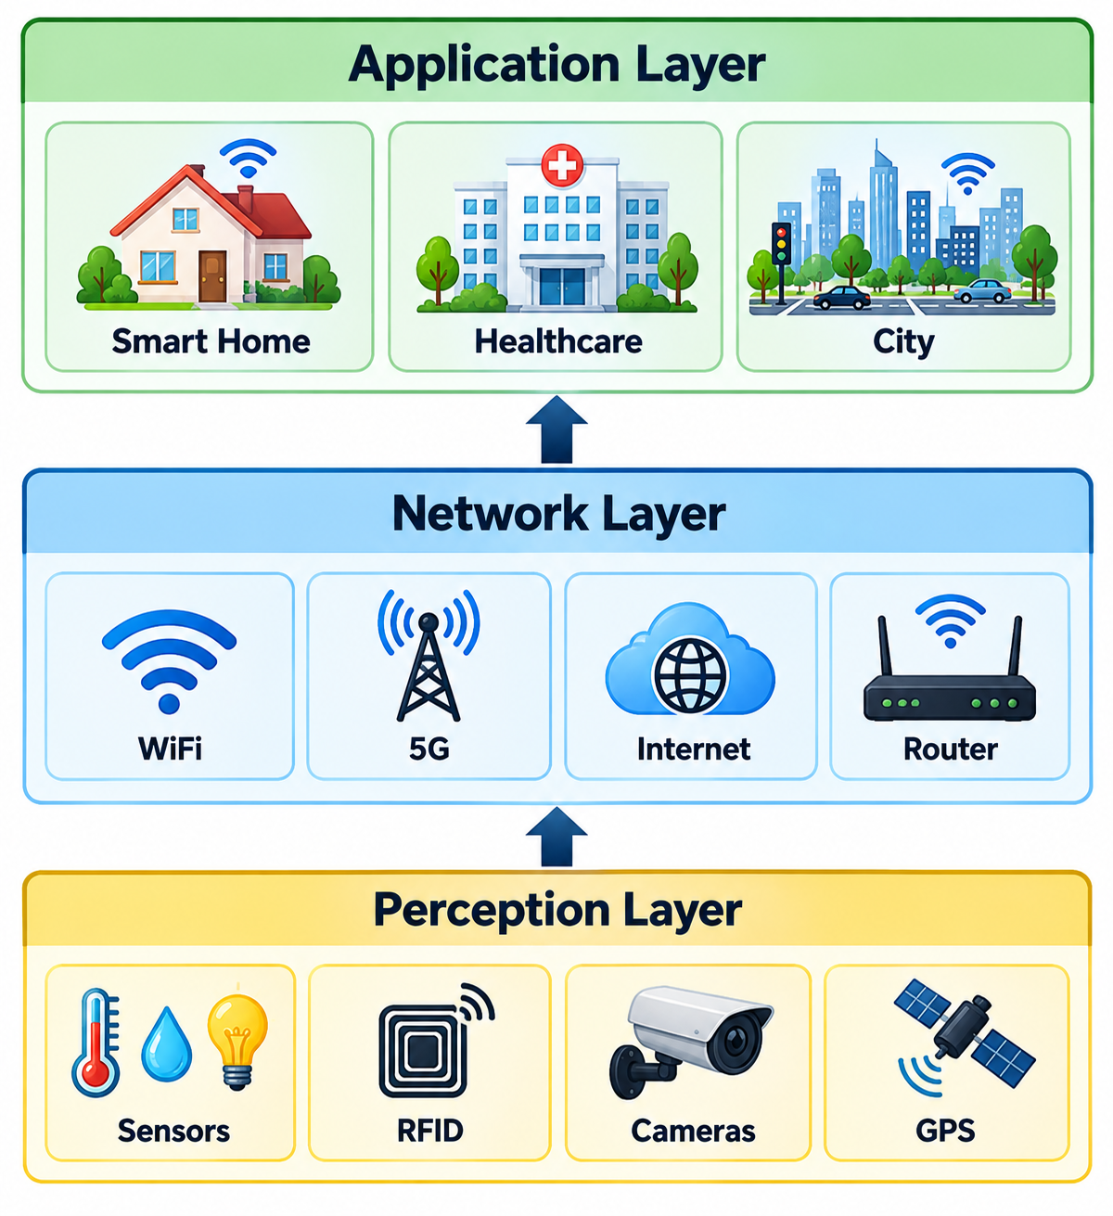
INTRODUCTION
Perception Layer
Physical layer of IoT
Collects data using sensors and RFID devices
Generates raw information
Network Layer
Transfers data between devices and servers
Uses communication technologies such as Wi-Fi, Bluetooth, ZigBee, and 5G
Application Layer
Delivers services to end users
Examples include healthcare, smart cities, agriculture, and industrial automation
Since all communication passes through the network layer, attackers often target IoT traffic, making intrusion detection essential.

Slide 5
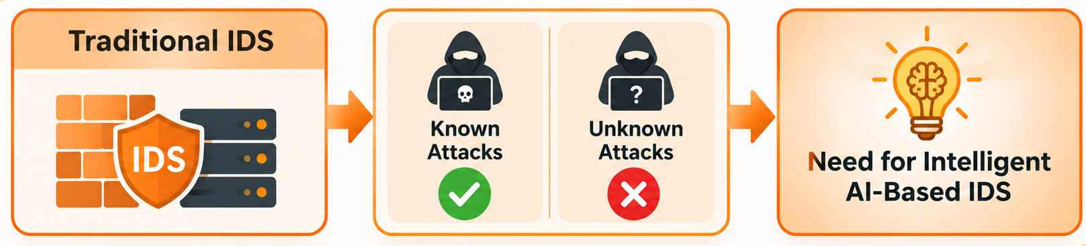
INTRODUCTION
INTRUSION DETECTION SYSTEM
Signature-Based IDS | Rule-Based IDS
Detects known attacks using predefined signatures | Detects attacks using manually defined security rules
Highly effective for previously identified attacks | Effective for policy violations and predefined behaviors
Requires frequent signature updates | Requires continuous rule maintenance
Cannot detect zero-day attacks | Difficult to adapt to new attack patterns
Limited scalability | High administrative effort

Slide 6
OBJECTIVE
To collect and preprocess an IoT network traffic dataset containing both normal and malicious traffic, including different attack types for binary and multi-class classification.
To develop and compare Machine Learning and Deep Learning models for accurately detecting malicious IoT network traffic.
To evaluate the developed intrusion detection models using metrics such as Accuracy, Precision, Recall, F1-Score, ROC-AUC, and False Alarm Rate.

Slide 7
LITERATURE REVIEW
Paper Title | Authors | Methodology | Key Findings | Limitations
Anomaly-based Intrusion Detection System for IoT Application | Mansi Bhavsar, Kaushik Roy, John Kelly, and Odeyomi Olusola | Proposed an anomaly-based IDS using machine learning techniques with feature selection to identify malicious IoT network traffic. | Demonstrated effective detection of both known and unknown attacks with reduced false alarms compared to signature-based IDS. | Focused mainly on anomaly-based detection and did not compare multiple ML and DL models on a large-scale IoT dataset.
A New DDoS Attacks Intrusion Detection Model Based on Deep Learning for Cybersecurity | D. Akgun, S. Hizal, and U. Cavusoglu | Developed a deep learning-based intrusion detection model for identifying DDoS attacks in cybersecurity environments. | Achieved high detection accuracy by automatically learning complex traffic patterns, showing the effectiveness of deep learning for DDoS detection. | Primarily focused on DDoS attacks and did not evaluate multiple learning algorithms or broader IoT attack categories.
A Multi-Class Classification Model on CICIoT2023 using Kolmogorov–Arnold Networks and Tree Ensembles | S. Almahaqeri, M. H. Almourish, A. A. Nasser, A. S. A. Alghawli, A. A. K. Elsayed, and A. N. Alhejoj | Proposed a multi-class intrusion detection framework using Kolmogorov–Arnold Networks (KAN) with Tree Ensemble models on the CICIoT2023 dataset. | Achieved excellent multi-class classification performance by combining advanced neural architectures with ensemble learning. | Focused on KAN and tree ensembles without comparing conventional deep learning models such as CNN and ANN under a unified framework.
An optimized gradient boosting framework for IoT intrusion detection: a comprehensive evaluation on the CICIoT2023 dataset | Salah A. Almahaqeri, Mohammed Hashem Almourish, Adel A. Nasser, Abed Saif Ahmed Alghawli, Amani A. K. Elsayed & Ali N. Alhejoj | Applied stratified undersampling and feature selection with XGBoost, LightGBM, and CatBoost on CICIoT2023. | XGBoost achieved 99.61% binary accuracy; reducing features from 46 to 23 improved inference speed by 30–51% with negligible accuracy loss. | Evaluated only on CICIoT2023 using undersampled data, limiting real-world generalizability; adversarial robustness and payload-based attacks were not evaluated.

Slide 8
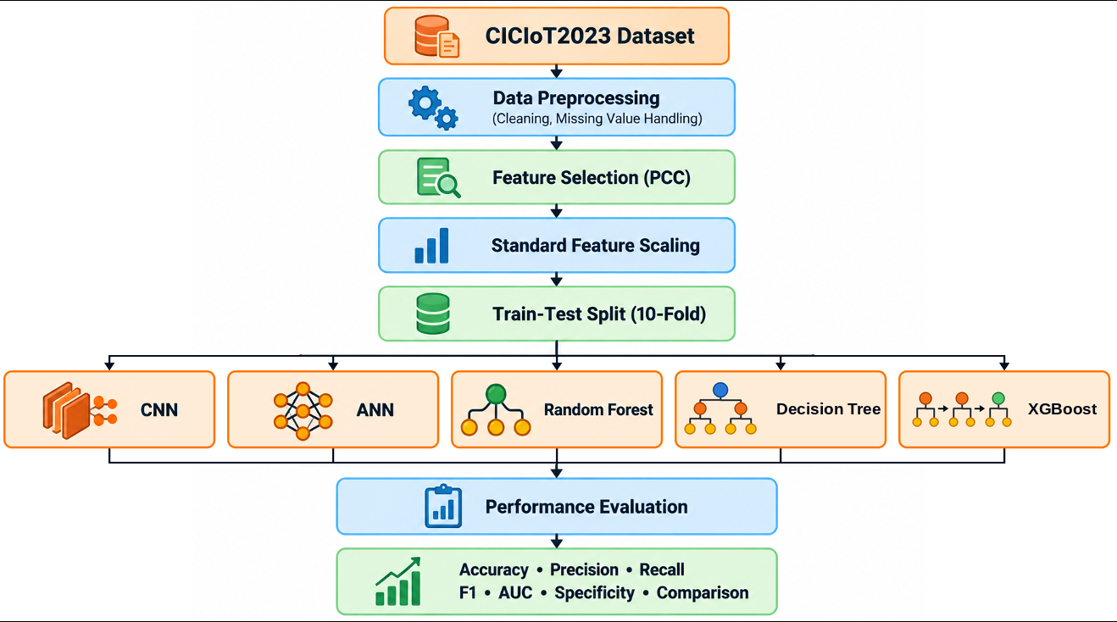
OPERATIONAL FLOW

Slide 9
FUNCTIONAL REQUIREMENTS
Requirement | Description
Dataset Loading | Load the CICIoT2023 dataset for intrusion detection.
Data Preprocessing | Clean the dataset by handling missing values, duplicates, and inconsistencies.
Feature Selection | Select the most relevant network traffic features using Pearson Correlation Coefficient (PCC).
Feature Scaling | Standardize the selected features before model training.
Model Training | Train CNN, ANN, Random Forest, Decision Tree, XG Boost models using the processed dataset.
Attack Classification | Classify network traffic into Attack and Benign classes.
Performance Evaluation | Evaluate models using 10-fold Cross Validation and performance metrics.
Result Generation | Generate confusion matrices, ROC curves, training plots, architecture summaries, and comparison reports.

Slide 10
IMPLEMENTATION
DATASET USED
CICIoT2023 Dataset
The proposed Intrusion Detection System (IDS) was developed using the CICIoT2023 dataset, which contains realistic IoT network traffic comprising both benign and malicious activities. The dataset includes various attack categories such as DDoS, DoS, spoofing, reconnaissance, brute-force, and web-based attacks, making it suitable for evaluating AI-based intrusion detection systems.
Key Characteristics
Dataset: CICIoT2023
Classification: Binary (Attack / Benign)
Feature Selection: Pearson Correlation Coefficient (PCC)
Selected Features: 15
Validation Technique: 10-Fold Cross Validation

Slide 11
IMPLEMENTATION
DATA PREPROCESSING & FEATURE ENGINEERING
Data Preprocessing
Feature Scaling
Data Preprocessing Steps :
  Removed duplicate records.
  Handled missing and infinite values.
  Converted attack categories into binary labels.
  Verified dataset consistency.
After feature selection, all selected features were standardized using StandardScaler to ensure they have zero mean and unit variance.
This improves the convergence of neural network models and ensures that all features contribute equally during training.
Feature Selection
The Pearson Correlation Coefficient was used to measure the relationship between each feature and the target class.
Advantages :
Removes irrelevant features.
Reduces dimensionality.
Improves computational efficiency.
Helps prevent overfitting.

Slide 12
MODEL DEVELOPMENT
Model | Purpose
CNN | Automatically extracts local feature patterns using convolution operations.
ANN | Learns nonlinear relationships among selected network traffic features.
Random Forest | Uses ensemble of decision trees to improve classification robustness and reduce overfitting.
Decision Tree | Splits traffic features using simple if-then rules to classify attacks in an easy-to-interpret way.
XG Boost | Builds trees one after another, each correcting the previous tree’s errors, for high accuracy and fast training.
Common Training Strategy
Same preprocessed dataset.
Same selected features.
Same evaluation metrics.
10-Fold Cross Validation.
This ensures a fair comparison between all three models.

Slide 13
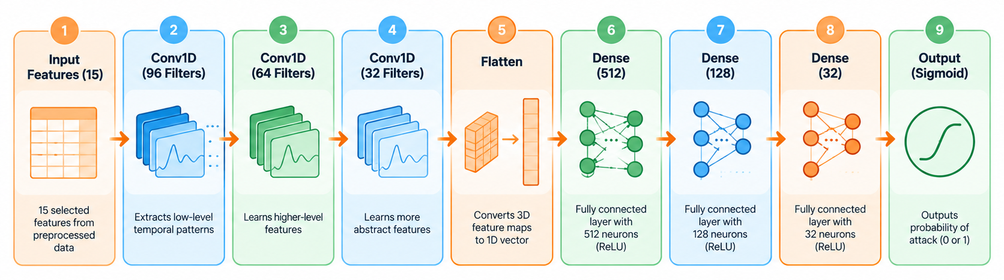
IMPLEMENTATION
CNN ARCHITECTURE
Key Components
Conv1D: Extracts local patterns from sequential feature vectors.
Flatten: Converts feature maps into a one-dimensional vector.
Dense Layers: Learn higher-level feature representations.
Sigmoid Layer: Produces the probability of Attack or Benign.

Slide 14
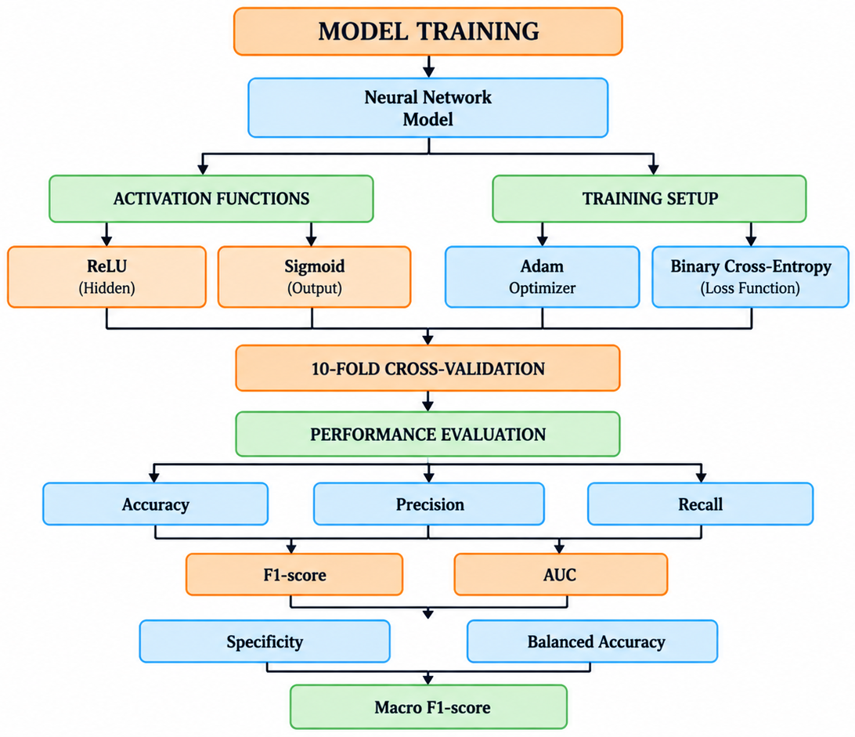
IMPLEMENTATION
TRAINING STRATEGY

Slide 15
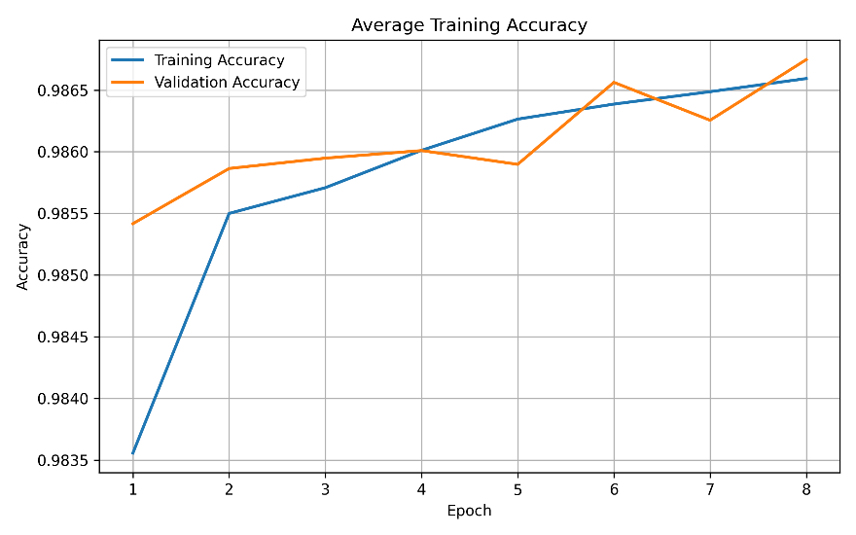
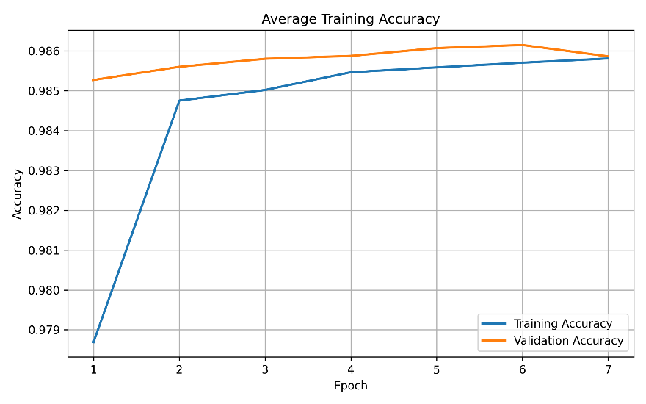
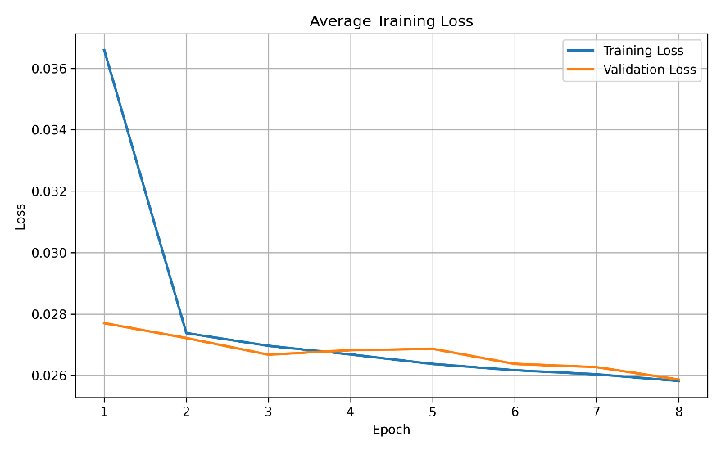
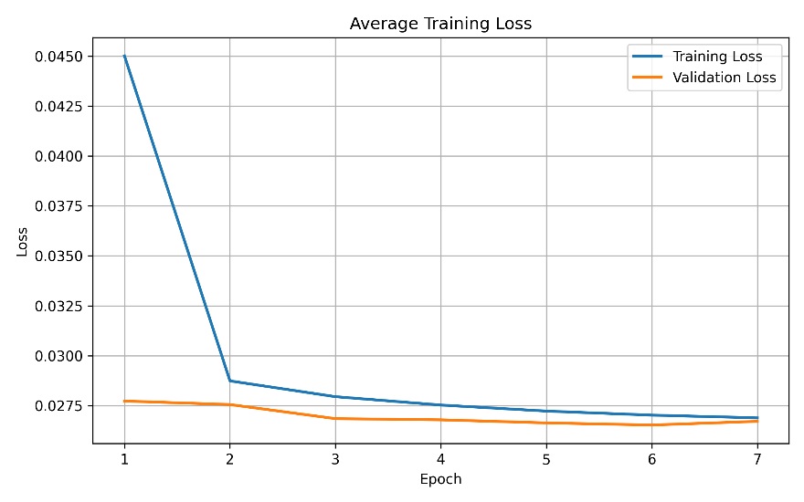
WORK DONE
TRAINING PERFORMANCE
CNN
ANN

Slide 16
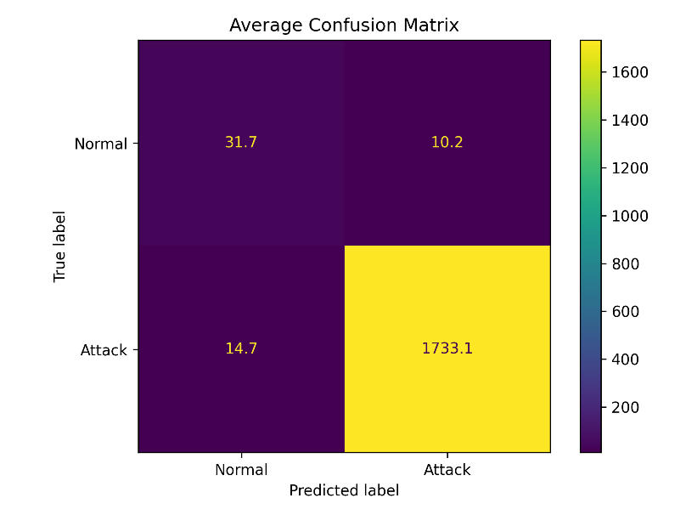
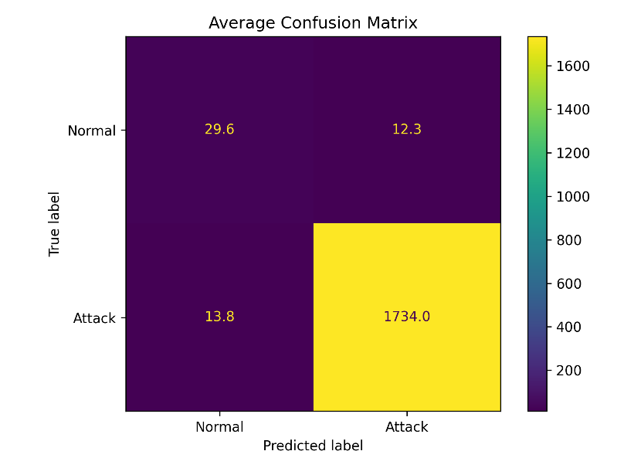
WORK DONE
DL CONFUSION MATRIX (Binary)
CNN
ANN

Slide 17
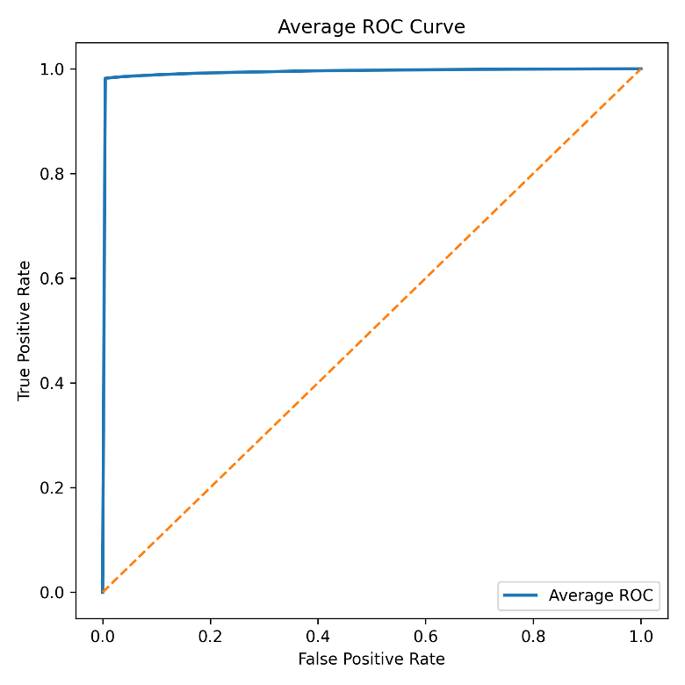

WORK DONE
DL ROC COMPARISION (Binary)
CNN
ANN
Model | AUC
CNN | 99.56
ANN | 99.55

Slide 18
WORK DONE
Hyperparameters
Hyperparameter | ANN (Binary) | CNN (Binary)
Input Features | 15 | 15
Optimizer | Adam | Adam
Learning Rate | 0.001 | 0.001
Epochs | 20 | 20
Batch Size | 64 | 64
Loss Function | Binary Crossentropy | Binary Crossentropy
Output Activation | Sigmoid | Sigmoid

Slide 19
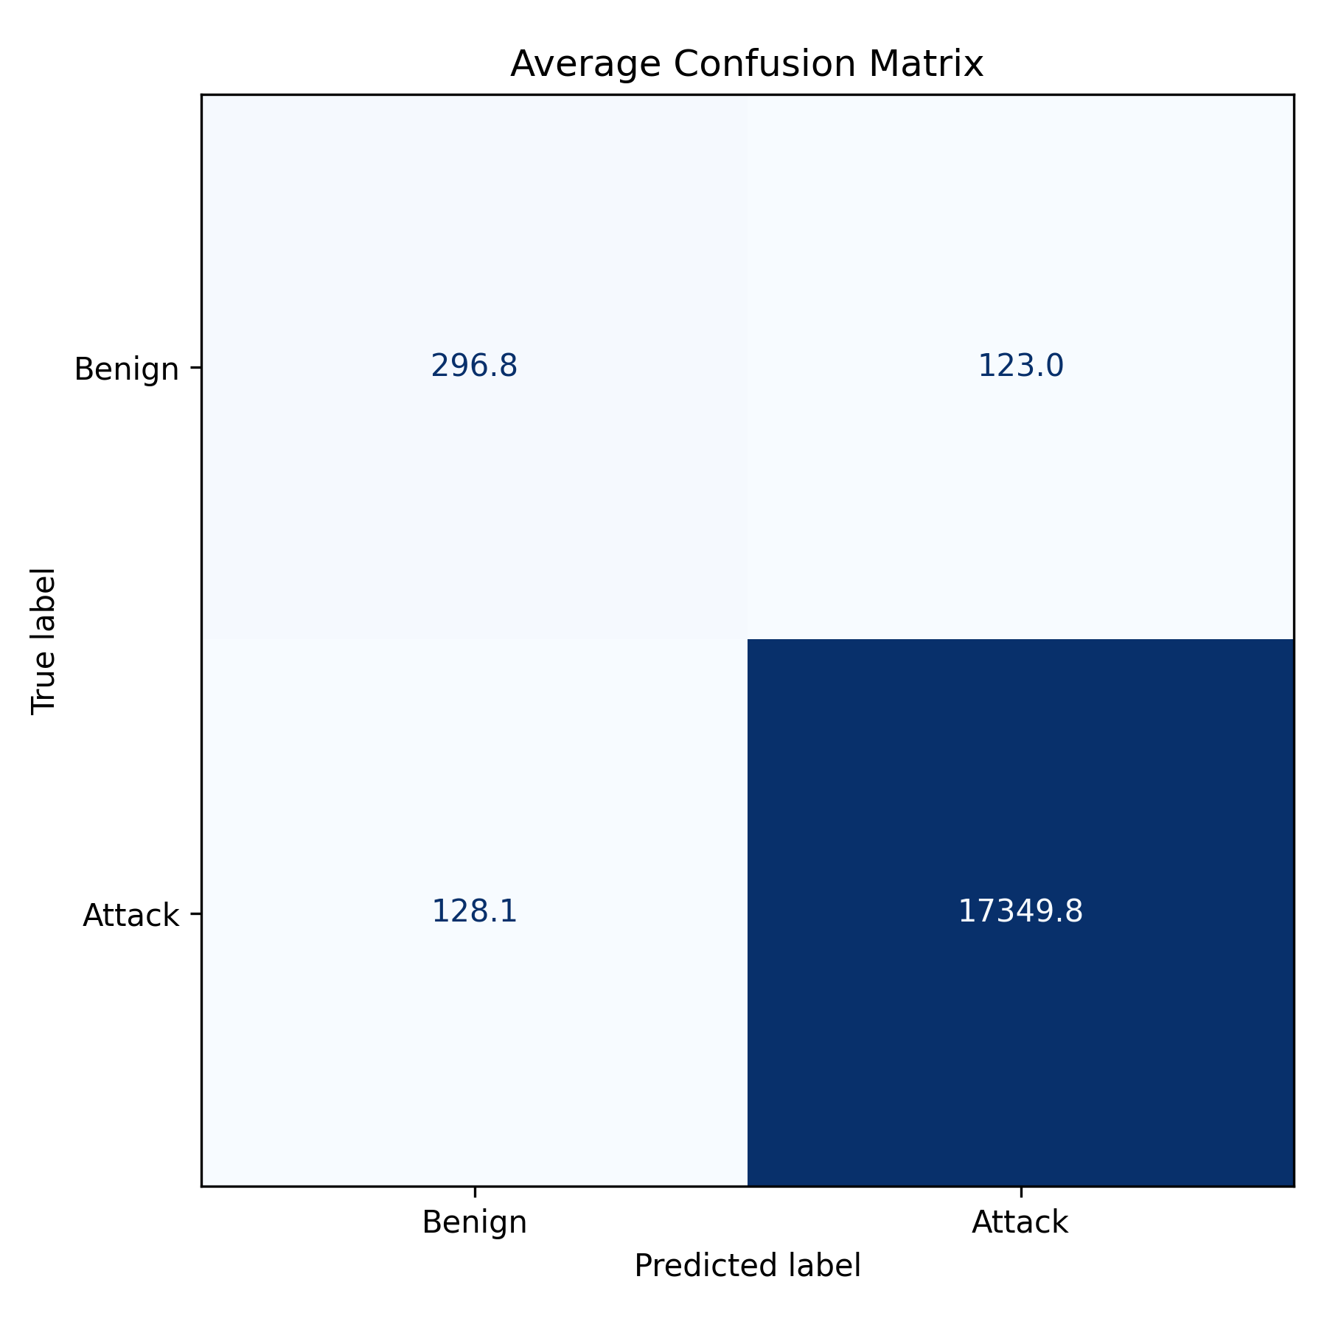

WORK DONE
ML CONFUSION MATRIX (Binary)
DT
RF

Slide 20
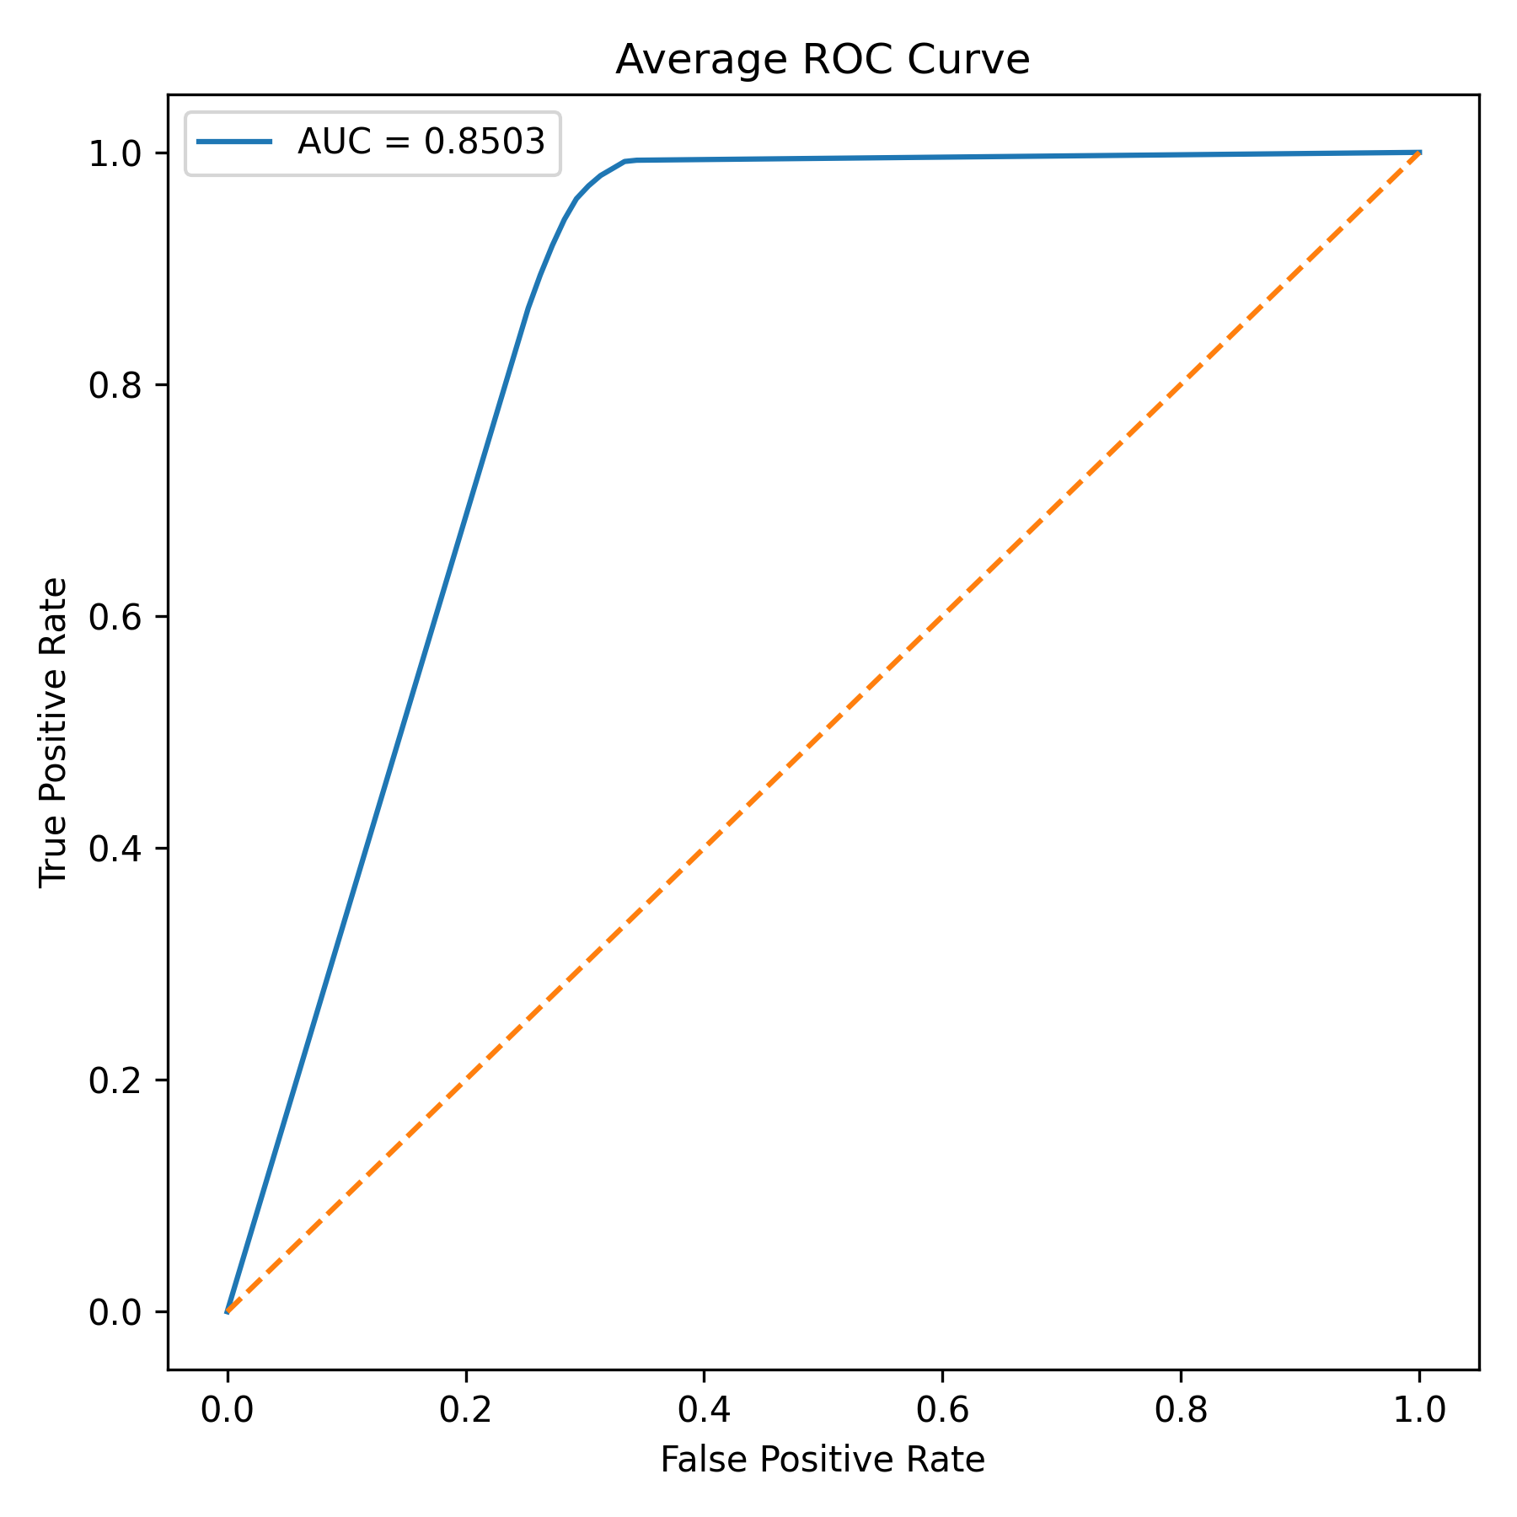
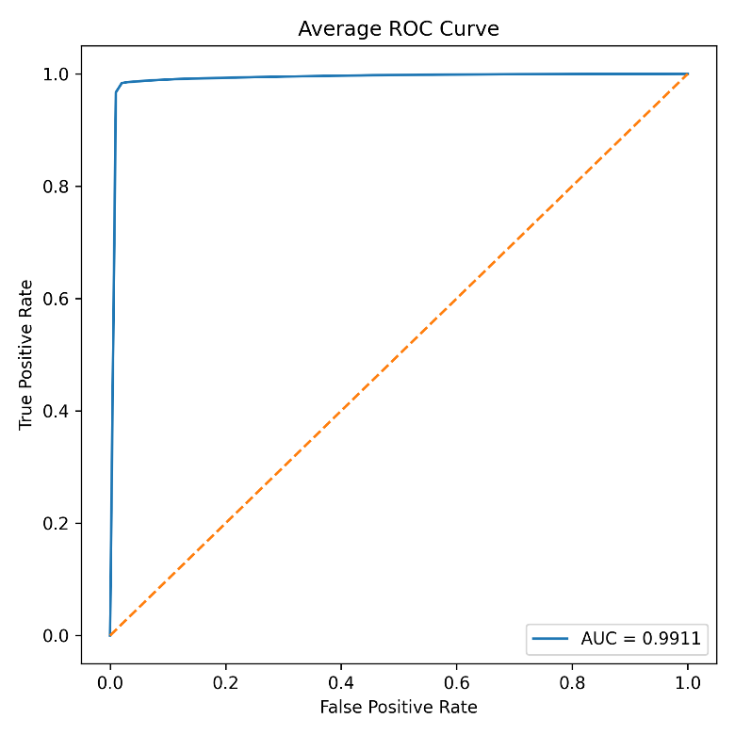
WORK DONE
ML ROC COMPARISION (Binary)
DT
RF

Slide 21
Hyper Parameters
Hyperparameters
Hyperparameter | Decision Tree (Binary) | Random Forest (Binary)
Algorithm | Decision Tree Classifier | Random Forest Classifier
Number of Trees | – | 100
Criterion | Gini | –
Splitter | Best | –
Random State | 42 | 42
PCC Threshold | 0.10 | 0.10

Slide 22
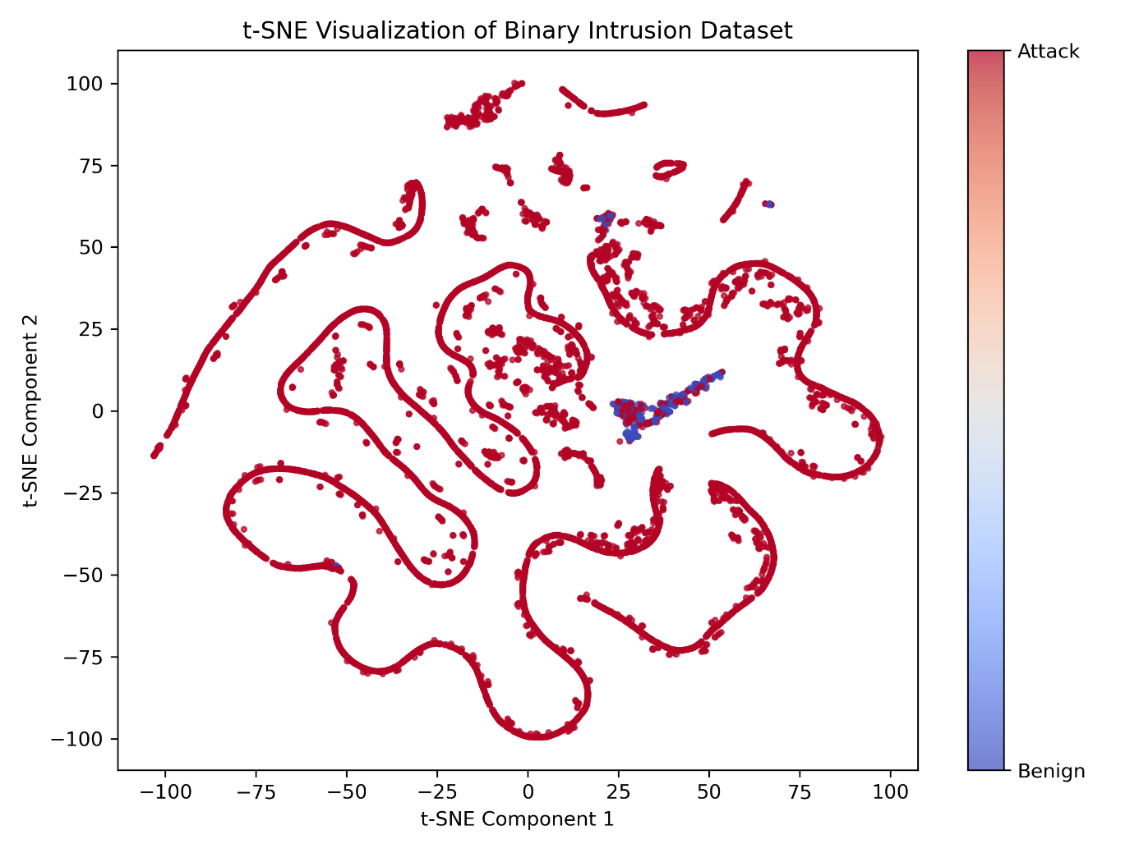
WORK DONE
t – SNE Visualisation

Slide 23
WORK DONE
PERFORMANCE METRICS COMPARISON (Binary)
Metric | CNN | ANN | RF | DT
Accuracy | 98.75 | 98.75 | 98.85 | 98.59
Precision | 99.42 | 99.49 | 99.43 | 99.29
Recall | 99.30 | 99.23 | 99.39 | 99.26
F1 | 99.36 | 99.36 | 99.41 | 99.28
AUC | 99.56 | 99.55 | 99.55 | 85.02
Specificity | 75.94 | 78.61 | 76.42 | 70.69

Slide 24
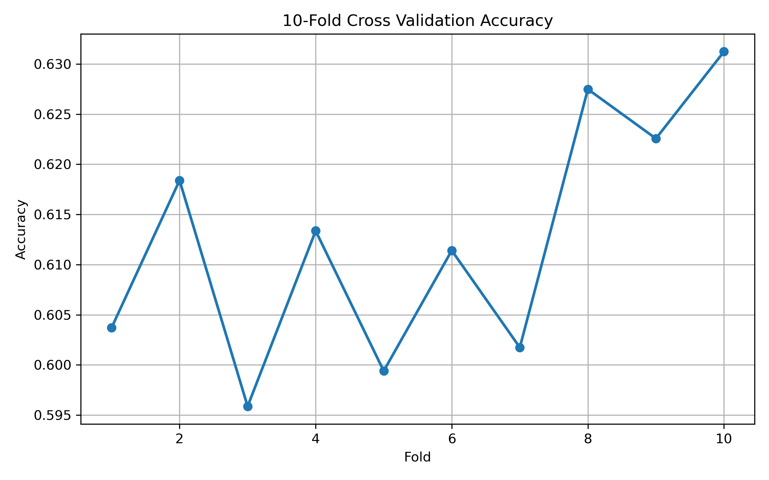
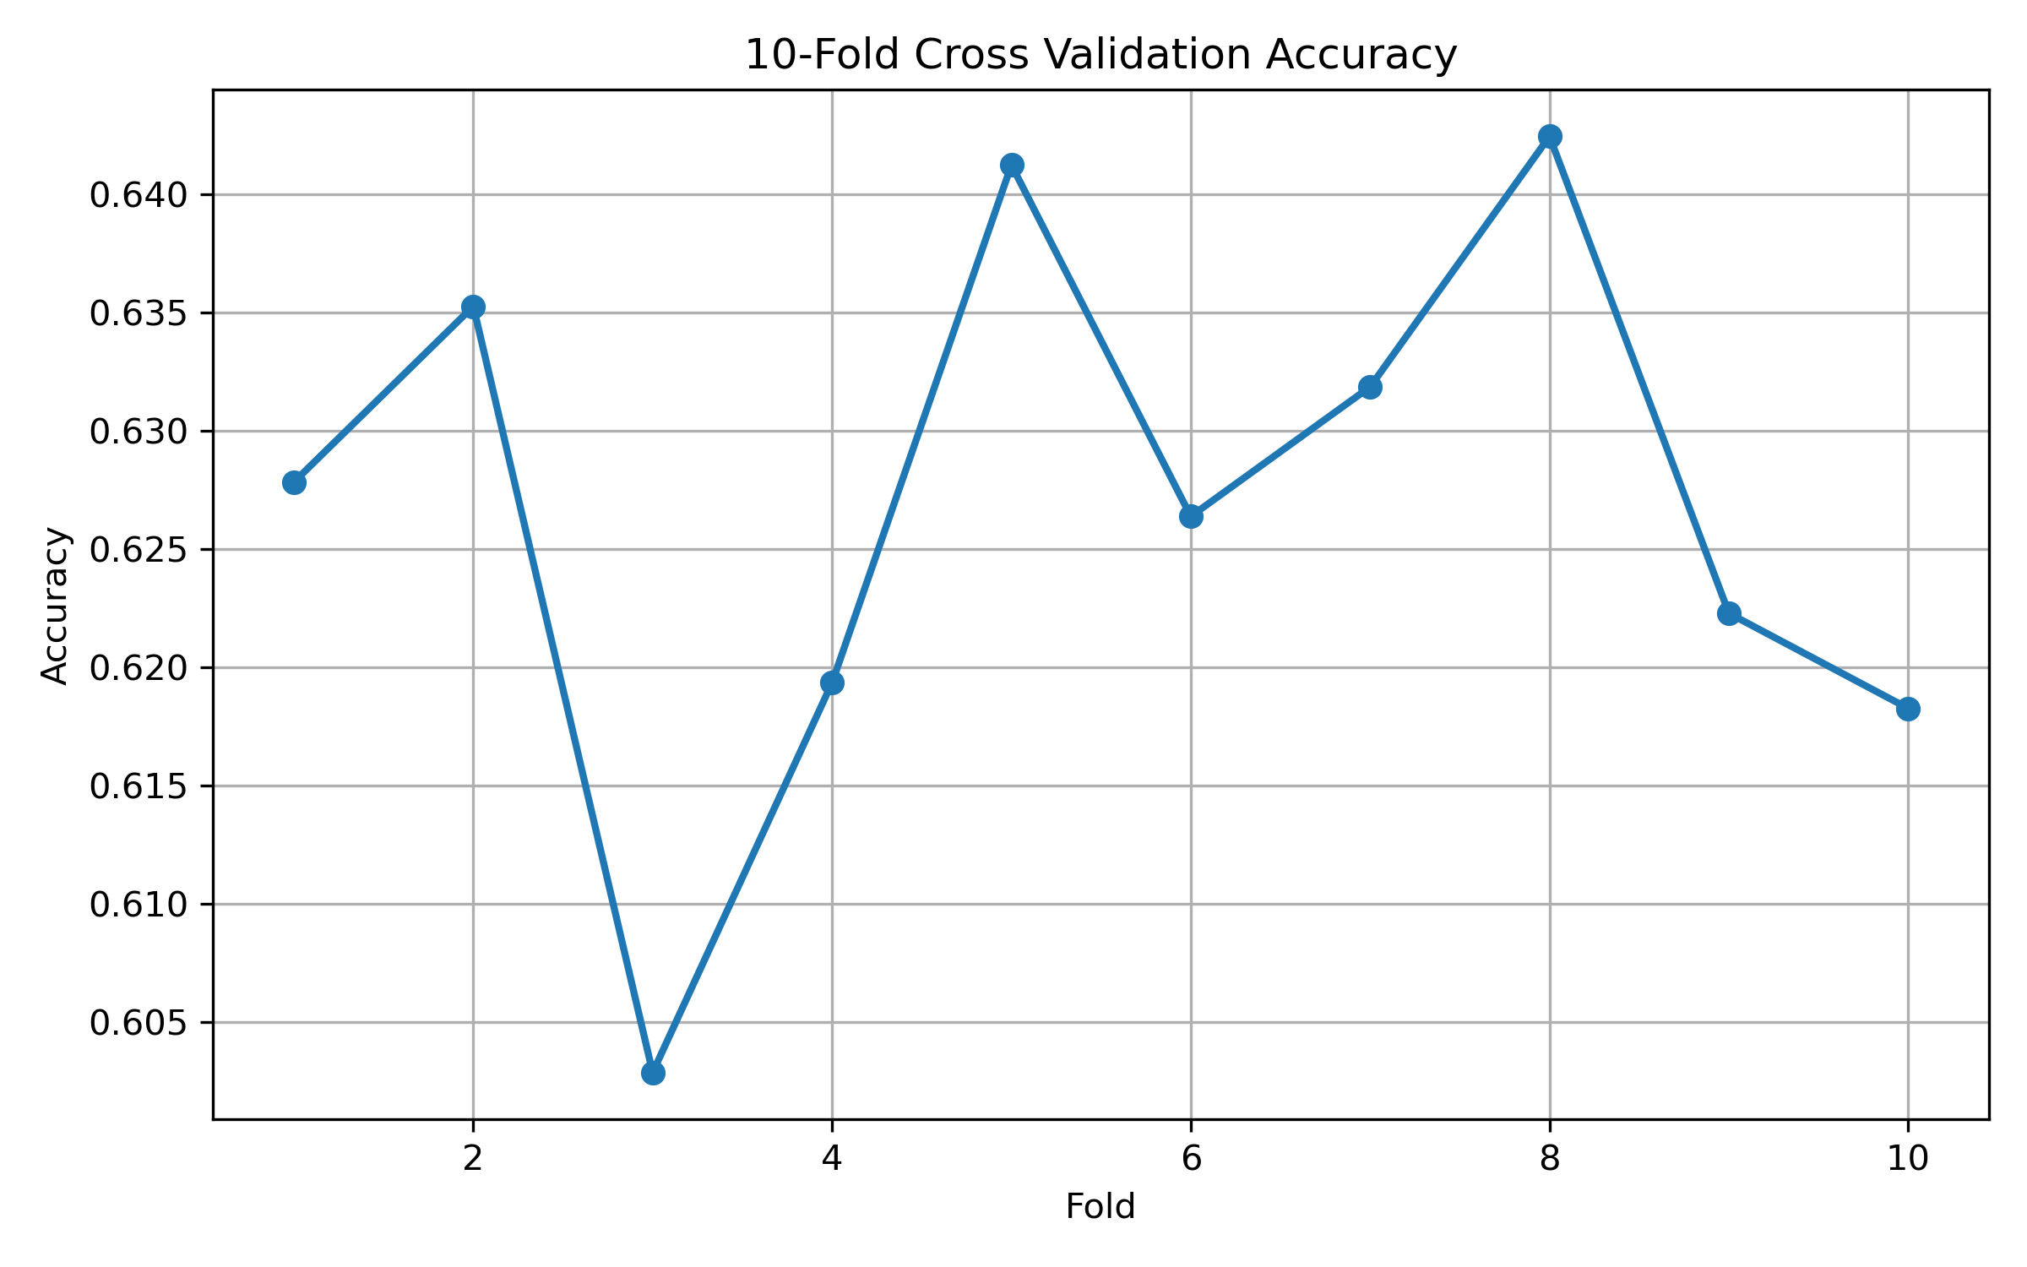
WORK DONE
DL FOLD ACCURACY (Multiclass)
ANN
CNN

Slide 25
WORK DONE
Hyperparameters
Hyperparameter | ANN (Multiclass) | CNN (Multiclass)
Epochs | 50 | 50
Batch Size | 256 | 256
Learning Rate | 0.001 | 0.001
Optimizer | Adam | Adam
Loss Function | Sparse Categorical Crossentropy | Sparse Categorical Crossentropy
Hidden Layers | 512 → 128 → 64 | –
Conv1D Filters | – | 96 → 64 → 32
Dropout | None | 0.3
Early Stopping | 10 | 10
Class Weights | Balanced | Balanced

Slide 26
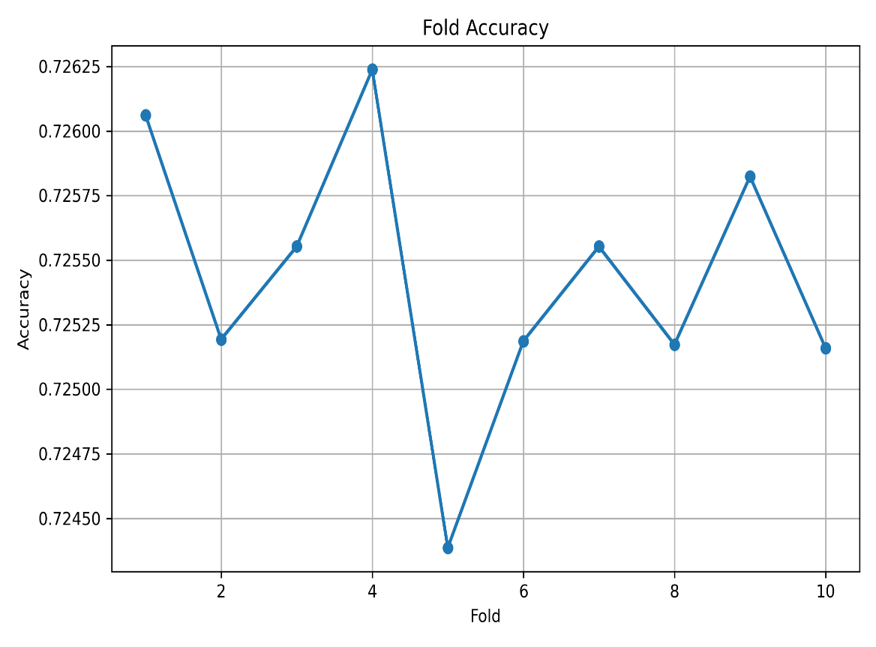
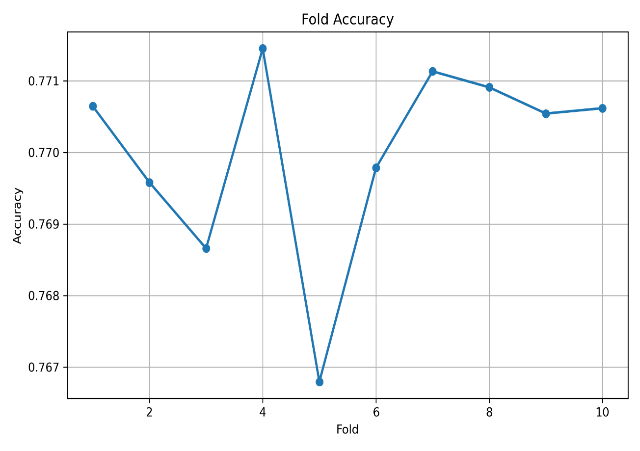
ML FOLD ACCURACY (Multiclass)
DT
RF

Slide 27
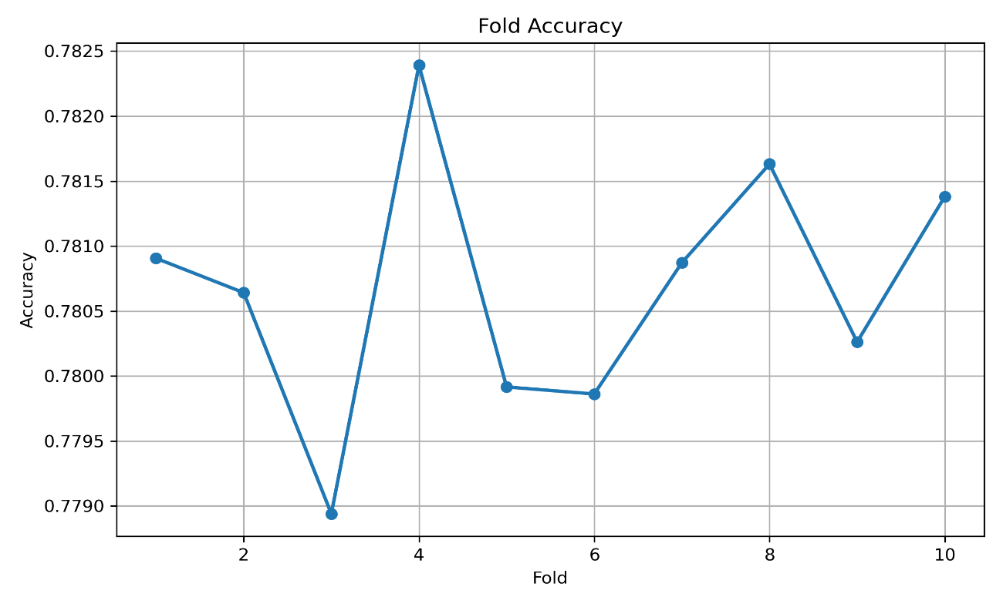
ML METRICS (Multiclass)
XG Boost

Slide 28
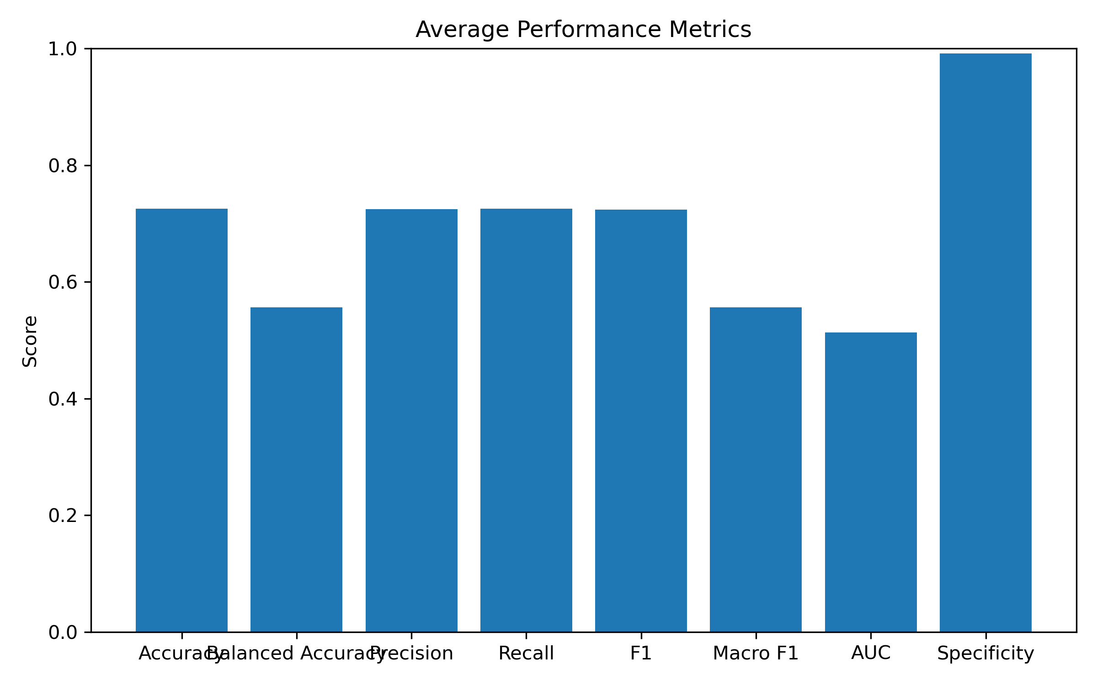
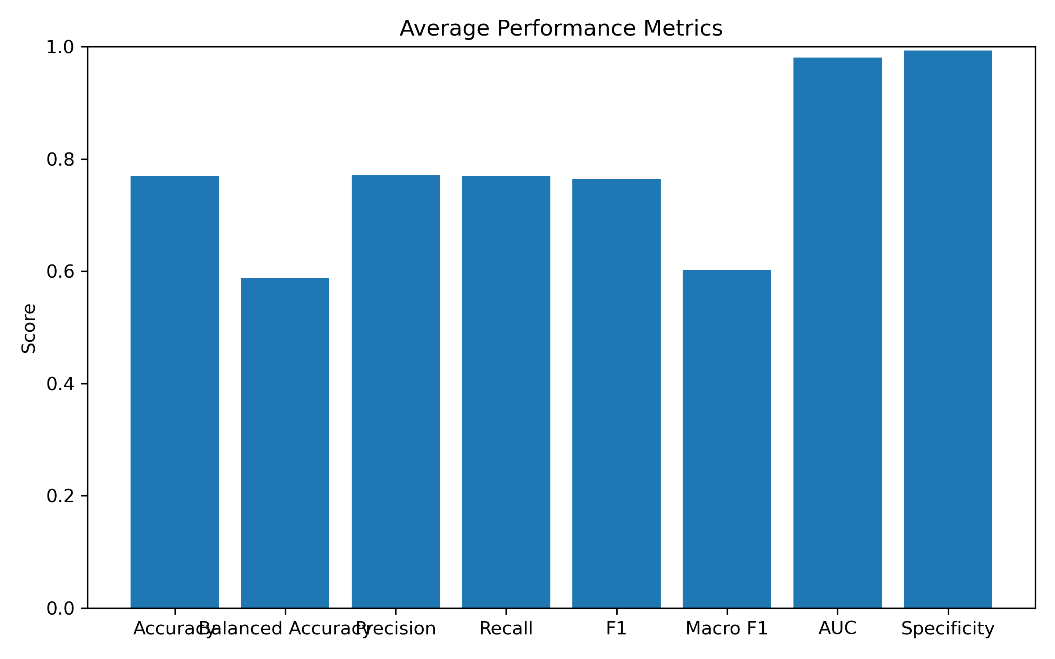
ML METRICS (Multiclass)
DT
RF

Slide 29
WORK DONE
PERFORMANCE METRICS COMPARISON (Multiclass)
Metric | RF | DT | XG Boost
Accuracy | 77.00 | 72.54 | 78.17
Precision | 77.08 | 72.46 | 66.32
Recall | 76.00 | 72.54 | 60.04
F1 | 76.35 | 72.36 | -
Macro F1 | 60.15 | 55.59 | 61.25
AUC | 98.05 | 51.30 | -
Specificity | 99.26 | 99.13 | -

Slide 30
WORK DONE
Hyperparameter | Decision Tree (Multiclass) | Random Forest (Multiclass) | XGBoost (Multiclass)
Algorithm | Decision Tree Classifier | Random Forest Classifier | XGBoost Classifier
Number of Trees | – | 300 | 1000
Criterion | Gini | Gini | –
Splitter | Best | – | –
Max Features | – | sqrt | –
Max Depth | – | – | 12
Learning Rate | – | – | 0.03
Subsample | – | – | 0.8
Colsample by Tree | – | – | 0.8
Min Child Weight | – | – | 3
Gamma | – | – | 0
Regularization (Alpha / Lambda) | – | – | 0 / 1
Eval Metric | – | – | mlogloss
Tree Method | – | – | hist (CUDA)
Class Weight | – | Balanced Subsample | –
Class Balancing | None | None | SMOTE (k = 2, per fold)
Variance Threshold | – | – | 0.001
Random State | 42 | 42 | 42

Slide 31
01 DATA INGESTION & PREPARATION
02 CROSS-VALIDATION: REPEAT FOR EACH OF THE 5 FOLDS
CICIoT2023
Input traffic records + multiclass attack labels
StratifiedKFold (n_splits = 5, shuffle = True, random_state = 42)
Split current fold
Training fold ≈ 80% | Held-out fold ≈ 20%
Load CSV and identify target column
X = numerical traffic features | y = attack category
DECISION TREE (DT)
RANDOM FOREST (RF)
XGBOOST (XGB)
400 max rounds; depth 12; LR 0.05
Clean invalid feature values
Fit DT on training fold
Fit RF on training fold
150 trees
Split XGB training portion
90% fit / 10% internal validation; stratified
Encode target labels
XGB-only imbalance handling
StandardScaler → tiered SMOTE on fit subset → inverse scale
Keep feature schema & class mapping
Train XGB + early stopping
Class weights; internal validation mlogloss; best boosting iteration
Configure reproducible experiment
Seed = 42 | 5 stratified folds | shared train/test indices
Predict held-out fold
Predict class probability for EVERY attack class
Predict held-out fold
Predict class probability for EVERY attack class
Predict held-out fold
Predict class probability for EVERY attack class

Slide 32
03 OUT-OF-FOLD (OOF) PREDICTIONS & BASELINE EVALUATION
Store each model’s held-out probabilities in its original row positions
OOF_DT [ ]
Evaluate each base model on held-out labels
Accuracy · Balanced Accuracy · Macro Precision · Macro Recall · Macro F1 · One-vs-Rest AUC
Repeat until all 5 folds finish
04 FOUR ENSEMBLE STRATEGIES: SAME THREE BASE PREDICTIONS
For a held-out record, collect P_DT, P_RF, P_XGB
HARD VOTING
3 predicted labels → majority class
Tie: resolve using soft probabilities
SOFT VOTING
Average 3 class-probability vectors
Choose class with highest mean
WEIGHTED VOTING
Search weights {1,2,3}³ = 27 options
Tune on OTHER folds’ OOF macro F1
STACKING
Concatenate 3 OOF probability vectors
Log transform → Logistic Regression
Hard-vote prediction
One class per record
Soft-vote prediction
Mean probabilities → argmax
Weighted prediction
Best weights from other folds → argmax
Stacked prediction
Meta-model trained on other folds’ OOF → class
Evaluate each ensemble on held-out fold
Macro F1 (primary ranking) + accuracy, balanced accuracy, precision, recall, AUC
Aggregate fold results and compare 7 approaches
DT | RF | XGB | Hard Voting | Soft Voting | Weighted Voting | Stacking

Slide 33
05 FINAL TRAINING, MODEL EXPORT & INFERENCE
Final model training & export
Fit final ensemble configuration using complete OOF predictions
Select weighted-voting weights on all OOF; fit stacking meta-model on all OOF
Retrain three base learners on the full labeled dataset
DT on all rows | RF on all rows | XGB with full-data SMOTE; use median best boosting rounds
Save deployable artifacts
DT.joblib | RF.joblib | XGB.ubj | metadata.joblib (encoder, feature names, weights, stacker)
Inference on new IoT traffic
NEW IoT network traffic record arrives
Same feature names / order as training; apply matching missing-value handling
Load saved models and metadata
Compute DT / RF / XGB probability vector for new traffic record
Apply chosen ensemble method
Hard majority | Soft mean | Weighted average | Stacking meta-model
Pick winning class and decode label
argmax of combined class scores → inverse LabelEncoder
FINAL OUTPUT: BENIGN or specific attack type
Multiclass intrusion detection result (e.g., DDoS / reconnaissance / spoofing)
IMPORTANT EXPERIMENT NOTES
SMOTE is used ONLY for XGBoost training, never on held-out folds.
The earlier binary 10-fold pipeline is separate.
Strict unbiased comparison of tuned ensembles requires a separate untouched test set or nested validation.

Slide 34
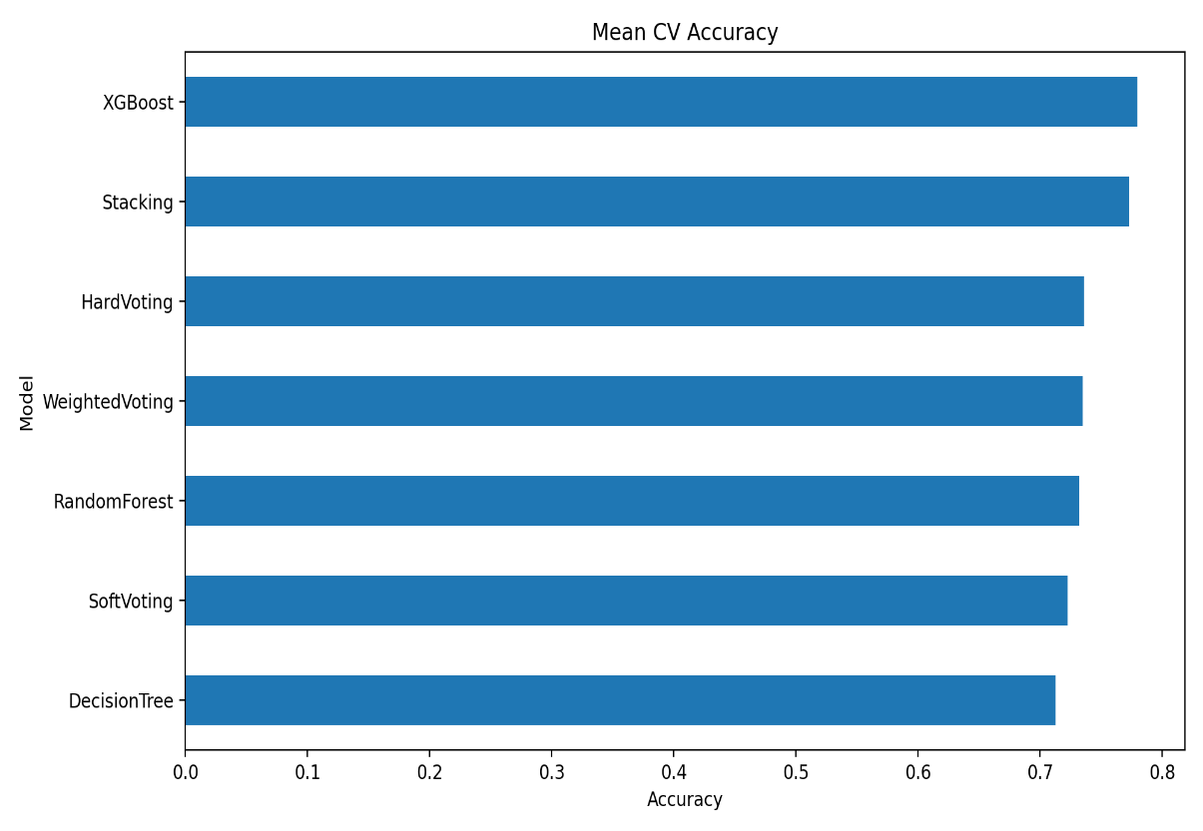
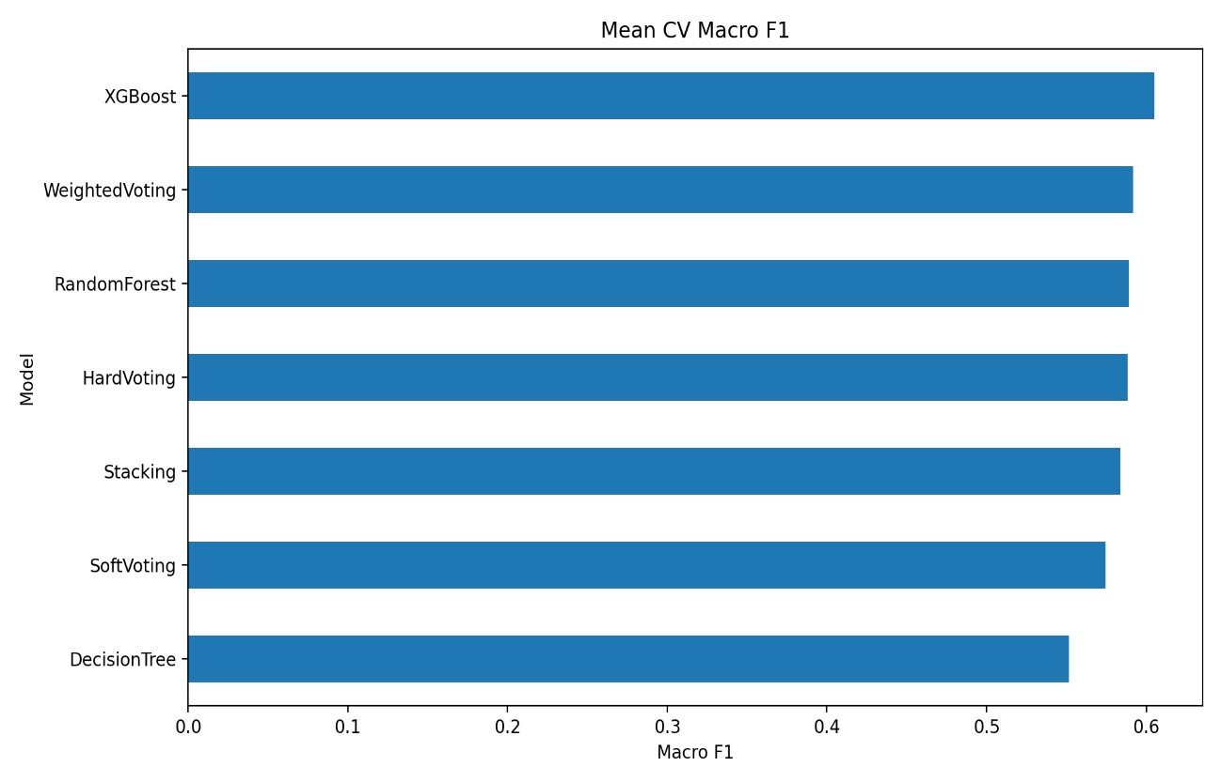
WORK DONE

Slide 35
CONCLUSION
BINARY CLASSIFICATION (Attack vs Benign)
CNN
ANN
Decision Tree
Random Forest ★ BEST
Highest AUC: 99.56%
Accuracy 98.75%, F1 99.36%
Stable training and validation curves
Highest Precision: 99.49%
Highest Specificity: 78.61%
Simple, low-complexity architecture
Simple, interpretable if-then rules
Lowest AUC: 85.03%
More false alarms than RF (123 vs 99)
Highest Accuracy: 98.85%
Highest Recall 99.39% & F1 99.41%
Best overall binary model
MULTICLASS CLASSIFICATION (Attack Types)
ANN
CNN
Decision Tree
Random Forest
XGBoost ★ BEST
Mean fold accuracy ≈ 61%
Balanced class weights
Lowest multiclass accuracy
Mean fold accuracy ≈ 63%
Outperformed ANN
Still below tree-based models
Accuracy ≈ 72.5%, stable folds
Macro F1 ≈ 55%, AUC ≈ 51%
Weak on minority attack classes
Accuracy ≈ 77.0%
AUC ≈ 98%, Specificity ≈ 99%
Macro F1 ≈ 60%
Highest accuracy ≈ 78.1%
Highest Macro F1 of all 7 approaches
Outperformed all 4 ensembles
Binary: Random Forest is the best model with the highest Accuracy (98.85%), Recall (99.39%) and F1 (99.41%).
Multiclass: XGBoost is the best model with the highest accuracy (≈78%) and Macro F1, outperforming Stacking and all voting ensembles.
Overall: Tree-based models performed best on structured tabular IoT traffic, while CNN and ANN remained highly competitive in binary detection.

Slide 36
EVALUATION METRICS
Metric | Simple Meaning | Formula
Accuracy | Out of all predictions, how many are correct. | (TP + TN) / (TP + TN + FP + FN)
Precision | Out of all traffic predicted as attack, how many are actually attacks. | TP / (TP + FP)
Recall (Sensitivity) | Out of all actual attacks, how many the model correctly caught. | TP / (TP + FN)
Specificity | Out of all actual benign traffic, how much is correctly identified as benign. | TN / (TN + FP)
F1-Score | A single score that balances Precision and Recall. | 2 × (Precision × Recall) / (Precision + Recall)
Balanced Accuracy | Average of the recall of every class, so small classes count as much as large ones. | Mean of per-class Recall
Macro F1 | F1-Score calculated for each class separately and then averaged; every attack type counts equally. | Mean of per-class F1-Score
ROC-AUC | How well the model separates attack from benign traffic (1 = perfect, 0.5 = random guess). | Area under the ROC curve (TPR vs FPR)

Slide 37
FUTURE SCOPE
1. Higher Accuracy via Ensembles
2. Interactive IDS Dashboard
3. Real-Time Traffic Detection
Improve multiclass detection accuracy (currently ≈78% with XGBoost) by refining ensemble methods such as stacking, weighted voting and hybrid ML–DL ensembles.
Develop a visual dashboard to monitor live predictions, attack alerts and model metrics such as Accuracy, F1-Score and False Alarm Rate.
Deploy the IDS on live IoT network traffic to evaluate how it performs in real time, including detection speed and reliability.
4. Better Minority-Class Detection
5. Deep Learning Optimisation
6. Lightweight Edge Deployment
Improve Macro F1 for rare attack types using advanced class balancing, cost-sensitive learning and better feature engineering.
Tune ANN and CNN architectures and explore models such as LSTM or hybrid CNN–LSTM to raise multiclass performance.
Optimise models for low-power IoT gateways and edge devices, and validate on other datasets
Goal: An accurate, real-time and deployable AI-based IDS that protects IoT networks against both known and evolving attacks.

Slide 38
REFERENCES
[1] M. Bhavsar, K. Roy, J. Kelly, and O. Olusola, "Anomaly-Based Intrusion Detection System for IoT Application," Journal of Reliable Intelligent Environments, Springer, 2025.
[2] S. Almahaqeri, M. H. Almourish, A. A. Nasser, A. S. A. Alghawli, A. A. K. Elsayed, and A. N. Alhejoj, "A Multi-Class Classification Model on CICIoT2023 Using Kolmogorov–Arnold Networks and Tree Ensembles," Scientific Reports, vol. 16, art. no. 47399, Apr. 2026, doi: 10.1038/s41598-026-47399-5.
[3] D. Akgun, S. Hizal, and U. Cavusoglu, "A New DDoS Attacks Intrusion Detection Model Based on Deep Learning for Cybersecurity," Computers & Security, 2025.
[4] X. Gao, C. Shan, C. Hu, Z. Niu, and Z. Liu, "An Adaptive Ensemble Machine Learning Model for Intrusion Detection," IEEE Access, vol. 7, pp. 82512–82521, 2019, doi: 10.1109/ACCESS.2019.2923640.
[5] N. G. Pardeshi and D. V. Patil, "Binary and Multiclass Classification Intrusion Detection System Using Benchmark NSL-KDD and Machine Learning Models," in Proceedings of the International Conference on Data Science and Network Security (ICDSNS), 2024, pp. 1–6.
[6] A. Hinojosa and N. E. Majd, "Edge Computing Network Intrusion Detection System in IoT Using Deep Learning," in Proceedings of the IEEE International Conference on Computer Science and Information Systems, 2024, pp. 1–6.
[7] A. Berguiga, A. Harchay, and A. Massaoudi, "HIDS-IoMT: A Deep Learning-Based Intelligent Intrusion Detection System for the Internet of Medical Things," IEEE Access, vol. 13, pp. 32145–32158, 2025, doi: 10.1109/ACCESS.2025.3543127.
[8] N. Hassouneh and S. Al-Sharaeh, "Intrusion Detection in IoT Networks Using LSTM Deep Learning Models with the UNSW-NB15 Dataset," in Proceedings of the IEEE International Conference on Platform Technology and Service, 2024, pp. 1–6.
[9] A. Alsarhan, M. Barhoush, B. Khassawneh, M. Al-Essa, M. Aljaidi, and Q. Al-Na'amneh, "Deep Learning Utilization for DDoS Attack Detection with Federated Learning: A Case Study on the CICDDoS2019 Dataset," Engineering, Technology & Applied Science Research, vol. 16, no. 1, pp. 31203–31208, Feb. 2026, doi: 10.48084/etasr.14119.
[10] Amali, A. A. Sulaeman, A. M. Rifa'i, S. Raharjo, and E. Utami, "Detecting DDoS Attacks Through Decision Tree Analysis: An EDA Approach with the CIC DDoS 2019 Dataset," in Proceedings of the International Conference on Information Technology and Computer Science, 2024, pp. 1–6.

Slide 39
THANK YOU

