Slide 1
MINI PROJECT
Reg No | Name | Branch
261100610001 | B. Nitin Sri Karthikeya | CSE
261100610017 | E. Dhanush Rajkumar | CSE
261100610019 | M. B. Usha | CSE
Project Title | AI - Based Intrusion Detection System for IoT Networks Using Machine Learning and Deep Learning
Guide | Raghudathesh G P

Slide 2
CONTENTS
Introduction
Objective
Literature Review
Operational Flow
Functional Requirements
Implementation
Work Done
Conclusion
References

Slide 3
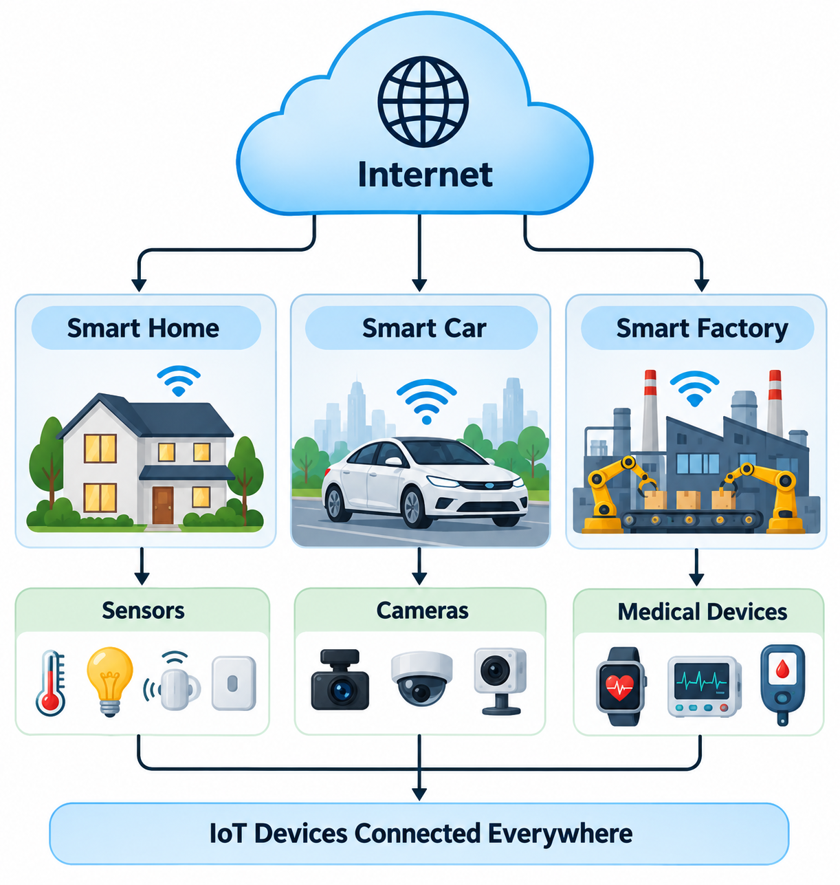
INTRODUCTION
The Internet of Things (IoT) is a network of interconnected physical devices embedded with sensors, software, and communication technologies that enable them to collect, exchange, and process data over the Internet with minimal human intervention.
IoT has become an integral part of modern applications such as:
  Smart Homes
  Smart Cities
  Healthcare
  Industrial Automation
  Agriculture
  Transportation
As the number of connected devices continues to grow, securing IoT networks has become increasingly important due to the large attack surface exposed to cyber threats.

Slide 4
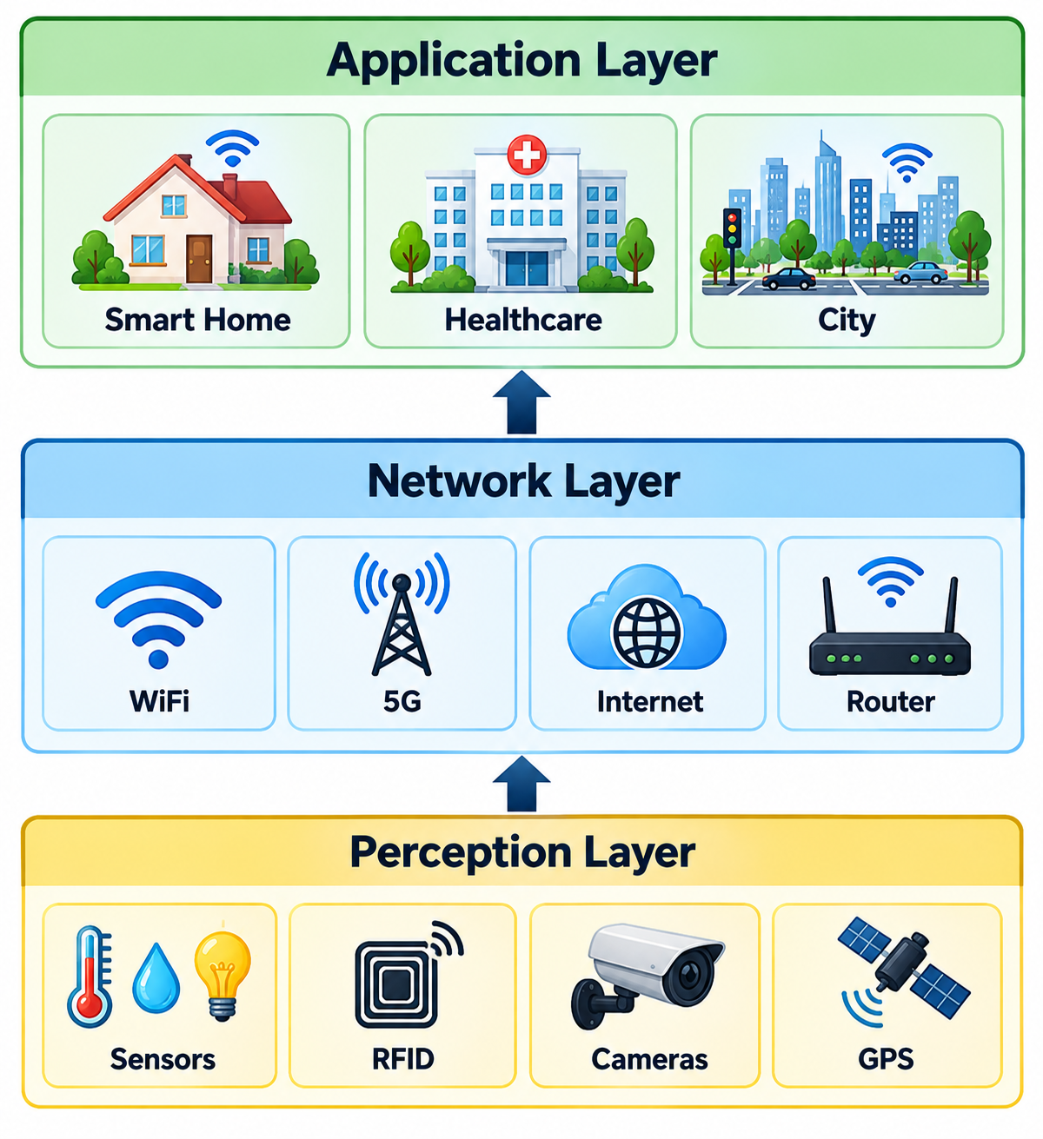
INTRODUCTION
Perception Layer
Physical layer of IoT
Collects data using sensors and RFID devices
Generates raw information
Network Layer
Transfers data between devices and servers
Uses communication technologies such as Wi-Fi, Bluetooth, ZigBee, and 5G
Application Layer
Delivers services to end users
Examples include healthcare, smart cities, agriculture, and industrial automation
Since all communication passes through the network layer, attackers often target IoT traffic, making intrusion detection essential.

Slide 5
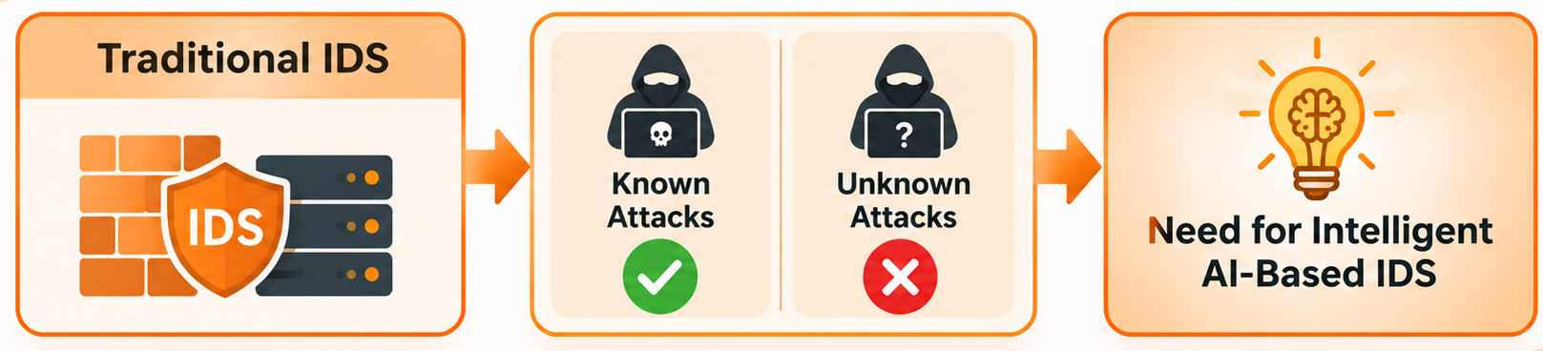
INTRODUCTION
INTRUSION DETECTION SYSTEM
Signature-Based IDS | Rule-Based IDS
Detects known attacks using predefined signatures | Detects attacks using manually defined security rules
Highly effective for previously identified attacks | Effective for policy violations and predefined behaviors
Requires frequent signature updates | Requires continuous rule maintenance
Cannot detect zero-day attacks | Difficult to adapt to new attack patterns
Limited scalability | High administrative effort

Slide 6
OBJECTIVE
To collect and preprocess an IoT network traffic dataset containing both normal and malicious traffic, including different attack types for binary and multi-class classification.
To develop and compare Machine Learning and Deep Learning models for accurately detecting malicious IoT network traffic.
To evaluate the developed intrusion detection models using metrics such as Accuracy, Precision, Recall, F1-Score, ROC-AUC, and False Alarm Rate and develop a visual dashboard to monitor and present their performance.

Slide 7
LITERATURE REVIEW
Paper Title | Authors | Methodology | Key Findings | Limitations
Anomaly-based Intrusion Detection System for IoT Application | Mansi Bhavsar, Kaushik Roy, John Kelly, and Odeyomi Olusola | Proposed an anomaly-based IDS using machine learning techniques with feature selection to identify malicious IoT network traffic. | Demonstrated effective detection of both known and unknown attacks with reduced false alarms compared to signature-based IDS. | Focused mainly on anomaly-based detection and did not compare multiple ML and DL models on a large-scale IoT dataset.
A New DDoS Attacks Intrusion Detection Model Based on Deep Learning for Cybersecurity | D. Akgun, S. Hizal, and U. Cavusoglu | Developed a deep learning-based intrusion detection model for identifying DDoS attacks in cybersecurity environments. | Achieved high detection accuracy by automatically learning complex traffic patterns, showing the effectiveness of deep learning for DDoS detection. | Primarily focused on DDoS attacks and did not evaluate multiple learning algorithms or broader IoT attack categories.
A Multi-Class Classification Model on CICIoT2023 using Kolmogorov–Arnold Networks and Tree Ensembles | S. Almahaqeri, M. H. Almourish, A. A. Nasser, A. S. A. Alghawli, A. A. K. Elsayed, and A. N. Alhejoj | Proposed a multi-class intrusion detection framework using Kolmogorov–Arnold Networks (KAN) with Tree Ensemble models on the CICIoT2023 dataset. | Achieved excellent multi-class classification performance by combining advanced neural architectures with ensemble learning. | Focused on KAN and tree ensembles without comparing conventional deep learning models such as CNN and ANN under a unified framework.

Slide 8
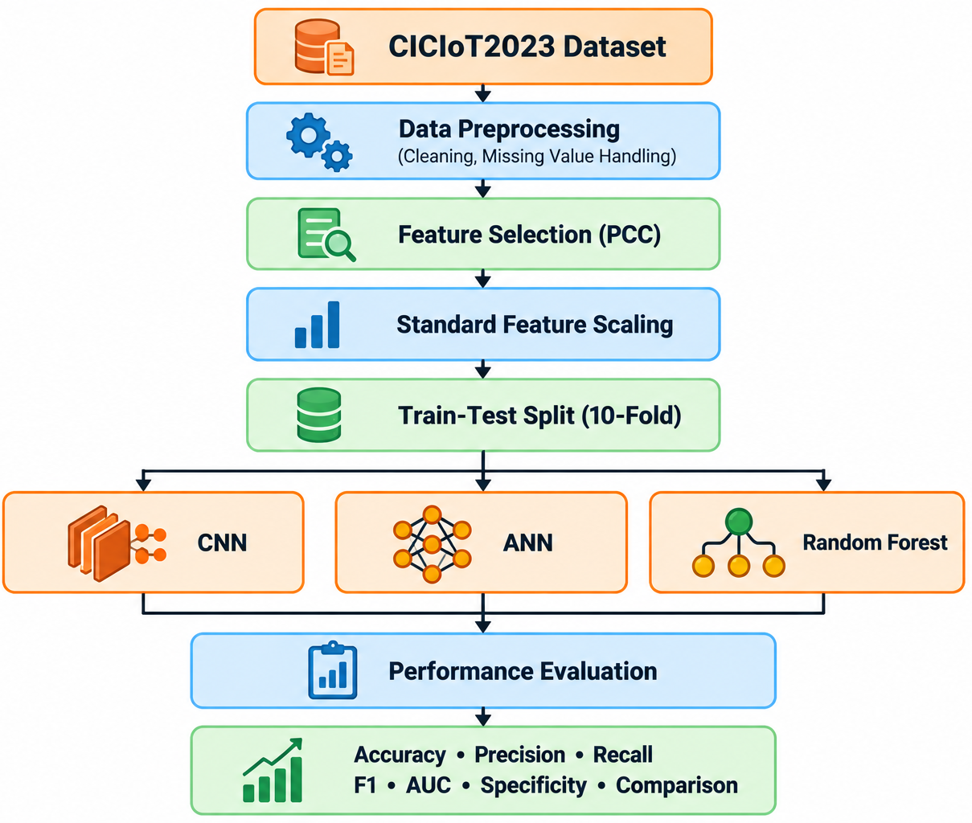
OPERATIONAL FLOW
Stage | Description
Dataset | CICIoT2023 binary dataset (Attack vs Benign)
Preprocessing | Missing value handling, duplicate removal, data cleaning
Feature Selection | Pearson Correlation Coefficient (PCC)
Scaling | StandardScaler
Models | CNN, ANN, Random Forest
Validation | 10-Fold Cross Validation
Evaluation Metrics | Accuracy, Precision, Recall, F1-score, AUC, Specificity

Slide 9
FUNCTIONAL REQUIREMENTS
Requirement | Description
Dataset Loading | Load the CICIoT2023 dataset for intrusion detection.
Data Preprocessing | Clean the dataset by handling missing values, duplicates, and inconsistencies.
Feature Selection | Select the most relevant network traffic features using Pearson Correlation Coefficient (PCC).
Feature Scaling | Standardize the selected features before model training.
Model Training | Train CNN, ANN, and Random Forest models using the processed dataset.
Attack Classification | Classify network traffic into Attack and Benign classes.
Performance Evaluation | Evaluate models using 10-fold Cross Validation and performance metrics.
Result Generation | Generate confusion matrices, ROC curves, training plots, architecture summaries, and comparison reports.

Slide 10
IMPLEMENTATION
DATASET USED
CICIoT2023 Dataset
The proposed Intrusion Detection System (IDS) was developed using the CICIoT2023 dataset, which contains realistic IoT network traffic comprising both benign and malicious activities. The dataset includes various attack categories such as DDoS, DoS, spoofing, reconnaissance, brute-force, and web-based attacks, making it suitable for evaluating AI-based intrusion detection systems.
Key Characteristics
Dataset: CICIoT2023
Classification: Binary (Attack / Benign)
Feature Selection: Pearson Correlation Coefficient (PCC)
Selected Features: 15
Validation Technique: 10-Fold Cross Validation

Slide 11
IMPLEMENTATION
DATA PREPROCESSING & FEATURE ENGINEERING
Data Preprocessing
Feature Scaling
Data Preprocessing Steps :
  Removed duplicate records.
  Handled missing and infinite values.
  Converted attack categories into binary labels.
  Verified dataset consistency.
After feature selection, all selected features were standardized using StandardScaler to ensure they have zero mean and unit variance.
This improves the convergence of neural network models and ensures that all features contribute equally during training.
Feature Selection
The Pearson Correlation Coefficient was used to measure the relationship between each feature and the target class.
Advantages :
Removes irrelevant features.
Reduces dimensionality.
Improves computational efficiency.
Helps prevent overfitting.

Slide 12
IMPLEMENTATION
MODEL DEVELOPMENT
Model | Purpose
CNN | Automatically extracts local feature patterns using convolution operations.
ANN | Learns nonlinear relationships among selected network traffic features.
Random Forest | Uses an ensemble of decision trees to improve classification robustness and reduce overfitting.
Common Training Strategy
Same preprocessed dataset.
Same selected features.
Same evaluation metrics.
10-Fold Cross Validation.
This ensures a fair comparison between all three models.

Slide 13
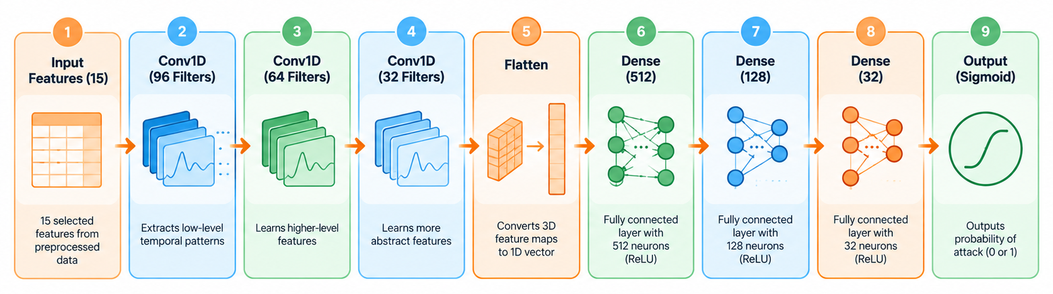
IMPLEMENTATION
CNN ARCHITECTURE
Key Components
Conv1D: Extracts local patterns from sequential feature vectors.
Flatten: Converts feature maps into a one-dimensional vector.
Dense Layers: Learn higher-level feature representations.
Sigmoid Layer: Produces the probability of Attack or Benign.

Slide 14
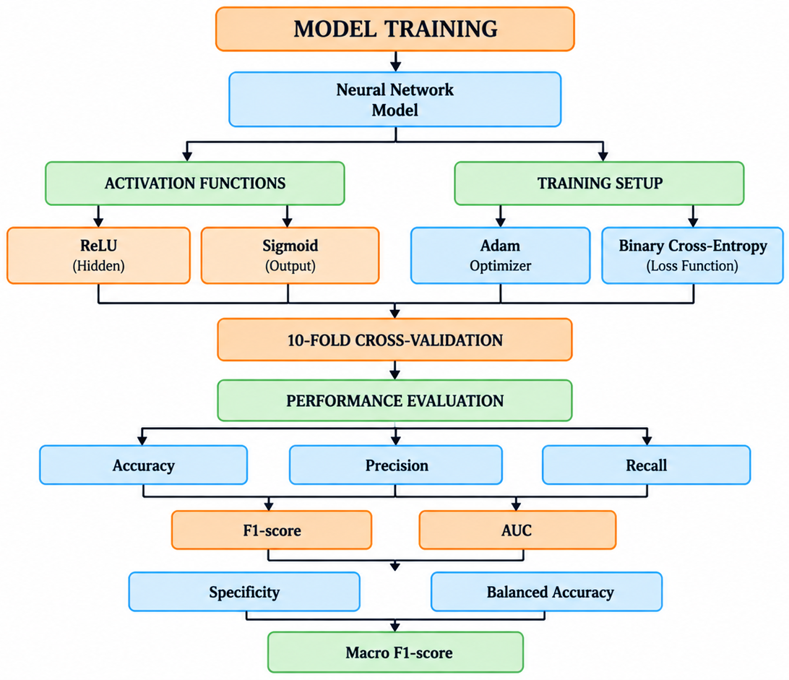
IMPLEMENTATION
TRAINING STRATEGY

Slide 15
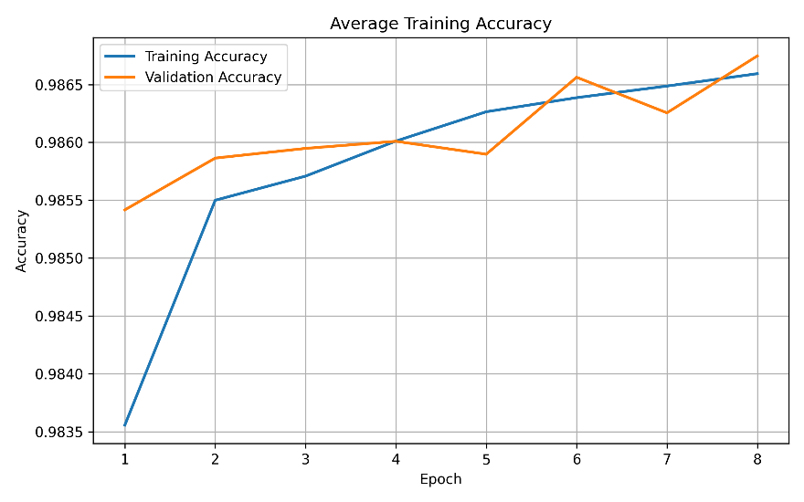
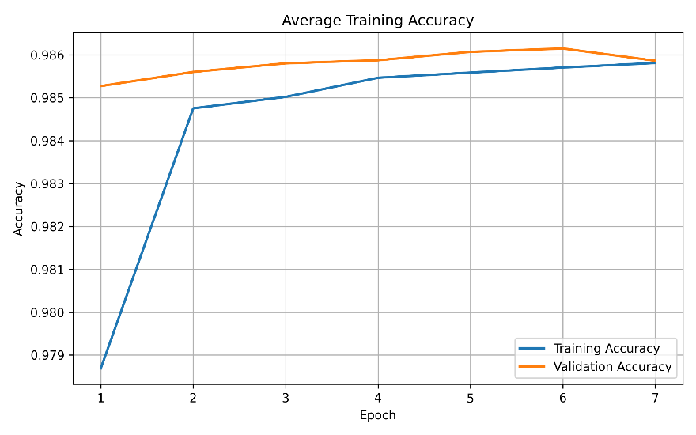
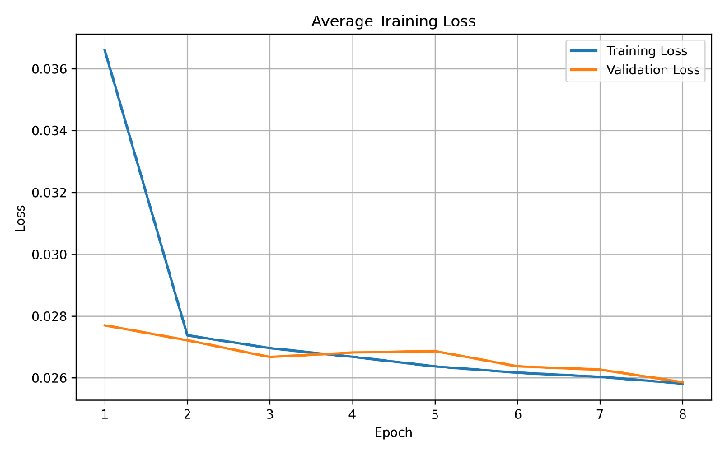
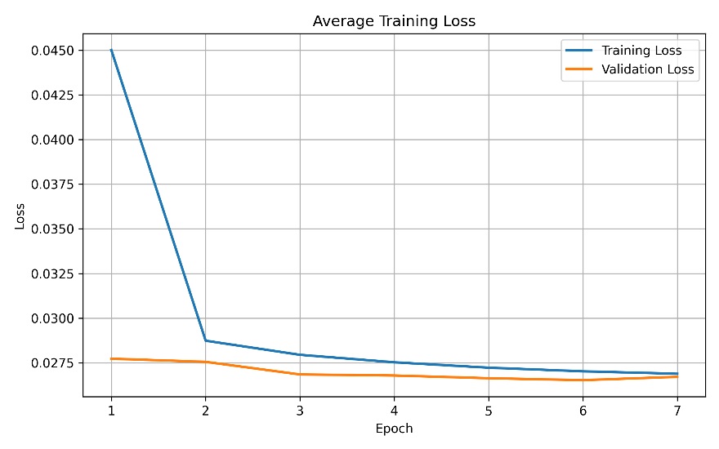
WORK DONE
TRAINING PERFORMANCE
CNN
ANN

Slide 16
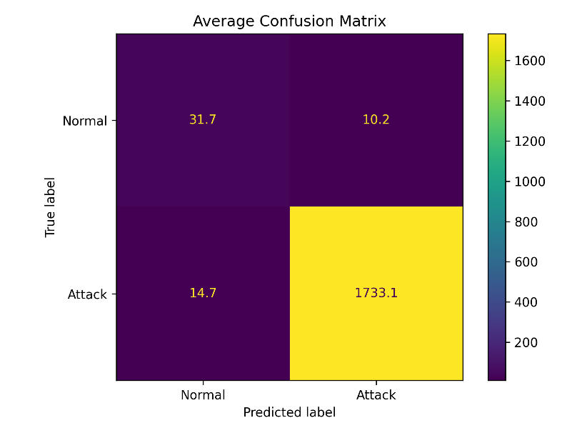
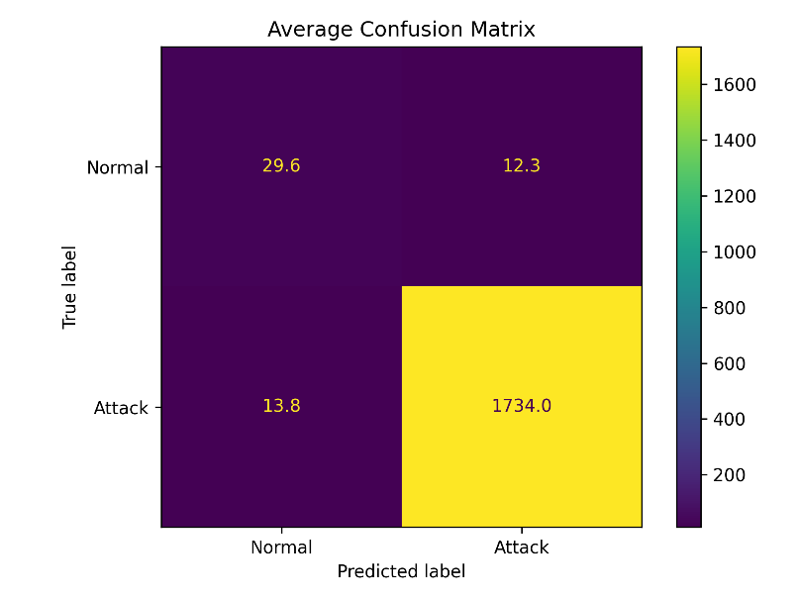
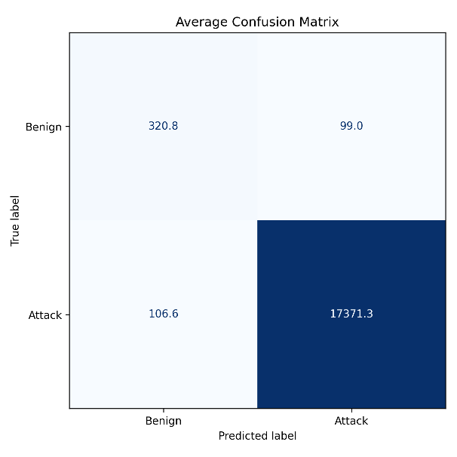
WORK DONE
CONFUSION MATRIX
CNN
ANN
RF

Slide 17
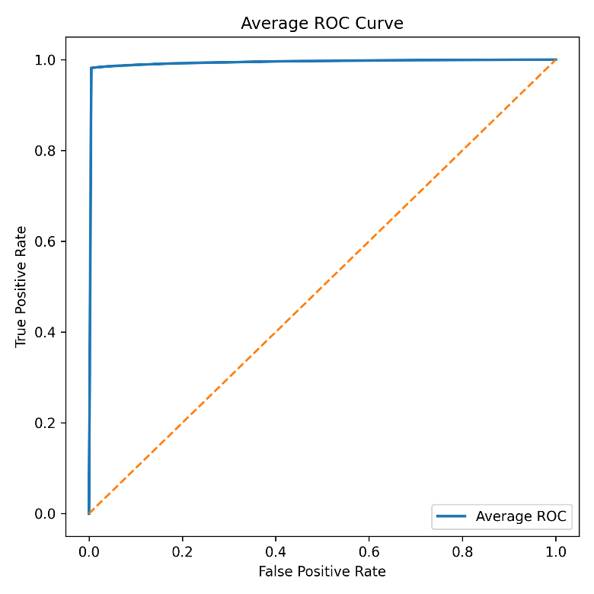

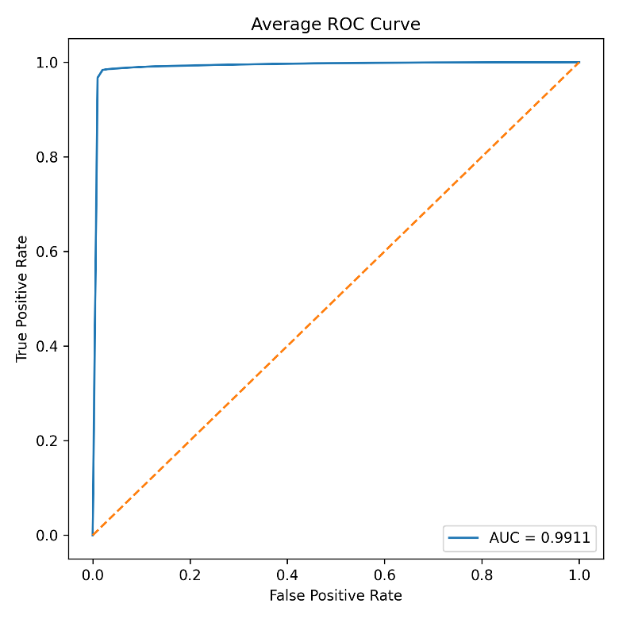
WORK DONE
ROC COMPARISION
CNN
ANN
RF
Model | AUC
CNN | 99.56
ANN | 99.55
RF | 99.55

Slide 18
WORK DONE
PERFORMANCE METRICS COMPARISON
Metric | CNN | ANN | RF
Accuracy | 98.75 | 98.75 | 98.85
Precision | 99.42 | 99.49 | 99.43
Recall | 99.30 | 99.23 | 99.39
F1 | 99.36 | 99.36 | 99.41
AUC | 99.56 | 99.55 | 99.55
Specificity | 75.94 | 78.61 | 76.42

Slide 19
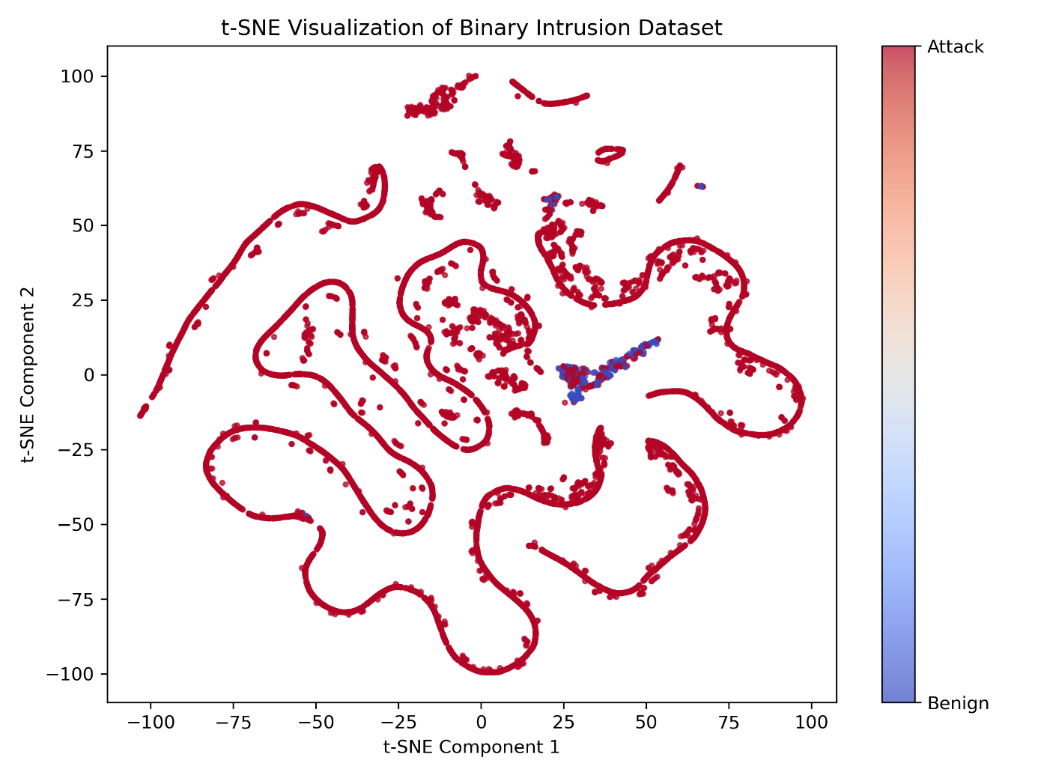
WORK DONE
t – SNE Visualisation

Slide 20
CONCLUSION
CNN
ANN
Random Forest
Excellent Feature Selection.
Highest AUC
Stable learning
Simple Architecture
High Specificity
Low Computational Complexity.
Highest Accuracy
Highest Recall
Best Overall Performance.
Random Forest performed best on structured tabular IoT traffic, whereas CNN demonstrated that deep learning can also achieve competitive performance.

Slide 21
REFERENCES
[1] M. Bhavsar, K. Roy, J. Kelly, and O. Olusola, "Anomaly-Based Intrusion Detection System for IoT Application," Journal of Reliable Intelligent Environments, Springer, 2025.
[2] S. Almahaqeri, M. H. Almourish, A. A. Nasser, A. S. A. Alghawli, A. A. K. Elsayed, and A. N. Alhejoj, "A Multi-Class Classification Model on CICIoT2023 Using Kolmogorov–Arnold Networks and Tree Ensembles," Scientific Reports, vol. 16, art. no. 47399, Apr. 2026, doi: 10.1038/s41598-026-47399-5.
[3] D. Akgun, S. Hizal, and U. Cavusoglu, "A New DDoS Attacks Intrusion Detection Model Based on Deep Learning for Cybersecurity," Computers & Security, 2025.
[4] X. Gao, C. Shan, C. Hu, Z. Niu, and Z. Liu, "An Adaptive Ensemble Machine Learning Model for Intrusion Detection," IEEE Access, vol. 7, pp. 82512–82521, 2019, doi: 10.1109/ACCESS.2019.2923640.
[5] N. G. Pardeshi and D. V. Patil, "Binary and Multiclass Classification Intrusion Detection System Using Benchmark NSL-KDD and Machine Learning Models," in Proceedings of the International Conference on Data Science and Network Security (ICDSNS), 2024, pp. 1–6.
[6] A. Hinojosa and N. E. Majd, "Edge Computing Network Intrusion Detection System in IoT Using Deep Learning," in Proceedings of the IEEE International Conference on Computer Science and Information Systems, 2024, pp. 1–6.
[7] A. Berguiga, A. Harchay, and A. Massaoudi, "HIDS-IoMT: A Deep Learning-Based Intelligent Intrusion Detection System for the Internet of Medical Things," IEEE Access, vol. 13, pp. 32145–32158, 2025, doi: 10.1109/ACCESS.2025.3543127.
[8] N. Hassouneh and S. Al-Sharaeh, "Intrusion Detection in IoT Networks Using LSTM Deep Learning Models with the UNSW-NB15 Dataset," in Proceedings of the IEEE International Conference on Platform Technology and Service, 2024, pp. 1–6.
[9] A. Alsarhan, M. Barhoush, B. Khassawneh, M. Al-Essa, M. Aljaidi, and Q. Al-Na'amneh, "Deep Learning Utilization for DDoS Attack Detection with Federated Learning: A Case Study on the CICDDoS2019 Dataset," Engineering, Technology & Applied Science Research, vol. 16, no. 1, pp. 31203–31208, Feb. 2026, doi: 10.48084/etasr.14119.
[10] Amali, A. A. Sulaeman, A. M. Rifa'i, S. Raharjo, and E. Utami, "Detecting DDoS Attacks Through Decision Tree Analysis: An EDA Approach with the CIC DDoS 2019 Dataset," in Proceedings of the International Conference on Information Technology and Computer Science, 2024, pp. 1–6.

Slide 22
THANK YOU

