Slide 1
K-Nearest Neighbour(KNN) Algorithm
K‑Nearest Neighbor (KNN) is a simple and widely used machine learning technique for classification and regression tasks.
It is one of the popular and simplest classification and regression classifiers used in machine learning today.
KNN works on a simple principle i.e Objects that are similar to each other are likely to belong to the same group.
For classification problems, a class label is assigned on the basis of a majority vote i.e. the label that is most frequently represented around a given data point
Regression problems use a similar concept as classification problem, but in this case, the average the k nearest neighbors is taken to make a prediction about a classification.

Slide 2
Basic Idea of KNN
We have students classified based on their:
Hours studied
Attendance
We want to predict whether a new student will Pass or Fail using KNN
How KNN algorithm do this task?
It calculates the distance between the new student and all existing students
Finds the K nearest students.
Check their classes
Assign the class that occurs most frequently

Slide 3
Continued
Example
Suppose K = 5 and the nearest neighbors are
There are: Pass = 4 , Fail = 1
Therefore:✅ Prediction = PASS
This is called majority voting.
Student Name | Result
Student 1 | Pass
Student 2 | Pass
Student 3 | Fail
Student 4 | Pass
Student 5 | Pass

Slide 4
'K' in K Nearest Neighbour
In the KNN algorithm “K” is just a number that tells the algorithm how many nearby points or neighbors to look at when it makes a decision.
Example: Imagine you're deciding which fruit it is based on its shape and size. You compare it to fruits you already know.
If K = 3, the algorithm looks at the 3 closest fruits to the new one.
If 2 of those 3 fruits are apples and 1 is a banana, the algorithm says the new fruit is an apple because most of its neighbors are apples.

Slide 5
Continued
Statistical Methods for Selecting K
Cross-Validation
Elbow Method
Odd Values of K

Slide 6
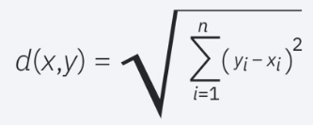
Distance Metrics Used in KNN Algorithm
KNN uses distance metrics to identify nearest neighbor, these neighbors are used for classification and regression task. To identify nearest neighbor we use below distance metrics:
Euclidean Distance
Euclidean distance is defined as the straight-line distance between two points in a plane or space
It is like the shortest path you would walk if you were to go directly from one point to another

Slide 7

Continued
2. Manhattan Distance
This is the total distance you would travel if you could only move along horizontal and vertical lines like a grid or city streets.
It’s also called "taxicab distance" because a taxi can only drive along the grid-like streets of a city.

Slide 8

Continued
3. Minkowski Distance
Minkowski distance is essentially a flexible formula that can represent either Euclidean or Manhattan distance depending on the value of p.
when p=2, it becomes the same as the Euclidean distance formula and when p=1, it turns into the Manhattan distance

Slide 9
Working of KNN algorithm
Step 1: Selecting the optimal value of K
K is the number of nearest neighbors considered for prediction.
Step 2: Calculating distance
Distance is calculated between data points in the dataset and target point
Step 3: Finding Nearest Neighbors
The k data points with the smallest distances to the target point are nearest neighbors.
Step 4: Make the prediction
For classification: Select the class with the majority vote
For regression: Calculate the average value of the nearest neighbors

Slide 10
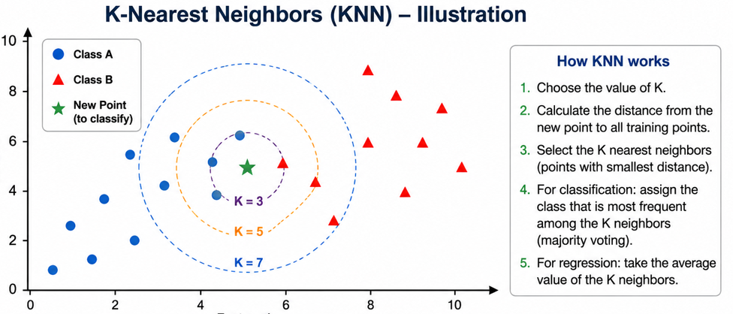
Continued

Slide 11
Applications, Advantage and Dis-advantage
Applications
Spam Detection
Speech Recognition
Data preprocessing
Recommendation Engines
Advantages
Easy to implement
Adapts easily
Few parameters
No training step
Dis-advantages
Slow with large data
Can Overfit
Struggles with many features
Curse of Dimensionality

