Slide 1
Abstract Data Type (ADT):

Slide 2
Abstract Data Type (ADT):
Data types such as int, float, double, long, etc. are considered to be in-built data types and we can perform basic operations with them such as addition, subtraction, division, multiplication, etc.
Now there might be a situation when we need operations for our user-defined data type which have to be defined.
These operations can be defined only as and when we require them.
So, in order to simplify the process of solving problems, we can create data structures along with their operations, and such data structures that are not in-built are known as Abstract Data Type (ADT).

Slide 3
Abstract Data type (ADT) is a type (or class) for objects whose behavior is defined by a set of values and a set of operations.
The definition of ADT only mentions what operations are to be performed but not how these operations will be implemented.
It does not specify how data will be organized in memory and what algorithms will be used for implementing the operations. It is called “abstract” because it gives an implementation-independent view.
The process of providing only the essentials and hiding the details is known as abstraction.

Slide 4
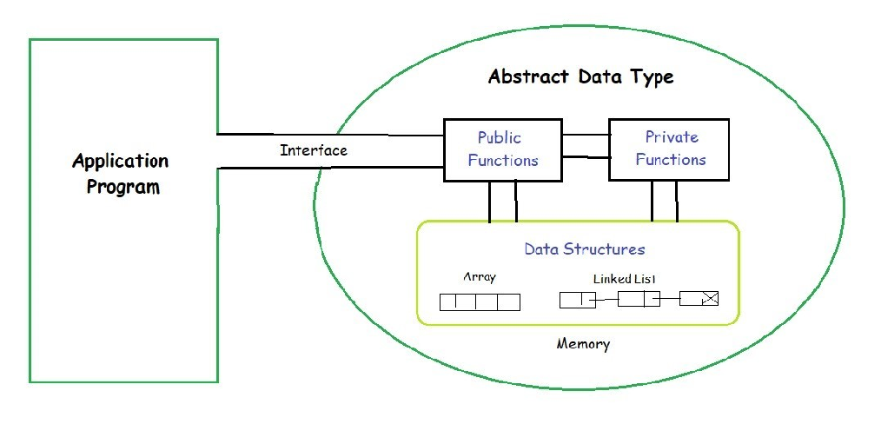

Slide 5
List ADT in Data Structures
One of the most common forms of data organization in computer programs is the ordered or linear list, which is often written as a = (a1,a2,... An) a_{i} ’s are referred to as atoms and they are chosen from some set. The The null or empty list has n = 0 elements.
A List ADT (Abstract Data Type) is a sequential collection of elements that maintains a specific order and supports a defined set of operations without revealing its internal implementation.
It focuses on what operations can be performed rather than how they are implemented, allowing flexibility in using arrays, linked lists, or other structures underneath.

Slide 6
Key Characteristics
Ordered Collection: Elements are stored in a sequence.
Position-based Access: Items can be accessed or modified by their position.
Implementation Independence: Can be implemented using arrays, linked lists, etc., without affecting external usage.
Common Operations
get(pos) – Retrieve the element at a given position.
insert(pos, element) – Add an element at a specific position.
remove(element) – Delete the first occurrence of a given element.
removeAt(pos) – Remove the element at a specific position.
replace(pos, element) – Replace the element at a given position.
size() – Return the number of elements.
isEmpty() – Check if the list is empty.
isFull() – Check if the list is full (relevant for fixed-size implementations).
Search(element) – Search for the given element

Slide 7
Advantages
Encapsulation & Abstraction – Hides implementation details.
Flexibility – Can switch between array or linked list internally.
Modularity – Easy to integrate with other ADTs.
Limitations
Overhead – May require extra memory or processing.
Complexity – Implementation can be intricate for dynamic resizing.
This makes the List ADT a foundational concept in data structures, widely used in algorithms and application development.

Slide 8
A linked list is a type of linear data structure individual items are not necessarily at contiguous locations. The individual items are called nodes and connected with each other using links.
A node contains two things first is data and second is a link that connects it with another node.
The first node is called the head node and we can traverse the whole list using this head and next links.

Slide 9
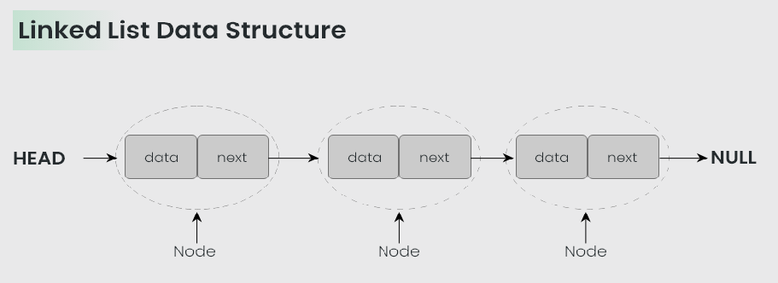

Slide 10
A big benefit with using linked lists is that nodes are stored wherever there is free space in memory, the nodes do not have to be stored contiguously right after each other like elements are stored in arrays.
Another nice thing with linked lists is that when adding or removing nodes, the rest of the nodes in the list do not have to be shifted.

Slide 11
STACKS AND QUEUES :
A stack is an ordered list in which all insertions and deletions are made at one end, called the top. A queue is an ordered list in which all insertions take place at one end, the rear, whereas all deletions take place at the other end, the front.
The operations of a stack imply that if the elements A, B,C,D,and E are inserted into a stack, in that order, then the first element to be removed (deleted) must be E. Equivalently we say that the last element to be inserted into the stack is the first to be removed. Stacks are referred to as Last In First Out (LIFO) lists.

Slide 12
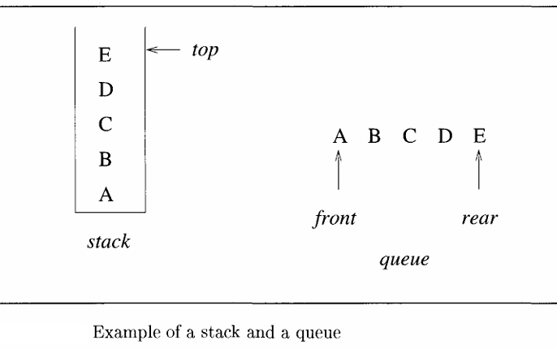

Slide 13
The simplest way to represent a stack is by using a one-dimensional array, say stack[0..n-1], where n is the maximum numberof allowable entries.
The first or bottom element in the stack is stored at stack[0], the second at stack[1],and the ith at stack[i], Associated with the array is a variable, typically called top, which points to the top element in the stack. To test whether the stackis empty, we ask "if (top < 0)". If not, the top most element is at stack[top]. Checking whether the stack is full can be done by asking "if (top > n)”.

Slide 14
Two more substantial operations are inserting and deleting elements. Thecorresponding algorithms are Add and Delete. Each execution of Add or Delete takes a constant amountof time and is independent of the number of elements in the stack.
Another way to represent a stack is by using links (or pointers). A node is a collection of data and link information. A stack can be represented by using nodes with two fields, possibly called data and link. The data field of each node contains an item in the stack and the corresponding link field points to the node containing the next item in the stack. The link field of the last node is zero, for we assume that all nodes have an address greater than zero.

Slide 15
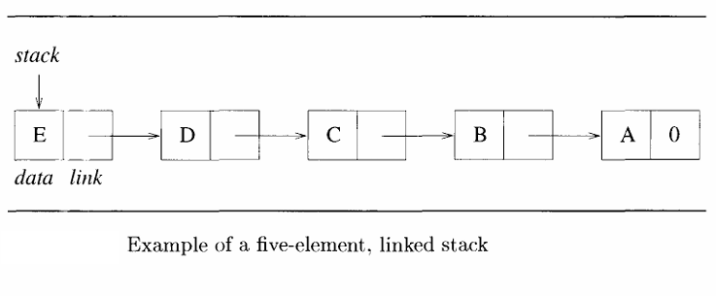

Slide 16
Queues:
The operations of a queue require that the first element that is inserted into the queue is the first one to be removed. Thus queues are known as FirstIn FirstOut (FIFO) lists.
An efficient queue representation can be obtained by taking an array q[0 : n -1]and treating it as if it were circular.
Elements are inserted by increasing the variable rear to the next free position. When rear = n-1, the next element is entered at q[0] in case that spot is free.

Slide 17
The variable front always points one position counter clockwise from the first element in the queue. The variable front= rear if and only if the queue is empty and we initially set front:=rear :=0.
Figure illustrates two of the possible configurations for a circular queue containing the four elements J1 to J4 with n >4.

Slide 18
To insert an element(enqueue), it is necessary to move rear one position clockwise. This can be done using the code
if (rear= n-1) then rear :=0;
else rear :=rear + 1;

Slide 19
A more elegant way to do this is to use the built-in modulo operator which computes remainders. Before doing an insert,we increase the rear pointer by saying
rear := (rear + 1) mod n;.
Similarly, it is necessary to move front one position clockwise each time a deletion(dequeue) is made.
An examination of given Algorithm shows that by treating the array circularly, addition and deletion for queues can be carried out in a fixed amount of time or O(1)

Slide 20
One feature that is to be noted in these two algorithms is that the test for queue full in AddQ and the test for queue empty in DeleteQ are the same.
In the case of AddQ, however, when
front= rear, there is actually one space free, q[rear], since the first element in the queue is not at q[front]but is one position clockwise from this point.

Slide 21
However, if we insert an item there, then we cannot distinguish between the cases full and empty, since this insertion leaves
front = rear.
To avoid this, we signal queue full and permit a maximum of n -1 rather than n elements to be in the queue at any time.

Slide 22
Oneway to use all n positions is to use another variable, tag, to distinguish between the two situations; that is, tag = 0 if and only if the queue is empty. This however slows down the two algorithms.
Sincethe AddQ and DeleteQ algorithms are used many times in any problem involving queues, the loss of one queue position is more than madeup by the reduction in computing time.

Slide 23
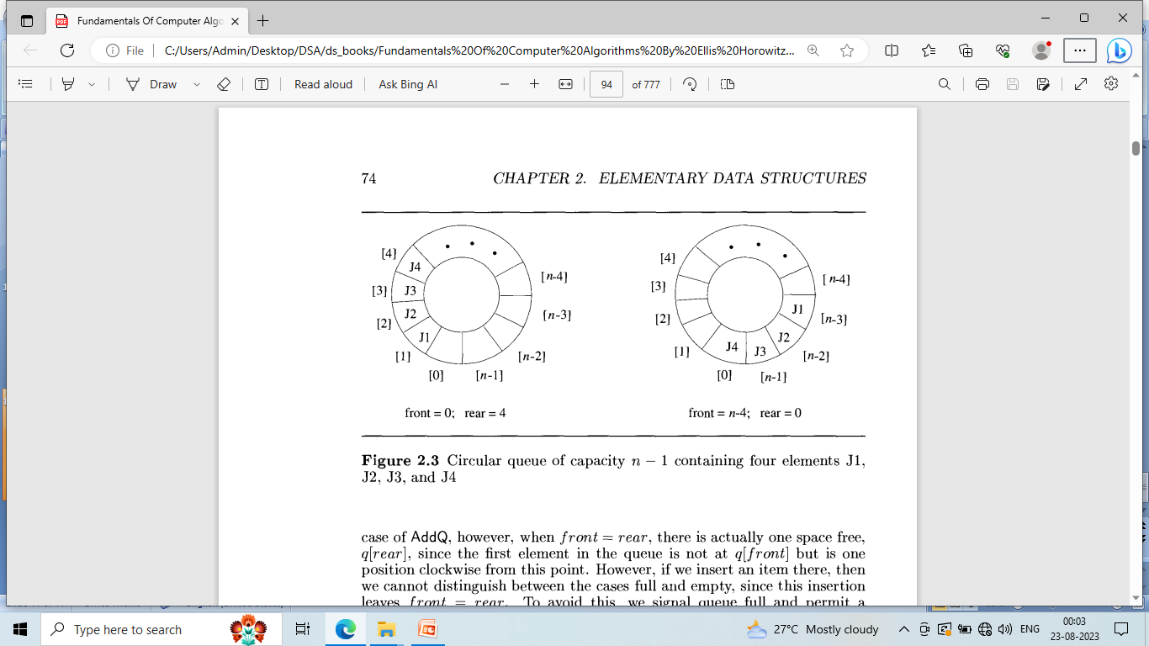

Slide 24
Another way to represent a queue is by using links. Figure shows a queue with the four elements A, B,C, and D entered in that order.
As with the linked stack example, each node of the queue is composed of the two fields data and link.
A queue is pointed at by two variables,front and rear.
Deletions are made from the front, and insertions at the rear. Variable front= 0 signals an empty queue.

Slide 25
