Slide 1
Performance Analysis

Slide 2
Time Complexity
The time T(P) taken by a program P is the sum of the compile time and the run (or execution)time.
The compile time does not depend on the instance characteristics. Also, we may assume that a compiled program will be run several times without recompilation.
Consequently, we concern ourselves with just the runtime of a program.This run time is denoted by
tp (instancecharacteristics)

Slide 3
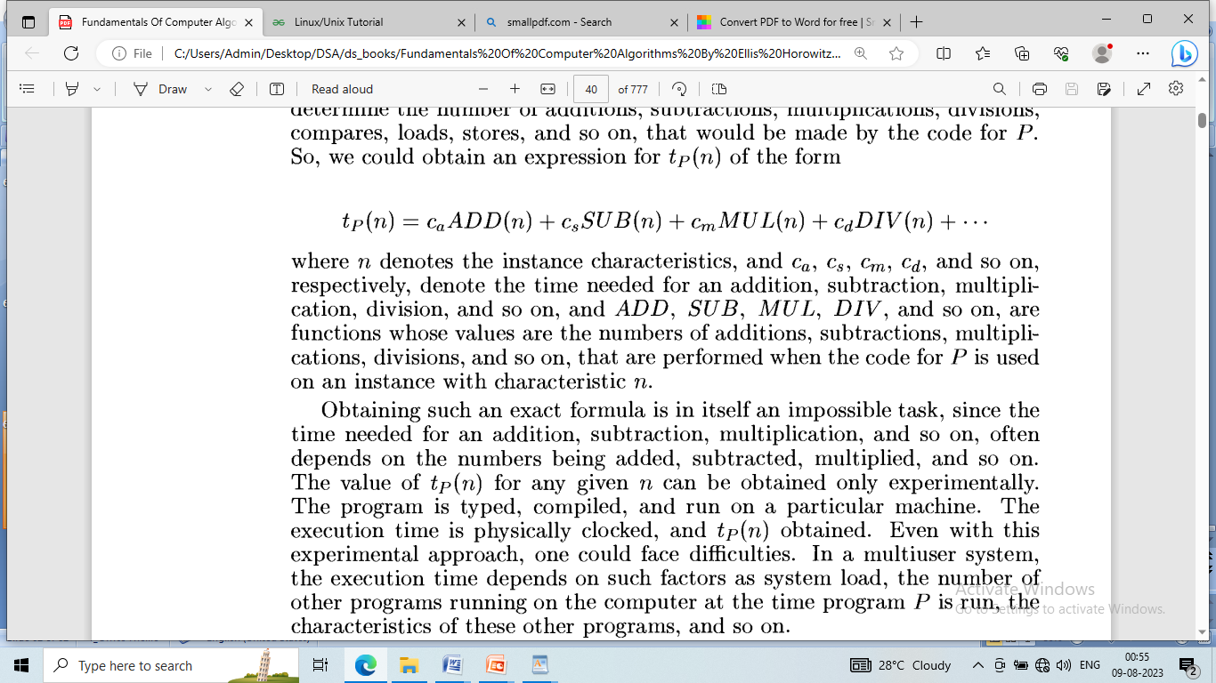

Slide 4
Obtaining such an exact formula is in itself an impossible task, since the time needed for an addition, subtraction, multiplication, and soon, often depends on the numbers being added, subtracted, multiplied, and so on.
The value of t_{p}(n) for any given n can be obtained only experimentally. The program is typed, compiled, and run on a particular machine. The execution time is physically clocked, and t_{p}(n) obtained. Even with this experimental approach, one could face difficulties.

Slide 5
In a multiuser system, the execution time depends on such factors as system load, the number of other programs running on the computer at the time program P is run, the characteristics of these other programs, and so on.

Slide 6
Given the minimal utility of determining the exact number of additions, subtractions, and so on, that are needed to solve a problem instance with characteristics given by n, we might as well lump all the operations together (provided that the time required by each is relatively independent of the instance characteristics) and obtain a count for the total number of operations. We can go one step further and count only the number of program steps.

Slide 7
A program step is loosely defined as a syntactically or semantically meaningful segment of a program that has an execution time that is independent of the instance characteristics.
For example, the entire statement :
return a+ b+b*c+(a+b-c)/(a+ b) + 4.0
could be regarded as a step since its execution time is independent of the instance characteristics
(this statement is not strictly true, since the time for a multiply and divide generally depends on the numbers involved in the operation)

Slide 8
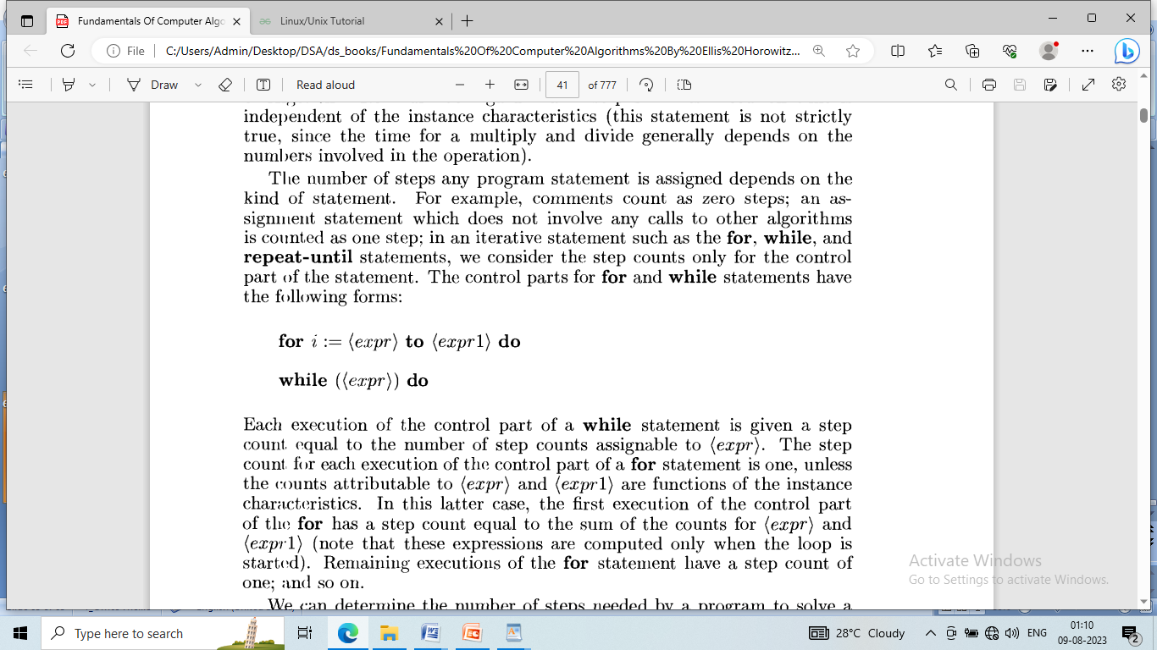

Slide 9
The number of steps any program statement is assigned depends on the kind of statement. For example, comments count as zero steps; an assignment statement which does not involve any calls to other algorithms is counted as one step; in an iterative statement such as the for, while, and repeat-until statements, we consider the step counts only for the control part of the statement. The control parts for ‘for’ and ‘while’ statements have the following forms:
for i := <expr> to <expr1> do
while << expr>> do

Slide 10
Each execution of the control part of a while statement is given a step count, equal to the number of step counts assignable to (expr).
The step count for each execution of the control part of a for statement is one,unless the counts attributable to (expr) and (expr1) are functions of the instance characteristics.
In this latter case, the first execution of the control part of the for has a step count equal to the sum of the counts for (expr)and (expr1) (note that these expressions are computed only when the loop is started).
Remaining executions of the for statement have a step count of one; and so on

Slide 11
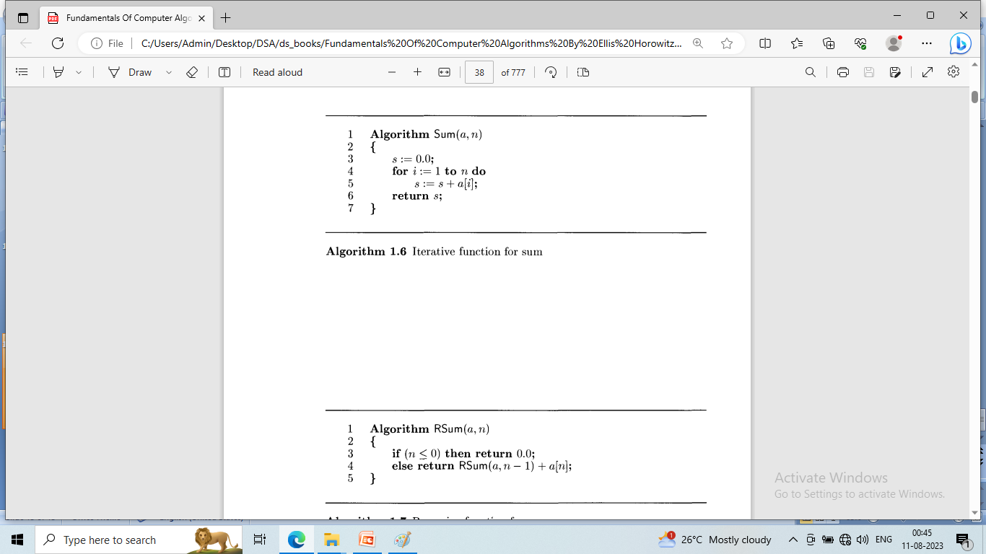

Slide 13
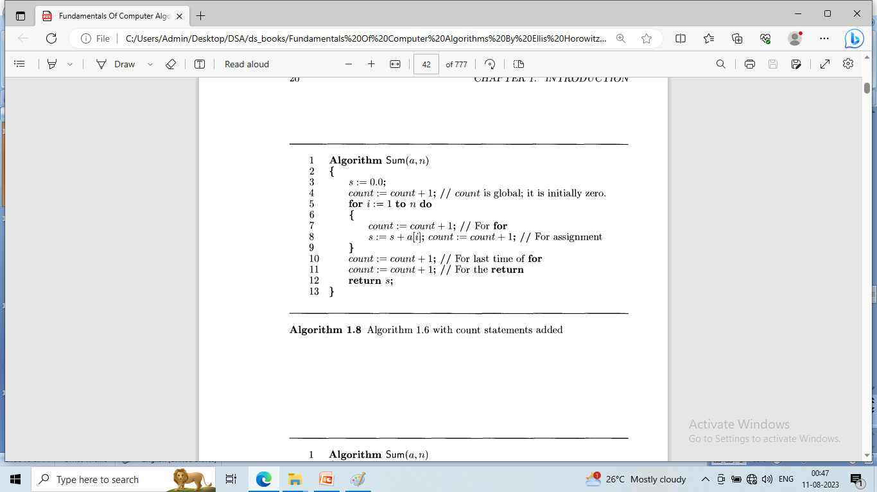

Slide 14
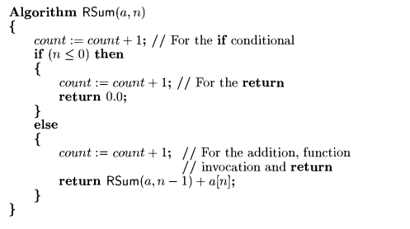

Slide 15
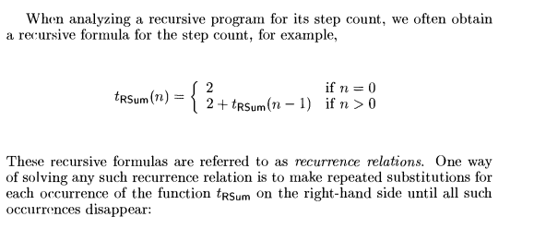

Slide 16
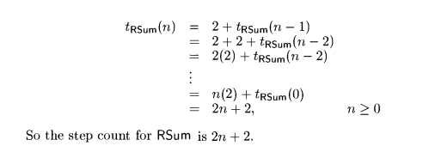

Slide 17
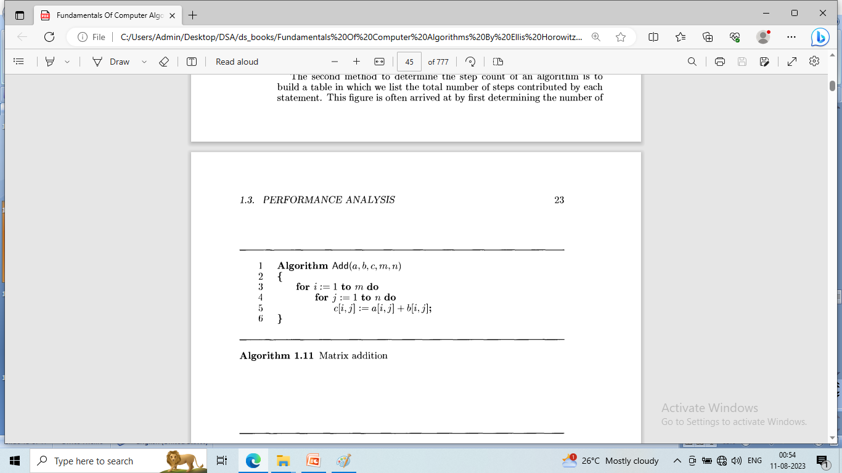

Slide 18
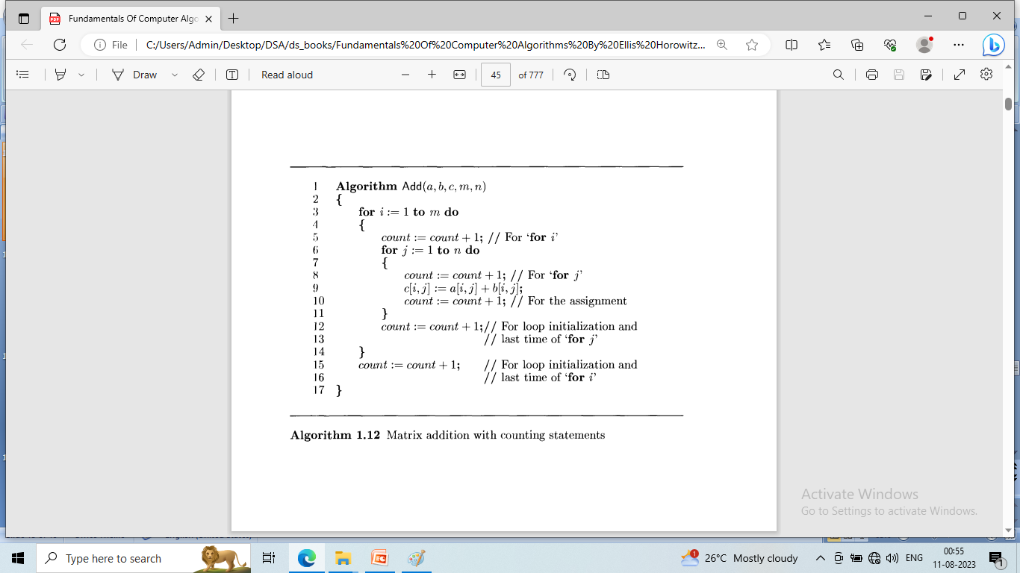

Slide 19
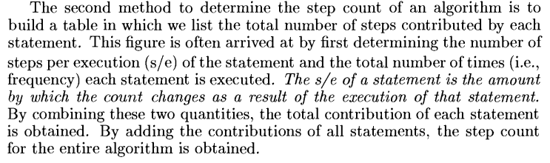

Slide 20
The second method to determine the step count of an algorithm is to build a table in which we list the total number of steps contributed by each statement.
This figure is often arrived at by first determining the number of steps per execution (s/e)of the statement and the total number of times(i.e., frequency) each statement is executed.
The s/e of a statement is the amount by which the count changes as a result of the execution of that statement. By combining these two quantities, the total contribution of each statement is obtained. By adding the contributions of all statements, the step count for the entire algorithm is obtained.

Slide 21
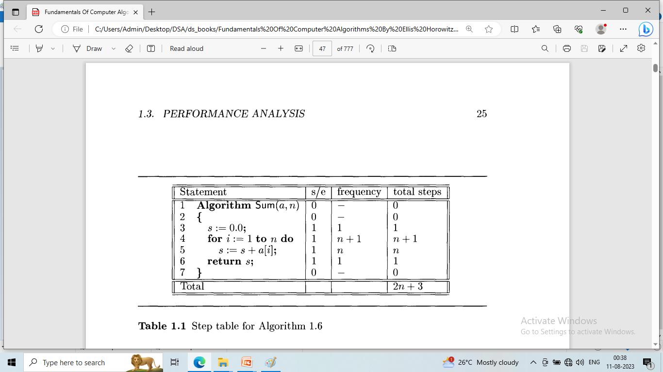

Slide 22
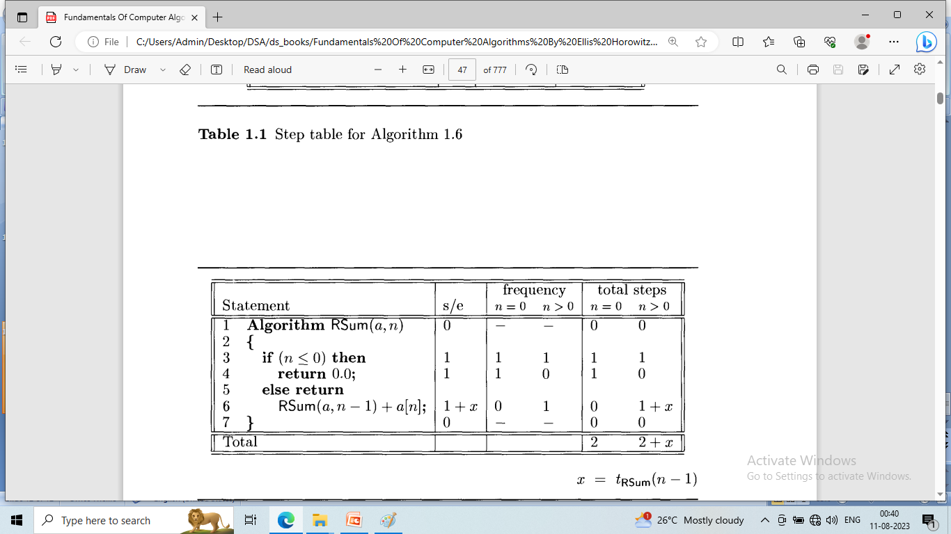

Slide 23
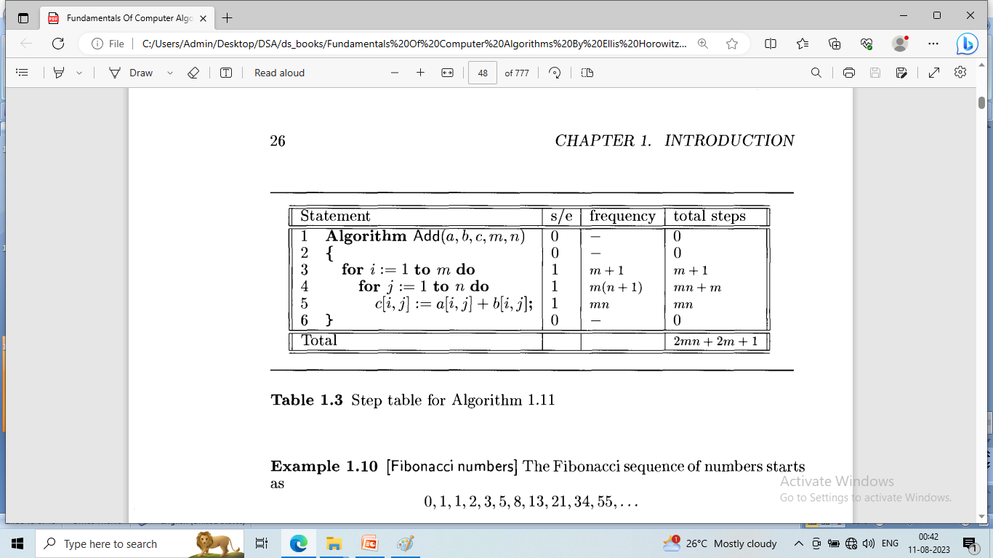

Slide 24
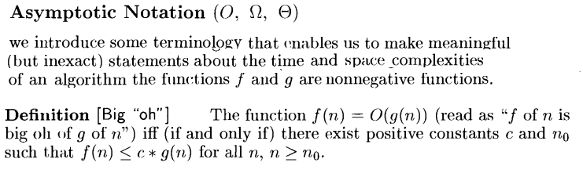

Slide 25
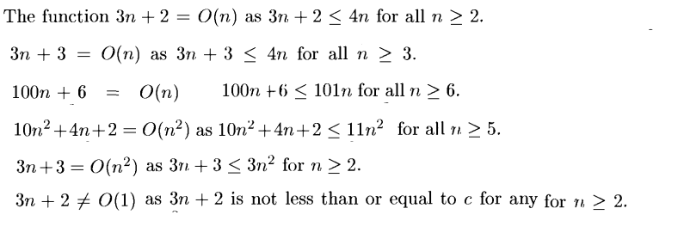

Slide 26
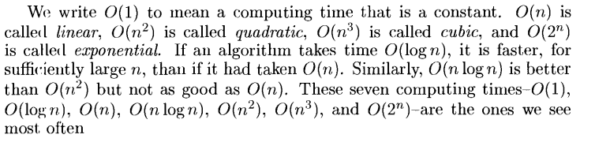

Slide 27
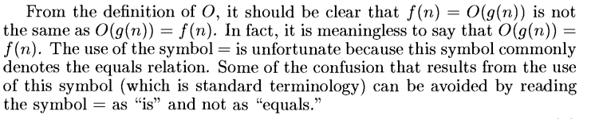

Slide 28

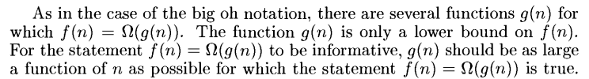

Slide 29
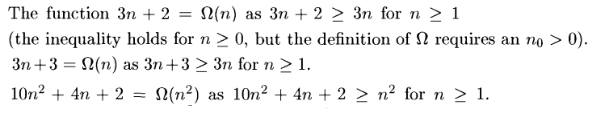

Slide 30

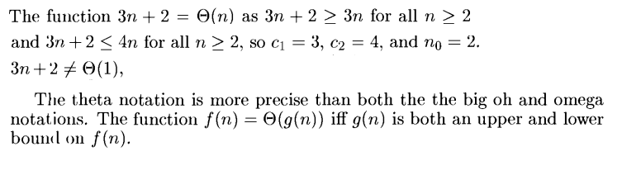

Slide 31
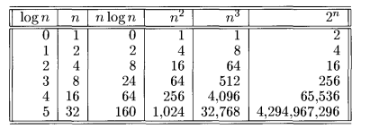

Slide 32
