Slide 1
Scheduling
Problem definition:
  One CPU with a number of processes/task. Only one process can use the CPU at a time and each process/task is specialized in one job. What’s the best way to organize the processes (schedule them) ?
  How will the CPU time be divided among the processes/task competing to use it ?

Slide 2
Scheduling
A set of policies and mechanisms built into the operating system that govern the order in which the work to be done by a computer system is completed.
Primary objective of scheduling is to optimize system performance.

Slide 3
Scheduling - Goals
Utilization / Efficiency
  Keep the CPU busy 100% of the time with useful work
Throughput
  Maximize the number of jobs processed per hour
Turnaround time
  From time of submission to the time of completion, minimize the time batch users must wait for output
Waiting time
  Sum of times spent in ready queue - Minimize this
Response Time
  Time from submission till the first response is produced, minimize response time for interactive users
Fairness
  Make sure each process gets a fair share of the CPU

Slide 4
Schedulers
Multiprogramming : CPU utilization maximized.
Time sharing : switch CPU among process so frequently that users can interact with each program while it running.
Scheduling
  Assigning a particular process for CPU usage
Types
  Long term
  Short Term
  Medium term

Slide 5
Schedulers
OS module that selects the next job to be admitted into system / next process to run.
Piece of OS code that decides priorities of processes and how long each will run
A process migrates between the various scheduling queues throughout its lifetime.
OS selects processes from queues.
Selection of processes - by appropriate schedulers.

Slide 6
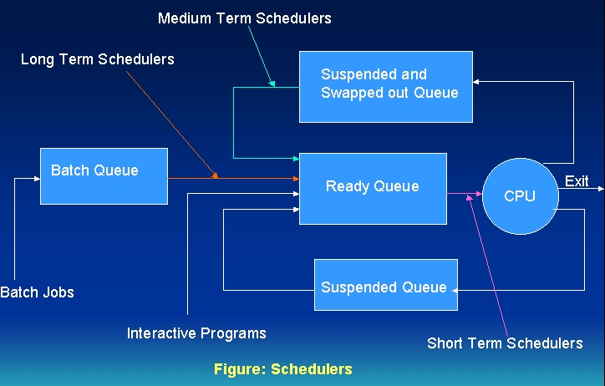
Schedulers…

Slide 7
Schedulers…
Long –term scheduler or Job scheduler : selects processes and loads them into memory for execution.
Short – term scheduler or CPU scheduler: selects from among the processes that are ready to execute and allocates the CPU to one of them.
Primary distinction between the two: Frequency of their execution.
Short – term scheduler must select a new process for the CPU frequently.
Process may execute for few milliseconds before waiting for I/O request.
Executes at least once for every 100 m.sec.
If it takes 10ms to decide to execute a process for 100ms, then 10(100+10) = 9% of CPU is being used (wasted) for scheduling the work.

Slide 8
Schedulers…
Long –term scheduler - executes much less frequently.
Takes time for creation of new process in the system.
Controls the degree of multiprogramming - the no. of processes in memory.
If degree of multiprogramming is stable, then avg. no of process creation must be equal to the avg. departure rate of processes leaving the system.
Long – term scheduler to be invoked only when process leaves the system.
Selects a good process mix of I/O – bound and CPU- bound processes.

Slide 9
Scheduling algorithms
Notes:
11-2-2012

Slide 10
Scheduling algorithms
Non-Preemptive:
Once a process enters running state, it is not removed from processor until it completes its service time.
Context switch only when process terminates or blocks.
Preemptive:
Notion of prioritized computation.
If a new process with higher priority enters ready list, process currently executing removed and returned to ready list.

Slide 11
Recap
Process states
Scheduling - Goals
Schedulers
  Long Term, Short term and medium term
Scheduling algorithm – approaches
  Preemptive and non- preemptive

Slide 12
Scheduling algorithms
FCFS
SJF
Round Robin
SRTN
Multilevel feedback queues

Slide 13

FCFS/ FIFO
One ready queue
OS runs processes at the head of the Q
New processes come in at end of Q
Running process continues till it finishes or performs I/O

Slide 14
FCFS/ FIFO
EXAMPLE DATA:
    Process Arrival Service
    Time Time
    1 0 8
    2 1 4
    3 2 9
    4 3 5
FCFS
P1
P2
P3
P4
0
8
12
21
26
Average turnaround time = ( (8-0) + (12-1) + (21-2) + (26-3) )/4 = 61/4 = 15.25
Problem: One process can monopolize CPU.
Solution: Limit maximum amount of time (time slice) that a process can run without a context switch.

Slide 15
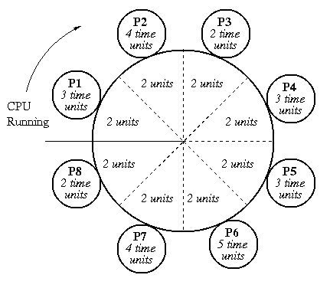
Round Robin
Used mostly on timeshared systems
Allows multiple users slices of the CPU on a “round robin” basis
Majority of users have the same priority
Rule of thumb :
Time slice > CPU burst
Implementation of priorities: run highest priority processes first, use round-robin among processes of equal priority. Re-insert process in run queue behind all processes of greater or equal priority

Slide 16
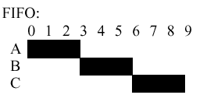
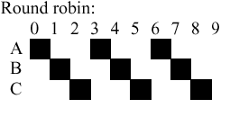
FIFO vs Round robin
Process A finishes after 3 units, B 6, and C 9. The average is (3+6+9)/3 = 6 units
Process A finishes after 7 units, B 8, and C 9, so the average is (7+8+9)/3 = 8 units

Slide 17
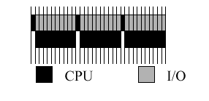
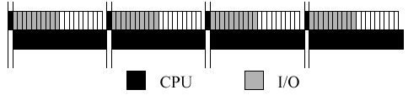
Role of timeslice
Process 1 – I/O bound – uses 1 ms CPU then 10 ms I/O
Process 2 – CPU bound
Two scenarios :
Timeslice : 1 ms
Timeslice : 20 ms

Slide 18

Time Quantum and Context Switch Time
Problem : Round Robin is fair, but uniformly inefficient.
Solution: Introduce priority based scheduling.

Slide 19
Priority based scheduling
Processes are allocated to the CPU on the basis of an externally assigned priority.
Key to the performance of priority scheduling is in choosing priorities for the processes.
Problem: May cause low-priority processes to starve.
Solution: (AGING) Starvation can be compensated if priorities are internally computed. Priority assignment function - amount of time process has been waiting. Longer a process waits, higher its priority . This could eliminate starvation.

Slide 20

Shortest Job First
Sorted according to job size
Shortest job assigned highest priority

Slide 21


Slide 22
SRTN / Shortest time to completion
Priorities are assigned in inverse order of time needed for completion of entire job
Minimizes average turnaround time
Optimal when all jobs arrive simultaneously
Store estimated value in PCB for the current burst, and compare with actual value
Knowledge of future needed
Problem : Starvation of large processes
Solution :: Multi-Level Feedback Queues

Slide 23
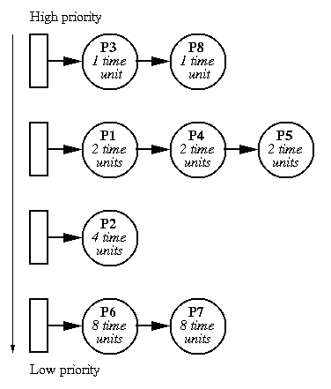
Multilevel feedback Q
Popular in interactive systems
A Q for each priority level
Efficiency and response time tackled
New process added at the end of highest priority Q
  It is alloted single time quantum when it reaches the front
    If it yields CPU within the time quantum, it is moved to the rear
    If not, it is placed at the rear of the next queue down
Dispatcher selects from head of highest priority queue
  A job that “succeeds” moves up
  A job that “fails” moves down
Eg: CTSS in MIT, Fairshare in Unix

Slide 24

Multilevel Feedback Q…

Slide 25
Multilevel Feedback Q…
A process can move between the various queues (aging implemented this way).
Multilevel-feedback-queue scheduler defined by the following parameters:
  number of queues
  scheduling algorithms for each queue
  method used to determine when to upgrade a process
  method used to determine when to demote a process
  method used to determine which queue a process will enter when that process needs service
Problem :High Complexity
Solution : ??

Slide 26
5 jobs P1 through P5 arrive at a computer at almost the same time. Their running times and priorities are given below. Draw Gantt charts and determine the average process turnaround-time and the average waiting time for:
Process CPU Burst Time Priority A.T
P1 10 3 0
P2 5 1 (lowest) 1
P3 4 5 (highest) 2
P4 9 2 3
P5 3 4 3
Round robin scheduling with time slice = 2 time units.
Shortest job first.
Priority scheduling with preemption.
Round robin scheduling with time slice = 2 time units and process switching overhead = 1 time unit.
First come, first served scheduling.

Slide 27
Question
Assume that the following five processes arrive at time 0, 1,2,3 and 4 respectively, with the length of the CPU burst time given in milliseconds:
Process CPU Burst Time
P1 6
P2 13
P3 7
P4 5
P5 15
Consider FCFS, SJF and RR (quantum=4) scheduling algorithms and determine the average turnaround time and average waiting time in each case, with the help of Gantt charts.

Slide 28
Review
Types of processes
Process relationship
Process states
Types of schedulers, difference between them
Scheduling
Criteria to evaluate scheduling algorithms
Role of Time slice

Slide 29
Review
Scheduling with / without
  Preemption
  Priority
Scheduling algorithms

Slide 30
Process Scheduling
END

