Slide 1

DEPARTMENT OF COMPUTER SCIENCE AND ENGINEERING
Project Name:Traffic Mangement
Team Name:Proj_224783_Team_5
Team members:
1.Dhanush J(113321104016)
2.Devanand C(113321104012)
3.Dhanush D(113321104015)
4.Dasetti Mahesh(113321104011)

Slide 2
PROJECT DEFINITION
Traffic Management refers to the systematic planning, control, and coordination of road networks and transportation systems to ensure safe, efficient, and orderly traffic flow.
Traffic Management involves the implementation of various strategies, including traffic signal optimization, road signage, lane management, and congestion mitigation, to improve overall road network performance.
Traffic Management encompasses both short-term interventions, such as managing traffic during events or accidents, and long-term urban planning to address the challenges of growing vehicular traffic in urban areas.

Slide 3
OBJECTIVES
Congestion Reduction: Minimize traffic congestion and delays by optimizing traffic flow, reducing bottlenecks, and improving road capacity.
Safety Enhancement: Enhance road safety for all road users, including drivers, pedestrians, and cyclists, through measures like traffic signals, speed limits, and safety infrastructure.
Emission Reduction: Mitigate the environmental impact of traffic by promoting sustainable transportation options, reducing vehicle emissions, and improving air quality.
Data-Driven Decision-Making: Utilize real-time data analysis and monitoring to make informed decisions, respond to changing traffic conditions, and plan for long-term improvements.
Public Transportation Promotion: Encourage the use of public transportation, cycling, and walking as alternatives to private vehicle travel to reduce traffic volume and environmental impact.
Efficient Transportation: Improve the efficiency of transportation systems to support economic growth, reduce travel times, and enhance overall quality of life in urban areas.

Slide 4
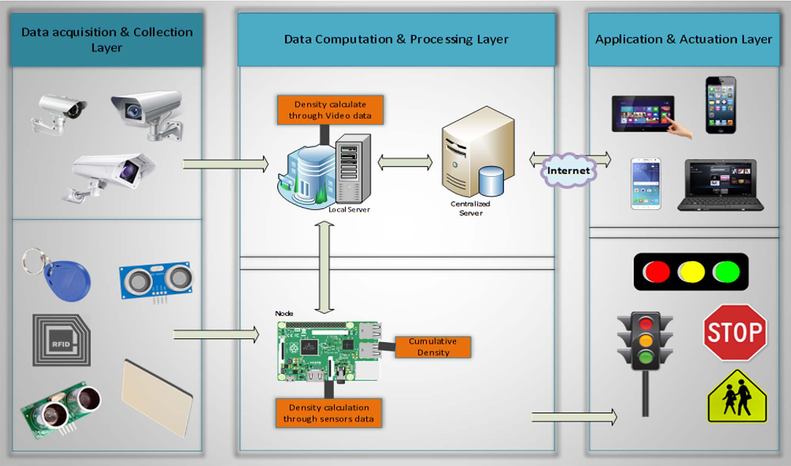
IOT DESIGN

Slide 5
Real-Time Transit Information Platform
Our mission in this phase of the Traffic Management Project is to design a cutting-edge web-based platform and user-friendly mobile apps that provide real-time traffic information to the public.
Live Traffic Updates:
Access real-time traffic flow, congestion, and incident information directly on your device. Stay informed about road closures, accidents, and alternative routes.
Interactive Maps:
Navigate your city effortlessly with dynamic maps displaying live traffic conditions. Get real-time route suggestions based on current traffic.
Historic Data Analysis:
Explore historical traffic data to identify trends and plan future journeys. Analyze traffic patterns for city planning purposes.

Slide 6
INTEGRATION APPROACH
Our vision extends beyond standalone web-based and mobile platforms; we aim to create a holistic ecosystem that harmonizes these elements for a superior user experience.
Web-Based Platform:
Our web-based platform serves as the cornerstone of this integration. With an intuitive interface accessible from any web browser, it offers a comprehensive view of the city's traffic dynamics. Here's how it plays a pivotal role:
Centralized Data Hub: The web platform acts as a centralized data hub, collecting real-time traffic data from various sources, including IoT sensors, traffic cameras, and user-generated reports.
Data Processing and Analysis: Advanced algorithms process incoming data to generate real-time traffic updates, congestion alerts, and route recommendations. This analysis is the backbone of our system.
User Accounts: For those who prefer a personalized experience, users can create accounts on the web platform. This facilitates customized route planning and alert settings.

Slide 7
INTEGRATION APPROACH
Mobile Apps:
Our mobile apps, available for both iOS and Android, extend the platform's capabilities to users on the move.
Real-Time Updates: Receive push notifications on your mobile device, ensuring you're always in the know about traffic incidents and route changes.
GPS Integration: Leverage your device's GPS capabilities for accurate location-based services. Get directions, estimated arrival times, and alerts tailored to your current location.
Reporting on the Go: Empower users to report traffic issues directly from their smartphones, contributing to a dynamic and responsive ecosystem.
Offline Access: In areas with limited connectivity, users can access cached data, ensuring uninterrupted service.

Slide 8
INTEGRATION BENEFITS
By seamlessly integrating the web-based platform and mobile apps, we provide a unified, all-encompassing solution to the public:
Real-Time Consistency: Users experience consistent real-time data and features across both web and mobile platforms.
Cross-Device Compatibility: Switch effortlessly between devices while maintaining access to the same personalized settings and data.
Data Synergy: Information gathered from mobile app users, such as incident reports, feeds back into the web platform for a richer, more dynamic dataset.
Enhanced User Engagement: This integration fosters a stronger sense of community and engagement, as users contribute to and benefit from a shared, up-to-the-minute traffic intelligence network.

Slide 9
INTEGRATION BENEFITS
1.Data-Driven Decision-Making: Integration provides decision-makers with comprehensive data for informed choices in resource allocation, infrastructure planning, and sustainability initiatives.
2.Environmental Impact: By reducing water wastage and promoting conservation, integrated systems contribute to a smaller environmental footprint. This is crucial for mitigating the impact of water scarcity and climate change.
3.Regulatory Compliance: Integration helps water utilities and authorities meet regulatory requirements and reporting obligations related to water quality and distribution, reducing the risk of non-compliance.
4.Scalability: Integrated systems are often designed with scalability in mind, allowing for the addition of new sensors, features, or geographic expansion as needed.
5.Operational Resilience: Integration can enhance the resilience of water infrastructure by providing redundancy, automated failover, and backup systems in case of emergencies or system failures.
6.Data Security: Integration also includes robust security measures to protect sensitive water-related data, ensuring it remains confidential and secure.

Slide 10






Thanks!

