Slide 1

Global Powerplant Analysis
Presented by:
Dhanush Kikkisetti(Data-612)
Dhruv Jain (Data -612)
American university
Guided by:
Pro. Rabya Ghafoor

Slide 2
Executive Summary
The type of analysis is application based.
Five Primary question are addressed in report.
Overall Approach to this question is using various tools and coding sets with providing the statistical data with convincing evidence.
Clean --> Design --> Plot –-> compare --> hypothesis --> statistical findings -->conclusion
Recommendations:
The issue is that what can be done with the data can we provided some explanation to justify the results. We would like to address those five question with different visual ideas

Slide 3
Introduction to Data Sources
>This dataset is collected from different open-source databases manually and later combined. Only 29.4 percent of capacity in database is geolocated using national data. All the other data is taken from other secondary sources or manually identified via satellite imagery and also most of the nationals not revealed their power plant details.
Name: WORLDS_RESOURCES_INSTITUE
The database collects the following characteristics and indicators:
All types of fuel
Technical characteristics (fuel, technology, ownership)
Operational characteristics (generation)
Plants’ geolocation
Plants over 1 megawatt (MW)
Plants in operation only (in first iteration)

Slide 4
Introduction to Literature Review
We are analyzing this global power plant data set for an overview of estimated and current electricity generation for different countries, different geo location, different years, different fuels and different capacity of each plant.
we can make decision based on different questions of interest using different R libraries like for making plots between variables, summarizing, taking particular rows for answering. Few of the libraries are tidy verse, ggthemes, ggplots, tidyr, dplyr etc.

Slide 5
Literature Review
The benefits and costs of power plants, including their environmental impacts, depend on their technology and on how much electricity each plant actually generates. However, plant-level generation data are not reported in most countries, including developing countries where electricity generation is projected to rapidly expand.
This technical note documents methods to estimate the annual electricity generation of power plants for the Global Power Plant Database. We use distinct estimation models for different fuel types, including wind, solar, hydropower (hydro), and gas power plants

Slide 6
Introduction to Context
The data is more than 35,000 or rows and contains 33 different variables.
The data is reliable, and the results kind is supporting the graphs and all the assumptions we have claimed in this report making.

Slide 7
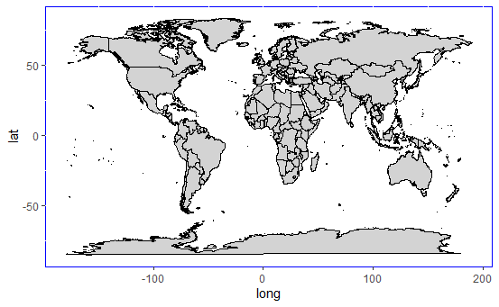
World map from r studio
[1] "country"
[2] "country_long"
[3] "name"
[4] "gppd_idnr"
[5] "capacity_mw"
[6] "latitude"
[7] "longitude"
[8] "primary_fuel"
[9] "other_fuel1"
[10] "other_fuel2"
[11] "other_fuel3"
[12] "commissioning_year"
[13] "owner"
[14] "source"
[15] "url"
[16] "geolocation_source"
[17] "wepp_id"
[18] "year_of_capacity_data"
[19] "generation_gwh_2013
[25] "generation_gwh_2019"
[26] "generation_data_source"
[27]estimated_gwh_2013
Till 2017

Slide 8
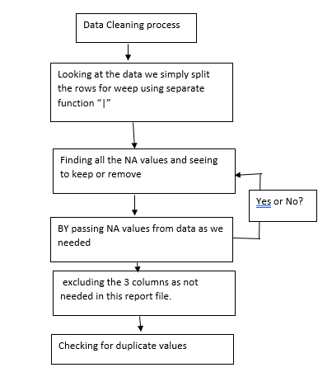
Data cleaning Steps

Slide 9
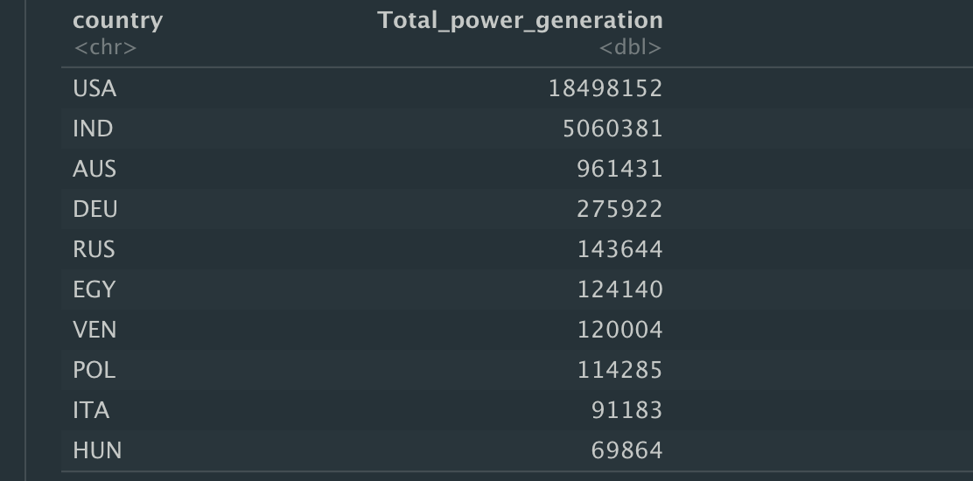
Top 10 countries with high power generation

Slide 10
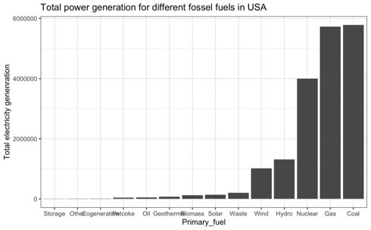
Country Wise analyzing type of powerplant has more electricity generation .

Slide 11
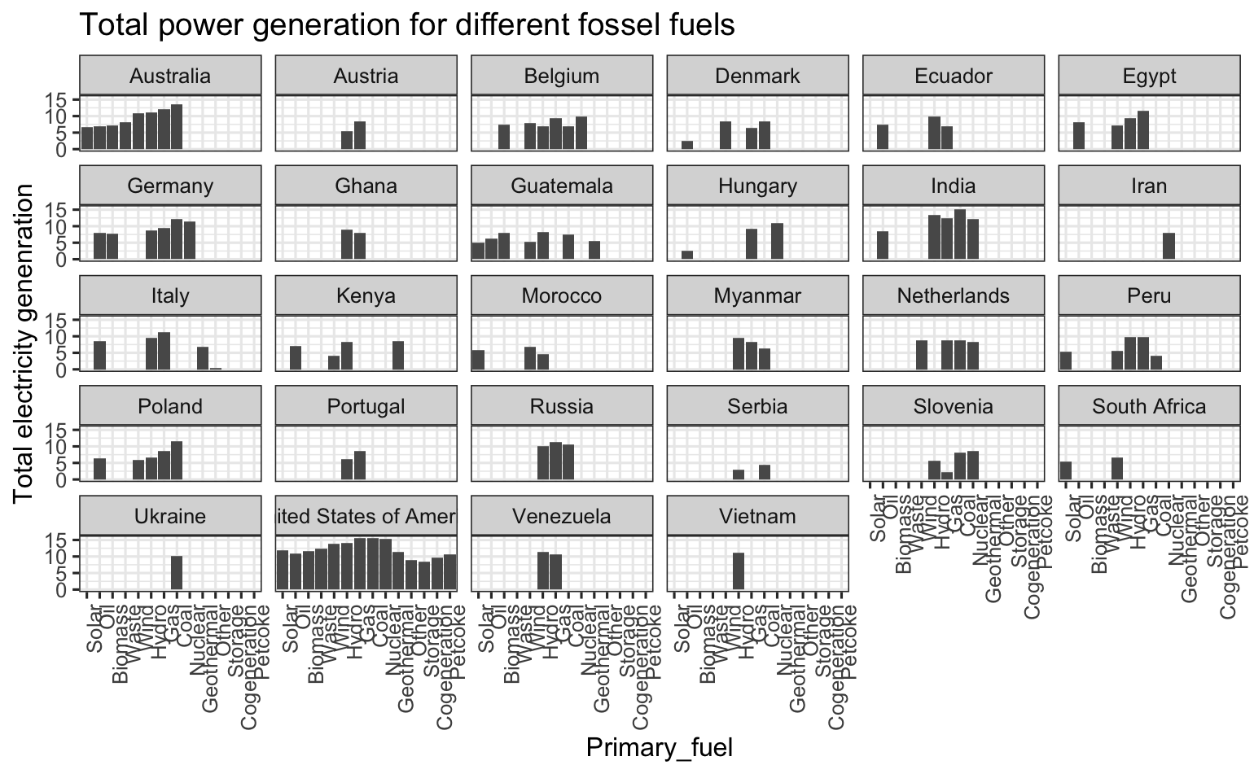

Slide 12
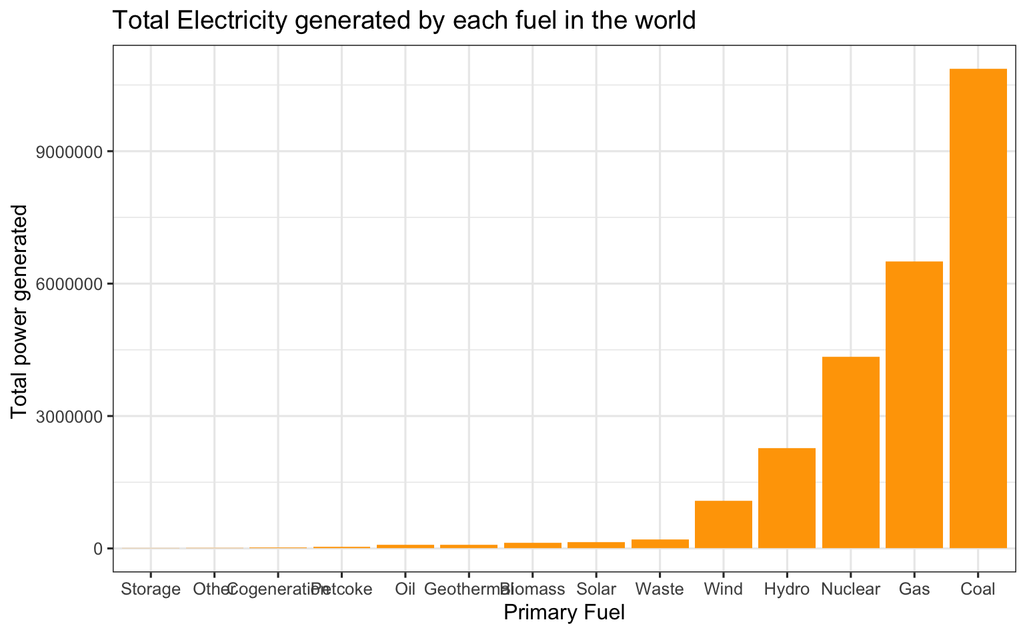
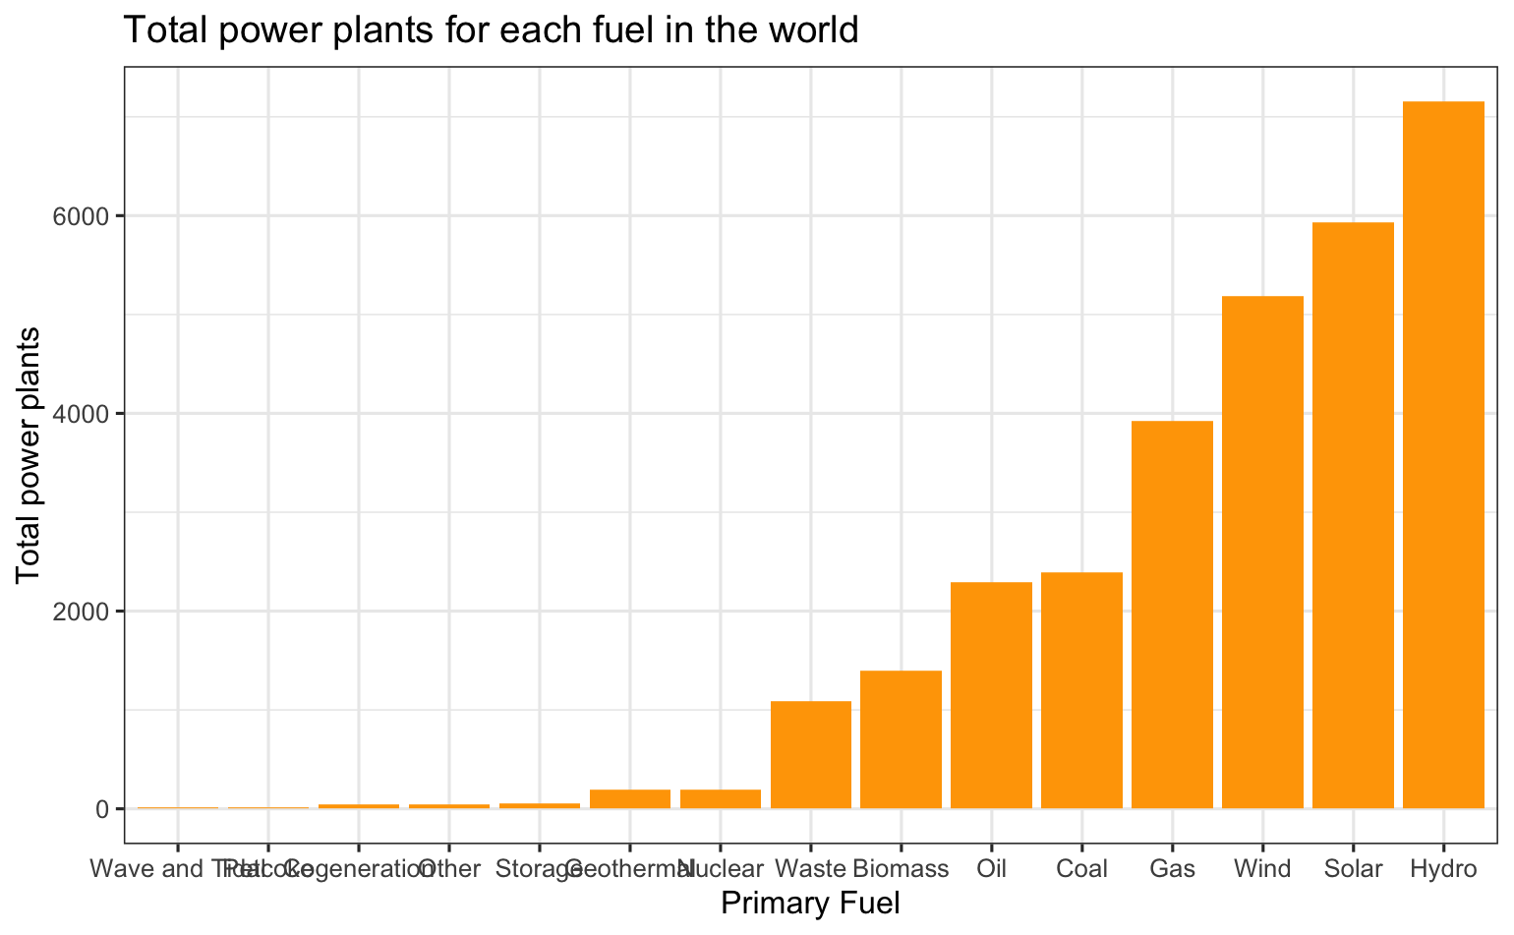
No. Of power plant vs there generation growth

Slide 13
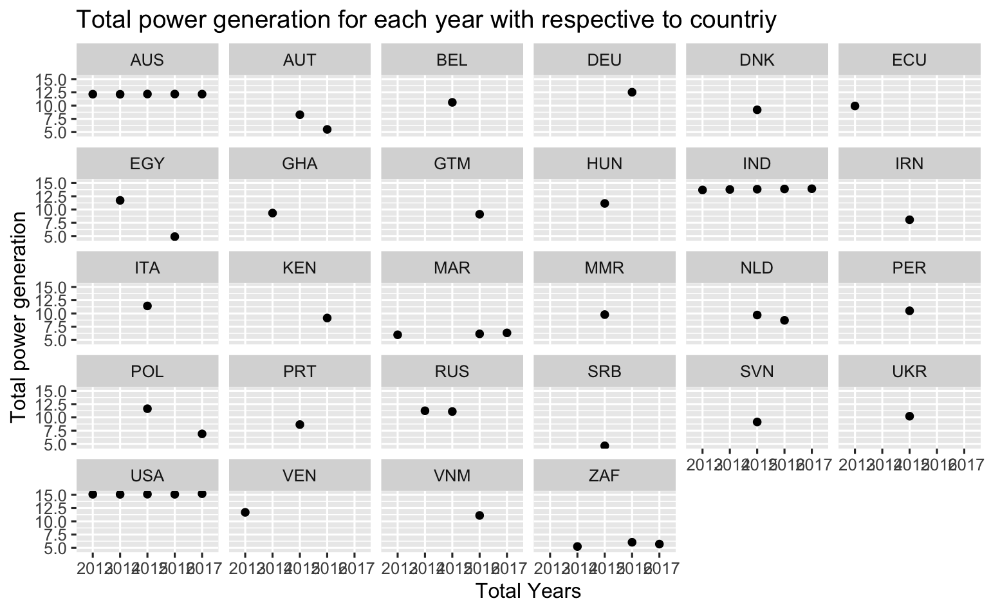
Country wise power generation After log transformation

Slide 14
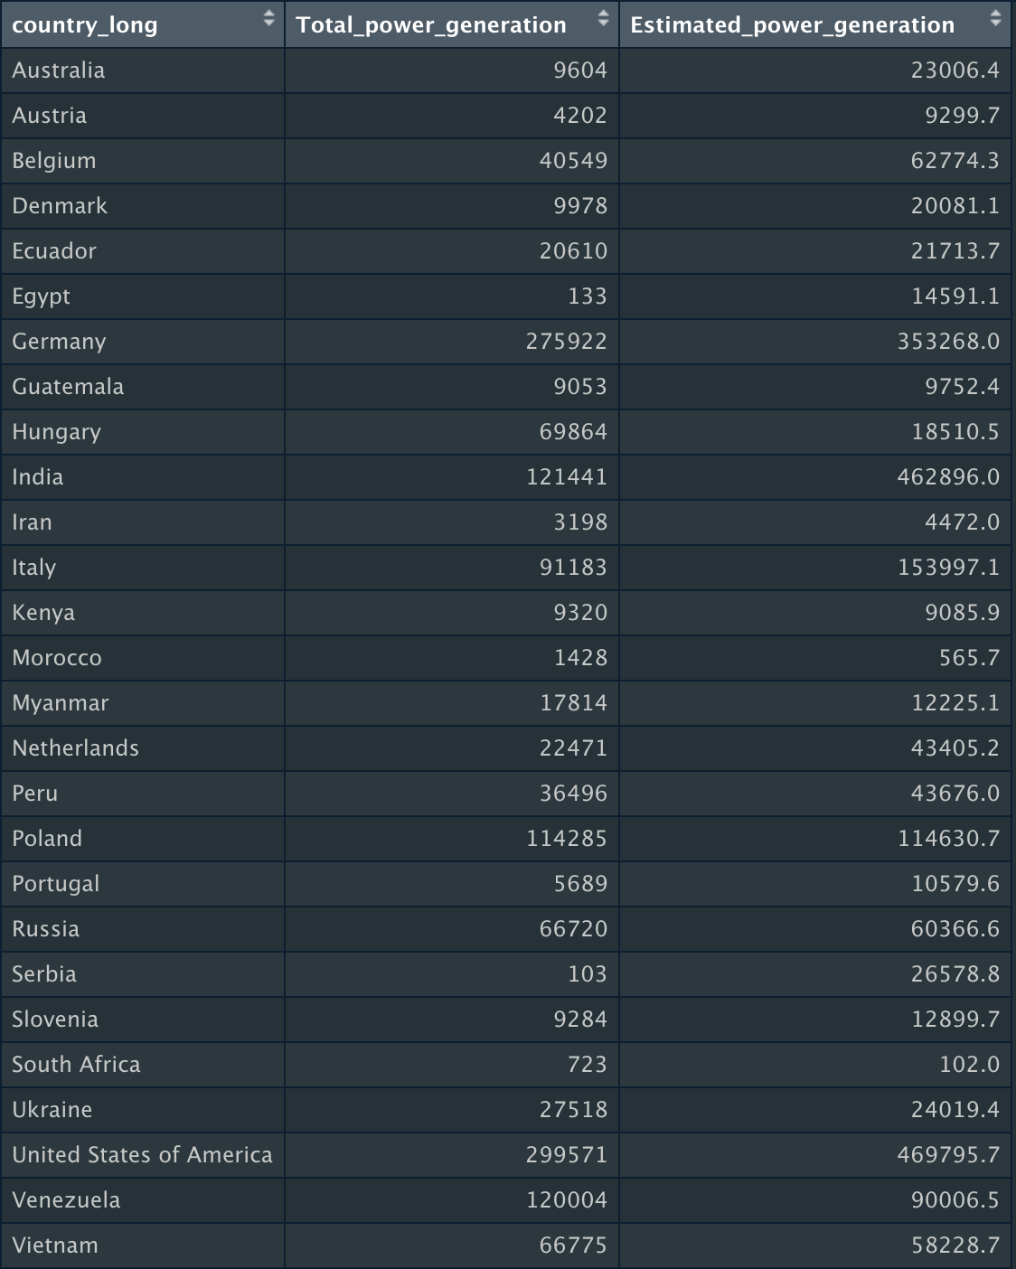
Analyzing if there is a difference in generated electricity and estimated electricity with respect to the country.

Slide 15
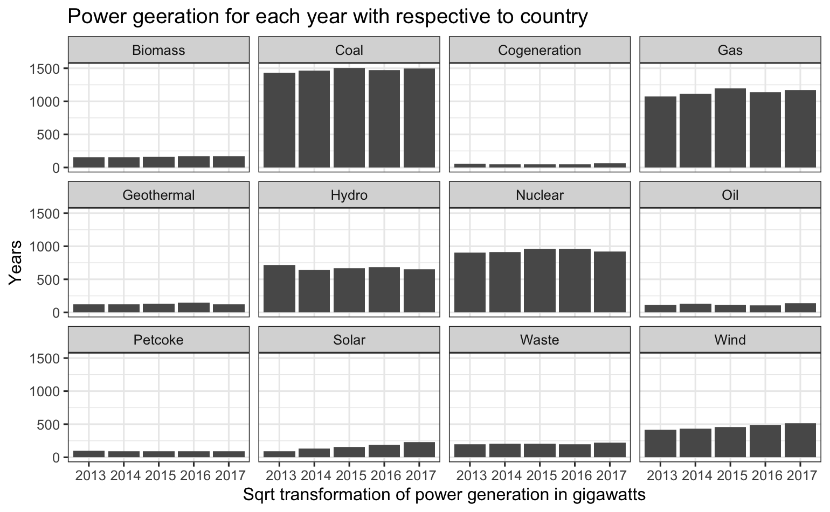
Power generation of types of fuel from 2013 to 2017

Slide 16
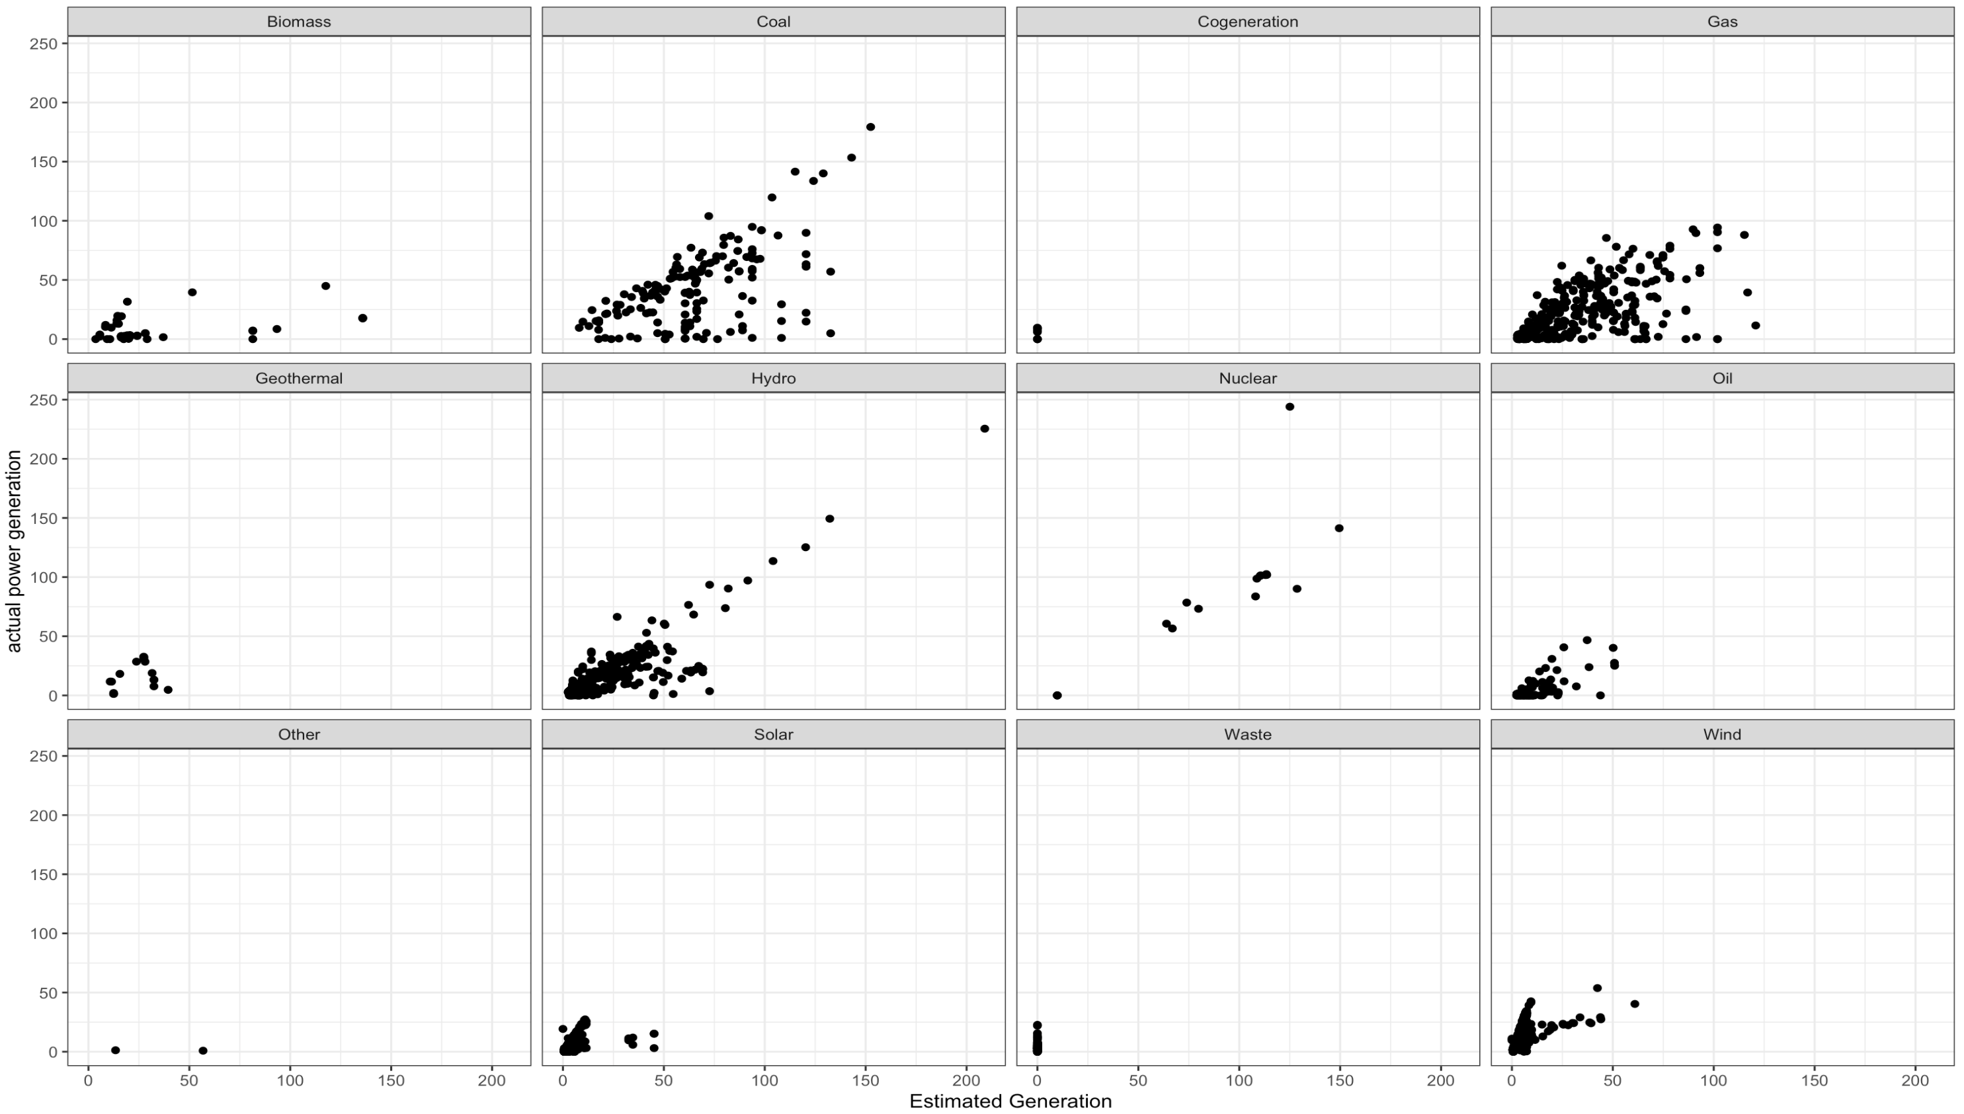
Actual vs estimated current generation

Slide 17

Let’s start Analysis using Statistical Methods
Let’s check if power generation increases with year passes by.
We want to find the trend or relation between years and current generation

Slide 18
Data Cleaning and Tidying
We removed all the unnecessary variables are not required for the statistical computation.
We have 136 countries power generation for each year from 2013 to 2017.
Using tidyverse function we convert these 5 years columns into a single column and those values to the other column.
We remove null values which are not usefull for the statistical computation.

Slide 19
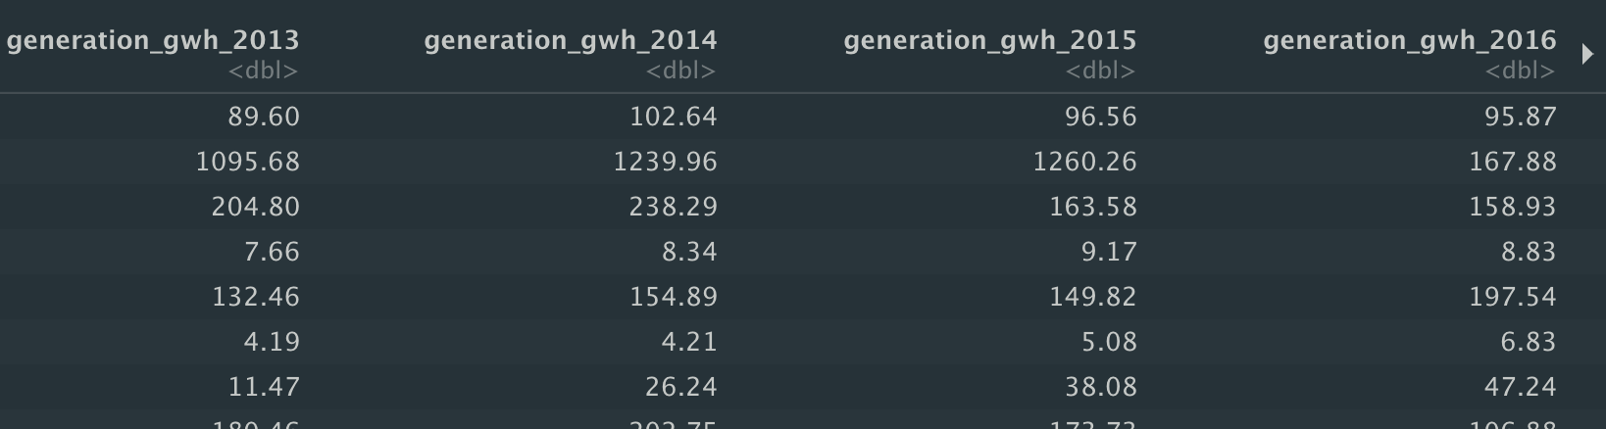
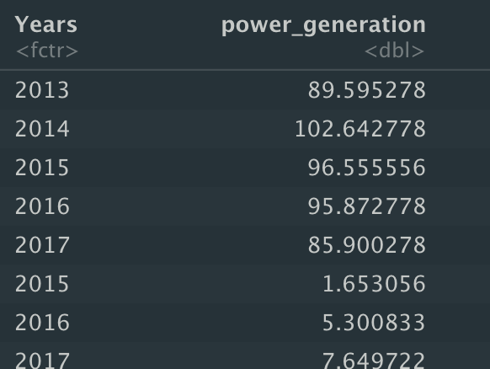
Before Tidying
After Tidying

Slide 20
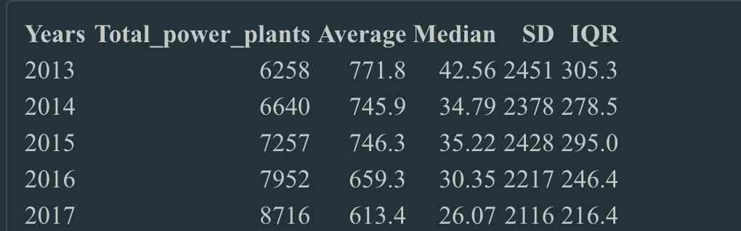
EDA
We get a simple statistics on power generation for each year

Slide 21
Some Assumptions to be considered
To statistically perform a test for comparing electricity generation for different years, we should have to consider some assumptions that are true for the sample.
1 Data should have a normally distribution
2 Homogeneity of variance

Slide 22
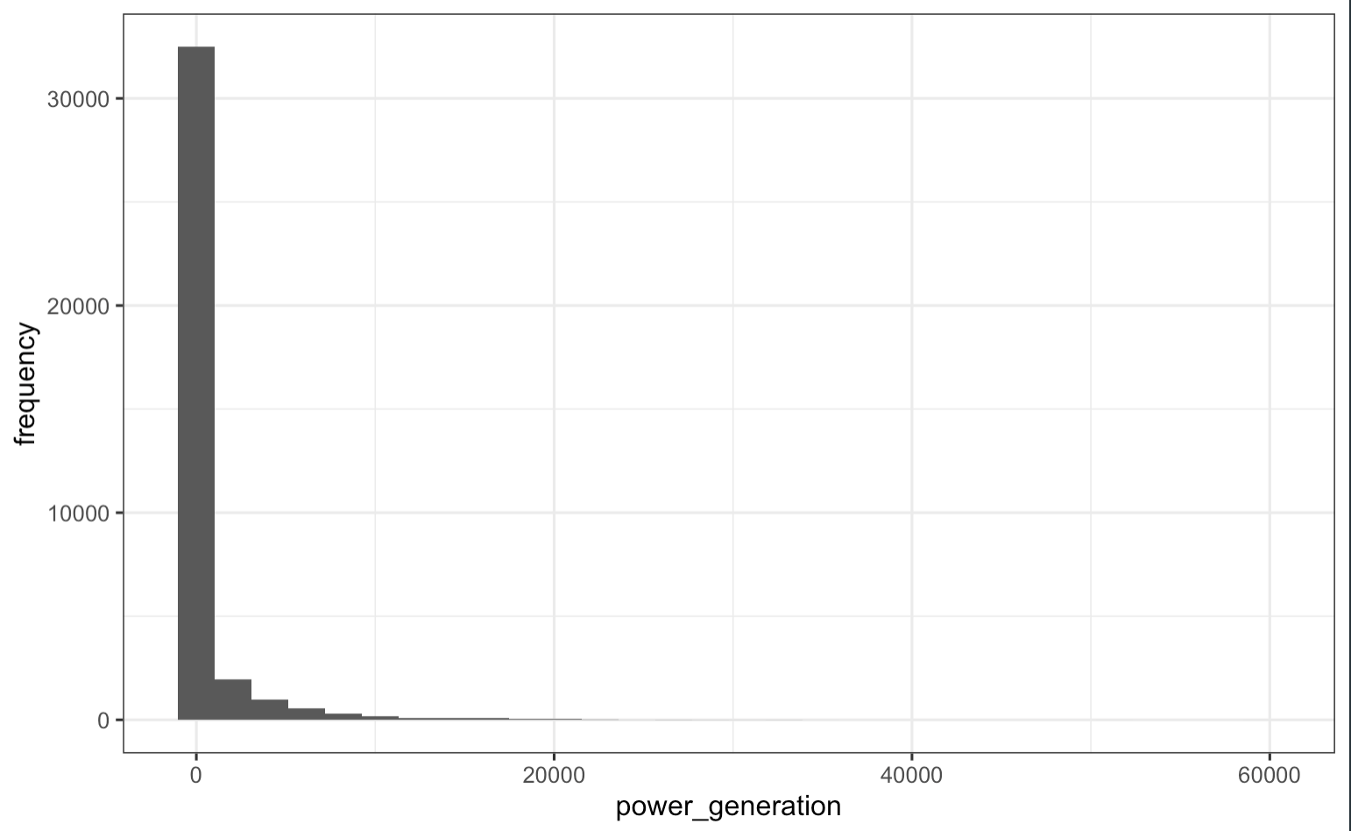
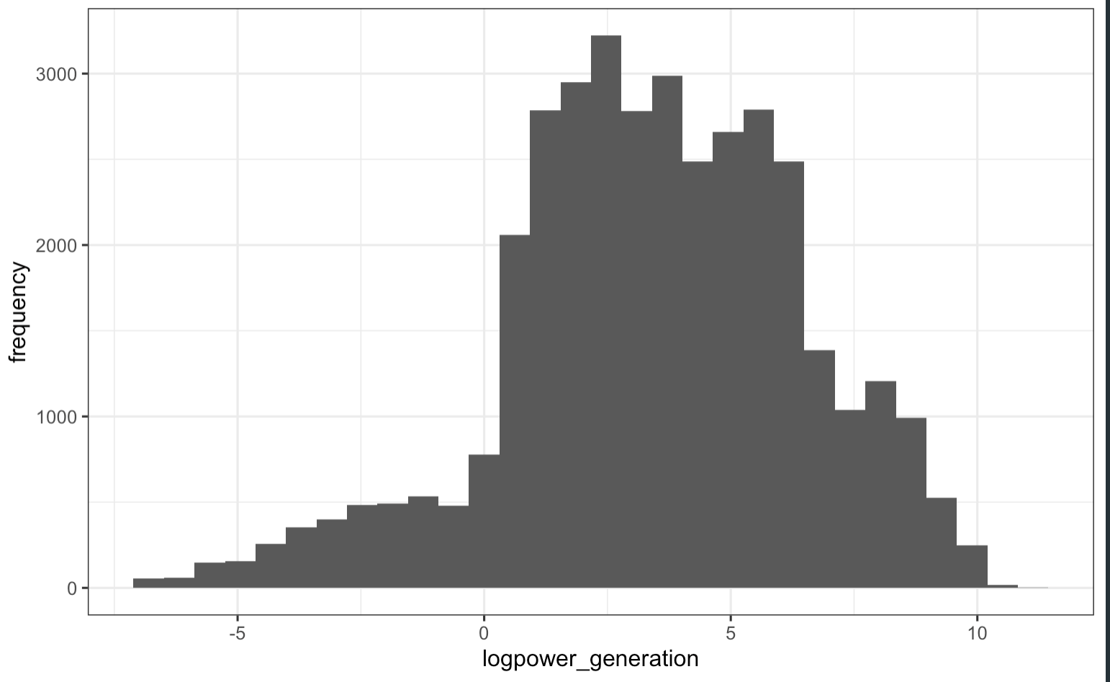
Spread of power generation Before and after log Transformation

Slide 23
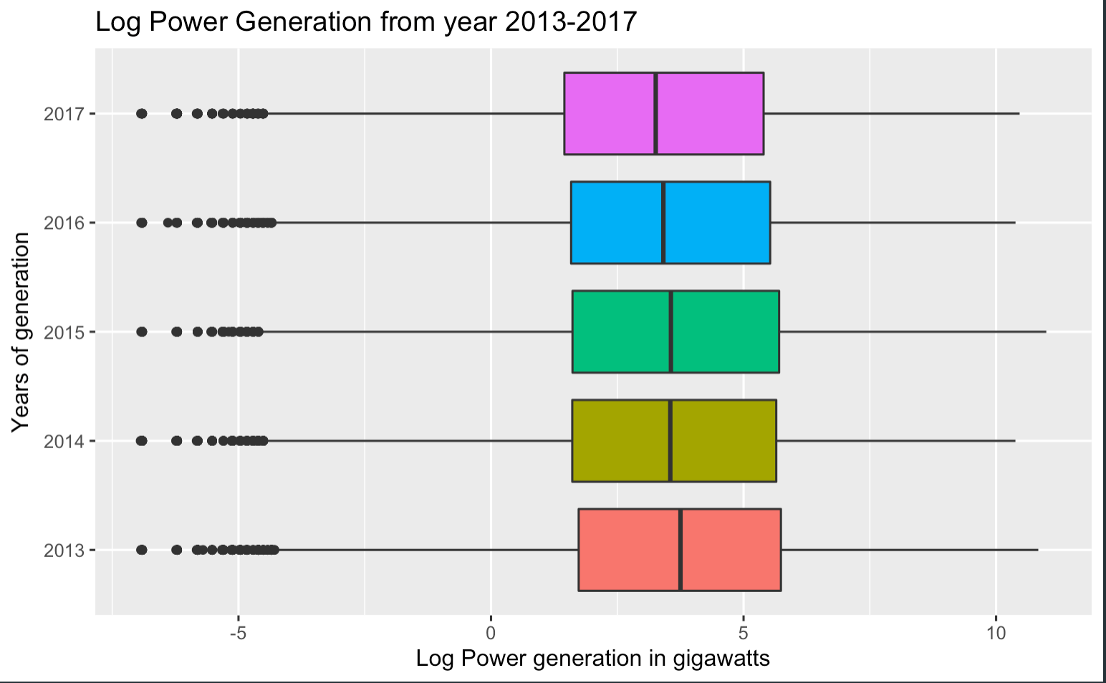
EDA

Slide 24
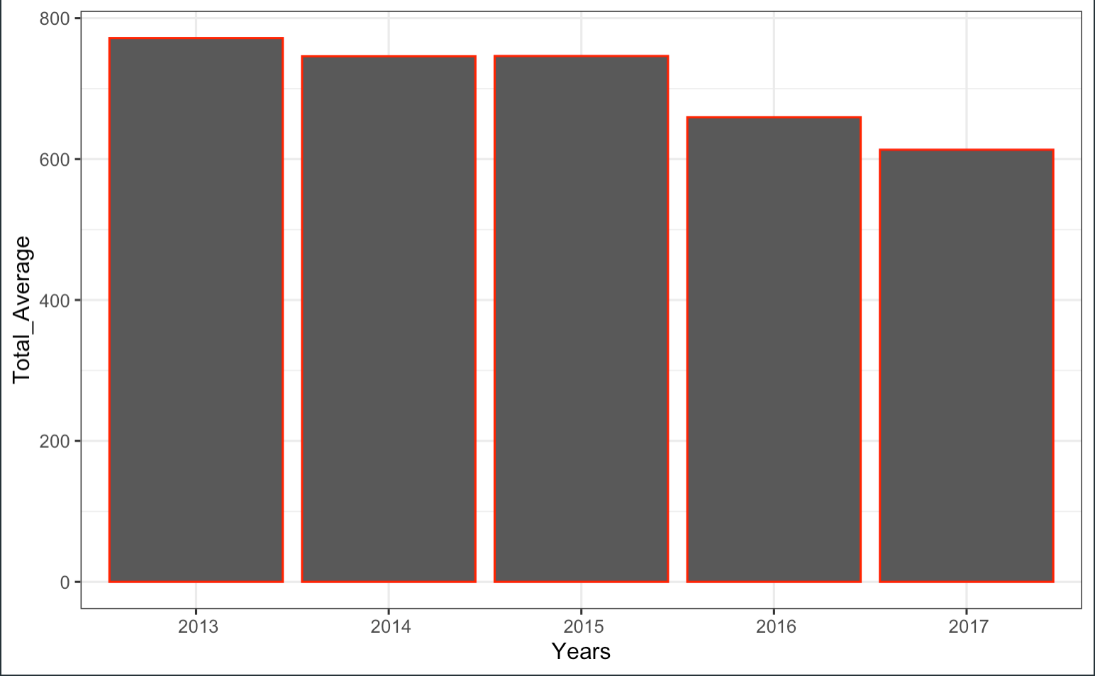

Slide 25
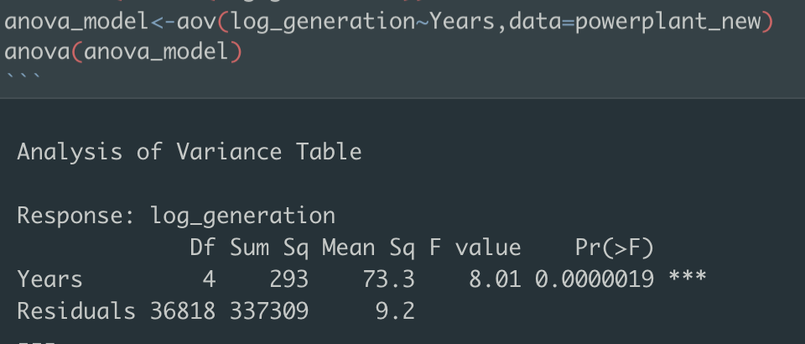
Initial hypothesis
Running Anova test for checking variability between years.
We make two hypothesis when running anova
Null hypothesis: Mean of power generation for all. Years are equal.
Alternative hypothesis: At least one of the mean power generations for years differ

Slide 26
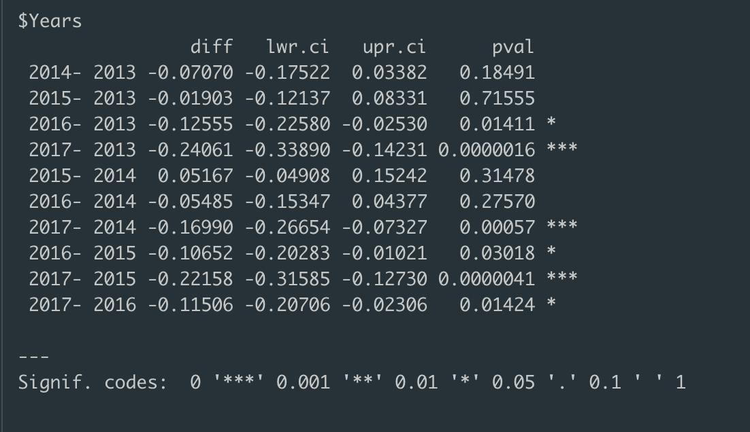
Year wise comparison of generated electricity

Slide 27
Summary
From the statistical test we have strong evidence that the current generation is not same for all the years with p values less than 0.001.
From the overall visualization, we can say that there is a decline trend as year passes by.
From a little research we found that, with shortages of natural gas and coal leading to volatile prices, demand destruction and negative effects on power generators, retailers and end users, notably in China, Europe and India.
In the year 2014 global growth in electricity demand took place in China, where demand grew by an estimated 10%. China and India suffered from power cuts at certain points in the second half of the year because of coal shortages.

Slide 28
Future Implementation
One can add the missing data in the excel and give much accurate results.
Currently for the coming years there is more scope for renewable energy leading to slight decline in global power sector CO2 emissions despite rising coal use in Europe and more gas crisis.

Slide 29
References
[1] Cawse-Nicholson, K., Townsend, P. A., Schimel, D., Assiri, A. M., Blake, P. L., Buongiorno, M. F., et al. (2021). NASA's surface biology and geology designated observable: A perspective on surface imaging algorithms. Remote Sensing of Environment, 257, 112349.(https://doi.org/10.1016/j.rse.2021.112349)
[2] Cusworth, D. H., Duren, R. M., Thorpe, A. K., Tseng, E., Thompson, D., Guha, A., et al. (2020). Using remote sensing to detect, validate, and quantify methane emissions from California solid waste operations. Environmental Research Letters, 15(5), 054012.(https://doi.org/10.1088/1748-9326/ab7b99)
[3] Green, R. O., Mahowald, N., Ung, C., Thompson, D. R., Bator, L., Bennet, M., et al. (2020). The Earth surface mineral dust source investigation: An Earth science imaging spectroscopy mission. In 2020 IEEE Aerospace Conference (pp. 1– 15). IEEE.
[4] Hockstad, L., & Hanel, L. (2018). Inventory of U.S. greenhouse gas emissions and sinks. United States Environmental Protection Agency. (https://doi.org/10.15485/1464240)
[5] Thorsten A. Stuetzle. Automatic control of the 30MWe SEGS VI parabolic trough plant[master paper].University of Wisconsin-Madison,2002.
[6] Defu CHE. Boilers-theory,design and operation.Xi’an:Xi’an Jiaotong University Press;2008

Slide 30

Any Questions?

Slide 31
Thank You

