Slide 1
SCROLL SAW Machine
Presented By A.D.D.U.Kumara

Slide 2
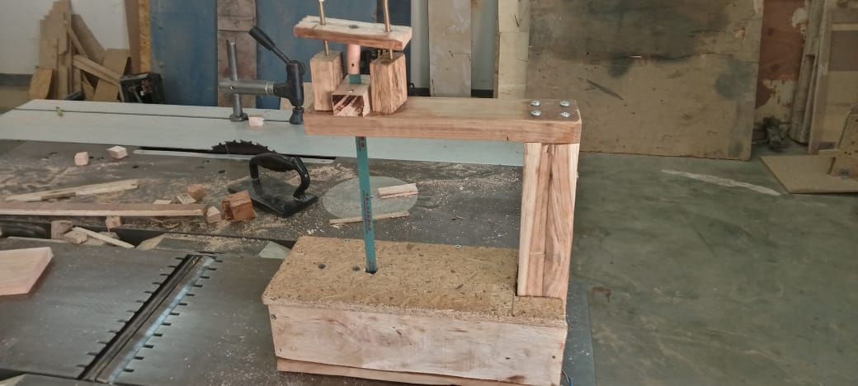
Introduction
Why I made this machine

Slide 3
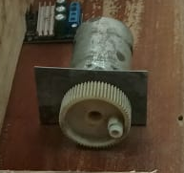
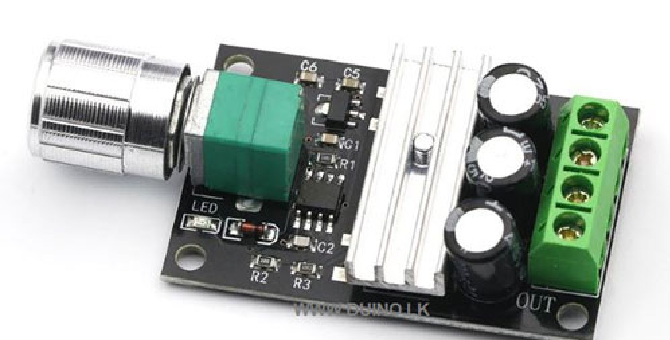
Mechanism
There are 4 main parts
2. Blade
3.Table
Motor
4.Control Unit

Slide 4
Advantages and disadvantages
Advantages | Disadvantages
Easy to use | Limited thickness of materials
Blade Speed Control | Limited cutting area
Low Cost | Safety concerns:
Low Noise | Dust and debris

Slide 5
Thank You

