Slide 1

GCM APP
HMDD HERATH
SE/2015/014

Slide 2
What is GCM?
Gcm App is Group class management system
This app can be only use by group class Teacher for manage his group class.
This app can , send sms for each student got marks, save student attendance, save class fees, Graph each student marks, and manage student and group information.
We can Export and import SQLite data base

Slide 3
Why?
If teachers use this app, then simple mange there group class, without manually.
Teachers do not memorize all of ,his class information.

Slide 4
Future plans
Implement Machin learning.

Slide 5
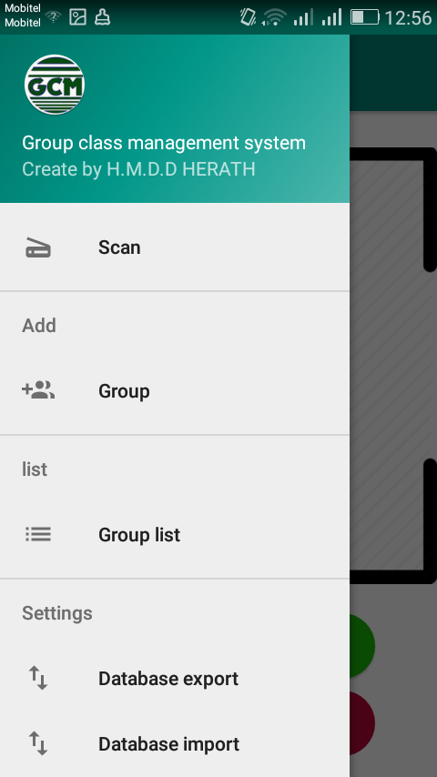
How to use?
Go to navigation bar…
Select , Group for create a new
Group class

Slide 6
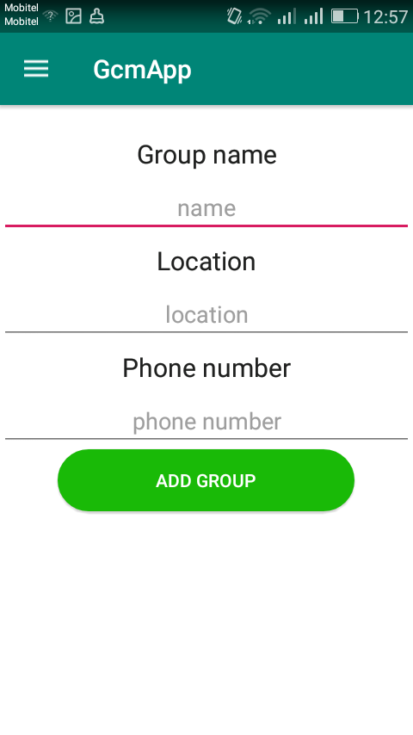
How to create Group
Group add
This fragment is use for get class
Information into SQLITE database.

Slide 7
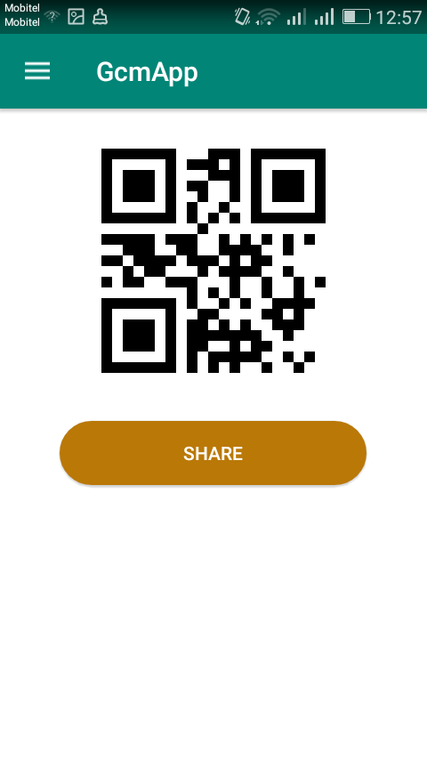
If we Crete a group
Automatically create QR code,
and it can be share for group leader.
Qr code is unique for each group
Extra : I am implement androidmads
library for create QR code.

Slide 8
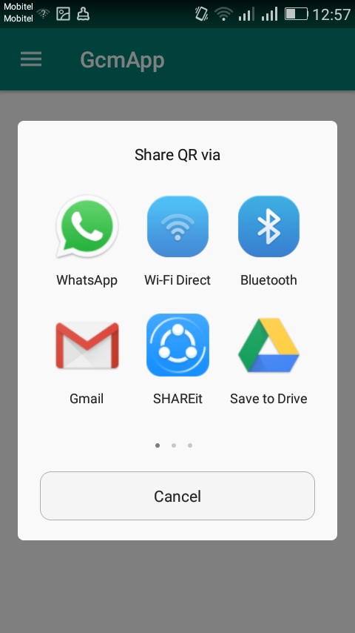
If we touch the ,share button…
Prompt the share window
and , we can share Qr code for
group leader(Student) ,using
WhatsApp, Bluetooth,….etc.

Slide 9
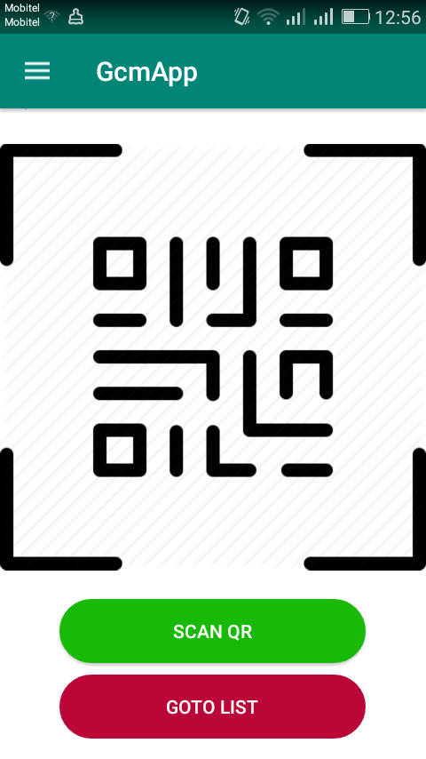
How to get each group?
If you want to get each group,
using QR code then,
Go to navigation bar and, Touch
the Scan item… →

Slide 10
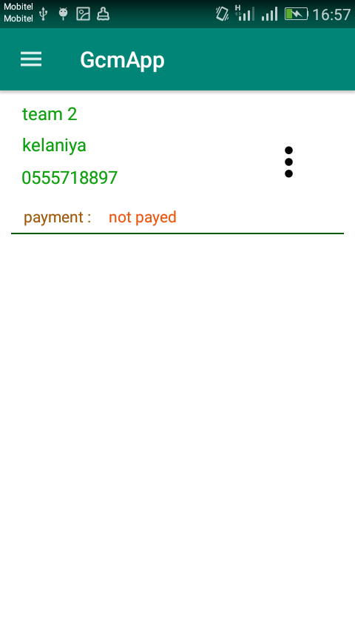
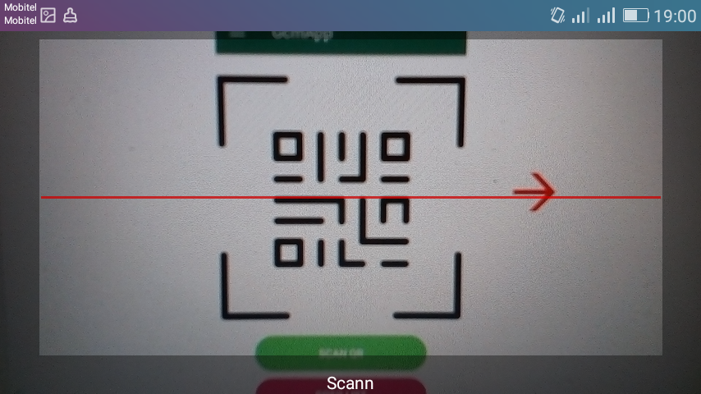
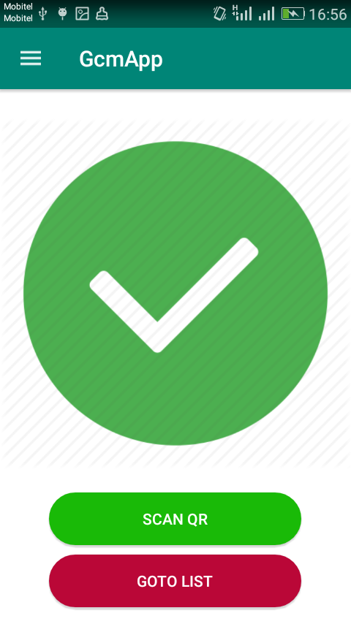
If we touch the Scan button
Prompt the QR scan window and, scan Qr code and it will return the
value of Qr code.
I am implement zxing library for Scan QR code.
Automatically ,view the group select by qr code…
→ → →

Slide 11
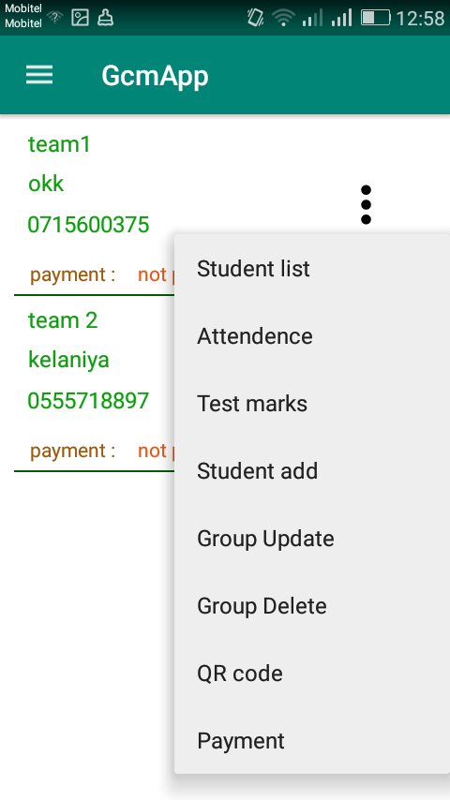
When touch menu icon of group..
Prompt the popup menu

Slide 12
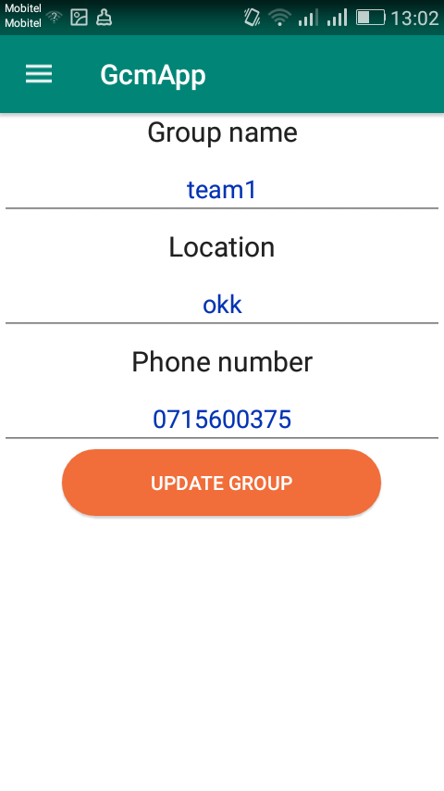
How to update group information?
Touch the menu icon in group class, and choose Group update..
→

Slide 13
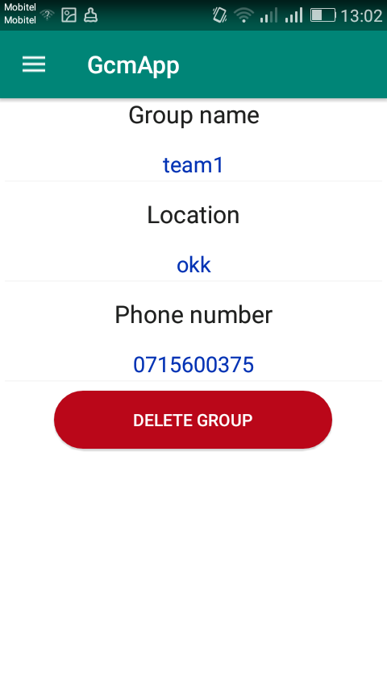
How to delete group information?
Touch the menu icon in group class, and choose Group delete..
→

Slide 14
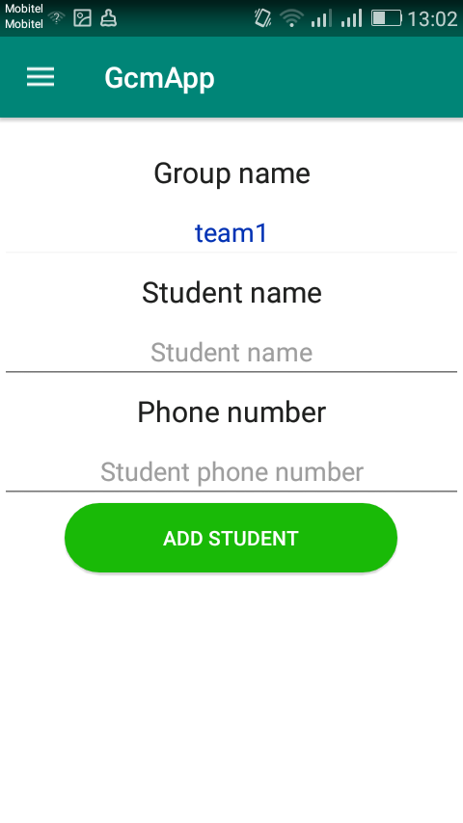
How to save student information
Touch the menu icon in group class, and choose Student add..
→

Slide 15
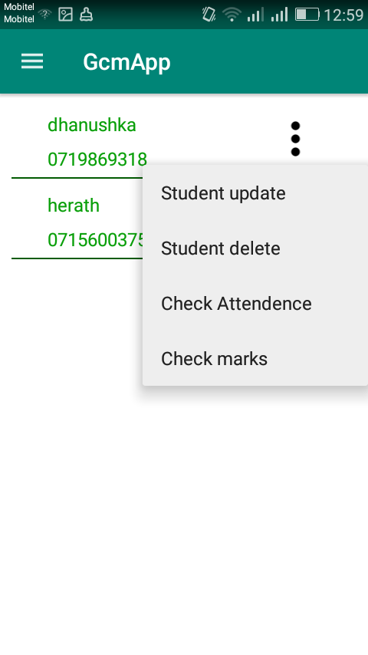
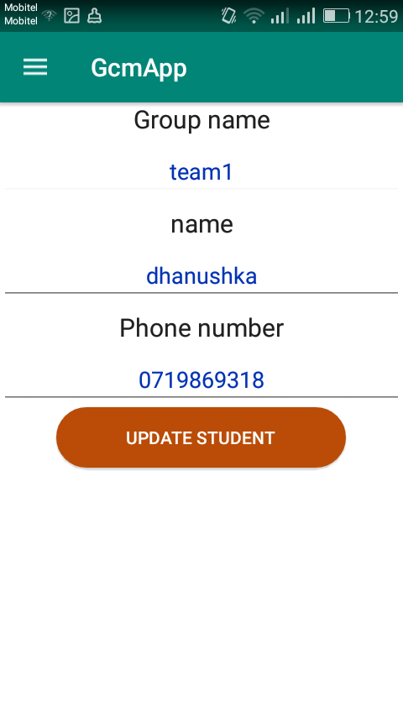
How to update student information
Go to student list and touch menu icon after choose Student update..
→ →

Slide 16
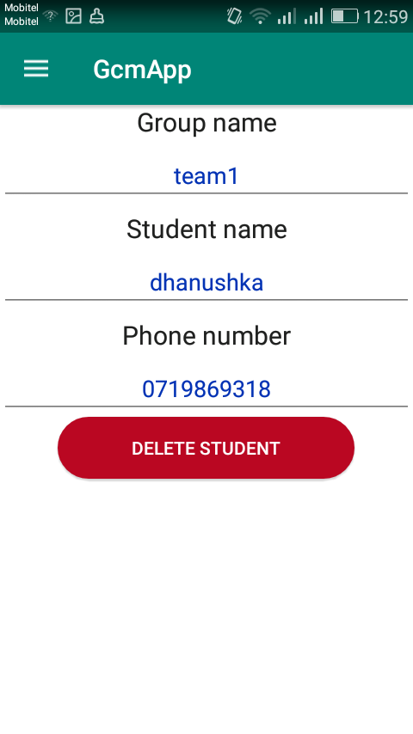
How to delete student information
Go to student list and touch menu icon after choose Student delete..
→ →

Slide 17
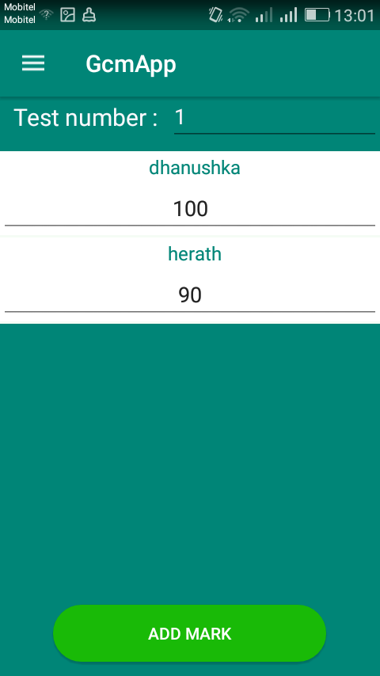
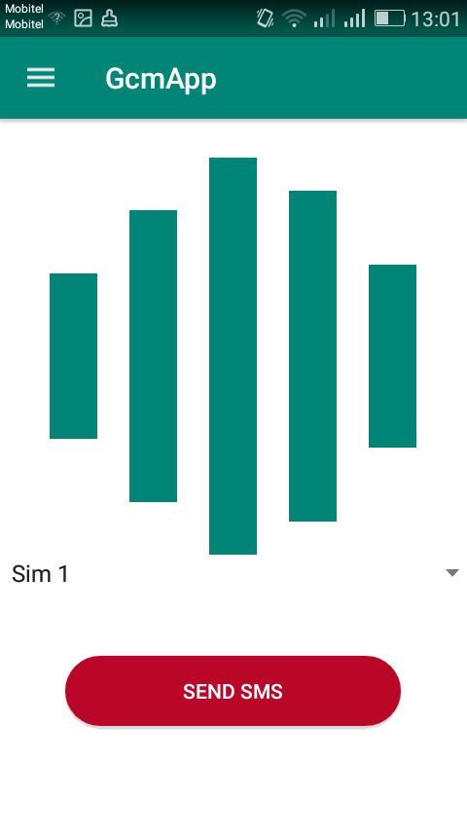
How to insert student marks?
Touch the menu icon in group class, and choose Test marks..
→ →

Slide 18
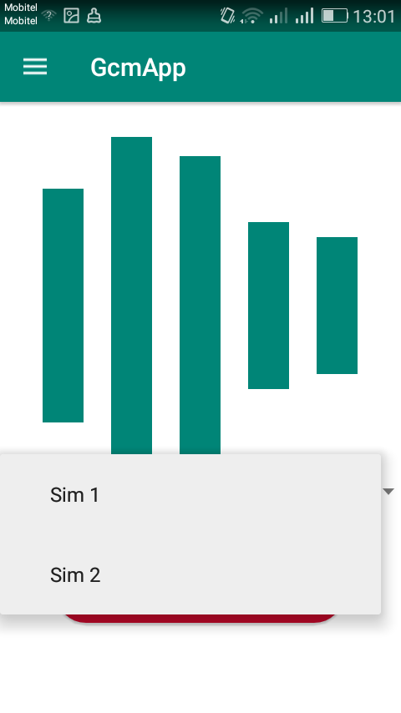
How to change sim ?
Touch the spinner , and change sim name

Slide 19
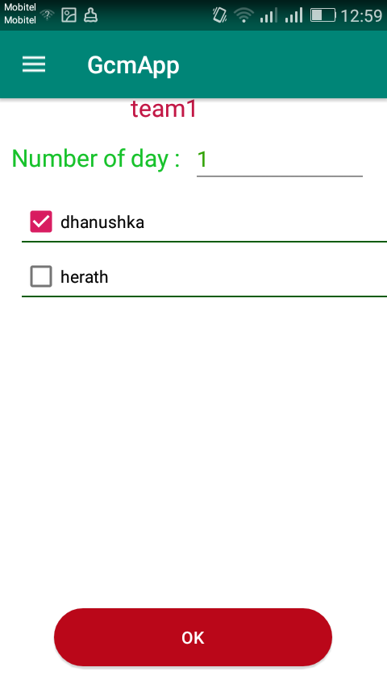
How to insert student attendance?
Touch the menu icon in group class, and choose attendance..
→

Slide 20
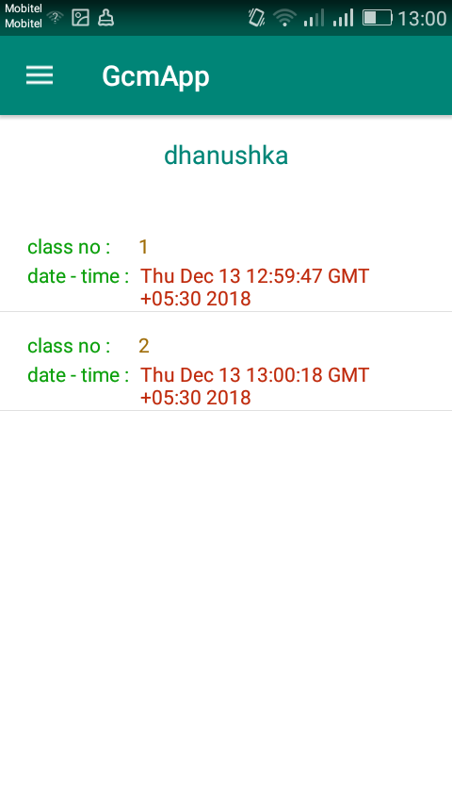
How to check student attendance?
Go to student list and touch menu icon -> choose check attendance
→ →

Slide 21
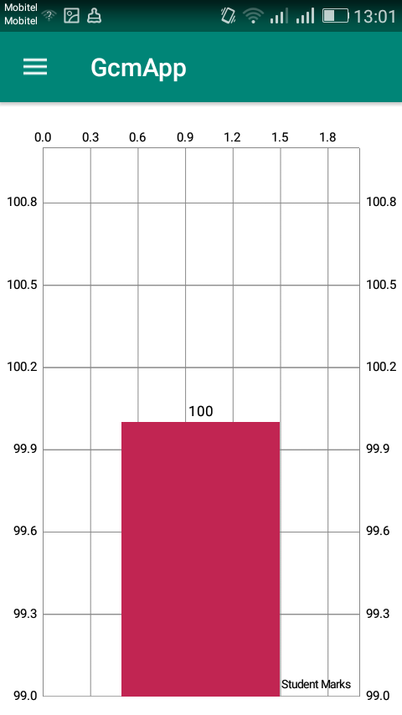
How to Graph student marks?
Go to student list and touch menu icon -> select check marks
→ →

Slide 22
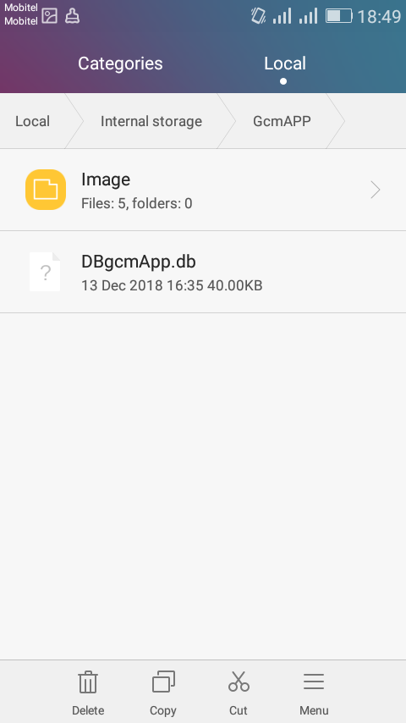
How to export and import DB?
Go to navigation view and select import / export
→

Slide 23
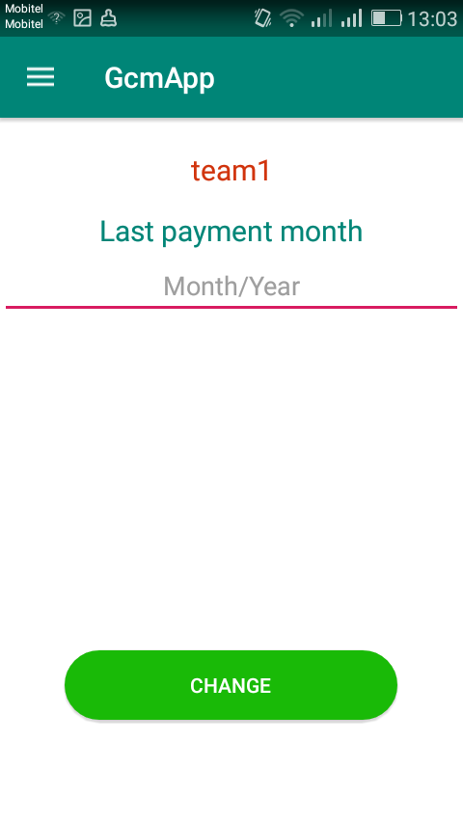
How to save class fees?
Touch the menu icon in group class, and choose payment..
→

Slide 24
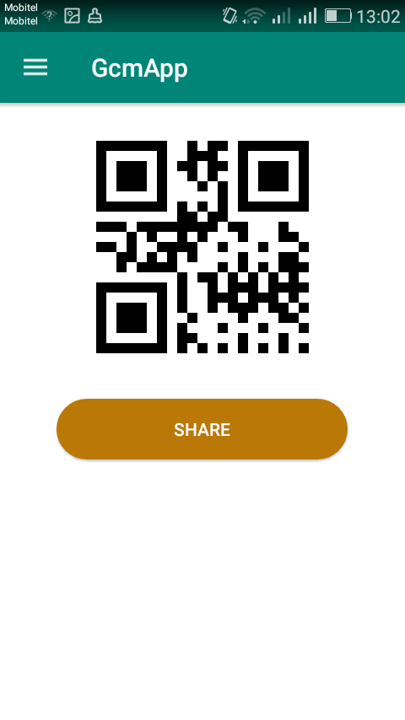
How to get Qr code in existing group?
Touch the menu icon in group class, and choose QR code..
→ →

Slide 25
Finally
I already completed my project……

