Slide 1
MACHINE LEARNING | 25SC2107E | ACADEMIC YEAR 2026-27
Multi-Task CNN-Transformer for Joint OTFS Channel Estimation and Doppler-Sensing Prediction
Srikar Prathap
Dakshesh Kumar
Dhanush Karthikeya
2520040006
2520040060
2520040032
Under the guidance of Mr. N Lava Prasad, Assistant Professor, Department of ECE
Notes:
Introduce the project title, team and guide.

Slide 2




INTRODUCTION
Why High-Mobility Wireless Needs Smarter Receivers
Orthogonal Time Frequency Space (OTFS) is a modulation technique built for high-mobility links. Vehicle motion, multipath propagation and Doppler shifts make the channel vary quickly, so the receiver must know the channel and the Doppler shift accurately.
Autonomous vehicles
Drones and UAVs
Reliable links under rapidly changing speeds.
Communication during high-speed flight.
Our idea
One shared CNN-Transformer learns channel features and solves both tasks together: channel estimation and Doppler prediction.
High-speed trains
5G and 6G networks
Estimation under large Doppler shifts.
ML-based signal processing for future systems.
Joint OTFS Channel Estimation & Doppler Prediction
2
Notes:
OTFS works in the delay-Doppler domain; fast-moving users make the channel change rapidly.

Slide 3
PROBLEM STATEMENT
What We Set Out to Solve
1
Rapid channel variation
User mobility and multipath make the channel change quickly.
PROBLEM
Develop a machine-learning approach that jointly performs channel estimation and Doppler-sensing prediction from OTFS received-signal data.
2
Noise and Doppler effects
Both make accurate channel estimation difficult.
3
Separate processing is costly
Doing the two tasks apart needs extra processing.
Proposed solution
A shared CNN-Transformer with two output heads.
4
Need for shared learning
A joint model can reuse features across both tasks.
Joint OTFS Channel Estimation & Doppler Prediction
3

Slide 4
PROPOSED METHODOLOGY
A Joint CNN-Transformer Approach
A CNN extracts local features from the delay-Doppler input; a Transformer encoder then learns how different delay-Doppler bins relate; one shared representation feeds both tasks.
1
2
3
CNN feature extraction
Transformer encoder
Multi-task learning
Finds local patterns in the received OTFS signal.
Uses attention to learn long-range links between delay-Doppler bins.
Shares one feature representation across both tasks.
Joint prediction: channel response estimate plus Doppler-related outputs from the same backbone.
Joint OTFS Channel Estimation & Doppler Prediction
4

Slide 5
ALGORITHM
Model Architecture and Training Pipeline
STAGE 1
STAGE 2
STAGE 3
STAGE 4
Channel head
OTFS input
CNN encoder
Transformer encoder
Shared features
›
›
›
›
Delay-Doppler grid with real and imaginary parts
Convolutional layers extract local features
Feature tokens learn long-range dependencies
One representation for both tasks
Doppler head
Channel head
Doppler head
Training
Estimates the channel response on the delay-Doppler grid.
Predicts normalized Doppler and its Low / High class.
Joint optimisation with a combined loss over both tasks.
Joint OTFS Channel Estimation & Doppler Prediction
5

Slide 6
IMPLEMENTATION
Workflow and Simulation Setup
1
Generate synthetic OTFS channels with multipath and Doppler
Parameter | Specification
Representation | OTFS-like delay-Doppler grid
Input | Two channels (real, imaginary)
Channel model | Synthetic multipath
Noise | AWGN
Dataset | 5,800 synthetic samples
Data split | 4000 train / 800 val / 1000 test
2
Add AWGN noise and prepare the delay-Doppler input
3
Extract local features with CNN layers
4
Tokenise features for the Transformer encoder
5
Train the joint estimation and prediction model
6
Evaluate with estimation and prediction metrics
Tools: Python, Google Colab, TensorFlow/Keras, NumPy, Matplotlib, Scikit-learn
Metrics: MSE, NMSE (channel); MAE, RMSE, accuracy, ROC-AUC (Doppler)
Joint OTFS Channel Estimation & Doppler Prediction
6

Slide 7
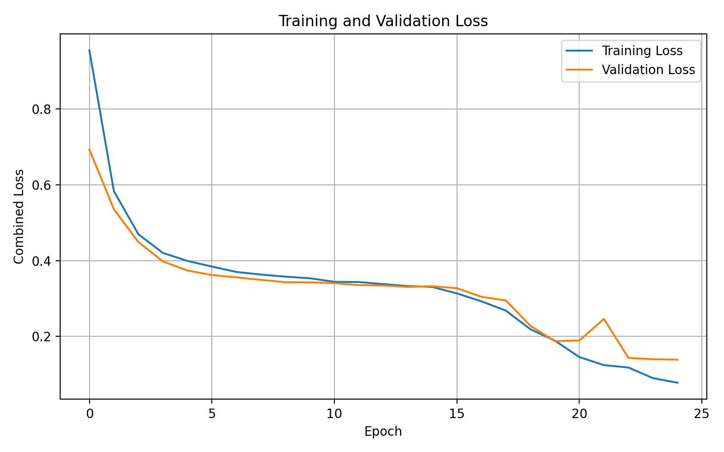
RESULTS 1 / 5
Training and Validation Loss
0.08
0.14
Final train loss
Final val loss
Fast drop in the first 5 epochs (train 0.95, val 0.69 at start)
Slow plateau from epoch 6 to 15, then a second drop
One brief validation spike near epoch 21, recovered by epoch 22
Train-val gap stays small (0.08 vs 0.14): stable learning, mild overfitting
Joint OTFS Channel Estimation & Doppler Prediction
7
Notes:
Combined loss over 25 epochs (0-24).

Slide 8
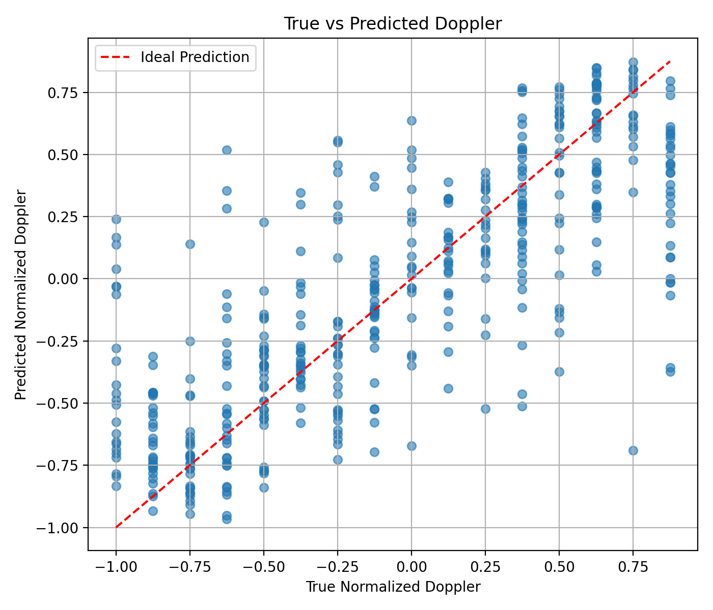
RESULTS 2 / 5
Doppler Prediction: True vs Predicted
16
Mid-range
Doppler levels, -1 to 0.875
Most accurate region
Predictions follow the ideal diagonal across the full range
Points near -0.5 to -0.25 and 0.25 to 0.6 sit closest to the line
Extremes are pulled toward the centre: true 0.875 is often predicted at 0.3 to 0.6
A few outliers remain, e.g. true 0.75 predicted near -0.7
Joint OTFS Channel Estimation & Doppler Prediction
8

Slide 9
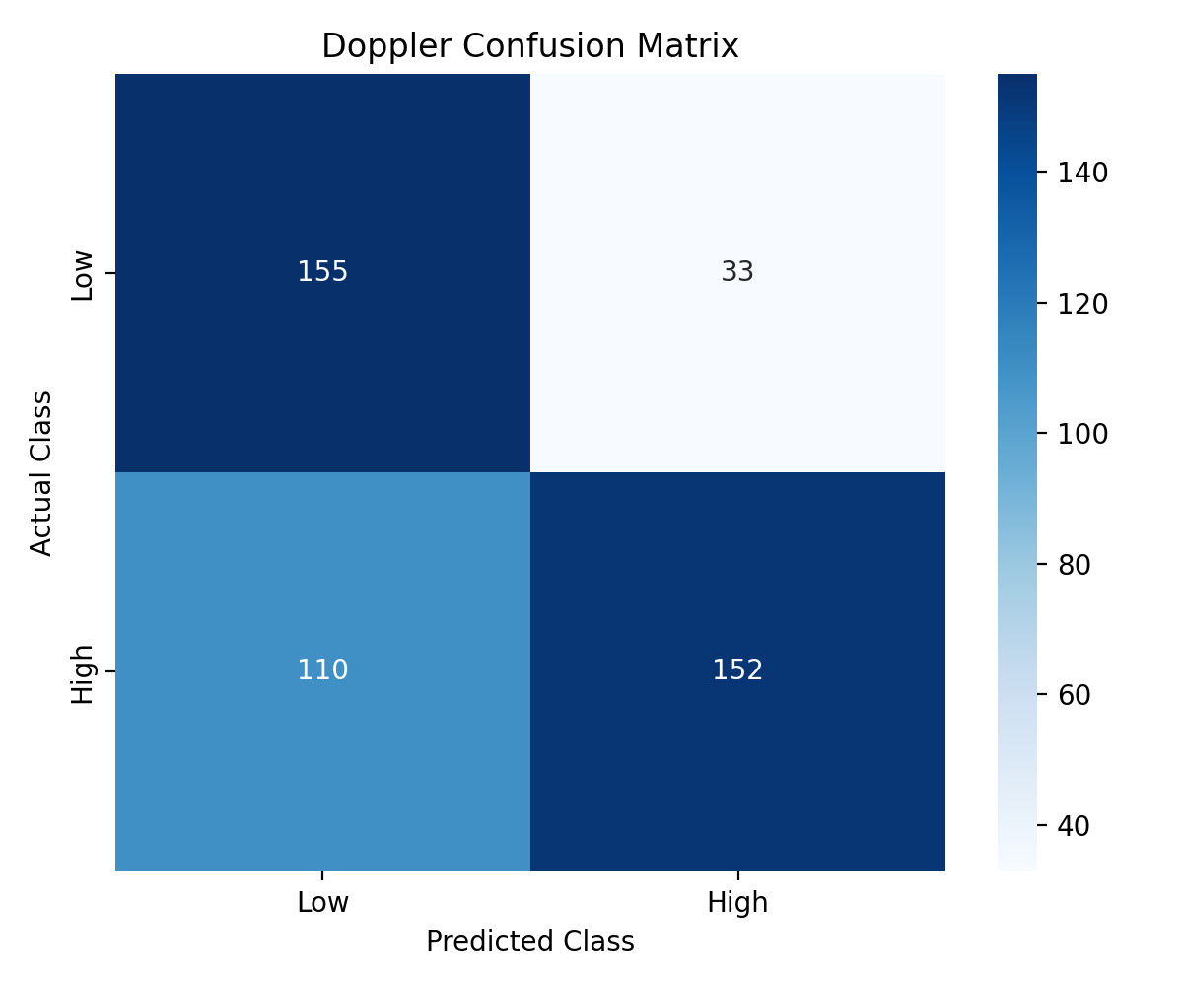
RESULTS 3 / 5
Low vs High Doppler Classification
68.2%
82.2%
Accuracy (307 / 450)
Precision, High class
58.0%
82.4%
Recall, High class
Recall, Low class
Only 33 of 188 Low samples are wrongly called High
110 of 262 High samples are missed (called Low)
F1 score is about 0.68 for both classes
The model leans toward predicting Low
Joint OTFS Channel Estimation & Doppler Prediction
9

Slide 10
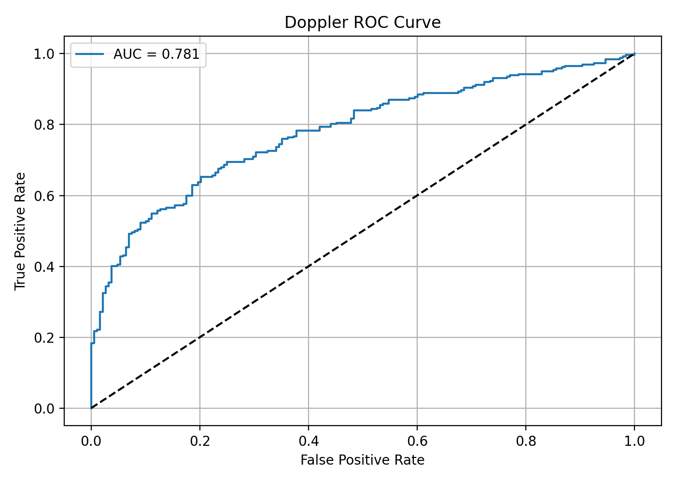
RESULTS 4 / 5
ROC Curve for Doppler Classification
AUC = 0.781
Well above the 0.5 of random guessing
About 0.5 true positive rate at only 0.1 false positive rate
About 0.65 TPR at 0.2 FPR and 0.78 at 0.4 FPR
Curve stays above the diagonal everywhere
Moving the decision threshold can trade precision for High-class recall
Joint OTFS Channel Estimation & Doppler Prediction
10

Slide 11
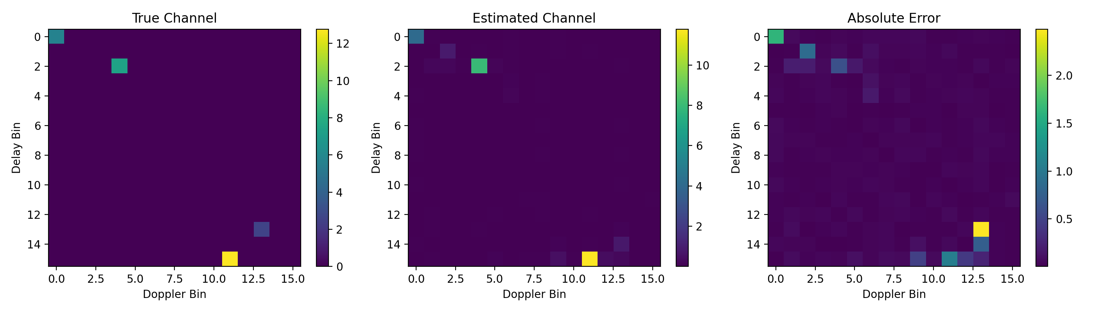
RESULTS 5 / 5
Channel Estimation on the Delay-Doppler Grid
Paths located
The four dominant paths (about delay, Doppler = 0,0; 2,4; 13,13; 15,11) appear in the estimate.
Amplitudes close
Strongest path about 12.8 true vs 11.7 estimated; error is mostly under 1 elsewhere.
Largest error
Peak error about 2.4 at the weak path near (13,13), partly shifted to delay 14.
Joint OTFS Channel Estimation & Doppler Prediction
11
Notes:
Left: true channel; middle: estimated; right: absolute error.

Slide 12
RESULTS SUMMARY
Key Findings at a Glance
Task | Evidence | Outcome
Training | Loss 0.95 to 0.08 (train), 0.69 to 0.14 (val) | Stable convergence over 25 epochs
Doppler regression | True vs predicted scatter, 16 levels | Follows diagonal; weaker at extremes
Doppler classification | Accuracy 68.2%, F1 about 0.68 | High precision (82.2%), lower High recall (58.0%)
Ranking quality | ROC AUC 0.781 | Clearly better than chance
Channel estimation | 16 x 16 delay-Doppler map | Main paths recovered; max error about 2.4
Joint OTFS Channel Estimation & Doppler Prediction
12

Slide 13
CONCLUSION
Conclusion and Future Work
What we achieved
Future work
A joint CNN-Transformer for channel estimation and Doppler prediction
Stable training with validation loss near 0.14
Doppler classification AUC of 0.781
Main channel paths recovered on the delay-Doppler grid
Improve High-Doppler recall (class weights, threshold tuning)
Compare against baseline estimators across SNR levels
Test under more channel conditions and noise levels
Reduce the train-validation gap with regularisation
Joint OTFS Channel Estimation & Doppler Prediction
13

Slide 14
Thank you
Questions?
Srikar Prathap | Dakshesh Kumar | Dhanush Karthikeya

