Slide 1
Predicting Movie Success
Presented by : Dhanush Krishnan A U
Notes:
Good morning everyone. My name is Dhanush Krishnan A U, and today I'm going to present my project, Predicting Movie Success.
In this project, I use machine learning to analyze movie-related data and classify movies into three categories: Hit, Average, and Flop.
I'll explain the problem, the dataset, the machine learning models I compared, the results I obtained, and the web application developed for this project.

Slide 2
Agenda
Introduction
Proposed Methodology
Problem Statement
Machine Learning Models
Project Objectives
Model Evaluation and Results
Dataset Overview
Web Application Development
Exploratory Data Analysis (EDA)
Limitations and Future Enhancements
Data Preprocessing
Conclusion and References
Notes:
First, I'll introduce the project and explain the problem statement and objectives.
Next, I'll discuss the dataset, exploratory data analysis, and data preprocessing. Then, I'll explain the machine learning algorithms and compare their performance.
Finally, I'll demonstrate the movie prediction system and AI-powered research assistant, discuss the limitations, and conclude with possible future improvements.

Slide 3
Introduction
Objectives
The movie industry involves uncertainty when evaluating a film's potential performance. Machine learning can analyze historical movie data to identify patterns and classify movies into different categories.
This project develops a machine-learning system that predicts a movie's success category based on selected movie metadata.
Analyze the movie dataset and identify important patterns.
Perform exploratory data analysis and data preprocessing.
Classify movies into Flop, Average, and Hit categories using IMDb scores.
Compare five machine-learning classification algorithms.
Evaluate model performance using appropriate classification metrics.
Develop an interactive web application using React and FastAPI.
Notes:
The movie industry involves considerable uncertainty because a movie's performance depends on several factors, including its genre, budget, director, cast, and other characteristics.
Machine learning can help us analyze historical movie data and identify patterns associated with different IMDb rating categories.
The main objectives of my project are to analyze the dataset, preprocess the data, compare five classification algorithms, evaluate their performance, and develop an interactive web application using React and FastAPI.

Slide 4
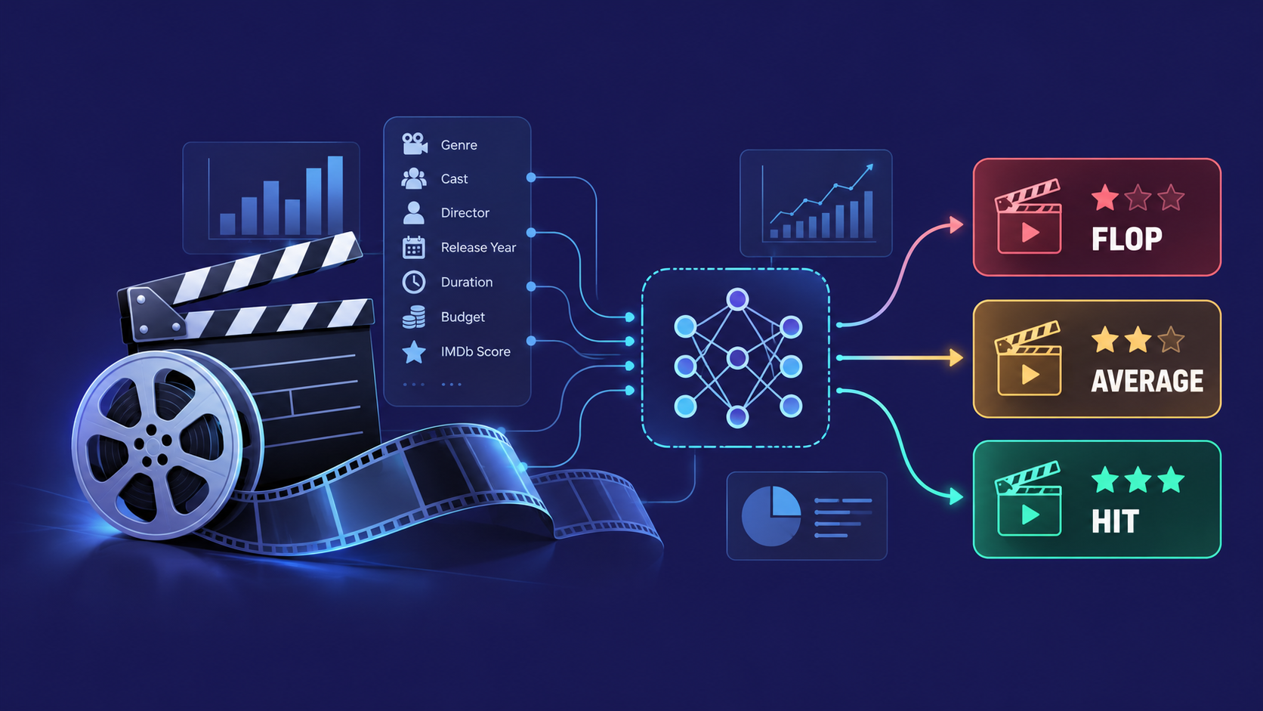
Problem Statement
Analyzing movie metadata to identify patterns associated with different IMDb rating categories can be challenging because movie datasets contain numerical and categorical features, missing values, and imbalanced target classes.
The objective is to develop and evaluate a machine-learning classification system that categorizes movies as Flop, Average, or Hit based on predefined IMDb score ranges.
The project also aims to provide an interactive interface through which users can explore the dataset and obtain model predictions.
Notes:
The main problem is that movie datasets contain both numerical and categorical information, missing values, and an imbalance between different rating categories. These challenges can affect the performance of a machine learning model.
To address this, I developed a classification approach that categorizes movies as Hit, Average, or Flop using predefined IMDb score ranges.
The project also aims to provide an interactive interface where users can explore movie data and obtain predictions from the trained model.

Slide 5
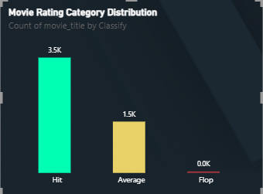
Dataset Overview
Dataset: Movie Metadata
Original records: 5,043 movies
Features: 28 columns containing movie metadata
Key features: Genre, budget, duration, director, cast, release year, and IMDb score
Target Categories
Flop: IMDb score ≤ 3
Average: IMDb score > 3 and ≤ 6
Hit: IMDb score > 6
Notes:
For this project, I used a movie metadata dataset containing 5,043 original movie records and 28 columns.
The dataset includes features such as genre, budget, duration, director, cast, release year, language, country, and IMDb score.
I divided the movies into three categories based on their IMDb scores. Movies scoring 3 or below are classified as Flop, movies scoring above 3 and up to 6 are Average, and movies scoring above 6 are Hits.
The chart shows that the dataset contains significantly more Hit and Average movies than Flop movies. This imbalance is important because it can affect how well the model learns to recognize each category.

Slide 6
Exploratory Data Analysis
Power BI was used to explore movie metadata and identify patterns in IMDb ratings.
Key analyses
Initial observations
IMDb score distribution
Most frequent movie genres
Average IMDb score by genre
Movie budget versus IMDb score
Movie release trends over time
Distribution of Flop, Average, and Hit categories
Hit movies outnumber Flop movies in the dataset.
Movie budgets do not show an obvious strong relationship with IMDb scores in the scatter plot.
IMDb ratings vary across genres.
Notes:
Exploratory Data Analysis, or EDA, helps us understand the dataset before building machine learning models.
I used Power BI to visualize the IMDb score distribution, identify the most frequent genres, compare average IMDb scores across genres, examine the relationship between movie budgets and IMDb scores, and explore movie release trends over time.
The initial observations suggest that IMDb ratings vary across genres and that movie budget alone does not show an obvious strong relationship with IMDb scores in the scatter plot.
These observations help us understand the data and guide the preprocessing and model-building stages.

Slide 7
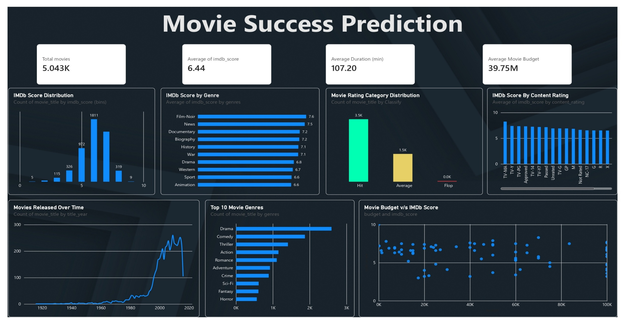
Notes:
This slide presents the Power BI dashboard created for analyzing the movie dataset.
The dashboard combines several visualizations, including IMDb score distribution, average IMDb scores by genre, movie rating categories, release trends, and the relationship between movie budgets and IMDb scores.
It also displays summary statistics, such as the total number of movies, average IMDb score, average movie duration, and average budget.
Instead of examining individual records manually, the dashboard allows us to understand the dataset through interactive visualizations and identify important patterns more easily.

Slide 8
Data Preprocessing & Methodology
Removed duplicate records.
Encoded categorical variables using One-Hot Encoding.
Handled missing values.
Imputed missing values and scaled numerical features.
Created three IMDb-based target categories.
Split the data into 80% training and 20% testing sets using stratification.
Selected relevant input features.
Workflow
Dataset
Cleaning
EDA
Preprocessing
Model Training
Evaluation
Web Application
Notes:
Before training the models, I performed several data preprocessing steps to improve data quality and prepare the dataset for machine learning.
First, I removed duplicate records and handled missing values. I then created the three target categories based on IMDb scores and selected relevant input features.
Categorical variables were converted into numerical representations using One-Hot Encoding. Missing values were imputed, and numerical features were scaled where required.
Finally, I divided the dataset into 80% training data and 20% testing data using stratification. The training data was used to train the models, while the testing data was used to evaluate their performance.
The complete workflow moves from data collection and cleaning to EDA, preprocessing, model training, evaluation, and web application development.

Slide 9
Models Compared
Five classification algorithms were evaluated:
Logistic Regression
Evaluation metrics
Decision Tree
Accuracy
Macro F1-score
Confusion matrix
Random Forest
K-Nearest Neighbors (KNN)
Macro F1-score helps evaluate performance across all three classes, including the underrepresented Flop category.
XGBoost
Notes:
I compared five classification algorithms: Logistic Regression, Decision Tree, Random Forest, K-Nearest Neighbors, and XGBoost.
Each algorithm learns patterns in the data differently, so comparing multiple models helps us understand which approach performs best for this classification problem.
I evaluated the models using accuracy, Macro F1-score, and a confusion matrix.
Accuracy measures the proportion of correct predictions. Macro F1-score calculates the F1-score for each class and gives equal importance to all three classes. This is particularly useful when the dataset is imbalanced.
The confusion matrix helps identify which categories the model predicts correctly and which categories it confuses with one another.

Slide 10
Model Performance Comparison
Model | Accuracy | Macro F1
XGBoost | 79.3% | 48.48%
Random Forest | 74.6% | 45.76%
KNN | 72.9% | 44.57%
Decision Tree | 69.9% | 43.04%
Logistic Regression | 63.5% | 43.12%
Random Forest — Final Model
Accuracy: 74.6%
Precision: 45.69%
Balanced Accuracy: 45.83%
Macro F1 Score: 45.76%
Key finding: XGBoost achieved the highest scores, but Random Forest was selected for the final implementation.
Notes:
This slide presents the performance of all five classification algorithms on the test dataset.
XGBoost achieved the highest accuracy of 79.3% and the highest Macro F1-score of 48.48%.
Random Forest achieved an accuracy of 74.6% and a Macro F1-score of 45.76%. KNN, Decision Tree, and Logistic Regression achieved lower accuracy scores than XGBoost.
Although XGBoost performed best according to both metrics shown in the comparison, I selected Random Forest for the final implementation.
The Random Forest model achieved 74.6% accuracy, with a Macro F1-score of 45.76% and a balanced accuracy of 45.83%.
These results show why we need to evaluate not only overall accuracy but also how effectively a model handles each category.

Slide 11
Movie Success Prediction System
Final Model: Random Forest
Technologies
Frontend: React
Backend: FastAPI
Machine Learning: Random Forest
Workflow
Enter movie details.
Process the input using the backend.
Generate a prediction using the trained Random Forest model.
Display the predicted category: Hit, Average, or Flop.
Notes:
This slide explains how the movie prediction system works.
The application uses React for the frontend, FastAPI for the backend, and the trained Random Forest model for making predictions.
The user first enters the required movie details through the interface. These details are sent to the backend, which processes the input and passes it to the trained model.
The model then predicts one of three categories: Hit, Average, or Flop. The application displays the predicted category to the user.
The main advantage of this approach is that users can interact with the machine learning model through a web interface without needing to run the model directly in a Python environment.

Slide 12
AI-POWERED MOVIE RESEARCH ASSISTANT
An interactive AI assistant for movie research and dataset exploration
1. General Movie Assistant
Answers questions about movies, actors, directors, genres, and filmmaking.
Provides conversational assistance powered by the Gemini API.
2. Dataset Researcher
Answers questions about the project's movie dataset.
Calculates genre-wise IMDb score averages and movie statistics using Python and Pandas.
Presents numerical evidence alongside AI-generated explanations.
3. AI Prediction Explainer
Explains predictions made by the trained Random Forest model.
Combines model outputs, feature analysis, and historical movie statistics.
Uses Gemini to communicate the results in understandable language.
Technology Stack: Gemini API | Python | Pandas | FastAPI | React
Key Benefit: Combines machine learning predictions, data-driven evidence, and conversational AI in one movie intelligence platform.
Notes:
In addition to the movie prediction system, I developed an AI-powered movie research assistant to make the platform more interactive.
It has three main functions.
The General Movie Assistant answers questions about movies, actors, directors, and genres using the Gemini API.
The Dataset Researcher answers questions about the project's dataset and uses Python and Pandas to calculate statistics, such as average IMDb scores by genre.
The AI Prediction Explainer helps users understand the model's predictions by combining prediction outputs, available feature analysis, and historical statistics with explanations generated using Gemini.
The overall goal is to combine machine learning, data analysis, and conversational AI in a single platform for movie research.

Slide 13
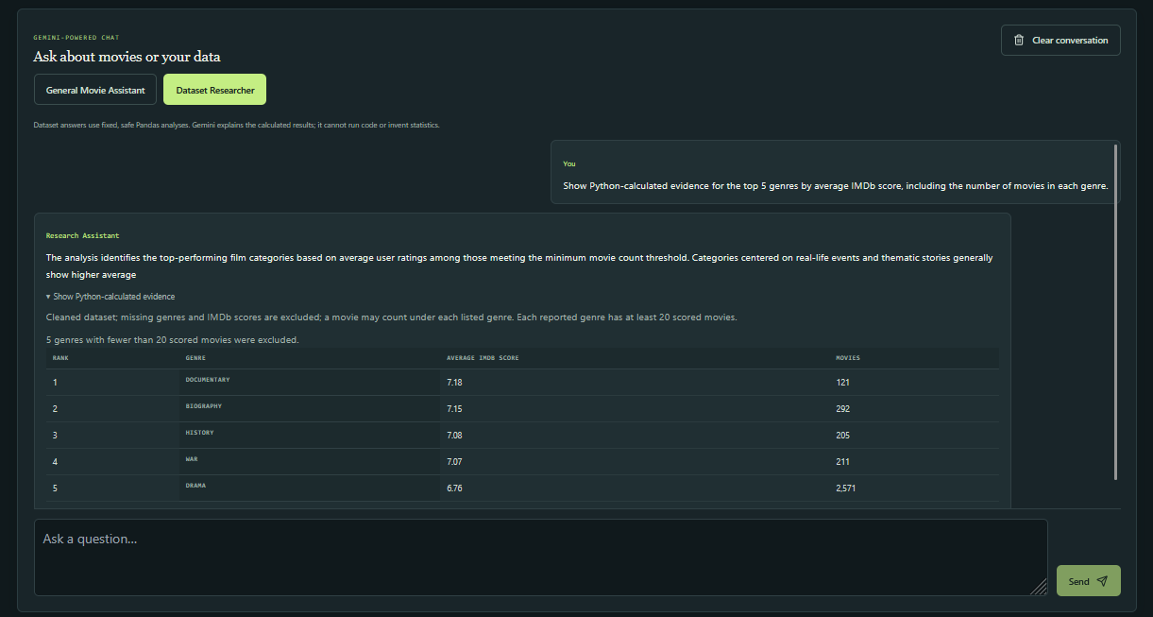
Notes:
This slide shows the interface of the AI-powered movie research assistant.
Users can select an assistant mode, enter a question, and receive a response through the chat interface.
For example, a user can ask the Dataset Researcher to identify the five genres with the highest average IMDb scores. The system can calculate the relevant statistics from the dataset and present the results in a readable format.
This makes the dataset easier to explore without requiring users to write Python code or manually calculate the statistics.
The screenshot demonstrates how the analytical capabilities of the project can be presented through a conversational interface.

Slide 14
Limitations
Imbalanced Dataset: The number of Flop movies is significantly lower than Hit and Average movies.
Prediction Performance: The model may not predict all three categories equally well.
Limited Features: Predictions depend on the available movie metadata.
IMDb-Based Classification: The categories represent IMDb ratings, not actual box-office success.
Data Quality: Missing values and inconsistencies in the dataset may affect prediction performance.
Generalization: Performance on new or unseen movies may differ from the results obtained during testing.
Notes:
Although the project demonstrates the application of machine learning to movie data, it has several limitations.
First, the dataset is imbalanced, with significantly fewer Flop movies than Hit and Average movies. This makes it difficult for the model to learn the Flop category effectively.
Second, the model's predictions depend on the available movie metadata. Missing values, inconsistent data, and limited features can affect prediction quality.
Another important limitation is that the target categories are based on IMDb ratings rather than actual box-office performance. Therefore, a predicted Hit does not necessarily mean that a movie will be commercially successful.
Finally, the model's performance on new movies may differ from its performance on the test dataset.
These limitations highlight areas where the system can be improved.

Slide 15
Conclusion
Performed exploratory data analysis using Power BI.
Compared five machine learning algorithms.
Selected Random Forest for the final implementation.
Achieved 74.6% accuracy in the model comparison.
Future Works
Improve prediction of Flop movies.
Address class imbalance.
Explore feature engineering and model optimization.
Complete and test the web application.
Notes:
To conclude, this project demonstrates how data analysis and machine learning can be applied to movie metadata to classify movies into Hit, Average, and Flop categories.
I performed exploratory data analysis using Power BI, prepared the dataset for machine learning, and compared five classification algorithms.
XGBoost achieved the highest accuracy of 79.3%, while Random Forest was selected for the final implementation, achieving an accuracy of 74.6%.
The project also incorporates a web-based prediction system and an AI-powered movie research assistant to make the analysis more accessible and interactive.
For future improvements, I plan to address class imbalance, improve the prediction of Flop movies, explore additional features and model optimization, and further test the web application.
Overall, this project demonstrates the potential of combining machine learning, data visualization, web development, and conversational AI in a single application.

Slide 16
Questions ?
Notes:
That brings me to the end of my presentation.
Thank you for your time and attention. I'm happy to answer any questions you may have about the project, the dataset, the machine learning models, or the application.

Slide 17
Thank You!
Notes:
Thank you, everyone, for listening to my presentation.

