Slide 1
ATLIQMART Ad-hoc INSIGHTS
Consumer Goods
By Dhanush Kumar

Slide 2
CONTENTS
Company Overview
Problem Statement
Dataset & Model
Ad-hoc Requests, Output, Insights
Recommendations

Slide 3
INTRODUCTION
AtliQ Hardwares (imaginary company) is one of the leading computer hardware producers in India and well expanded in other countries too.

Slide 4
Product line
P & A
N & S
P & C
Peripherals
Internal HDD
Graphic Card
Processors
Motherboard
Networking
Wi-fi Extender
Notebook
Personal Laptops
Business Laptops
Gaming Laptops
Security
External Solid State drives
USB Flash Drives
Desktops
Business Desktops
Personal Desktops
Accessories
Mouse
Keyboard
Batteries

Slide 5
Problem statement
Management noticed a lack of insights for quick, smart data-informed decisions.
Decision made to expand the data analytics team with several junior data analysts.
The data analytics director, seeks candidates with strong tech and soft skills.
To evaluate these skills, I have decided to conduct a SQL challenge.

Slide 6
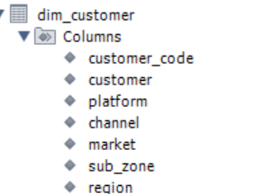
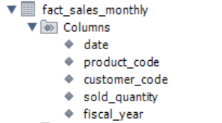
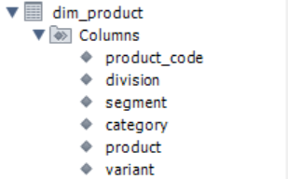
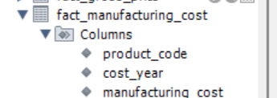
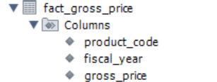
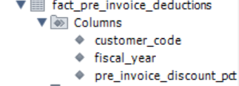
DATASET

Slide 7
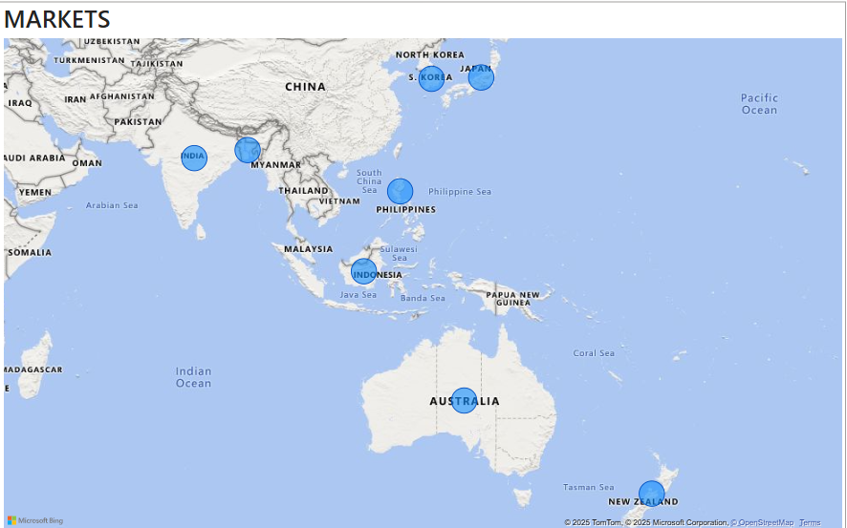
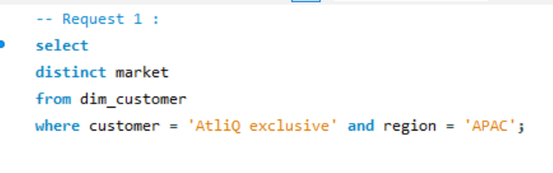
Request 1
Provide the list of markets in which customer "Atliq Exclusive" operates its business in the APAC region.
OUTPUT
INSIGHT
AtliQ Exclusive operates in eight countries within the APAC region, demonstrating a significant regional market presence.

Slide 8
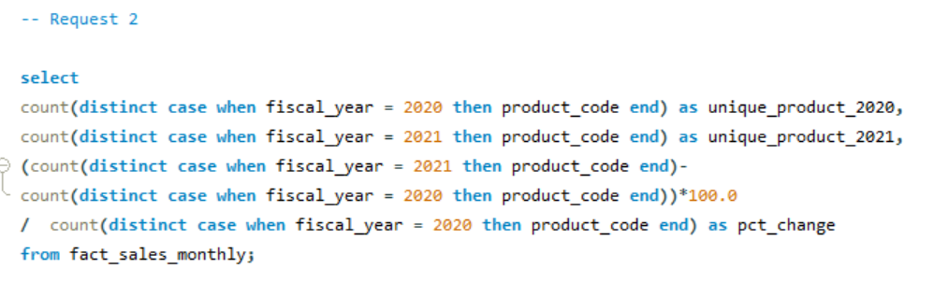
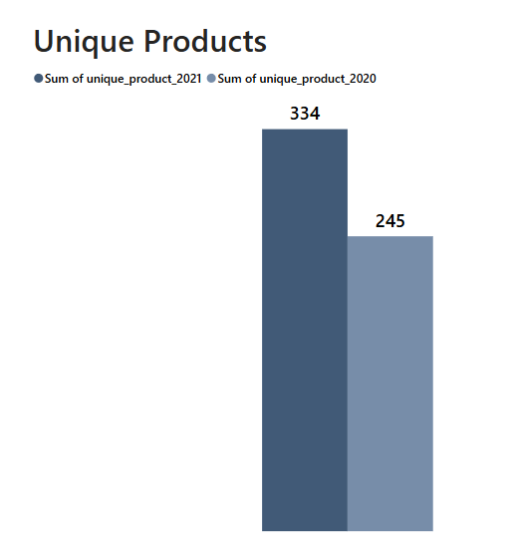
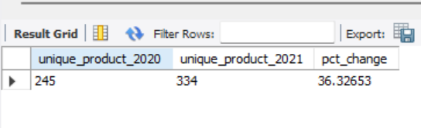
Request 2
What is the percentage of unique product increase in 2021 vs. 2020? The final output contains these fields, unique_products_2020,unique_products_2021,percentage change ?
OUTPUT
INSIGHT
1. The number of unique products grew from 245 in 2020 to 334 in 2021, marking a 36.33% increase. 2. This significant increase highlights the company's commitment to innovation and meeting diverse customer needs.

Slide 9
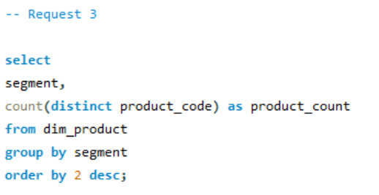
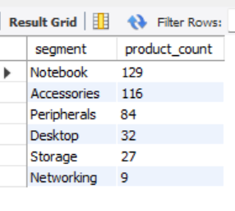
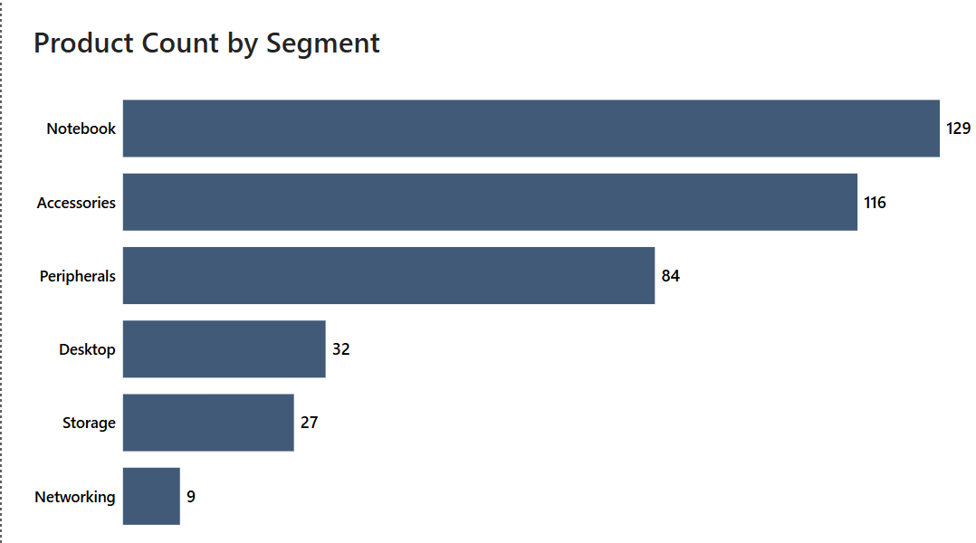
Request 3
What is the percentage of unique product increase in 2021 vs. 2020? The final output contains these fields, unique_products_2020,unique_products_2021,percentage change ?
OUTPUT
1. AtliQ shines in Notebooks, Accessories, and Peripherals segment, accounting for a whopping 82.87% of product variety. 2. Desktops, Storage, and Networking currently hold a minor share (17.13%) of AtliQ's product portfolio. 3. In Desktops, Storage, and Networking segment AtliQ should focus on products that align with current customer trends and industry demands.
INSIGHTS

Slide 10
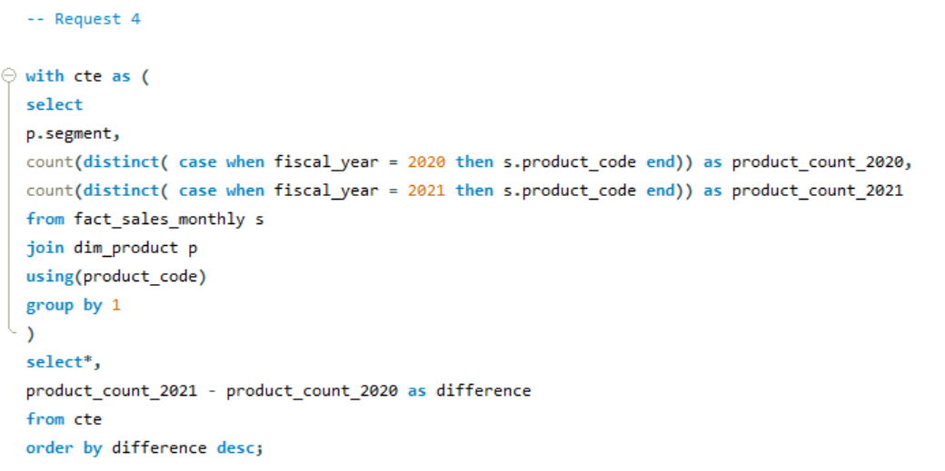
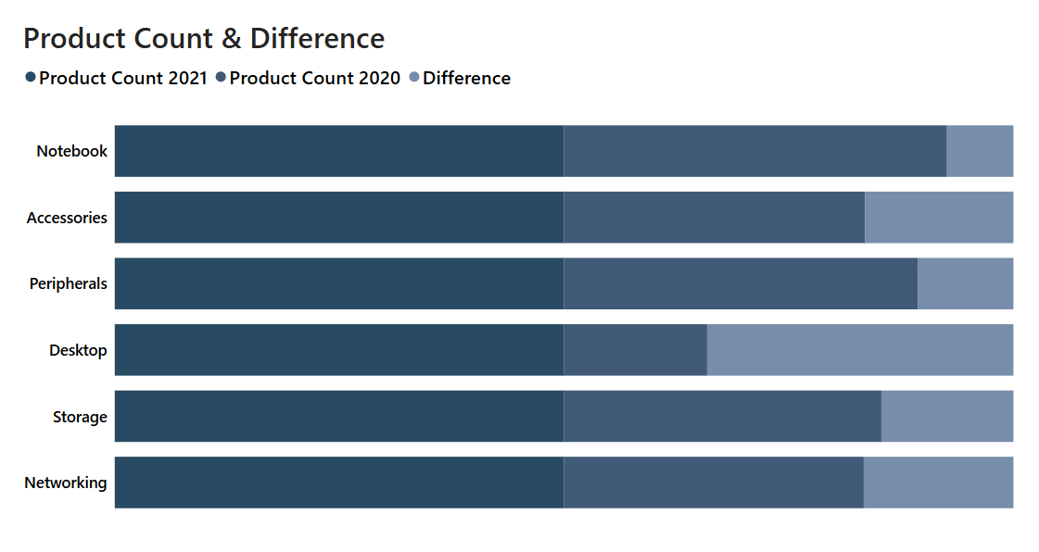
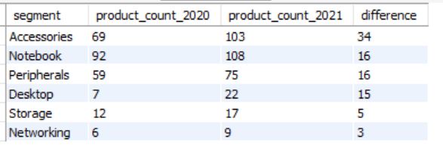
Request 4
Which segment had the most increase in unique products in 2021 vs 2020? The final output contains these fields, segment ,product_count_2020 ,product_count_2021, their difference
OUTPUT
1. Accessories have the most increased products from 2020 to 2021, with an increase of 34 new products. 2. Desktop products production increased drastically by approximately 214% from 2020 to 2021. 3. Storage and Networking segments are producing the least new products from 2020 to 2021.
INSIGHTS

Slide 11
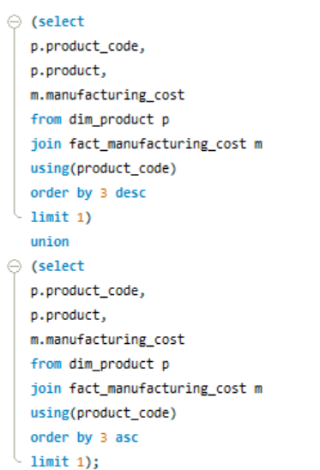
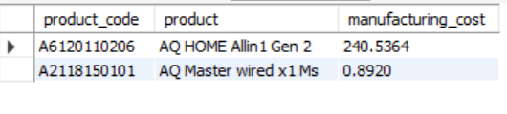
Request 5
Get the products that have the highest and lowest manufacturing costs. The final output should contain these fields, product_code, product manufacturing_cost
OUTPUT

Slide 12
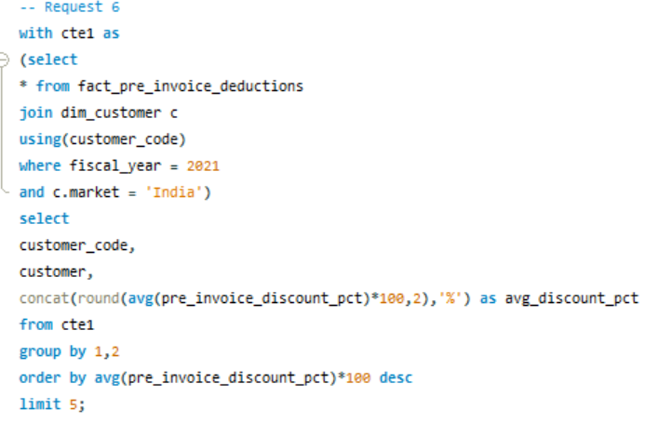
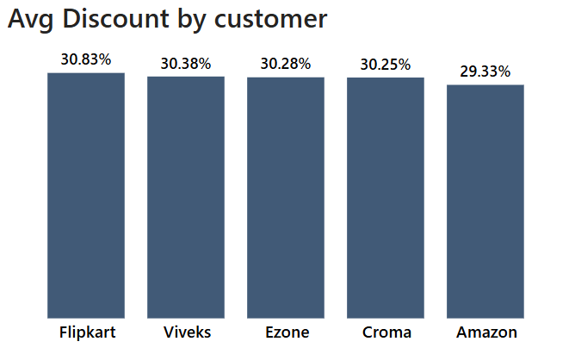
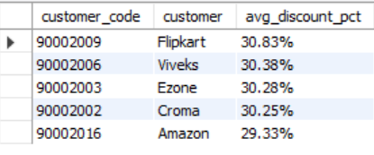
Request 6
Generate a report which contains the top 5 customers who received an average high pre_invoice_discount_pct for the fiscal year 2021 and in the Indian market. The final output contains these fields, customer_code customer average_discount_percentage
OUTPUT
INSIGHTS
1. Flipkart leads the list with the highest average discount percentage at 30.83%. 2. AtliQ has provided relatively uniform discount percentages to its top 5 customers, with a narrow range of discounts from 29.33% to 30.83%.

Slide 13
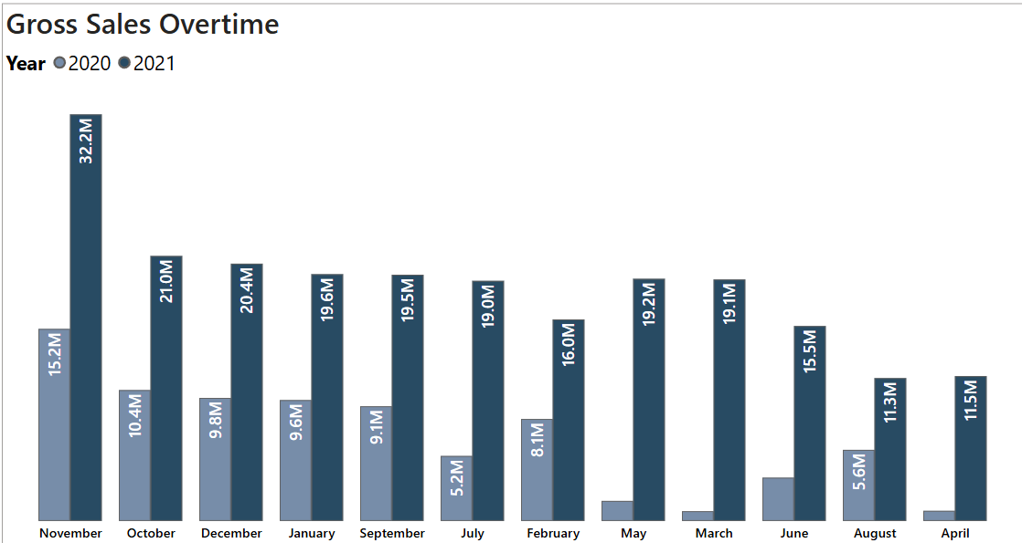
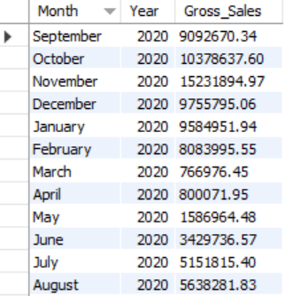
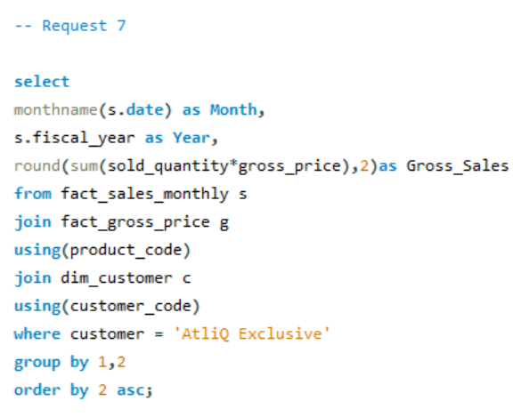
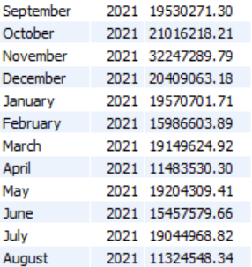
Request 7
Get the complete report of the Gross sales amount for the customer “Atliq Exclusive” for each month
OUTPUT
1. March, April, May recorded the lowest sales in 2020, likely due to the COVID-19 pandemic. Sales began to recover after June 2020.
2. November generated the highest sales for 2020, with around
15.2M
3. Sales figures in 2021 show significant growth compared to 2020.
4. In 2021, the lowest sales were in August, accounting for 11.32M, while the highest sales were in November, reaching 32.2M
INSIGHTS

Slide 14
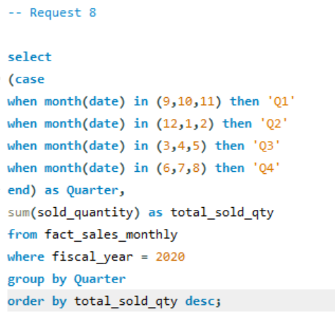
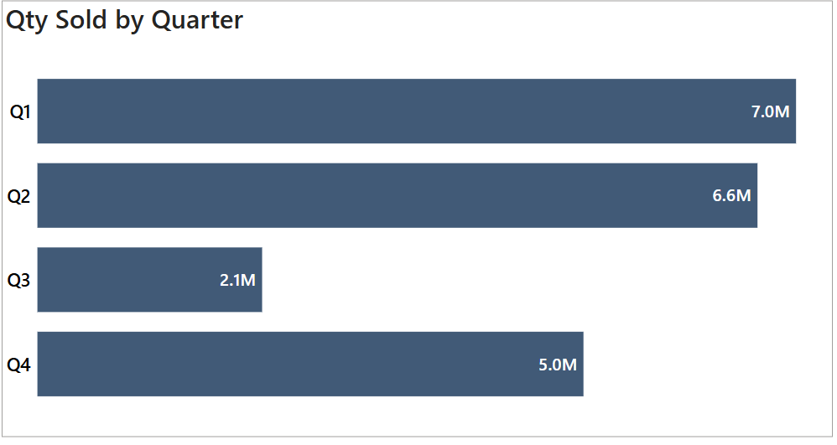
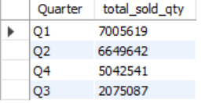
Request 8
In which quarter of 2020, got the maximum total_sold_quantity?
OUTPUT
1. Q1 (2020) saw the highest sales volume, reaching around 7M units, indicating strong performance early in the year. 2. AtliQ experienced a significant decline in sales during Q3 (March, April, May), possibly due to the COVID-19 pandemic, reflecting challenging market conditions and shifting consumer behavior.
INSIGHTS

Slide 15
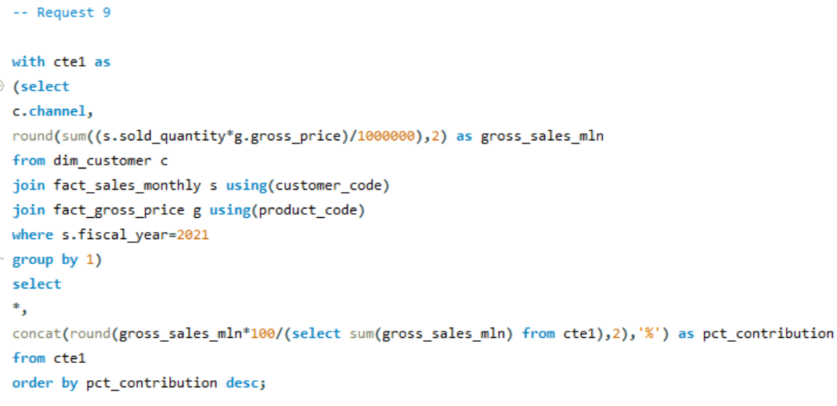
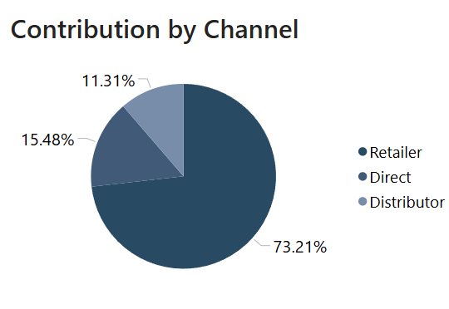
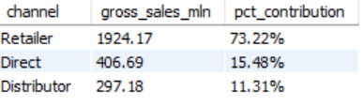
Request 9
Which channel helped to bring more gross sales in the fiscal year 2021 and the percentage of contribution?
OUTPUT
1. The majority of AtliQ's sales come from retailers, accounting for a substantial 73.2% of the total gross sales. 2. Direct and distributor channel together contributes only 26.8% of the total sales.
INSIGHTS

Slide 16
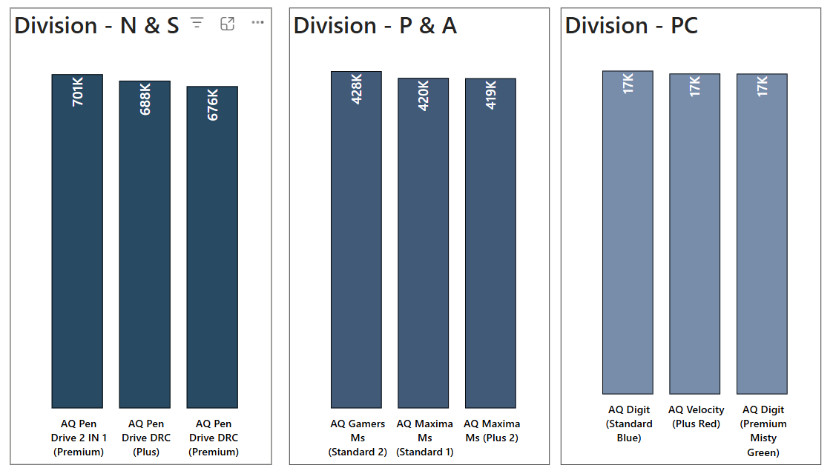
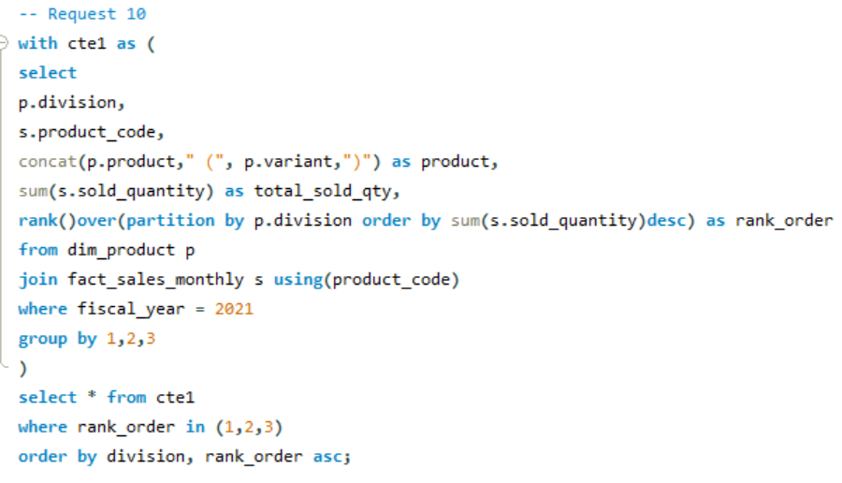
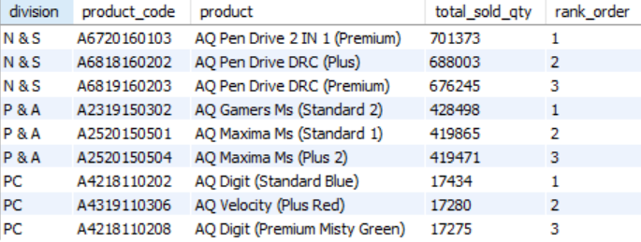
Request 10
Get the Top 3 products in each division that have a high total_sold_quantity in the fiscal_year 2021?
OUTPUT
INSIGHTS
1. In the N & S division, pen drives dominate the top three spots, showcasing their popularity and high sales performance. 2. The P & A division's top three products are exclusively mouse, reflecting a clear demand for these devices. 3. The PC division's bestsellers are all personal laptops.

Slide 17
Key INSIGHTS
Market Presence: AtliQ Exclusive operates in eight APAC markets, showing strong regional expansion.
Product Expansion: The number of unique products grew by 36.33% from 2020 to 2021, showcasing AtliQ’s commitment to innovation.
Product Category Analysis:
Notebooks, Accessories, and Peripherals account for 82.87% of the product portfolio.
Desktops, Storage, and Networking have lower representation (17.13%), needing strategic focus.
Product Growth Insights:
Accessories saw the largest increase (+34 new products).
Desktops saw 214% growth in production from 2020 to 2021.
Storage & Networking segments had minimal product growth.
Cost Analysis: Identified highest and lowest manufacturing cost products to optimize pricing strategy.
Customer Discounts: Flipkart received the highest average discount (30.83%), while AtliQ maintained consistent discounting for top customers.
Sales Analysis:
Lowest monthly sales: March-May 2020 (COVID-19 impact).
Highest sales month: November 2020 (15.2M) and November 2021 (32.2M).
Q1 2020 had the highest sold quantity (7M units); Q3 saw a major decline.
Sales Channel Performance: Retailers contributed 73.2% of total gross sales; direct and distributors made up only 26.8%.
Best-Selling Products in Each Division:
N&S: Pen drives dominated the top 3.
P&A: Mouse products were the top sellers.
PC: Personal laptops were the best performers.

Slide 18
RECOMMENDATIONS
Prioritize desktops, storage, and networking segments to drive growth.
Strengthen multi-channel marketing strategies for broader reach.
Integrate competitive pricing with compelling promotions to boost sales.
Leverage customer feedback for continuous product and service improvements.
Invest in sales team training to enhance expertise and performance.

