Slide 1



ELECTRICITY DEMAND · DATA SCIENCE · FORECASTING
PJM Regional Energy Consumption: Time Series Modeling & Forecasting
Comparative Analysis of Statistical, Machine Learning and Deep Learning Models
TEAM MEMBERS
COLLEGE / DEPARTMENT
PROJECT GUIDE
GROUP-4 MEMBERS
ACADEMIC YEAR
PROJECT MENTOR
GROUP-4 MEMBERS
Ingavale Sahil Laxman
Tinu Bawne
Raman Ingle
Dhanush
[Add team member names]
[Add college & department]
[Add guide name]
[Add academic year]
Prof. Dilawar Basha
G Tejeswar Dora
Sahani Rithik Roshan
Dasaya Revanth

Slide 2
INTRODUCTION
Project Objective
Electricity demand changes continuously over time
Accurate forecasting helps with resource planning and energy management
The project analyzes historical electricity consumption
Multiple forecasting techniques are compared
The final objective is to generate a future 30-day forecast
Historical Electricity Data
↓
EDA & Pattern Analysis
↓
Feature Engineering
↓
Model Building
↓
Model Comparison
↓
Final Forecast
Electricity Consumption Forecasting — ML & Deep Learning
2

Slide 3
DATA
Dataset Details
📁
🔢
📅
⏱
FILE
RECORDS
PERIOD
FREQUENCY
PJMW_hourly.csv
~143,000 hourly observations
2002 – 2018
Hourly
Target variable: PJMW_MW (electricity demand / consumption in MW) · Time variable: Datetime
Sample Structure
Datetime | PJMW_MW
2002-04-01 01:00 | value in MW
2002-04-01 02:00 | value in MW
2002-04-01 03:00 | value in MW
The data was sorted chronologically before time-series analysis and modeling.
Electricity Consumption Forecasting — ML & Deep Learning
3

Slide 4
DATA
Data Preprocessing
Converted Datetime from object/string to datetime format
Sorted observations chronologically
Checked missing values
Checked duplicate timestamps
Investigated irregular time intervals
Investigated outliers rather than automatically removing them
One clearly suspicious demand observation was corrected using linear interpolation
Raw Data
Datetime
Conversion
Sorting
Duplicate
Check
Missing /
Anomaly Check
Clean
Dataset
Feature
Engineering
Electricity Consumption Forecasting — ML & Deep Learning
4

Slide 5
ANALYSIS
Exploratory Data Analysis — Understanding Demand Patterns
📈
📉
⏰
📅
🔥
Chart placeholder
Chart placeholder
Chart placeholder
Chart placeholder
Chart placeholder
Overall demand over time
One-year demand trend
Hour-of-day average demand
Day-of-week average demand
Hour × Day-of-week heatmap
EDA was performed to identify:
Daily patterns
Weekly patterns
Seasonal patterns
Holidays / weekends
Long-term trends
Demand spikes & unusual observations
Electricity Consumption Forecasting — ML & Deep Learning
5

Slide 6
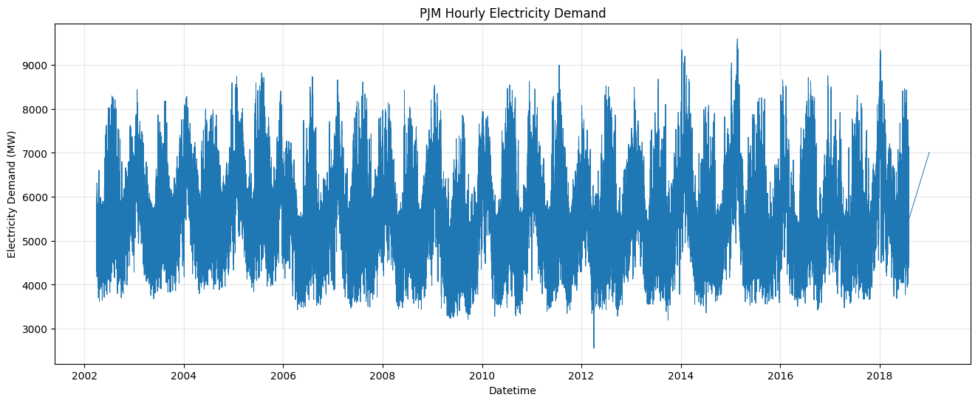
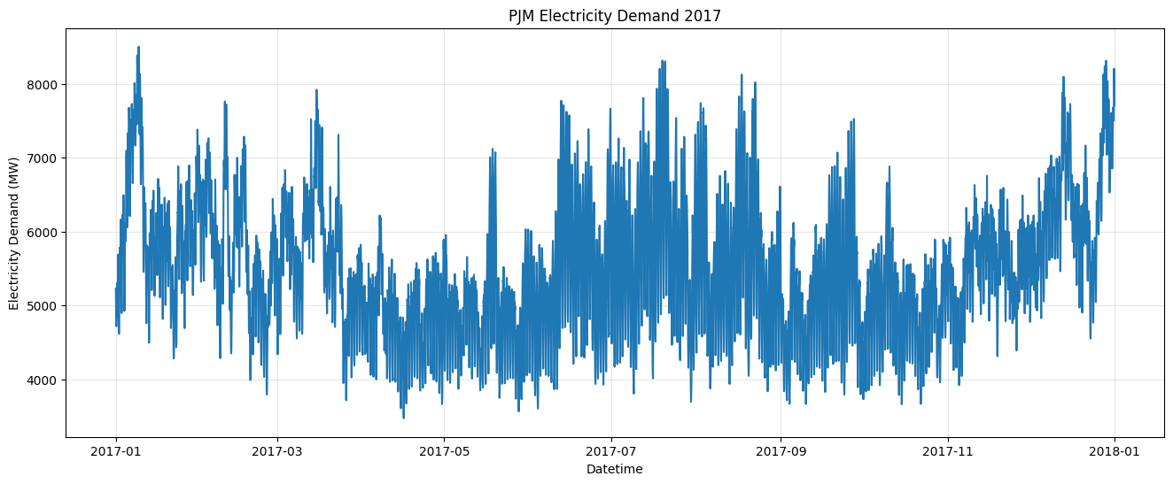
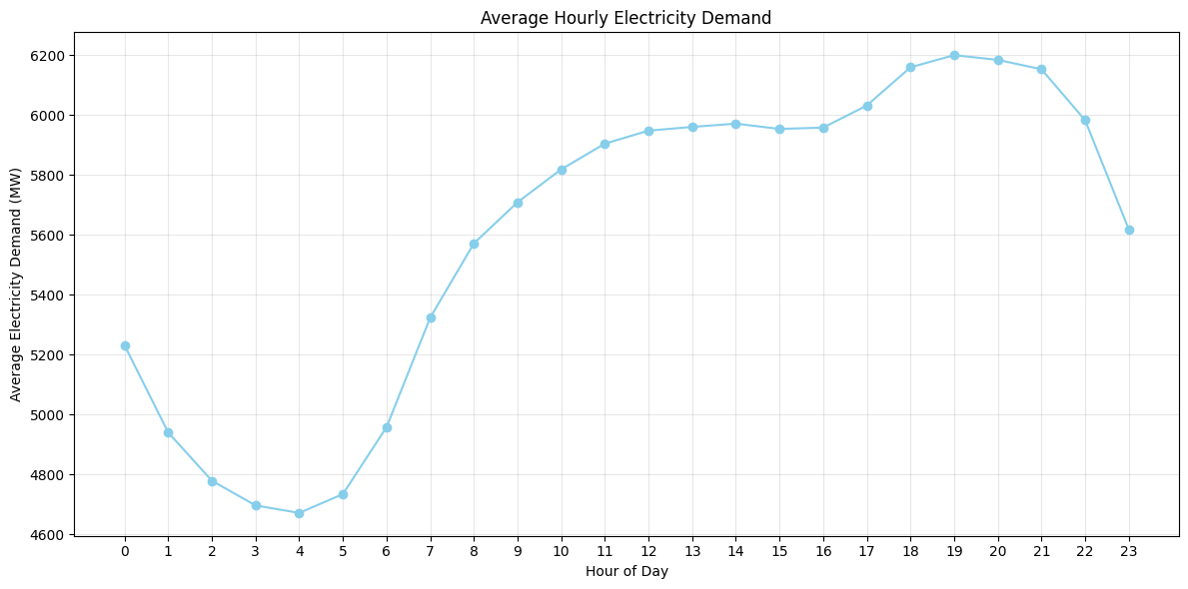
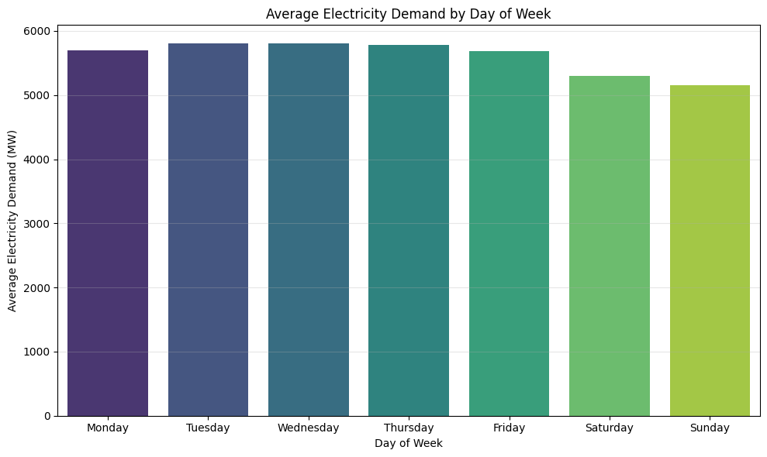
ANALYSIS
Exploratory Data Analysis — Understanding Demand Patterns
📈
📉
📅
🔥
Chart placeholder
Chart placeholder
Chart placeholder
Chart placeholder
Overall demand over time
EDA was performed to identify:
Weekly patterns
Holidays / weekends
Long-term trends
Demand spikes & unusual observations
Electricity Consumption Forecasting — ML & Deep Learning
5

Slide 7
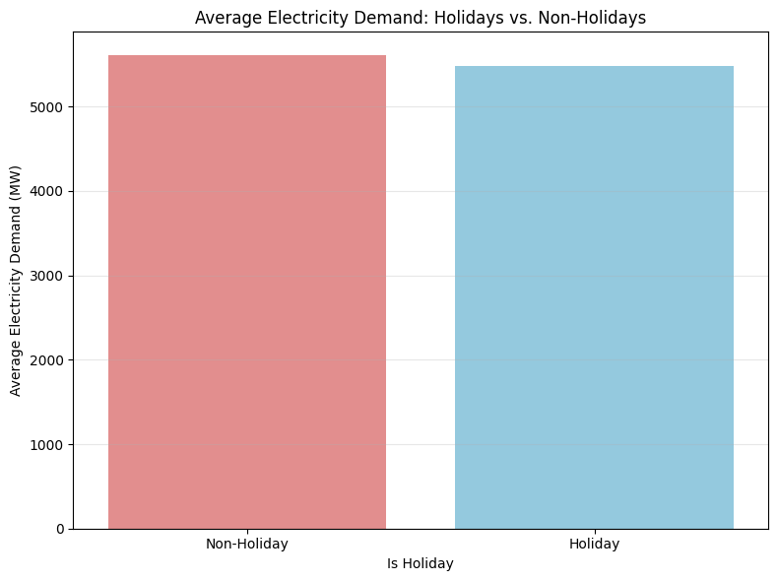
ANALYSIS
Hourly, Weekly & Holiday Patterns
⏰
📅
🎉
Hour of Day
Day of Week
Holidays
Electricity demand changes significantly throughout the day, with higher demand during active daytime / evening periods.
Weekday and weekend demand patterns differ due to changes in human and commercial activity.
US federal holidays were derived using a holiday calendar, since the original dataset did not contain an explicit holiday column.
⚖
🔥
Normal Day vs Holiday demand comparison
Chart placeholder — Hour × Day-of-Week heatmap
Electricity Consumption Forecasting — ML & Deep Learning
6

Slide 8
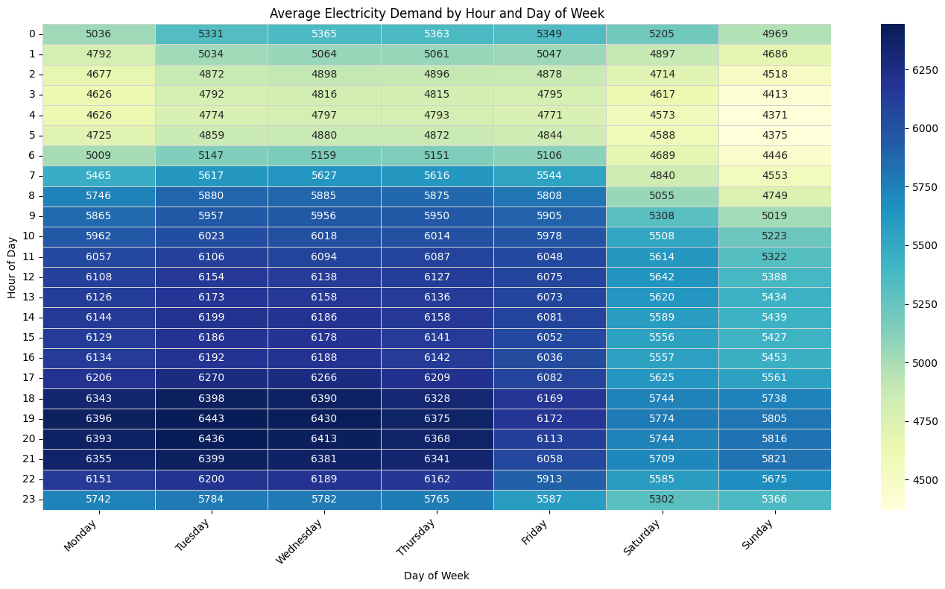
ANALYSIS
Hourly, Weekly & Holiday Patterns
⏰
📅
🎉
Hour of Day
Day of Week
Holidays
Electricity demand changes significantly throughout the day, with higher demand during active daytime / evening periods.
Weekday and weekend demand patterns differ due to changes in human and commercial activity.
US federal holidays were derived using a holiday calendar, since the original dataset did not contain an explicit holiday column.
⚖
🔥
Chart placeholder — Normal Day vs Holiday demand comparison
Chart placeholder — Hour × Day-of-Week heatmap
Electricity Consumption Forecasting — ML & Deep Learning
6

Slide 9
ANALYSIS
Seasonal & Long-Term Trends
Season | Months
Winter | December, January, February
Spring | March, April, May
Summer | June, July, August
Fall | September, October, November
Included Analyses
Seasonal hourly demand curves
Summer vs Winter comparison
Monthly average demand
Yearly average demand
Monthly trends across years
Daily electricity-demand behavior changes depending on the time of year, which makes seasonality an important forecasting component.
Electricity Consumption Forecasting — ML & Deep Learning
7

Slide 10
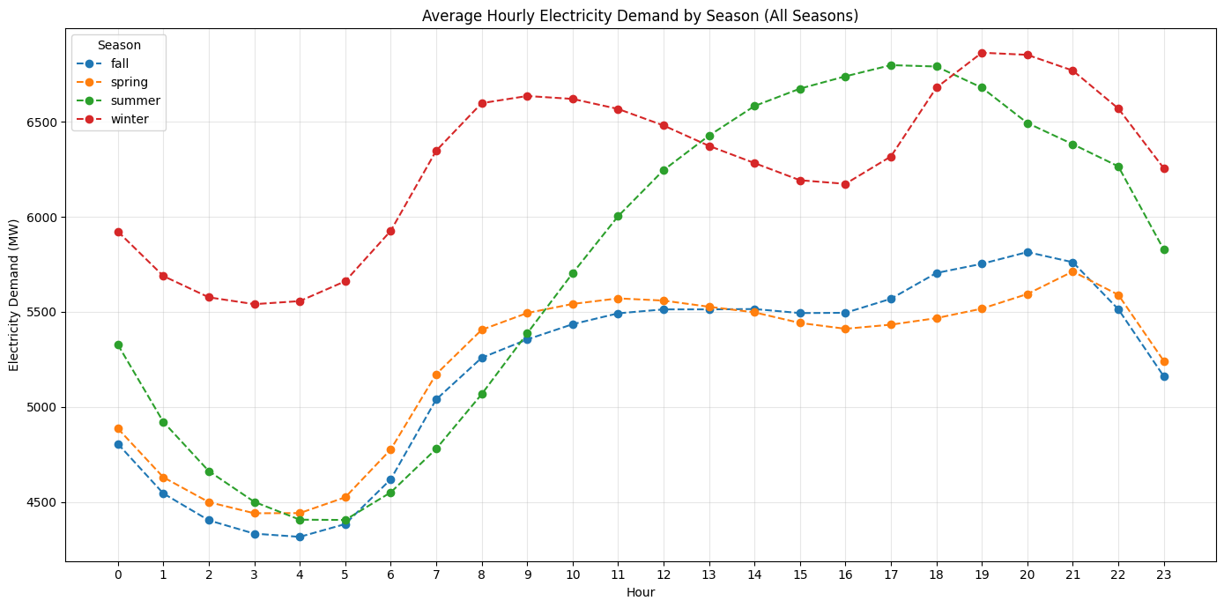
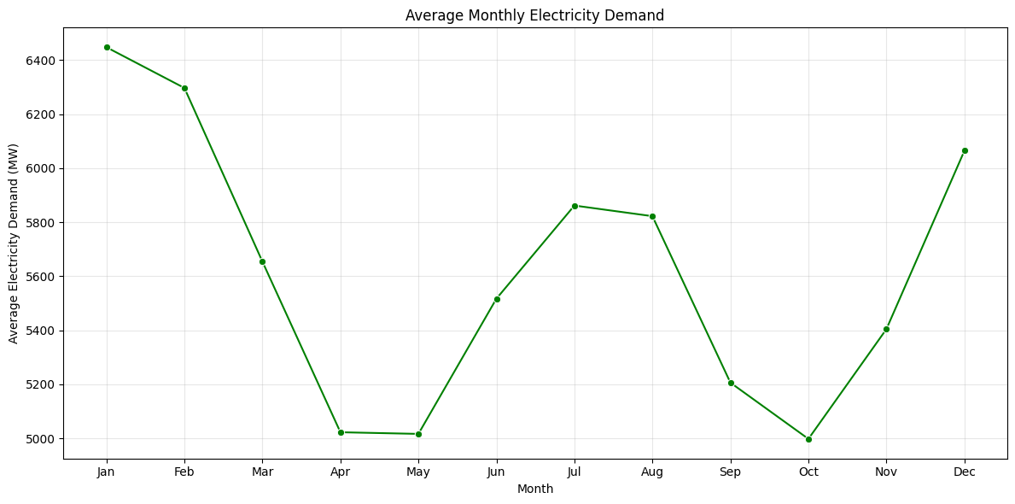
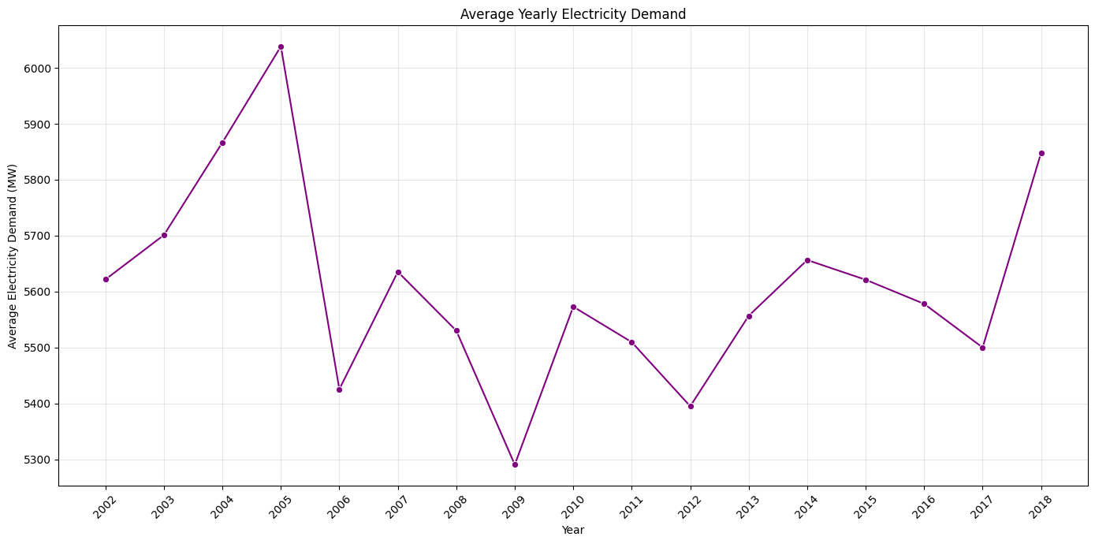
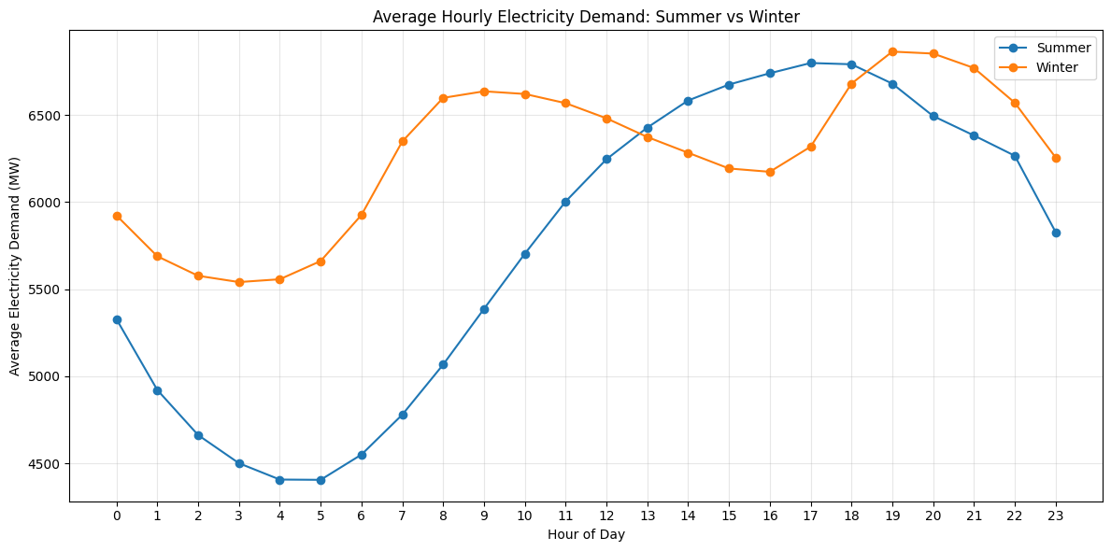
Seasonal & Long-Term Trends
Season | Months
Winter | December, January, February
Spring | March, April, May
Summer | June, July, August
Fall | September, October, November
Electricity Consumption Forecasting — ML & Deep Learning
7

Slide 11
METHODOLOGY
Train / Test Split
The last one year of data was reserved as the test set
All earlier observations were used for training
No random train / test split was used
This better simulates real-world forecasting, since future observations must not influence training
TRAINING DATA
TEST
(Last 1 Year)
2002 → 2018 (chronological order)
Electricity Consumption Forecasting — ML & Deep Learning
8

Slide 12
MODELING
Models Used
🔁
📊
🌳
🧠
♻
Seasonal Naive
SARIMAX
XGBoost
LSTM
GRU
Uses demand from the same hour one week earlier as the prediction.
Traditional statistical time-series model capturing temporal and seasonal patterns.
Gradient-boosted decision-tree model using engineered calendar, lag, and rolling features.
Deep-learning recurrent neural network designed to learn sequential dependencies.
Recurrent neural network similar to LSTM with a simpler gating architecture.
Electricity Consumption Forecasting — ML & Deep Learning
9

Slide 13
MODELING
Feature Engineering for XGBoost
Calendar Features
Datetime + Historical Demand
Hour
Day of Week
Month
Day of Year
Is Weekend
↓
Calendar Features
Lag Features
↓
Lag Features
Lag_1 = previous hour
Lag_24 = same hour, previous day
Lag_168 = same hour, previous week
↓
Rolling Features
Rolling Features
Rolling_24 (24-hour rolling average)
Rolling_168 (168-hour rolling average)
↓
XGBoost
Rolling features were calculated using shifted demand values, to avoid using the current target value and causing data leakage.
↓
Predicted Demand
Electricity Consumption Forecasting — ML & Deep Learning
10

Slide 14
EVALUATION
Model Performance Comparison
Model | MAE | RMSE | MAPE
XGBoost | 62.46 | 84.87 | 1.05%
LSTM | 241.79 | 292.43 | 3.85%
GRU | 253.48 | 310.41 | 4.01%
Seasonal Naive | 664.03 | 887.52 | 11.24%
SARIMAX | 1474.74 | 1860.92 | 24.64%
Lower values indicate smaller prediction errors.
MAE average absolute prediction error · RMSE penalizes larger errors more strongly · MAPE average percentage error
Electricity Consumption Forecasting — ML & Deep Learning
11

Slide 15
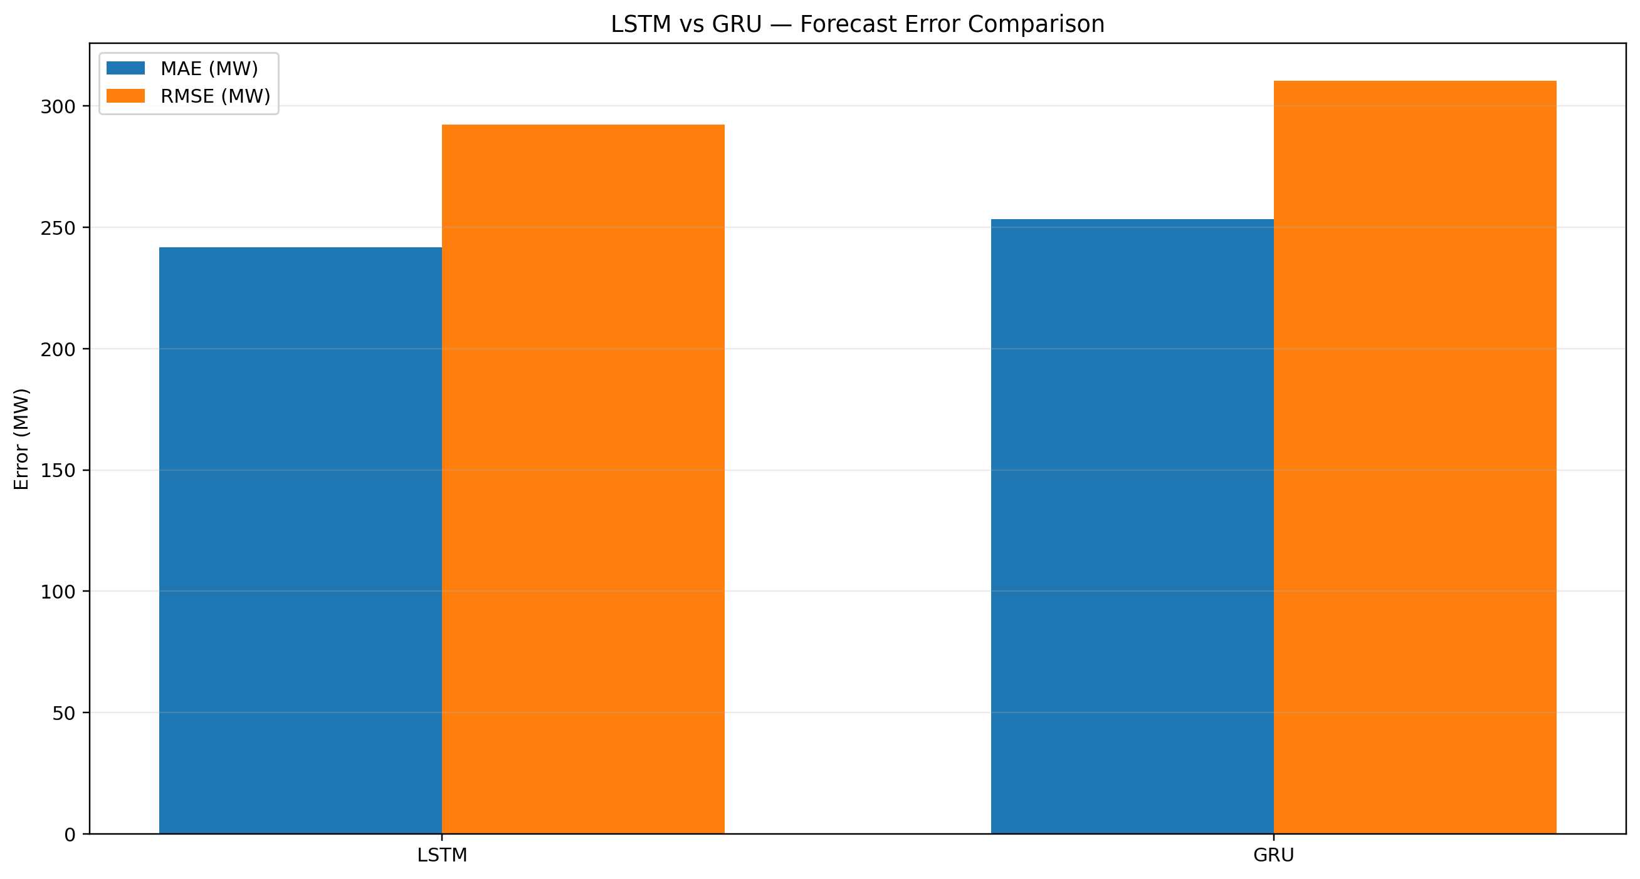
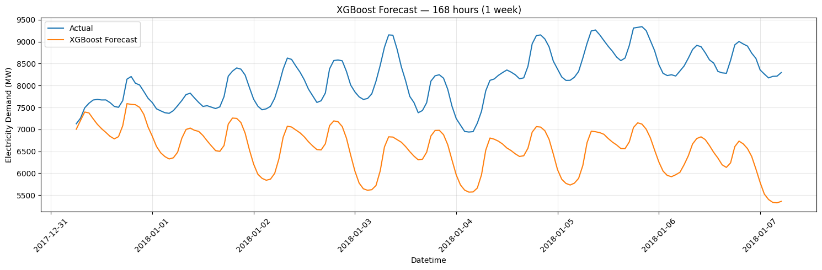
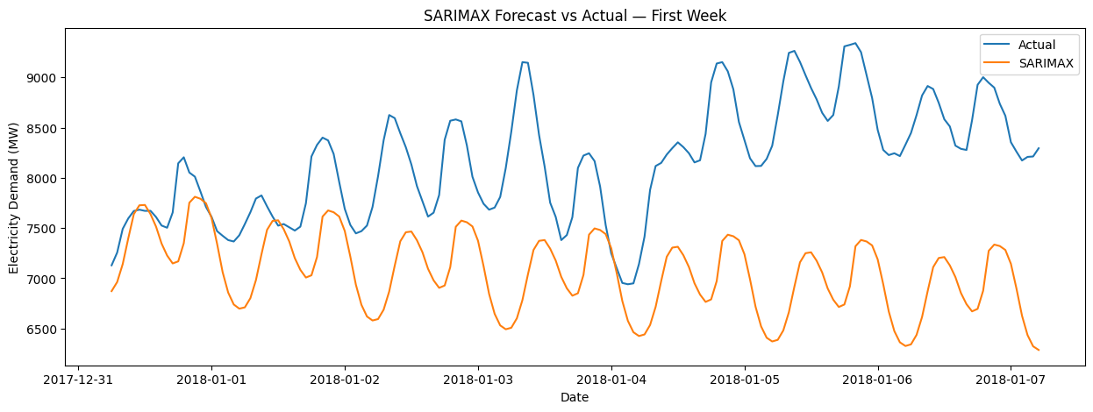
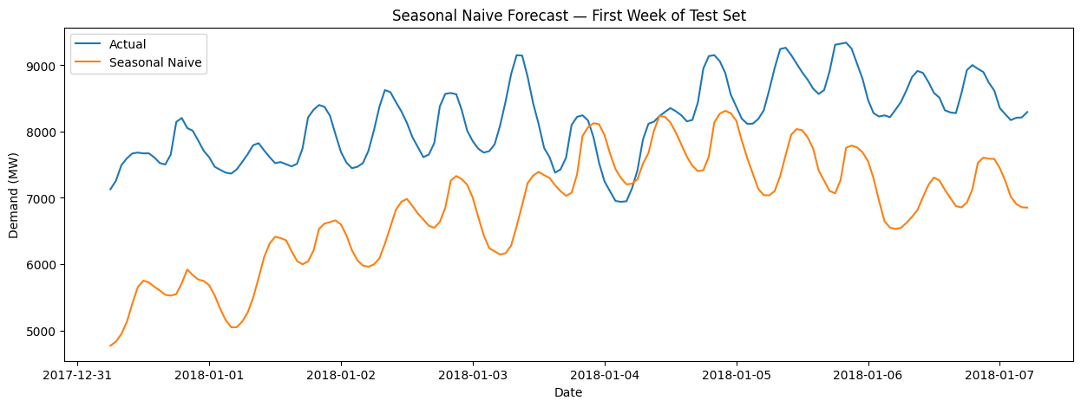
FORECASTING RESULTS
Visual comparison of historical test-period forecasts

Slide 16
EVALUATION
Model Analysis
XGBoost
LSTM
GRU
Seasonal Naive
SARIMAX
MAE 62.46 · RMSE 84.87 · MAPE 1.05%
MAE 241.79 · RMSE 292.43 · MAPE 3.85%
MAE 253.48 · RMSE 310.41 · MAPE 4.01%
Provides a useful baseline; shows that weekly seasonality is important.
Performed worse under the tested configuration; trained on a 90-day window because fitting the full hourly dataset caused a memory / RAM problem — interpret results in this context.
Performed best among the evaluated models on the one-year test set.
Conclusion: XGBoost was selected as the final model because it achieved the lowest MAE, RMSE, and MAPE among the evaluated approaches on the historical test set.
Electricity Consumption Forecasting — ML & Deep Learning
12

Slide 17
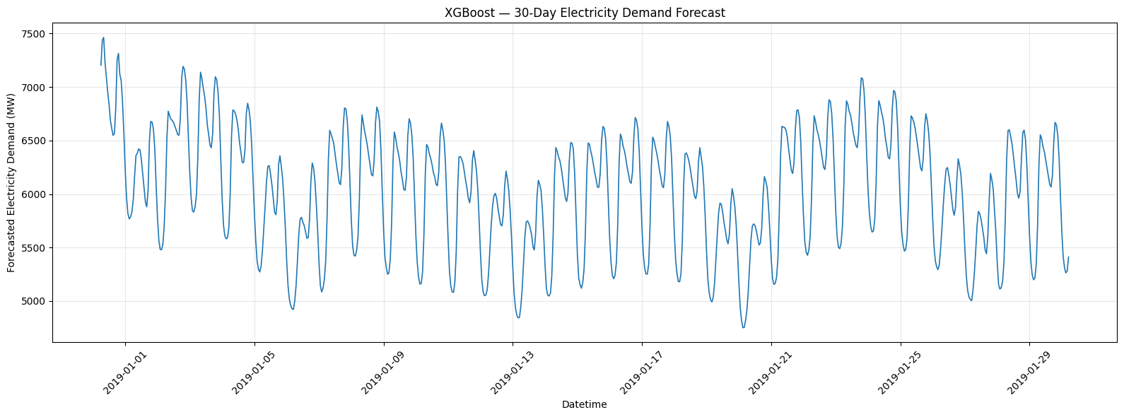
30-DAY FUTURE FORECAST
XGBoost recursive forecast — 720 hourly steps
Forecasting approach: predict one hour → append prediction → regenerate lag/rolling features → repeat for 720 hours.

Slide 18
DEPLOYMENT
Final Forecasting Pipeline
Historical PJMW
Electricity Data
Data
Preprocessing
Feature
Engineering
XGBoost
Model
Recursive Future
Forecasting
720 Hours /
30 Days Forecast
Recursive Forecasting — Actual future demand is unavailable, so:
1
2
3
4
5
Predict the next hour
Add the prediction to the historical sequence
Generate the next set of lag / rolling features
Predict the following hour
Repeat for 720 hours
Actual future demand values are not used at any point during the 30-day forecast.
Electricity Consumption Forecasting — ML & Deep Learning
13

Slide 19
REFLECTION
Challenges Faced
🗄
⚠
🔍
🔐
🧩
Large Hourly Dataset
SARIMAX RAM Limitation
Data Anomalies
Data Leakage Prevention
Different Model Requirements
Processing a large time-series dataset required careful memory management.
Fitting SARIMAX on the full hourly training dataset caused a RAM issue; a 90-day training window was used instead.
Statistical outliers were investigated rather than blindly removed; one clearly suspicious observation was corrected via interpolation.
Chronological splitting was used, and rolling features were shifted before calculation; test-period future demand was never used as a training feature.
XGBoost required engineered tabular features; LSTM / GRU required sequential input; SARIMAX required time-series-specific modeling.
Electricity Consumption Forecasting — ML & Deep Learning
15

Slide 20
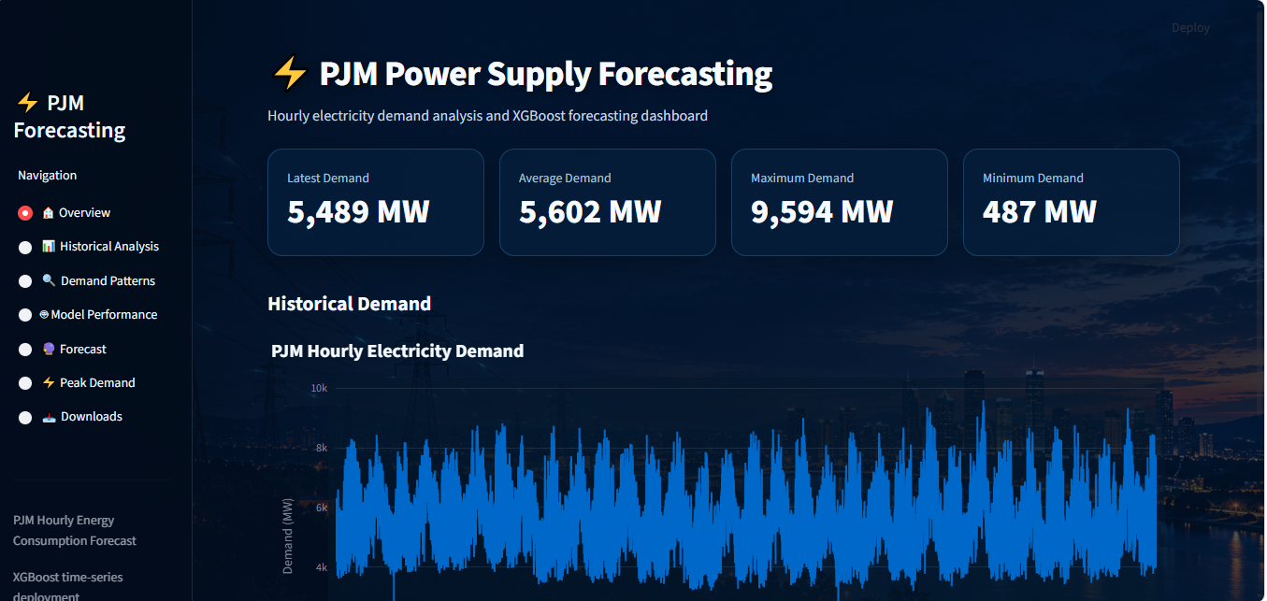
Application / Dashboard – (Click To Open The App)
SELECTED MODEL
XGBoost
FORECAST HORIZON
30-Day / 720-Hour
OUTPUT
Interactive Electricity Demand Chart
Deployed Streamlit dashboard — interactive 30-day / 720-hour electricity demand forecast
Electricity Consumption Forecasting — ML & Deep Learning
14

Slide 21
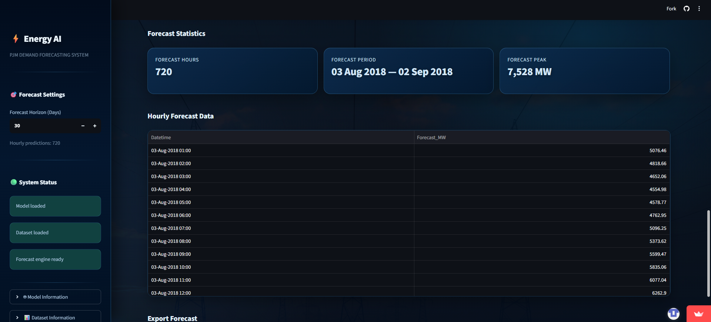
Application — Forecast Data & Export
The application exposes hourly forecast values, forecast period, peak demand and export functionality.

Slide 22
CLOSING
Conclusion & Key Learnings
Electricity demand contains strong hourly, weekly, seasonal, holiday, and long-term patterns
EDA helped identify important forecasting characteristics
Lag and rolling features were highly useful for machine-learning forecasting
Different forecasting models produced significantly different results
XGBoost achieved the lowest error among the evaluated models on the historical test set
Model complexity does not automatically guarantee better forecasting performance
Proper chronological evaluation and leakage prevention are essential for time-series forecasting
The final system can be extended for future energy-demand forecasting and monitoring
Electricity Consumption Forecasting — ML & Deep Learning
16

Slide 23
⚡
THANK YOU
Questions & Discussion
Electricity Consumption Forecasting Using Machine Learning and Deep Learning

