Slide 1
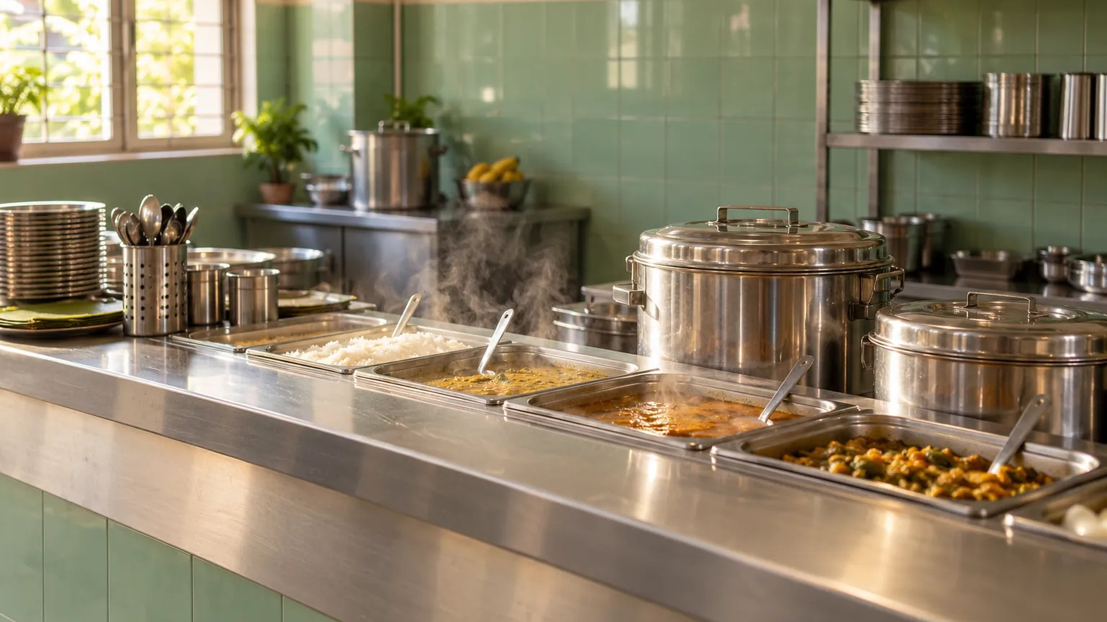
MCA 'C' · 3RD SEMESTER · KRISTU JAYANTI COLLEGE
● TOKEN
PROJECT DNA
Dhanush & Anusha
CAMPUS CANTEEN PRE-ORDER SYSTEM
Dhanush J 25MCAC18 · Anusha G 25MCAC11
Kristu Jayanti College (Deemed to be University), Bengaluru

Slide 2
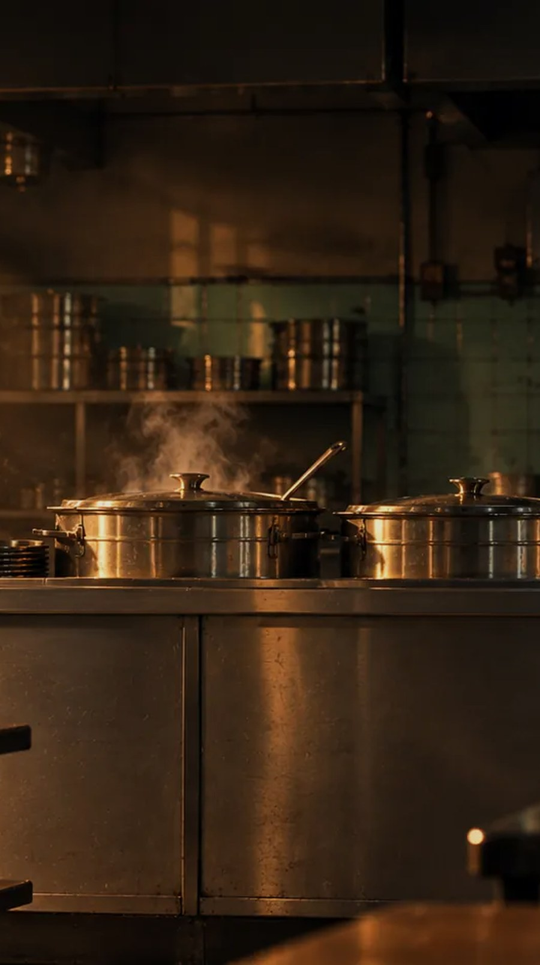
PROBLEM DEFINITION
What a canteen queue
actually costs
Long queues eat into short breaks between classes
No visibility into stock — dishes turn out sold out only after queuing
No tracking from order to pickup, so students wait blind
No filtering for health-conscious students on a static paper menu
Manual tokens and cash-only lines slow checkout and invite disputes
2

Slide 3
OBJECTIVES
What Token sets out to do
1
2
3
Pre-order from anywhere
Real-time order tracking
A live counter dashboard
Browse the live menu and order ahead from any device
Placed, Accepted, Cooking, Ready, Collected — visible at every stage
Staff manage the queue and stock without manual bookkeeping
4
5
6
An AI ordering assistant
Flexible payment
A familiar, fast experience
Recommends by budget, diet and time, including healthy-eating picks
Pay online by UPI or offline at the counter, whichever is faster
Built around pickup, with the polish of apps students already use
3

Slide 4
PROPOSED METHODOLOGY
How Token is built
SYSTEM ARCHITECTURE
ORDER LIFECYCLE
Student App React + Vite front end
↓
1
→
2
→
3
→
4
→
5
Data & API Layer Mirrors the REST endpoints exactly
↓
Placed
Accepted
Cooking
Ready
Collected
Live Order Engine Pushes status updates as orders move
An in-browser kitchen ticker advances demo orders on a timer, the same stages a live counter would move them through by hand.
↓
Counter Dashboard Queue view and stock control for staff
Same interface throughout — the Node/Express + MongoDB backend already built drops in without changing the front end.
Development approach: iterative, feature by feature, validated by a 58-check automated test suite covering auth, ordering, coupons, permissions and the assistant before any UI was wired to it.
4

Slide 5
TOOLS & TECHNOLOGY
What Token runs on
FRONTEND
BACKEND
INTELLIGENCE
TESTING & DESIGN
React
Node.js
AI Ordering Assistant
58-Check Test Suite
Vite
Express
Rule-Based Fallback
Custom Visual Identity
React Router
MongoDB
Original Food Photography
Framer Motion
Socket.io
JWT Auth
5

Slide 6
EXISTING SYSTEM VS TOKEN
Why pre-order changes the counter
EXISTING CANTEEN PROCESS
TOKEN
✕
Physical queue with no visibility into wait time
✓
Order ahead, walk over only when it is ready
✕
No live stock — dishes go sold out mid-queue
✓
Live menu — stock updates instantly for everyone
✕
No order tracking or status updates
✓
Real-time tracking, Placed through to Collected
✕
Manual, verbal tokens — easy to dispute
✓
Digital, numbered tokens — nothing to dispute
✕
No feedback loop from students to the kitchen
✓
Ratings and reviews feed back to the kitchen
✕
Cash-only, one-speed checkout
✓
Online UPI or pay offline at the counter
6

Slide 7
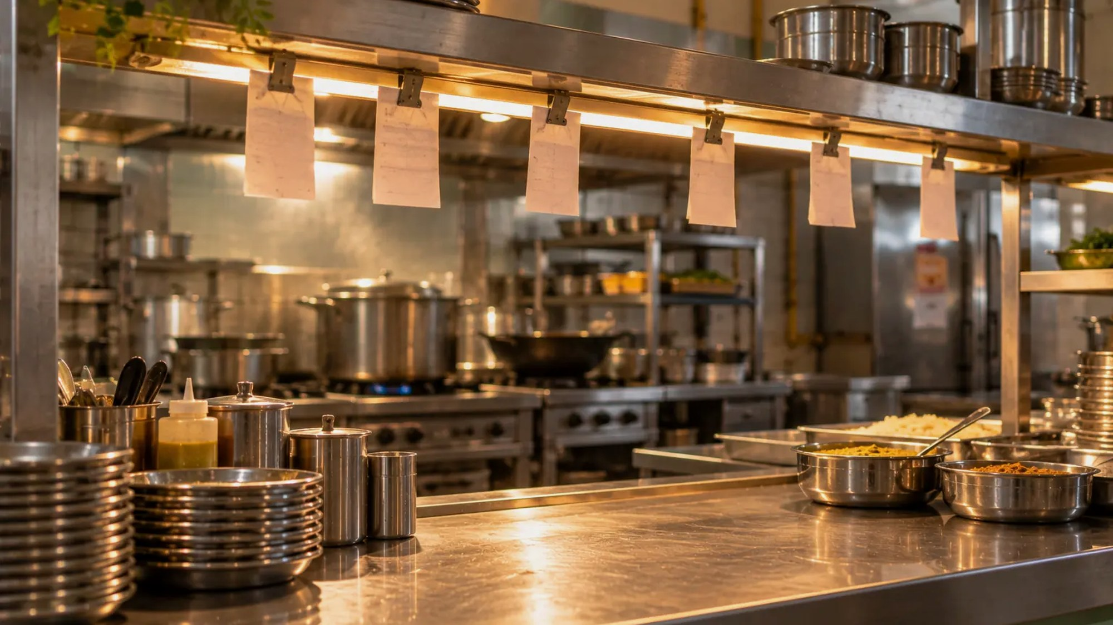
● TOKEN
Thank You
CAMPUS CANTEEN PRE-ORDER SYSTEM
Dhanush J 25MCAC18 · Anusha G 25MCAC11
MCA 'C', 3rd Semester · Kristu Jayanti College (Deemed to be University)

