Slide 1



AI-BASED CROP
RECOMMENDATION SYSTEM
Random Forest & Real-Time Weather API Integration
STUDENT
USN
COURSE
DATE
Dhanush R
Sudeep
AMB2059
AMB 2269
EAI-421
16/04/2026
University of Agricultural Sciences × REVA University, Bengaluru
Slide 1
1

Slide 2




THE PROBLEM
Farmers choose crops based on TRADITION, not science
30%
Soil nutrients (N, P, K, pH) are IGNORED in crop selection
CROP FAILURE
RATE IN INDIA
Weather conditions NOT considered before sowing
Result: Financial losses & wasted resources
Slide 2
2

Slide 3
OUR SOLUTION
INPUTS
OUTPUTS
🌱 Nitrogen (N)
✅ Recommended Crop
🌿 Phosphorus (P)
🤖 AI
ENGINE
→
→
📊 Yield Score
🌾 Potassium (K)
⚗️ Soil pH
🌱 Soil Health Report
🌤 Temperature
📈 6 Visual Charts
💧 Humidity
🌧 Rainfall
Slide 3
3

Slide 4

THE DATASET
2,200
8
22
Kaggle
Records
Columns
Crop Types
Source
KEY FEATURES
22 CROPS COVERED
Feature | Range | Unit
Nitrogen (N) | 0 – 140 | mg/kg
Phosphorus (P) | 5 – 145 | mg/kg
Potassium (K) | 5 – 205 | mg/kg
Temperature | 8.8 – 43.7 | °C
Humidity | 14.3 – 99.9 | %
pH | 3.5 – 9.9 | —
Rainfall | 20.2 – 298.6 | mm
🍚 Rice
🌽 Maize
🫘 Chickpea
☕ Coffee
🍌 Banana
🥭 Mango
🍇 Grapes
🍉 Watermelon
🍎 Apple
🍊 Orange
🥥 Coconut
🌿 Cotton
Slide 4
4

Slide 5

HOW IT WORKS — PIPELINE
1
2
3
4
5
DATA
LOADING
→
FEATURE
ENG.
→
MODEL
TRAINING
→
WEATHER
API
→
PREDICT
& VISUALIZE
2,200 crop records loaded from CSV
Yield score = T×0.3 + H×0.2 + R×0.5
RF Classifier + RF Regressor trained
Live data fetched via OpenWeatherMap
Crop + Yield + 6 Charts generated
DATA PREPROCESSING:
✓ No missing values ✓ No explicit scaling needed (RF uses thresholds, not distances) ✓ Duplicates checked ✓ Outliers verified
Slide 5
5

Slide 6


WHY RANDOM FOREST?
No Scaling Needed
Handles 22 Classes
Uses thresholds, not distances
Multi-class naturally supported
🗳 MAJORITY
VOTE
Outlier Robust
High Accuracy
Ensemble averaging reduces noise
~99% on agricultural data
→
RICE: 🟩🟩🟩🟩
MAIZE: 🟩
→ RICE WINS!
Tree 1
Tree 2
Tree 3
Tree 4
Tree 5
Slide 6
6

Slide 7
LIVE WEATHER API
👨‍🌾
FARMER
Enters City Name
🌐
OpenWeatherMap
API Call
📊
LIVE DATA
Returned
━━━▶
━━━▶
DATA FETCHED IN REAL-TIME:
🌡
💧
🌧
🔄
Temperature
Humidity
Rainfall
Fallback
°C from API
% from API
1hr rain × 10mm
5mm if no rain data
📍 EXAMPLE — BANGALORE: Temp: 32.99°C | Humidity: 33% | Rainfall: 50mm → Recommended: mothbeans
Slide 7
7

Slide 8

TWO AI MODELS
MODEL 1: CLASSIFIER
MODEL 2: REGRESSOR
Random Forest
Classifier
Random Forest
Regressor
Task: Predict best crop Output: 1 of 22 crop classes Accuracy: ~99.1%
Task: Estimate yield score Formula: T×0.3+H×0.2+R×0.5 R² Score: ~0.9997
Slide 8
8

Slide 9
PERFORMANCE METRICS
99.1%
99.0%
99.1%
0.9997
1.82
Accuracy
Precision
Recall
R² Score
RMSE
Classifier
Weighted
Weighted
Regressor
Regressor
WHY SO HIGH?
✓ Well-structured Kaggle dataset
✓ Clear feature-label relationships
✓ 22 crops well-separated
✓ Random Forest ensemble power
Slide 9
9

Slide 10

THE WEB INTERFACE — GRADIO UI
🌾 AI Crop Recommendation System
KEY FEATURES
Enter Region
🏙 Just type ANY city name
Bangalore
⚡ Real-time weather data fetched
Predict
🌾 Crop recommendation in seconds
🌱 Recommended Crop:
mothbeans
📊 6 charts generated automatically
🌱 Soil: N: Low | P: High | K: High
👩‍🌾 Designed for non-tech users
📊 Yield Score: 44.16 | 🌡 32.99°C | 💧 33% | 🌧 50mm
🔓 No login required
Slide 10
10

Slide 11

SAMPLE OUTPUT — BANGALORE
RECOMMENDED CROP:
🌱
mothbeans
Yield Score: 44.16
Confidence: HIGH
🌡
💧
🌧
🌱
🌿
🧪
Temperature
Humidity
Rainfall
Nitrogen
Phosphorus
Potassium
32.99 °C
33 %
50 mm
LOW
HIGH
HIGH
🧬 SOIL HEALTH REPORT:
Nitrogen: LOW ⚠️
Phosphorus: HIGH ✅
Potassium: HIGH ✅
Slide 11
11

Slide 12
6 DYNAMIC VISUALIZATIONS
1
📊
2
🌤
3
📈
Soil Nutrient Bar Chart
Weather Data Bar Chart
Yield Prediction Bar
N, P, K levels as vertical bars
Temp, Humidity, Rainfall side-by-side
Predicted yield score visualized
4
📉
5
🥧
6
⚖
Weather Trend Line Plot
Soil Composition Pie
Current vs. Ideal Conditions
5-point simulated weather trend
Proportional nutrient breakdown
Your values vs. ideal agricultural levels
Slide 12
12

Slide 13
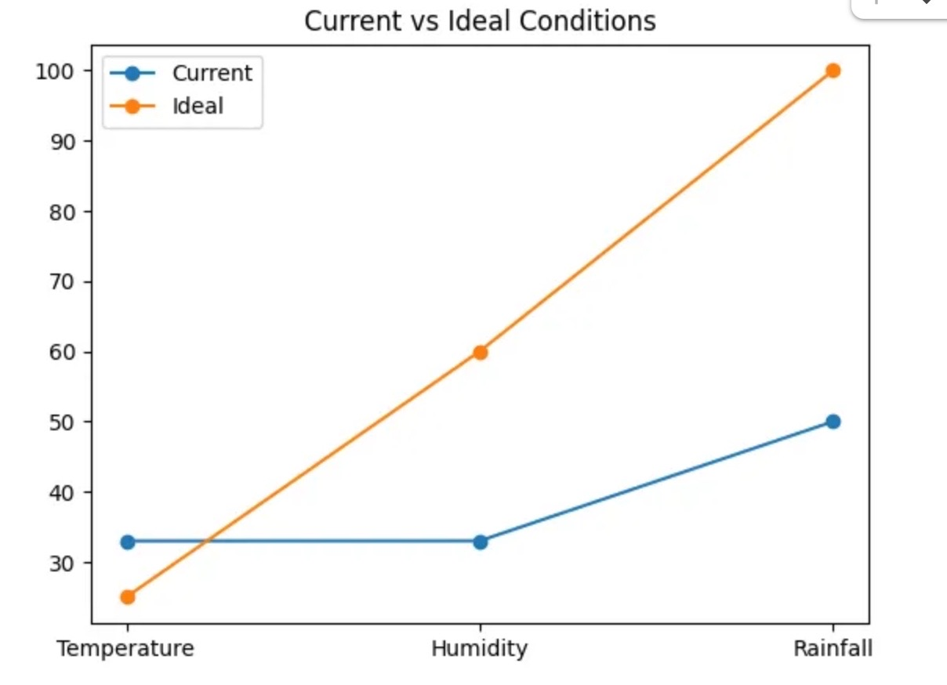
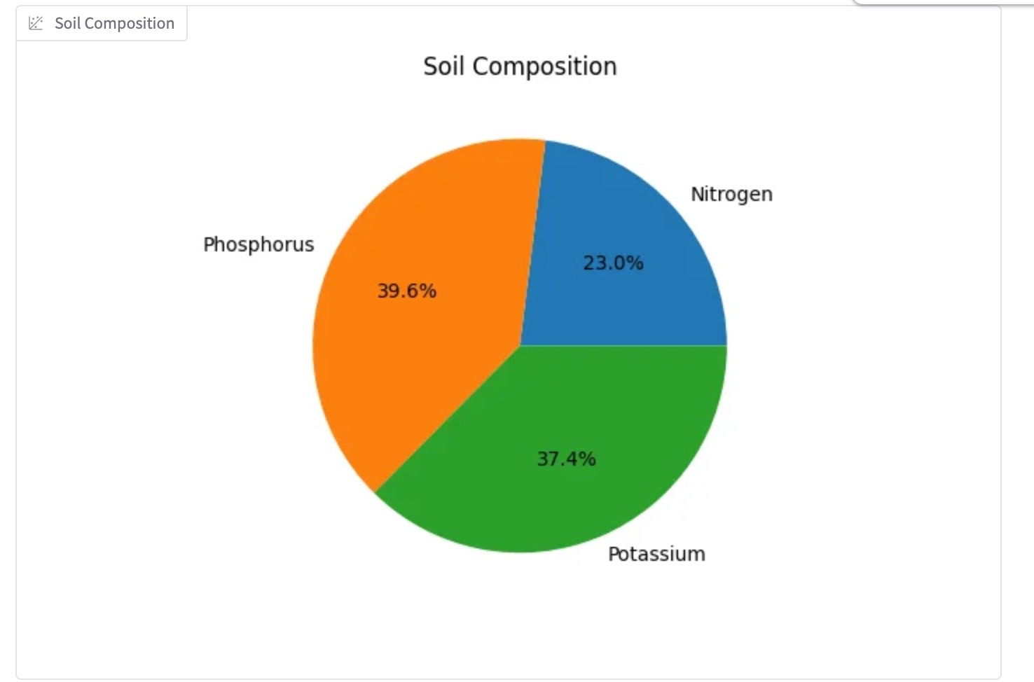
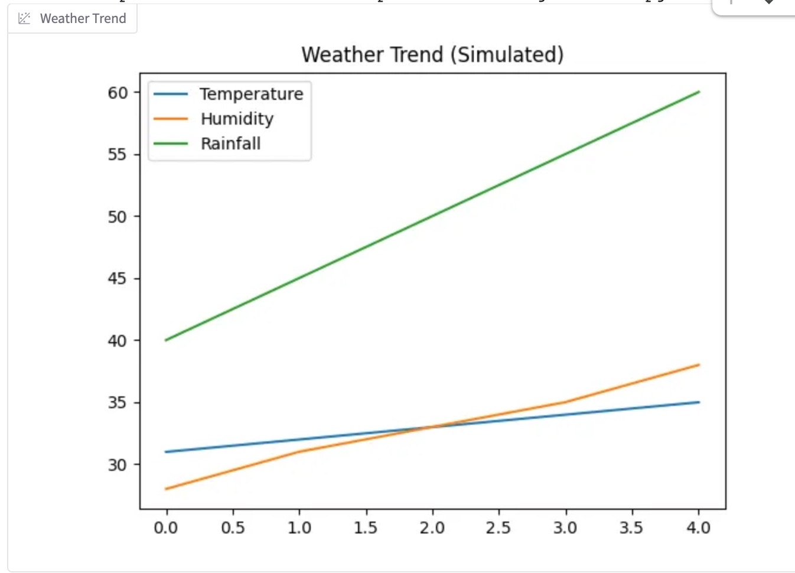
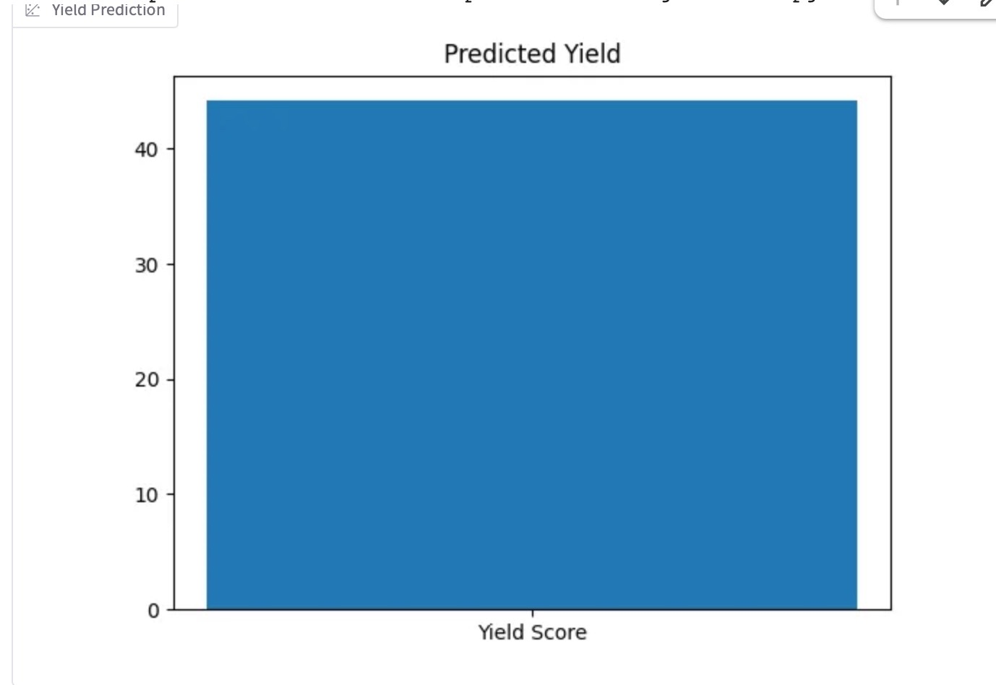
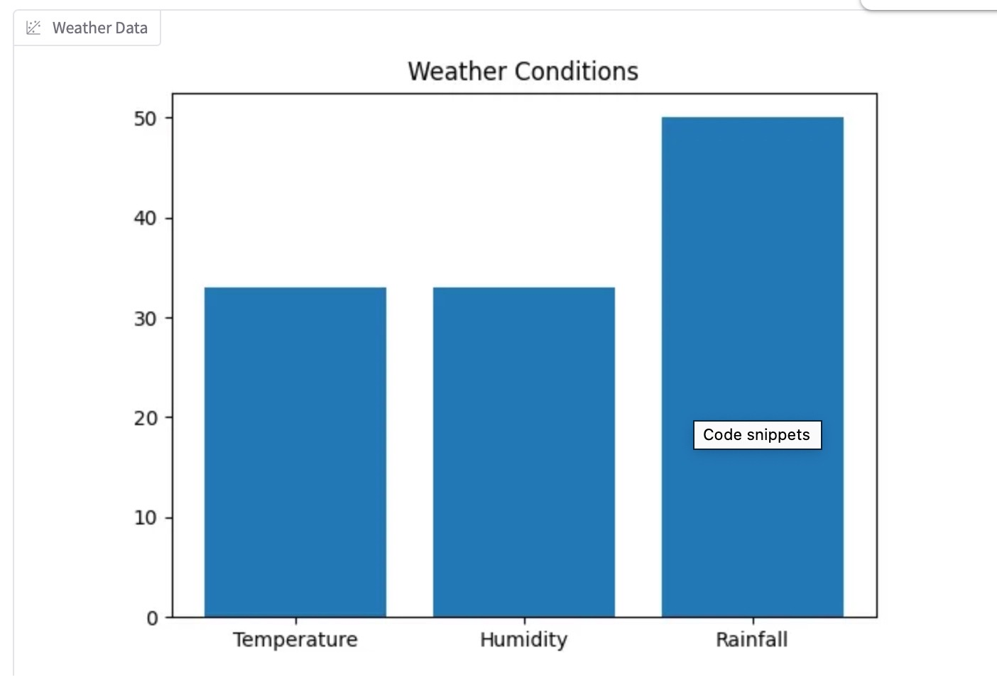
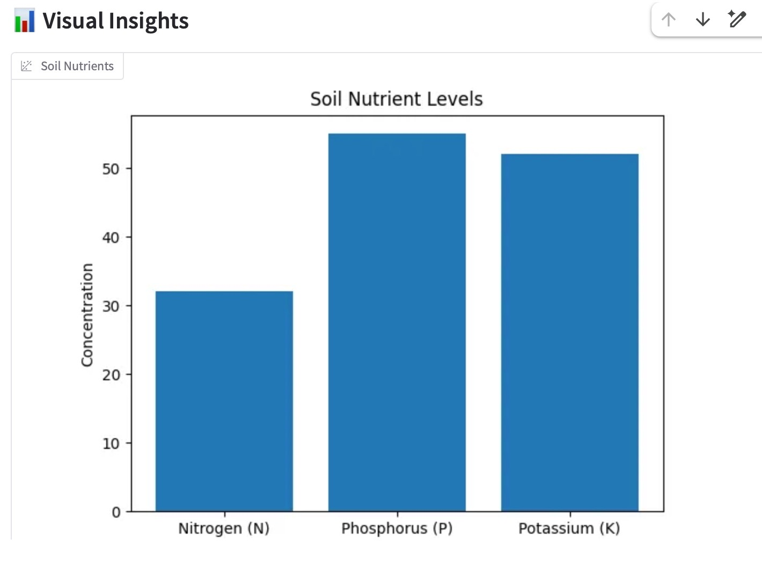
VISUALIZATIONS — LIVE CHARTS
Slide 13
13

Slide 14
STRENGTHS & LIMITATIONS
✅ STRENGTHS
⚠️ LIMITATIONS
Real-time weather makes it context-aware
Soil N,P,K: random sample, not real sensor
Gradio UI: No technical knowledge needed
Rainfall: 1-hour API, not seasonal
6 charts = rich analytical insights
Yield score is synthetic, not validated
RF handles mixed data, no scaling needed
No crop rotation or irrigation data
Fast prediction — results in seconds
Full dataset training — no train/test split
Slide 14
14

Slide 15

REAL-WORLD APPLICATIONS
💧
🔬
📦
Smart Irrigation
Disease Detection
Yield Forecasting
Extend to evapotranspiration models → save 40% water
Replace crop label with disease type + CNN on field photos
Predict seasonal volumes for market & supply chain planning
🧪
🏛
🛰
Fertilizer Optimizer
Government Advisory
Satellite NDVI
N,P,K thresholds → specific dosage recommendations
Scale to district-level SMS advisory for extension officers
Integrate satellite crop health monitoring data
Slide 15
15

Slide 16

FUTURE IMPROVEMENTS
PHASE 1
🌱 Real Soil Sensors
Integrate IoT soil sensor APIs for live N,P,K,pH readings instead of dataset samples
PHASE 2
📊 Real Yield Data
Replace synthetic yield_score with actual crop yield records (kg/hectare) from government data
PHASE 3
🔬 Disease Prediction
Extend model to predict crop diseases using CNN analysis of field photographs
PHASE 4
📱 Mobile App
Native Android/iOS app with offline mode for farmers in low-connectivity rural areas
🎯 Vision: Full-stack AI precision agriculture platform for Indian smallholder farmers
Slide 16
16

Slide 17
TECH STACK & CODE SUMMARY
🐍
Python
🤖
Scikit-learn
🐼
Pandas
Core Language
ML Models (RF)
Data Handling
🖥
Gradio
📊
Matplotlib
🌤
OpenWeatherMap
Web UI
6 Charts
Weather API
$ pip install pandas scikit-learn requests gradio matplotlib
📒 Google Colab: colab.research.google.com/drive/1-PfnF5Jk_DRZK0A_E-ZKL5m74GBHxIEC
Slide 17
17

Slide 18
IN SUMMARY...
AN AI THAT HELPS
FARMERS GROW SMARTER 🌾
✅ ~99% accuracy with Random Forest Classifier
✅ Real-time weather via OpenWeatherMap API
✅ Soil health + yield score + 6 visual charts
✅ Simple Gradio UI — usable by any farmer
🙏 THANK YOU! — Dhanush R | AMB2059 | EAI-421 | UAS × REVA University
Slide 18
18

