Slide 1
BUILD REPORT
Jenkins Current Build Status | Success (except Sukuplatformv5api )
Robot test cases | All passed
Protractor test cases | Not running in pipeline
Unit test cases | Not running in pipeline
Sonarqube | Latest report not available

Slide 2
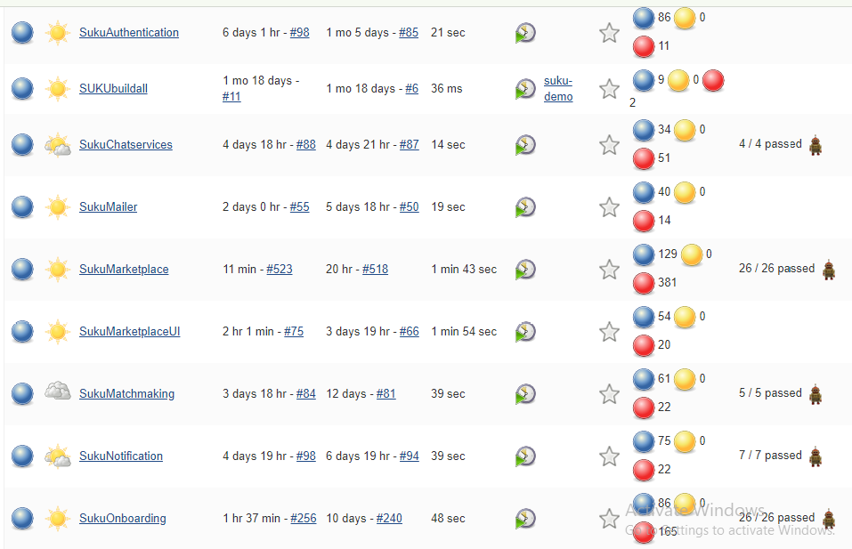
Jenkins Build Status Report

Slide 3
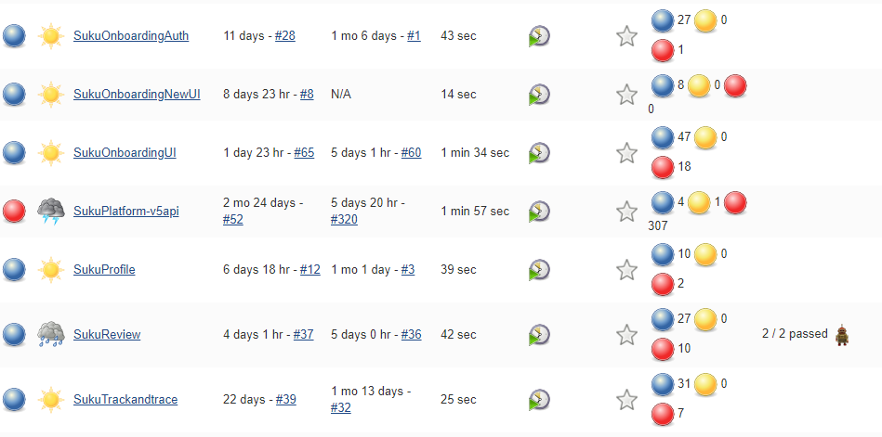
Contd..

Slide 4
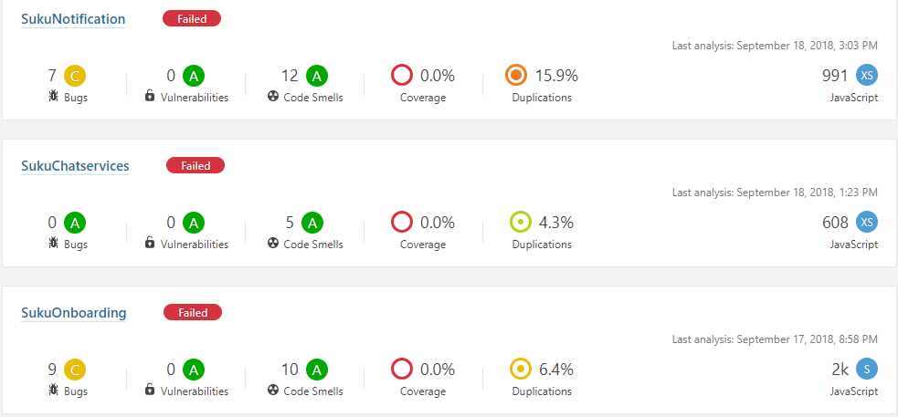
Sonarqube Report

Slide 5
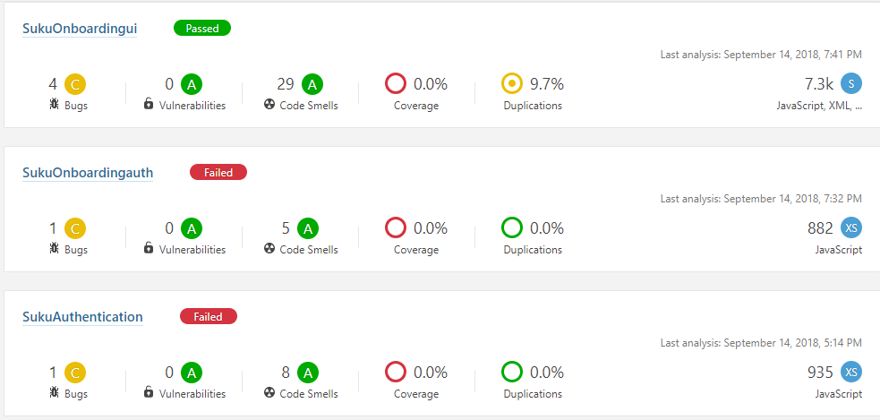
Contd..

Slide 6
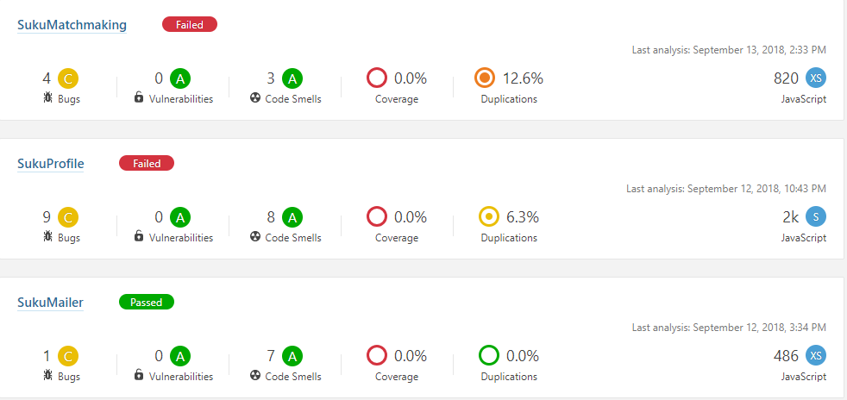
Contd..

Slide 7
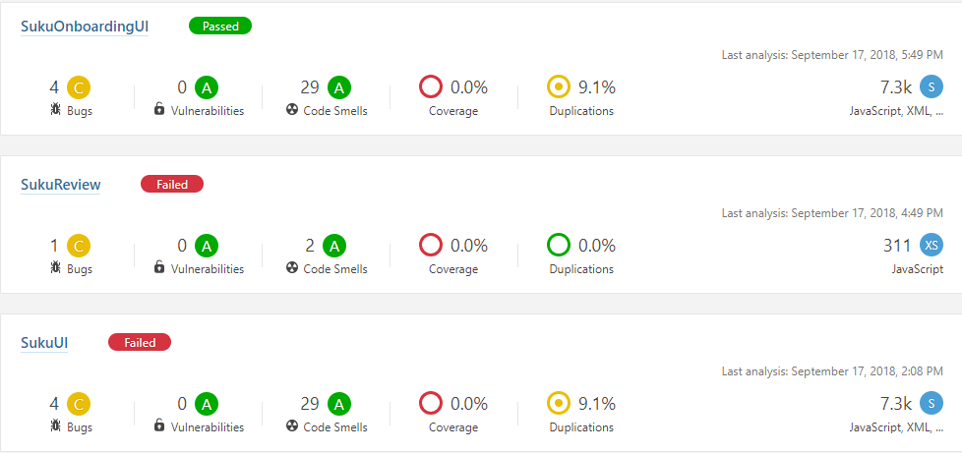
Contd..

Slide 8
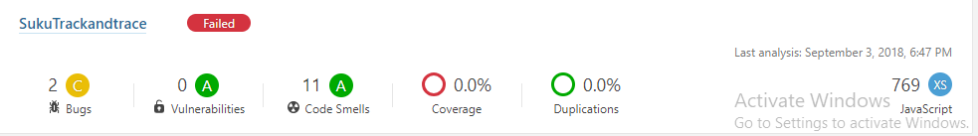
Contd..

Slide 9
For SukuMarketplaceui no sonarqube analysis done as we created this job after the jenkins/sonarqube certificate issue
Sonarqube analysis failed in most of the build due to certificate issue in jenkins/sonarqube
Need to push protractor test cases to Testinfra repo as we are creating seperate pipeline to run protractor testcases by containerizing testing infrastructure

Slide 10
Thank You

