Slide 1
BUILD REPORT
Jenkins Current Build Status | Success (except Sukuplatformv5api )
Robot test cases | All passed
Testing Infracture | Dockerized selenium webdriver and chrome
Protractor test cases | No test case is running in pipeline(path issue)
Sonarqube | Latest report not available as there is a certificate issue with jenkins/sonar
Unit test cases | 27 unit test cases – for onboarding running in pipeline

Slide 2
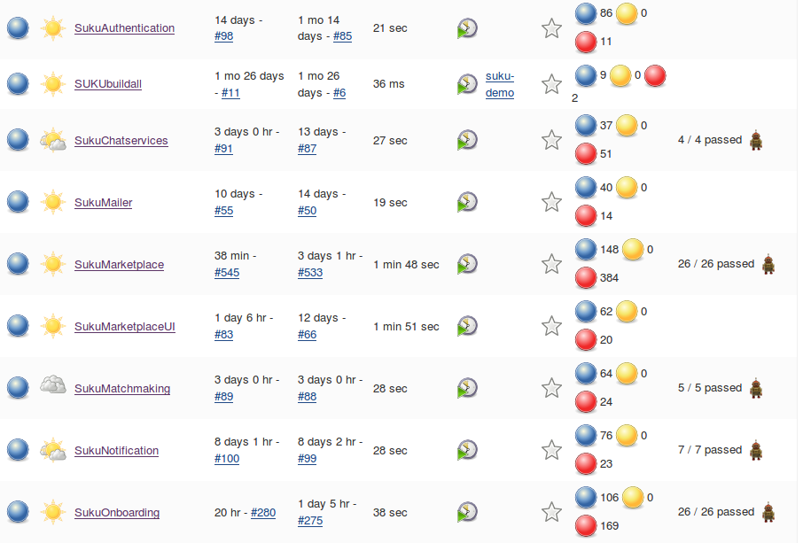
Jenkins Build Status Report

Slide 3
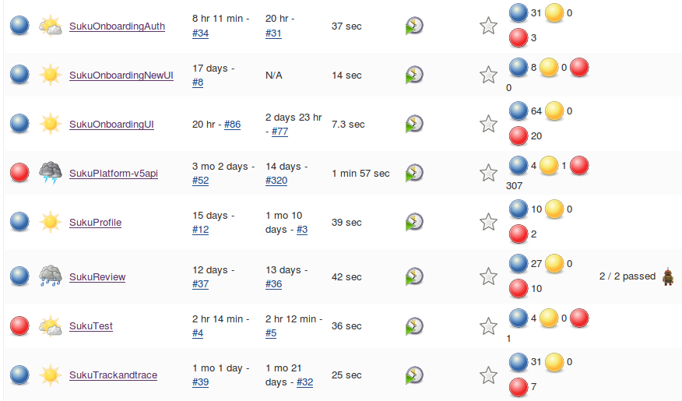
Contd..

Slide 4
For SukuMarketplaceui no sonarqube analysis done as we created this job after the sonar/jenkins certificate issue
Need to push protractor test cases to Testinfra repo as we are creating seperate pipeline to run protractor testcases by containerizing testing infrastructure
Containerized testing infracture in uitest server
Able to run protractor test cases inside the container and publish allure-results in jenkins
27/27 unit test cases passed in onboarding pipeline but need to publish the test results in jenkins – working on it
Onboarding-Central need to shift to a different VM -VM need to be created
Not able to run Onboarding robot test cases using build(34.217.161.150) server url
Not able to run protractor sanity test case using build server url(34.217.161.150)
Added ganache-cli as a service to docker-compose.yml for nodes to fix payment issue(for development only)
SukuTest is failing as no test cases running because of path issue in testcases

Slide 5
Thank You

