Slide 1
Breast Cancer
Survival Prediction
Using Logistic Regression | Random Forest | XGBoost
Machine Learning
SMOTE
Medical AI
Classification
Presented by:
Dhanushree N
Capstone Project | Machine Learning

Slide 2
What is Breast Cancer?
Breast cancer occurs when cells in the breast grow uncontrollably, forming a tumor. It is the most commonly diagnosed cancer in women worldwide, affecting 1 in 8 women in their lifetime.
Causes & Risk Factors
Common Symptoms
Treatments
Age — risk increases after 40
Family history & BRCA gene mutations
Hormonal factors (estrogen exposure)
Obesity and unhealthy lifestyle
Late pregnancy or no pregnancy
Excessive alcohol consumption
Lump or thickening in the breast
Change in breast shape or size
Skin dimpling or redness
Nipple discharge or inversion
Pain in breast or armpit
Swollen lymph nodes
Surgery — lumpectomy or mastectomy
Chemotherapy — kills cancer cells
Radiation therapy — targeted beams
Hormone therapy — blocks estrogen
Targeted therapy — HER2 blockers
Immunotherapy — boosts immunity

Slide 3
Problem Statement & Objective
📌 Problem Statement
Breast cancer is a leading cause of death among women worldwide. Existing ML models fail on imbalanced medical datasets — they are biased toward predicting Alive, causing them to miss high-risk Dead patients. Missing a Dead patient in clinical screening is life threatening.
🎯 Objective
01
Predict breast cancer patient survival status (Alive / Dead) using clinical features
02
Build and compare 3 ML models — Logistic Regression, Random Forest, XGBoost
03
Handle class imbalance using SMOTE to improve detection of high-risk patients
04
Maximize Recall — ensuring maximum Dead patients are correctly identified

Slide 4
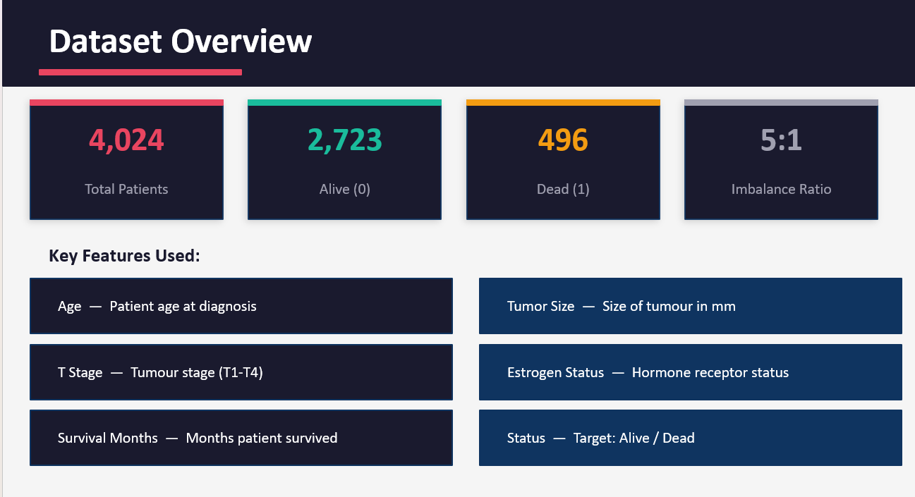

Slide 5
Exploratory Data Analysis
📊 Class Distribution
👤 Age vs Survival
Dataset is highly imbalanced — 2723 Alive vs 496 Dead patients (5:1 ratio). Models trained without balancing will be biased toward Alive.
Most patients are aged 40–70. Dead patients tend to be slightly older than Alive patients.
🔬 Tumor Size
⚗️ Estrogen Status
Dead patients have larger tumor sizes on average. Very large tumors (outliers) are more common in the Dead group.
Estrogen Positive patients have significantly better survival rates. Estrogen Negative patients are at higher risk of death.
📈 T Stage
📉 Kaplan-Meier Curve
Higher T Stage (T3, T4) is strongly associated with mortality. T1 and T2 patients have much better survival chances.
Estrogen Negative patients show a steeper survival probability drop over time — higher risk of early death.

Slide 6
Data Preprocessing
01
Missing Value Check
02
Label Encoding
df.isnull().sum() — No missing values found in the dataset. Data is clean and ready for modelling.
Target variable 'Status' encoded: Alive → 0, Dead → 1. Converts text labels to numeric for ML models.
03
One-Hot Encoding
04
Train-Test Split
pd.get_dummies() applied to all categorical features. Converts categories to binary columns.
80% training, 20% testing. random_state=42 for reproducibility. Ensures fair model evaluation.

Slide 7
Model Building
📐
Logistic Regression
🌳
Random Forest
⚡
XGBoost
Params:
Params:
Params:
max_iter=1000
n_estimators=400, max_depth=12, class_weight='balanced'
n_estimators=400, max_depth=6, learning_rate=0.05
Baseline linear model. Simple and interpretable. Good for understanding feature relationships.
Ensemble of decision trees. Handles non-linear patterns. class_weight='balanced' handles imbalance.
Gradient boosting model. scale_pos_weight handles class imbalance. Most powerful of the three.
✅ High ROC-AUC (0.902)
✅ Better Recall (0.508) than LR
✅ Best Recall with SMOTE (0.642)
⚠️ Low Recall (0.425) — misses 57% of Dead patients
⚠️ Still misses ~49% of Dead patients
⚠️ Slightly lower accuracy than others

Slide 8
Handling Class Imbalance — SMOTE
Before SMOTE
After SMOTE
Alive (0): 2,723 | Dead (1): 496
Alive (0): 2,723 | Dead (1): 2,723
SMOTE ▶
What is SMOTE? (Synthetic Minority Oversampling Technique)
Creates synthetic (not duplicate) samples of the minority class (Dead patients)
Finds nearest neighbors of each minority sample and generates new points between them
Applied ONLY on training data — test data remains unchanged for honest evaluation
Result: Balanced training set of 2,723 Alive and 2,723 Dead patients

Slide 9
Model Results & Comparison
Model
Accuracy
Recall (Dead)
ROC-AUC
Logistic Regression
0.901
0.425
0.902
Random Forest
0.906
0.508
0.897
XGBoost
0.886
0.608
0.850
RF + SMOTE
0.902
0.617
0.884
XGB + SMOTE
0.893
0.550
0.870
XGB + SMOTE + Threshold 0.3
0.873
0.642 ⭐
0.870
⭐ Best Model: XGBoost + SMOTE + Threshold 0.3 | Highest Recall = 0.642 (most Dead patients detected)

Slide 10
Why Recall is the Key Metric
❌ High Accuracy, Low Recall
✅ Best Recall Model
Logistic Regression: Accuracy = 90.1%
But Recall = 42.5%
It misses 57% of Dead patients.
In a hospital, these patients go untreated.
This is dangerous.
XGB + SMOTE + Threshold 0.3
Accuracy = 87.3% | Recall = 64.2%
Detects 64% of Dead patients correctly.
Acceptable trade-off — false alarms are
safer than missed diagnoses.
Medical Context: Cost of Errors
False Negative (predict Alive, actually Dead): Patient does not receive treatment → life threatening False Positive (predict Dead, actually Alive): Patient gets extra screening → manageable

Slide 11
Conclusion
🔧 What We Built
A Binary Classification system using Logistic Regression, Random Forest, and XGBoost to predict breast cancer patient survival. Applied SMOTE to fix class imbalance and threshold tuning to maximize detection of high-risk patients.
🔍 What We Found
Logistic Regression had highest ROC-AUC (0.902) but lowest Recall (0.425) — missed 57% of Dead patients
XGBoost + SMOTE + Threshold 0.3 gave best Recall (0.642) — best model for medical use
SMOTE significantly improved minority class detection by balancing training data from 5:1 to 1:1
🌍 Real World Impact
Helps doctors identify high-risk patients early — enabling timely treatment and saving lives
Reduces bias in medical AI — ensuring Dead patients are not overlooked due to class imbalance

Slide 12
Thank You
Breast Cancer Survival Prediction
Logistic Regression | Random Forest | XGBoost + SMOTE
3
SMOTE
0.642
0.902
ML Models
Imbalance Fix
Best Recall
Best ROC-AUC

