Slide 1
INSURANCE RISK
AND CLAIMS ANALYSIS
Power BI Dashboard Project
Presented by:
Dhanushree N
2026 | Insurance Analytics

Slide 2
PROJECT OVERVIEW
🎯 Objective
📊 Data Source
⚡ Tool Used
This project looks at car insurance data to understand who makes claims, how much they cost, and what factors lead to higher claims.
The dataset (insurance_data_car) includes details like age, gender, car model, claim amounts, location zone, and education.
Microsoft Power BI was used to build the dashboard with custom DAX formulas for age groups, gender counts, and totals.

Slide 3
KEY METRICS AT A GLANCE
37,542
$187.8M
0.51
Total Policies
Total Claim Amount
Avg Claim Frequency
Total number of insured customers
Total money paid out in claims
On average, how often claims happen
$5.0K
18.7K
18.8K
Avg Claim Amount
Male Policyholders
Female Policyholders
Average amount per claim
Total male customers
Total female customers

Slide 4
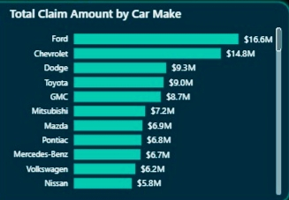
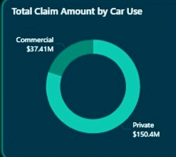
CLAIMS BY CAR MAKE & CAR USE
What this tells us:
• Ford ($16.6M) and Chevrolet ($14.8M) have the highest claims among all car brands.
• 80% of all claims come from private cars. Only 20% come from commercial vehicles.

Slide 5
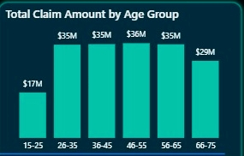
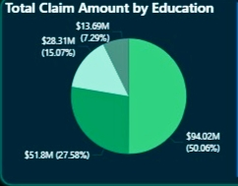
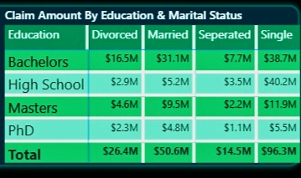
CLAIMS BY AGE GROUP & EDUCATION
What this tells us:
What this tells us:
People aged 26 to 65 make the most claims. The youngest group (15-25) has the lowest claims. Middle-aged drivers are the highest risk group.
High School educated policyholders make up the biggest share of claims. Single people with High School education have the highest claims at $40.2M — nearly 4x more than married ones ($5.2M).

Slide 6
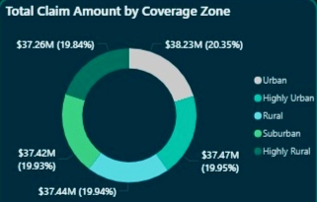
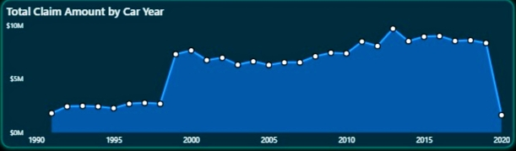
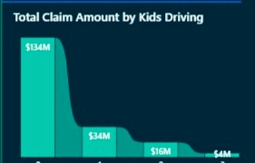
CLAIMS BY LOCATION, CAR YEAR & KIDS DRIVING
What this tells us:
• All 5 coverage zones show almost equal claims (~20% each) — where you live does not change the risk much.
• Cars made between 2000 and 2017 have the highest claims. Newer 2020 cars have very few claims.
• Customers with no kids driving have the most claims ($134M).

Slide 7
DAX MEASURES USED
Age
Total Policies
DATEDIFF(insurance_data_car[BirthDate], TODAY(), YEAR)
COUNT(insurance_data_car[ID])
Calculates how old each policyholder is today
Counts total number of policies
Age Group
Male Count
SWITCH(TRUE(), Age>=15 && Age<=25, '15-25', ... )
CALCULATE(COUNT([ID]), Gender='Male')
Groups customers into 6 age buckets for easy analysis
Counts only male policyholders
Total Claim Amount
Female Count
SUM(insurance_data_car[Claim Amount])
CALCULATE(COUNT([ID]), Gender='Female')
Adds up all claim amounts in the dataset
Counts only female policyholders
Avg Claim Amount
AVERAGE(insurance_data_car[Claim Amount])
⚡ The [select measure] switch lets you toggle between Total Claim Amount and Total Policies on all visuals.
Finds the average claim amount per policy

Slide 8
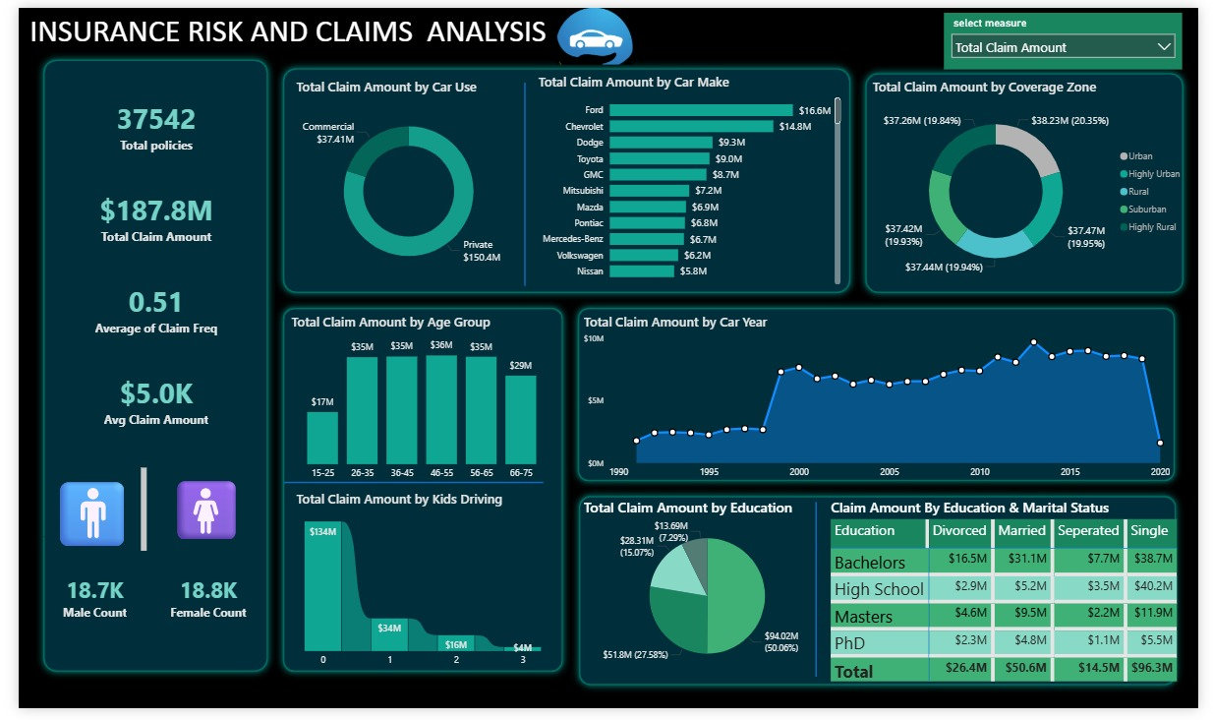
THE DASHBOARD

Slide 9
CONCLUSION
This project analyzed car insurance data for 37,542 policyholders with a total claim amount of $187.8M. The analysis shows that Ford and Chevrolet customers file the most claims, and 80% of all claims come from private car owners. People between the ages of 26 and 55 are the highest risk group, while young drivers (15-25) have the lowest claims. When we look at education and marital status, single people with a High School education have the highest claims at $40.2M. Interestingly, the location of the customer does not matter much — all five coverage zones contribute almost equally to total claims. Cars manufactured between 2000 and 2017 show the highest claim amounts, while newer 2020 cars have very few claims so far. Overall, this dashboard gives insurance companies a clear picture of who makes the most claims, helping them make smarter decisions about pricing, coverage, and risk management.

Slide 10
THANK YOU
for your attention
Presented by Dhanushree N
Insurance Risk & Claims Analysis | Power BI Project

