Slide 1


Predictive Maintenance in Solar Power Systems

Slide 2
Content
Abstract
Problem Statement
Objective
Data Collection and Preparation
Proposed Solution (Methodology)
Model Performance Evaluation
Screenshots / Demonstration (video)
Future Scope
Conclusion
Notes:
Abstract
Problem Statement (Clearly define the challenge)
Objective (State your project's goal)
Background and Research (Discuss existing solutions, trends, and gaps)
Data Collection and Preparation (Focus on data sources, cleaning, and augmentation)
Proposed Solution (Methodology)
Model Architecture (e.g., CNN, U-Net, YOLOv5)
Key Techniques (e.g., Transfer Learning, Image Augmentation)
Model Performance Evaluation
Metrics (Accuracy, Precision, Recall, IoU, etc.)
Graphs (Confusion Matrix, ROC Curve, etc.)
Screenshots / Demonstration (Visual proof of system functionality)
Future Scope (Improvements, scalability, and integration ideas)
Conclusion (Summarize results and impact)
Q&A Session

Slide 3
Abstract
Predictive maintenance using machine learning is a game-changer in the solar
power industry.
By leveraging sensor data and historical maintenance records.
AI models can proactively identify
1).Potential inverter failures
2).Reducing downtime
3)Increasing efficiency and lowering costs.

Slide 4
Problem Statement
Challenge:
Maintaining large solar farms efficiently is difficult.
Traditional Approach:
Time-based maintenance can be inefficient.
Real-World Impact:
Example of a solar farm in California facing inverter failures.
Solution:
AI-driven predictive maintenance can reduce failures and improve
performance.

Slide 5
Objective
Identify critical features that contribute to equipment failures.
Develop a predictive machine learning model for inverter failure.
Improve model accuracy using advanced techniques.
Recommend actions based on failure predictions.
Demonstrate how predictive maintenance supports sustainability.

Slide 6
Data Collection and Preparation
Dataset:
1). Historical sensor data from solar panels
2). Including temperature, voltage, current, and maintenance logs.
Preprocessing:
1).Handling missing values by removing or imputing missing
data.
2).Splitting dataset into training and testing sets.
3)Standardizing data for better model performance.

Slide 7
Proposed Solution (Methodology)
Feature Selection:
1).Selected features: Temperature, Voltage, Current, Days Since Last
Maintenance.
2).Evaluated feature importance using permutation importance.
Machine Learning Model:
1).Used Support Vector Machine (SVM) classifier with RBF kernel.
2).Split dataset into 80% training and 20% testing.
Prediction & Decision Making:
1).If failure is predicted, suggest immediate maintenance.

Slide 8
Model Performance Evaluation
Accuracy:
Achieved high prediction accuracy.
Classification Report:
Displayed precision, recall, and F1-score.
Feature Importance Analysis:
Showed the impact of different features on failure prediction.

Slide 9
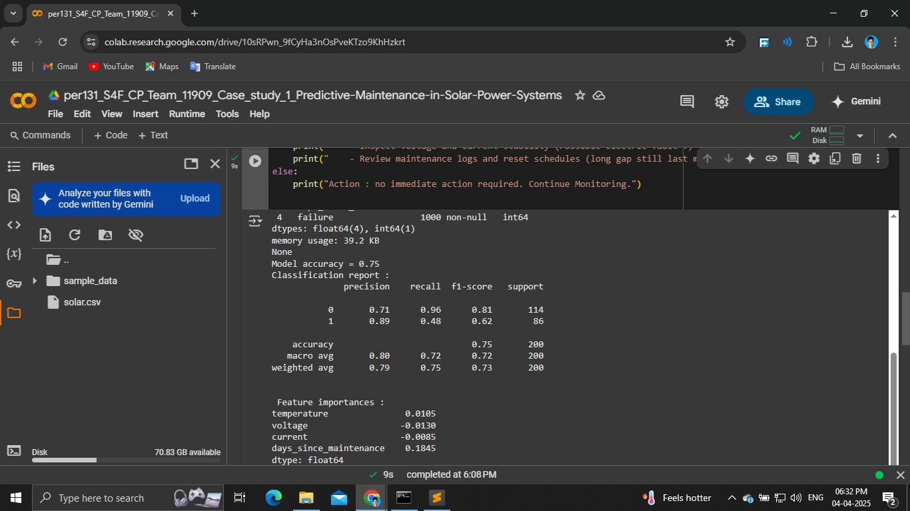
Screenshots / Demonstration (video)

Slide 10
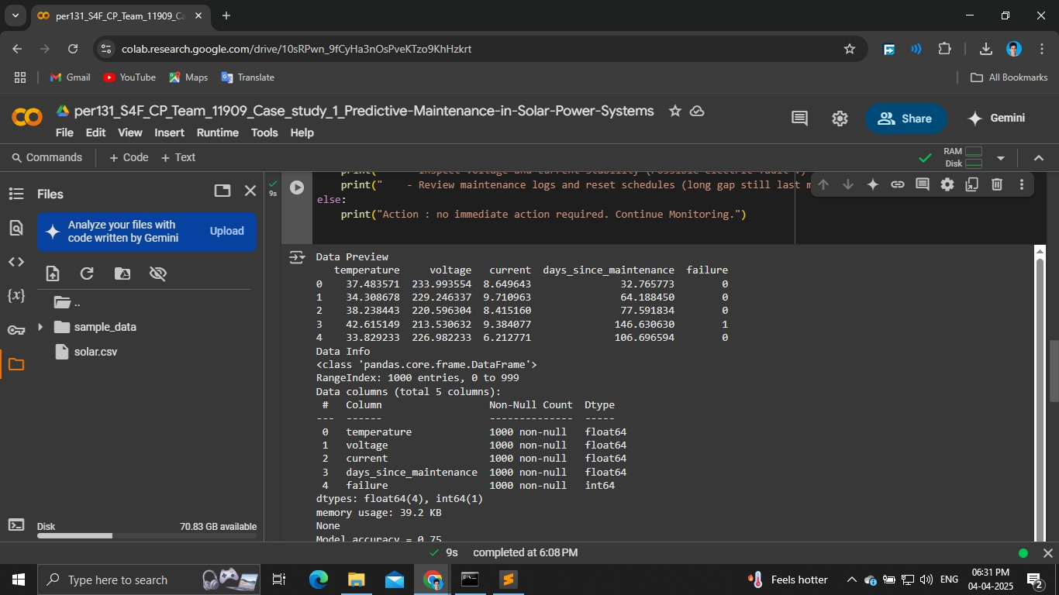

Slide 11
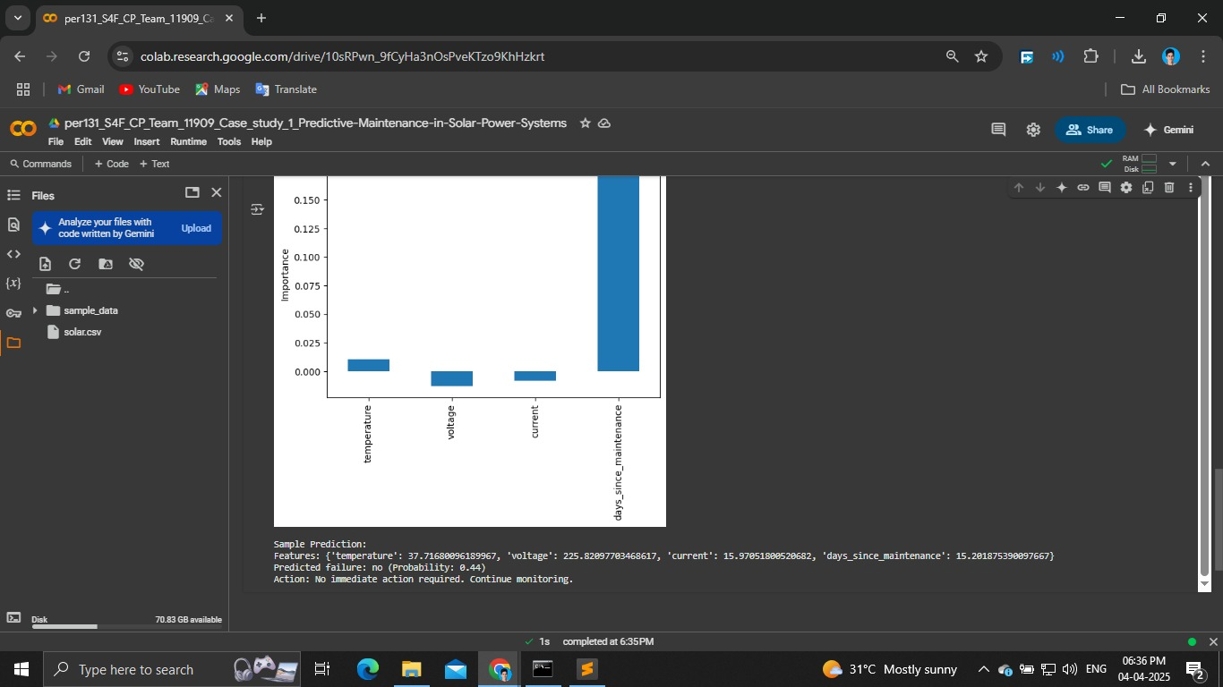
Collab link: https://colab.research.google.com/drive/10sRPwn_9fCyHa3nOsPveKTzo9KhHzkrt
Git hub link: https://github.com/dhanushs005/per131_S4F_CP_Team_11909_Case_study_1_Predictive- Maintenance-in-Solar-Power-Systems/

Slide 12
Future Scope
Improving Model Accuracy:
1). Experiment with different ML algorithms like Random Forest,
XGBoost.
2).Use deep learning for more complex pattern recognition.
Integration with IoT Systems:
1).Real-time monitoring using live sensor data.
2).Automated alerts and preventive actions based on predictions.
Expansion to Other Equipment:
1).Extend predictive maintenance to other solar farm components
(eg: batteries and transformers).

Slide 13

Conclusion
Predictive maintenance using machine learning significantly improves solar
farm efficience by reducing unexpected failures and optimizing resource
allocation.
This AI-driven approach enhances sustainability, minimizes financial losess
and ensures a reliable renewable energy supply.

