Slide 1
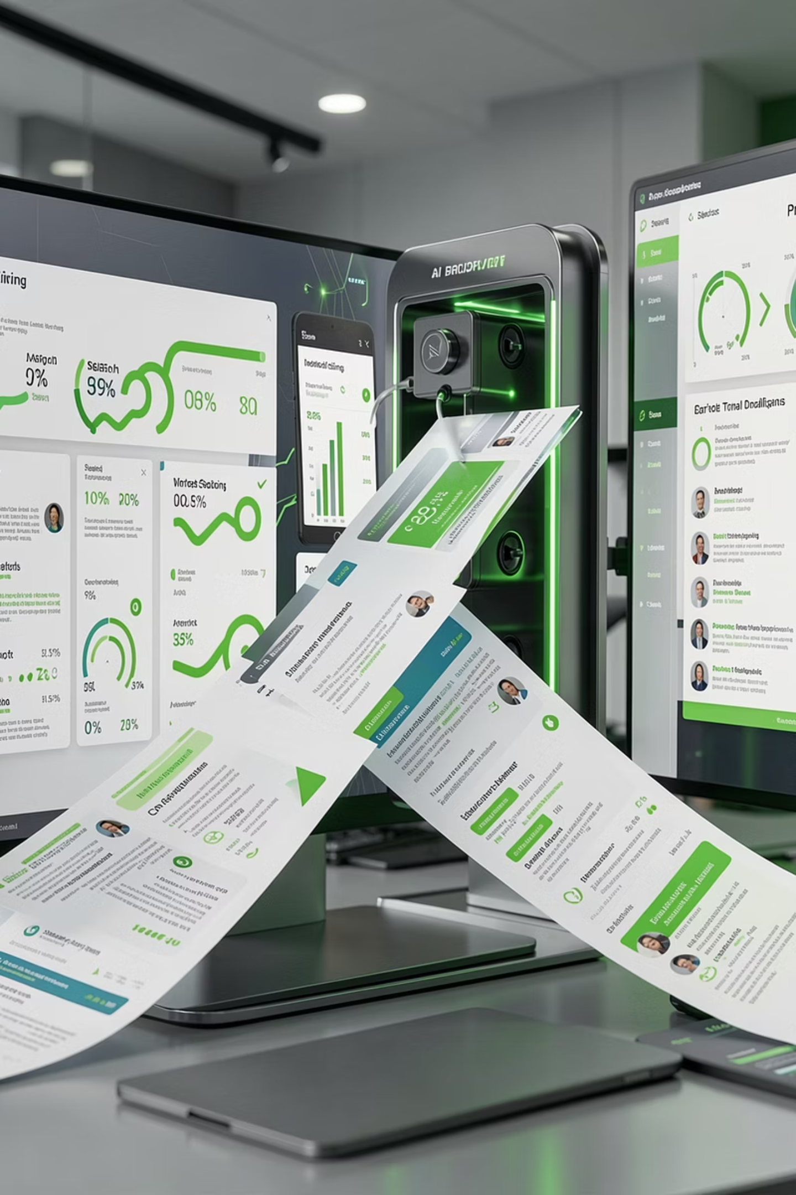
Talent Intelligence System
AI-Powered Candidate Ranking, Explained
From job description to ranked shortlist in minutes — built for recruiting teams who need speed without sacrificing trust.

Slide 2
OVERVIEW
From Job Description to Ranked Shortlist in Minutes
The Talent Intelligence System transforms how recruiting teams process high-volume candidate pools. Instead of relying on keyword filters or gut-feel shortlisting, the pipeline extracts structured intelligence from every job description and maps it against enriched candidate profiles using a multi-signal scoring engine.
The result: a defensible, ranked shortlist — complete with signal-level transparency and recruiter-ready briefs — delivered in minutes, not days.
JobDNA
Multi-Signal
Structured extraction from every JD
Four weighted scoring layers
LLM Review
Transparent
Human-like judgment on top-N
Every score is explainable

Slide 3


The Problem
Hiring Breaks at Scale
Hiring does not scale when candidate volume grows. What works for 200 applicants collapses at 20,000.
Keyword Search Over-Ranks Noise
Embeddings Miss Hard Constraints
Manual Review Collapses
BM25-style matching surfaces keyword stuffers and irrelevant profiles that happen to share terminology, burying genuinely qualified candidates beneath false positives.
Semantic similarity captures broad relevance but ignores dealbreakers — years of experience, certifications, location — leading to shortlists that fail on must-haves.
Recruiters spending hours skimming unranked resumes cannot maintain quality at scale. The result: top talent slips through, and review fatigue sets in rapidly.
Recruiters need ranked recommendations with reasons they can trust — not another black-box tool that quietly filters out the wrong people.

Slide 4

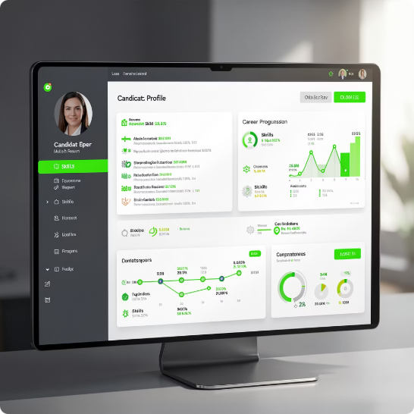



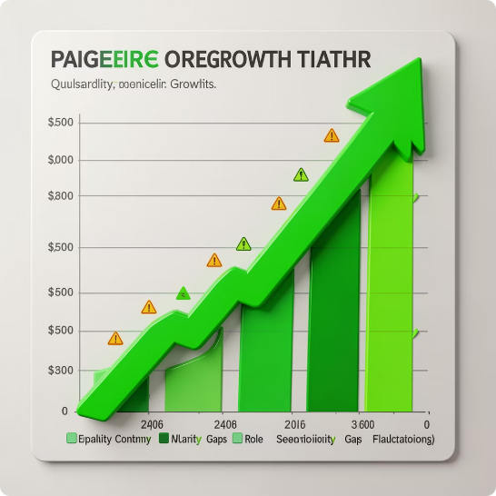
ARCHITECTURE
What I Built — A Six-Layer Pipeline
Each layer addresses a specific failure mode in traditional candidate screening. Together, they form a pipeline that is greater than the sum of its parts.
JobDNA Extraction
Candidate Profile Enrichment
Semantic Similarity
Hard-Constraint Matching
Parses the job description into a structured object — role, seniority, must-have skills, preferred skills, domain context, and dealbreakers — creating a machine-readable blueprint of what "great" looks like.
Uses embedding-based matching to capture broad relevance — surfacing candidates whose experience aligns conceptually even when exact keywords differ.
Applies strict Boolean-style filtering on must-have requirements — certifications, years of experience, location, work authorization — ensuring no shortlisted candidate fails on dealbreakers.
Transforms raw resume data into recruiter-friendly signals: normalized skills, inferred seniority, career trajectory, and red-flag indicators — making every profile comparable on a level playing field.
LLM Judgment
Trajectory & Red Flags
For top candidates only, an LLM applies human-like reasoning — evaluating fit nuances that signals alone cannot capture. Run only on the shortlisted set to control cost and latency.
Rewards upward career momentum while penalizing weak signals: frequent role changes, employment gaps, declining seniority, and missing critical context. A quality-control layer that adds depth to the score.

Slide 5



Design Philosophy
Why This Design — No Single Signal Trusted Alone
The core insight: no single ranking signal is sufficient on its own. Each layer compensates for another's blind spots.
Semantic similarity finds relevant profiles but misses hard constraints. BM25 enforces dealbreakers but cannot assess fit nuance. The LLM adds judgment but is too expensive for full-pool scoring. The trajectory layer adds qualitative depth that quantitative signals cannot.
Layered together, the pipeline remains explainable, affordable, and scalable — without sacrificing the quality of the final shortlist.
Explainable
Every score decomposite into transparent, auditable signal components
Affordable
LLM runs only on top-N, not the full pool
Scalable
Handles 100K+ candidates with deterministic fallbacks

Slide 6
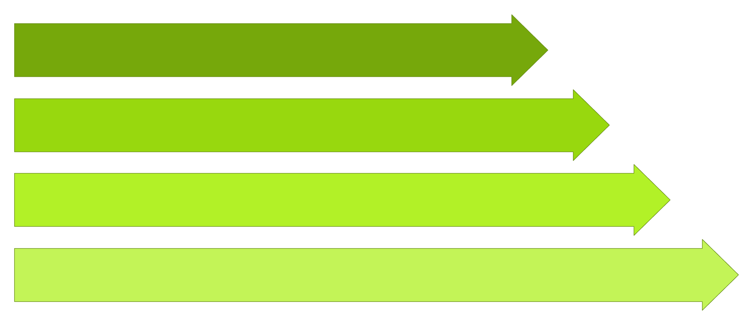
PIPELINE
How It Works — End to End
From raw job description to ranked, briefed candidate shortlist — six sequential stages, each building on the previous layer's output.
Ingest Data
Extract JobDNA
Enrich Profiles
Score & Review
The pipeline is designed for modularity — each stage can be swapped, tuned, or bypassed without breaking downstream stages. This makes iteration fast and debugging surgical.

Slide 7
Deliverables
Outputs & UI — Transparency by Design
Every artifact is structured for human review. Recruiters can trace any ranking decision back to its individual signal contributions, and engineering teams can inspect the full analysis for debugging or audit purposes.
1
2
3
4
ranked_candidates.csv
score_breakdown.csv
candidate_briefs.csv
full_analysis.json
The final shortlist — candidate IDs sorted by composite score, ready for recruiter review. This is the primary output.
Signal-level transparency: each candidate's individual scores for semantic similarity, hard constraints, LLM judgment, and trajectory — so every ranking is fully auditable.
Recruiter-ready summaries with key strengths, concerns, and fit rationale per candidate — designed for fast human review without opening every resume.
Complete structured output for deep inspection, debugging, and integration. Includes every intermediate computation and metadata object.

Slide 8

Example Impact
Validated at 100,000 Candidates
The pipeline has been tested end to end against a dataset of 100,000 candidates, ranking the full pool with deterministic fallbacks in dry-run mode and with Anthropic API scoring in live mode.
100K
4
2
Candidates Ranked
Weighted Signals
Operating Modes
Full pool processed end to end
Semantic, constraints, LLM, trajectory
Dry-run with fallbacks + live with API
This dual-mode architecture makes the system useful across contexts — from local testing and demos to production-style evaluation against real recruiter outcomes.

Slide 9
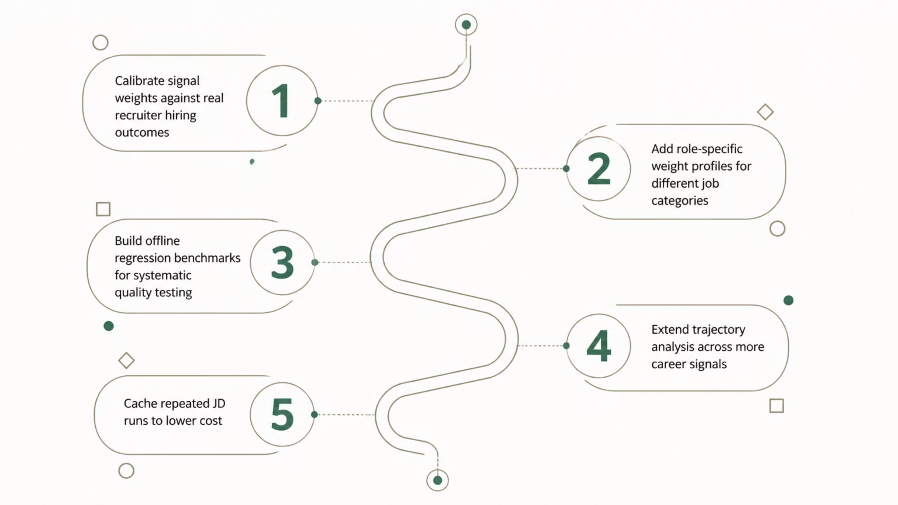
ROADMAP
What's Next — Calibration and Scale
The current system is a strong foundation. The roadmap focuses on closing the feedback loop, personalizing scoring, and driving down cost per run.

Slide 10

Sample Output
Top Candidates — Ranked Shortlist
Sample results from a dry-run ranking of the candidate pool. Scores reflect the composite of all four weighted signals. Candidates within a 0.01–0.02 range are statistically tied — recruiter judgment drives the final selection.
Rank
Candidate ID
Composite Score
1
CAND_0055905
0.6159 — Dry run mode
2
CAND_0005260
0.6053 — Dry run mode
3
CAND_0072660
0.5947 — Dry run mode
4
CAND_0005649
0.5944
5
CAND_0070525
0.5937 — Dry run mode
6
CAND_0045250
0.5935
7
CAND_0065501
0.5933
8
CAND_0011687
0.5924 — Dry run mode
9
CAND_0094759
0.5919
10
CAND_0081846
0.5916 — Dry run mode
Scores in dry-run mode use deterministic fallbacks for the LLM signal. Live mode with Anthropic API scoring may shift rankings within the tied band — the top tier remains stable.

