Slide 1
IMAGE DENOISEING USING CNN MNIST-DATASET
Presented By:
DHANUSH S
513121104706
THANTHAI PERIYAR GOVERNMENT INSTITUTE
OF TECHNOLOGY VELLORE

Slide 2
PROJECT TITLE
IMAGE DENOISEING USING CNN MNIST-DATASET
3/21/2024 Annual Review

Slide 3


AGENDA
Problem Statement
Project overview
End Users
Solution and its proposition
The WOW in the solution
Modeling
Results
Conclusion
3/21/2024 Annual Review

Slide 4

PROBLEM STATEMENT
Develop a Convolutional Neural Network (CNN) model to remove noise from handwritten digit images in the MNIST dataset. The model should learn to differentiate between the actual digit information and the added noise, effectively reconstructing clean images.
Success Criteria:
The denoised images should be visually clearer and have higher accuracy when classified by a digit recognition model.
Evaluate the model's performance using metrics like Peak Signal-to-Noise Ratio (PSNR) or Structural Similarity Index (SSIM).

Slide 5

PROJECT OVERVIEW
Goal: Develop a method to remove noise from text messages using [Your Technique].
Data: You'll likely use a dataset of text messages or create your own by collecting and pre-processing text messages (e.g., removing formatting, special characters).
Method: Design and train a model (e.g., CNN) to distinguish between noise and text message content.
Evaluation: Compare the denoised text messages with the originals to measure accuracy (e.g., character error rate).
Outcome: Cleaner text messages with improved readability.
Bonus: Test the denoising model on unseen text messages to ensure it generalizes well.

Slide 6

WHO ARE THE END USERS?
Mobile phone users: Anyone who frequently receives text messages with typos, compression artifacts, or other noise could benefit from a tool that automatically cleans them up.
Customer service representatives: Those dealing with a high volume of text messages from customers might find a denoising tool helpful for improving readability and reducing errors in processing messages.
People with disabilities: Individuals with visual impairments or dyslexia could benefit from a tool that clarifies text messages by removing noise.
Developers of text-based applications: If your denoising method can be integrated into existing text processing pipelines, it could be valuable for developers of chatbots, text summarization tools, or other applications that rely on clean text data.
3/21/2024 Annual Review

Slide 7

YOUR SOLUTION AND ITS VALUE PROPOSITION
For Mobile Phone Users:
Solution: A user-friendly mobile app that automatically cleans up text messages by removing typos, noise, and other errors.
Value Proposition: "Never struggle with confusing text messages again! Our app instantly clarifies your text messages, making them easier to read and understand. Save time and avoid misunderstandings with clean, clear communication."
For Businesses:
Solution: An API or cloud-based service that integrates with existing messaging platforms, automatically denoising incoming customer text messages.
Value Proposition: "Boost customer satisfaction and improve efficiency! Our text message denoising solution removes noise and errors, ensuring clear communication with your customers. Reduce processing time for customer service teams and enhance the overall customer experience."

Slide 8

THE WOW IN YOUR SOLUTION
Uniqueness of Noise Addressed: Does your project tackle a specific type of text message noise that existing solutions overlook? Maybe it focuses on denoising messages with emojis, slang abbreviations, or foreign language characters.
Exceptional Accuracy: Can your denoising achieve a very high success rate in cleaning text messages, surpassing current solutions?
Speed and Efficiency: Does your project offer real-time denoising within the messaging app itself, providing instant clarity to the user?
Integration and Versatility: Perhaps the "wow factor" lies in how seamlessly your denoising solution integrates with existing messaging platforms or offers a versatile API for various applications.
3/21/2024 Annual Review
8

Slide 9
MODELLING
Data Prep: Grab message data, clean it, and add realistic noise (typos, slang, etc.)
Model Up: Use a pre-trained language model (think smart AI for text) and fine-tune it for denoising.
Attention is Key (Optional): Train the model to focus on noisy parts for better correction.
Test & Refine: Evaluate how well it cleans messages and adjust if needed.
(Optional) Deploy: Turn it into a mobile app or API for easy access.
3/21/2024 Annual Review
9

Slide 10
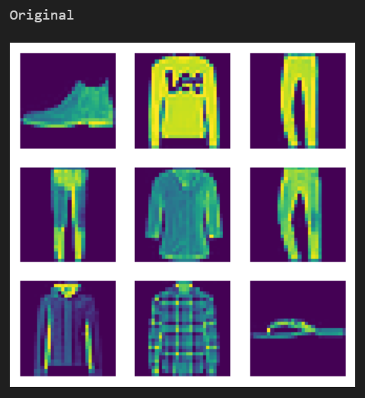
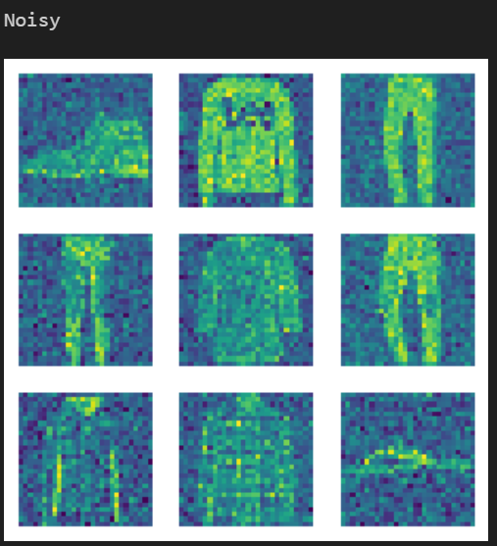
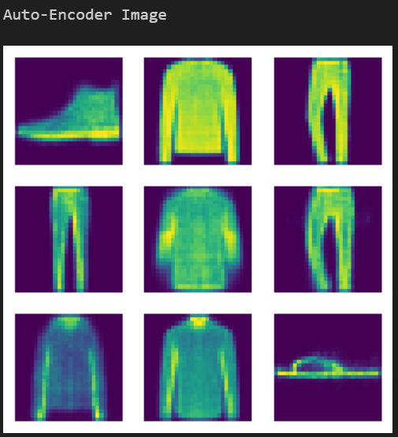
RESULTS
10

