Slide 1
Predicting Airbnb Listing Price Across Different Cities
New York City · Paris · Berlin
UE24CS352A Machine Learning · Mini Project 71
Dhanush S S (PES1UG24AM082)
Harsha K R (PES1UG24AM114)
Notes:
Introduce the team and the problem: we predict the nightly price of Airbnb listings in three cities, following the Stanford CS229 reference report.

Slide 2
Hosts guess their price; we learn it from data
1
Predict
Why it matters
the nightly price of a listing from its size, room type, location, amenities, reviews, host details and description
New hosts have no pricing system, unlike hotels
Guests want to know whether a price is fair
Rules differ by city (e.g. NYC's 2023 short-term rental law), so a model that travels is harder than it looks
2
Compare
five models: linear regression, KNN, random forest, XGBoost and a neural network
3
Transfer
test whether one model can serve several cities, and price listings in a city it has never seen
Notes:
Three goals. The third, transfer to an unseen city, is the 'across different cities' part of the title.

Slide 3
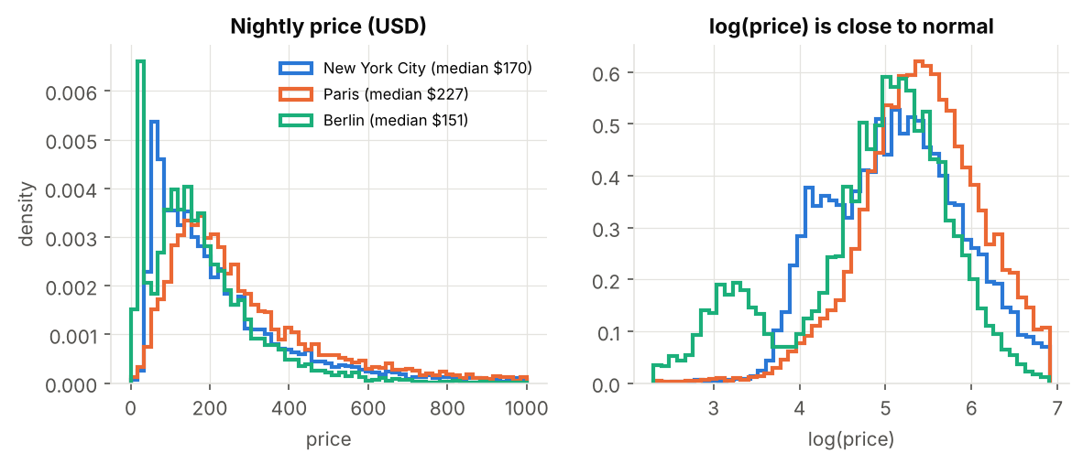
75,222 listings from Inside Airbnb, June/July 2026
New York City
Paris
Berlin
20,890
46,000
8,332
listings · median $170/night · 78% need 28+ nights
listings · median $227/night · 14% need 28+ nights
listings · median $151/night · 20% need 28+ nights
90 columns per listing: size, room and property type, location, amenities, reviews, host details, title and description
Kept listings priced 10 to 1000 USD per night; EUR converted to USD at a fixed 1.15
Fixed 80/20 train/test split per city, used by every experiment
Target is log(price): raw prices are heavily skewed, logs are close to normal
Notes:
Data is public Inside Airbnb. Note the NYC long-stay share: since Local Law 18 (2023) most NYC listings require 30-night stays. This matters later.

Slide 4
From raw listings to a price in five steps
1
2
3
4
5
Clean
Engineer
Encode
Train
Evaluate
parse prices, bathrooms, amenities; drop missing or extreme prices
distance to centre, review ages, shared-bath flag, licence flag
one sklearn ColumnTransformer: scale, one-hot, multi-hot, TF-IDF + SVD
five regressors on log(price); XGBoost tuned by 3-fold random search
R² and MSE on log price, MAE in dollars, on held-out test sets
Leakage control
Columns computed from the price (price_quote_*, estimated_revenue_l365d) and the length of the quoted stay are never used. The pipeline is fitted on training data only, so the test set never influences scaling, TF-IDF vocabulary or SVD.
Notes:
Walk through the pipeline. Stress leakage control: estimated revenue is price times occupancy, so using it would be cheating.

Slide 5
189 features in three groups
C
Continuous
O
Categorical
T
Text
55 columns
84 columns
50 columns
guests, bedrooms, beds, bathrooms, minimum nights, availability, reviews and 7 review scores, host tenure, superhost, licence, distance to centre, lat/lon (+ missing-value flags)
room type and property type (one-hot) plus the 60 most common amenities (multi-hot: wifi, kitchen, dishwasher, air conditioning ...)
title + description → TF-IDF on unigrams and bigrams → truncated SVD to 50 dimensions (same idea as the reference report)
The final multi-city model also gets a one-hot city indicator. The transfer experiments drop lat/lon and keep distance to centre, which means the same thing in every city.
Notes:
Explain why distance to centre exists: raw latitude means nothing in a new city, distance to the centre does.

Slide 6
Five models, from baseline to boosted trees
Ridge regression
Baseline. Linear in the features, L2 penalty (α = 10).
K-nearest neighbours
Baseline. Average price of the 15 most similar listings, distance-weighted.
Random forest
300 trees on bootstrap samples, a third of features per split, averaged.
XGBoost
1,170 boosted trees, depth 8, learning rate 0.0225, row and column subsampling; tuned by 3-fold random search on NYC (CV R² 0.848).
Neural network (MLP)
Two hidden layers (64, 32, ReLU), Adam, L2 = 0.001, early stopping on 10% validation.
All models predict log(price) and are scored on the same held-out listings.
Notes:
Same five model families as the reference report (they used sklearn defaults; we tuned XGBoost).

Slide 7
XGBoost wins in every city
0.85
NYC test R²
0.84
Paris test R²
0.90
Berlin test R²
Typical error ≈ 15% of the price (MAE $50 NYC, $57 Paris, $39 Berlin). Reference report: 0.74 NYC, 0.70 Paris.
Notes:
Tree ensembles beat linear and KNN because price depends on interactions (e.g. room type x guests x location). The MLP is decent but needs more tuning and data than boosting.

Slide 8
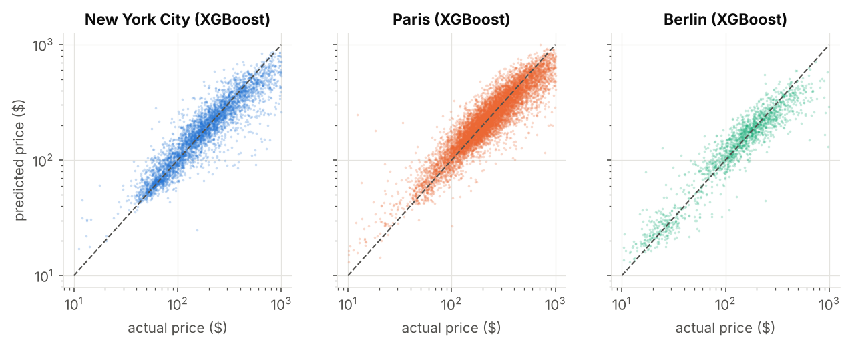
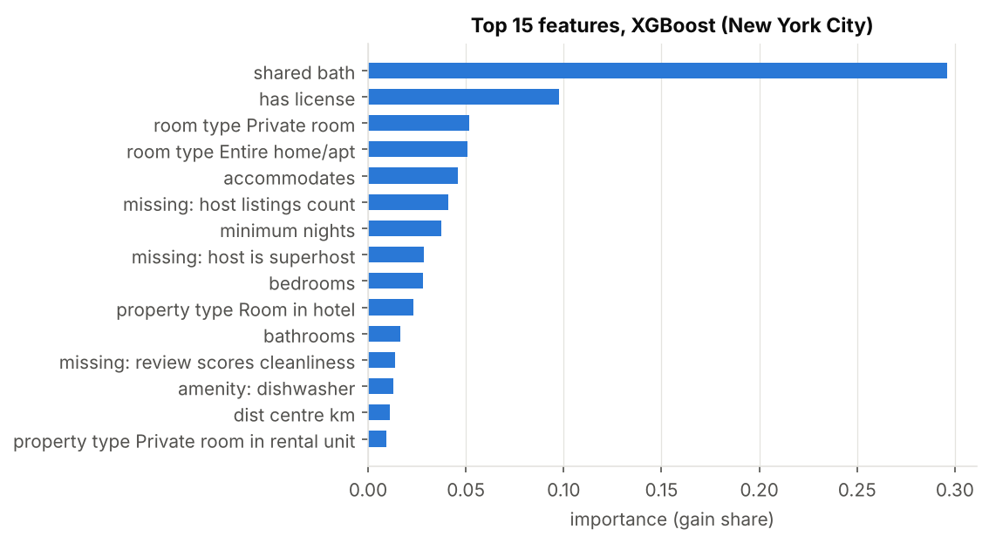
Predictions track real prices across the range
Each dot is a held-out listing; the dashed line is a perfect prediction.
What drives price
Shared vs private bathroom and room type: a room in a shared flat is far cheaper
Licence status and minimum stay: long-stay listings are quoted at monthly-discount rates
Capacity (guests, bedrooms, bathrooms), then location (distance to centre) and amenities
Notes:
Importance is XGBoost gain, so it shows association, not causation.

Slide 9
Structured features carry the signal; text adds little
Continuous features alone reach 0.84 / 0.82
Categorical + amenities add ≈ 0.015
Text alone is weak (0.53 / 0.38) and adds almost nothing on top: descriptions mostly restate size and location
Notes:
The reference found text helped more; with 2026 data the structured columns are richer (e.g. licence, bathrooms text).

Slide 10
A similar market transfers; more data does not
Combined training
One model on NYC + Paris scores 0.836 / 0.825, almost the same as two separate models (0.844 / 0.829).
Why NYC fails
Since NYC's 2023 short-term rental law, 78% of its listings need 28+ night stays (Paris 14%, Berlin 20%). NYC prices follow different rules, so its model misleads in Europe.
Notes:
Key finding and a difference from the reference report, where NYC + Paris transferred best. Our point: market similarity beats data size.

Slide 11
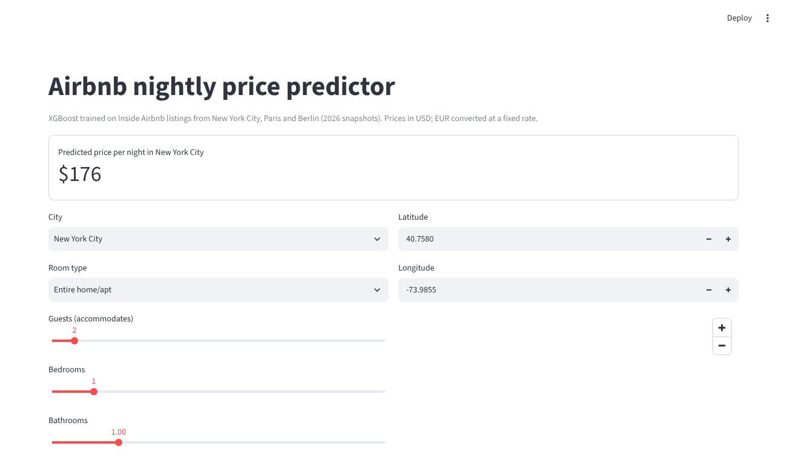
Live demo: price any listing in three cities
Demo script
Pick a city and room type; change guests and bedrooms; watch the price move
Switch NYC → Paris → Berlin with the same flat
Set minimum nights to 30 and see the monthly-rate drop
Terminal: python scripts/predict.py --sample 5 shows real test listings, actual vs predicted
streamlit run app/app.py
Notes:
Have the app already running before the review. Backup: the CLI commands in the README, which need no browser.

Slide 12
Conclusions
XGBoost on log(price) predicts within ≈15%: R² 0.85 NYC, 0.84 Paris, 0.90 Berlin
Size, room type, bathroom sharing, licence and minimum stay matter most; text adds little
One model can serve several cities; transfer to a new city works from a similar market (Paris → Berlin 0.77), not from NYC
Next: seasonality and calendar data, booked prices, domain adaptation for new cities
Notes:
Close with the three findings, then invite questions.

Slide 13
Thank you · Questions?
Dhanush S S (PES1UG24AM082) · Harsha K R (PES1UG24AM114)
Code, data and results: GitHub repository (see README)

