Slide 1
Artificial Intelligence

Slide 2
The study of computer systems that attempt to model
and apply the intelligence of the human mind.

Slide 3
Computer Vision

Slide 4
Computer vision is a field that includes methods for acquiring, processing, analyzing, and understanding images

Slide 5
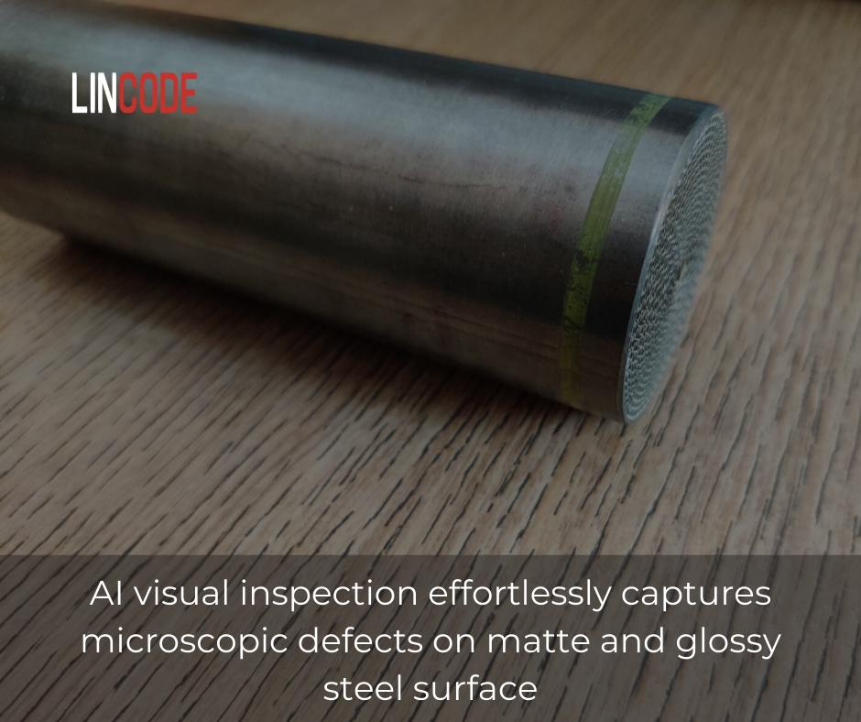

Slide 6
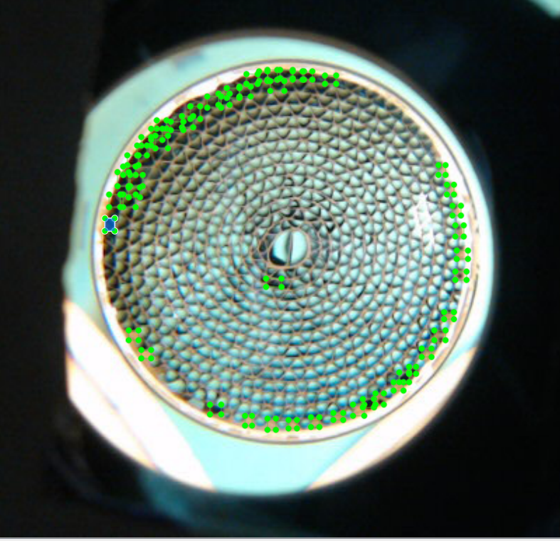
A manufacturer and supplier of Automotive Catalyst products, Motorcycle and General Purpose Engine Products, and Environmental Chemical Products, wanted to inspect the steel of the Air filter present in the silencer.
OCR (optical character recognition), Segmentation, and defect & features identification such as:
✓ Lot mark
✓ Single ring mark
✓ Model numbers
✓ Double ring mark
✓ Mantle dent
✓ Abnormal coating
✓ Slurry stick
✓ Good & bad inner shell
✓ Damaged cell
✓ Presence & absence of coil core

Slide 7
Start
Make a video of the object with defects in different angles and different lighting conditions
Convert Videos into Images
Locate the defects in the images
Convert the xml files to a csv file
Save the coordinates of the located defects in an xml file , where the image file and the xml file are in the same folder
A

Slide 8
A
Create two folders train ,test inside the API folder and paste 70% of the images and the xml files in train folder and the remaining 30% to test folder
Create two csv files , one with coordinates of the images in the train folder , and second with the coordinates of the images in the test folder
Run the code to train the model , until the accuracy is as expected
B

Slide 9
B
Run the code to check for the output and the accuracy of the output
Accuracy is Bad
Retrain the model with new images
Accuracy is good
End

Slide 10
Challenges

Slide 11
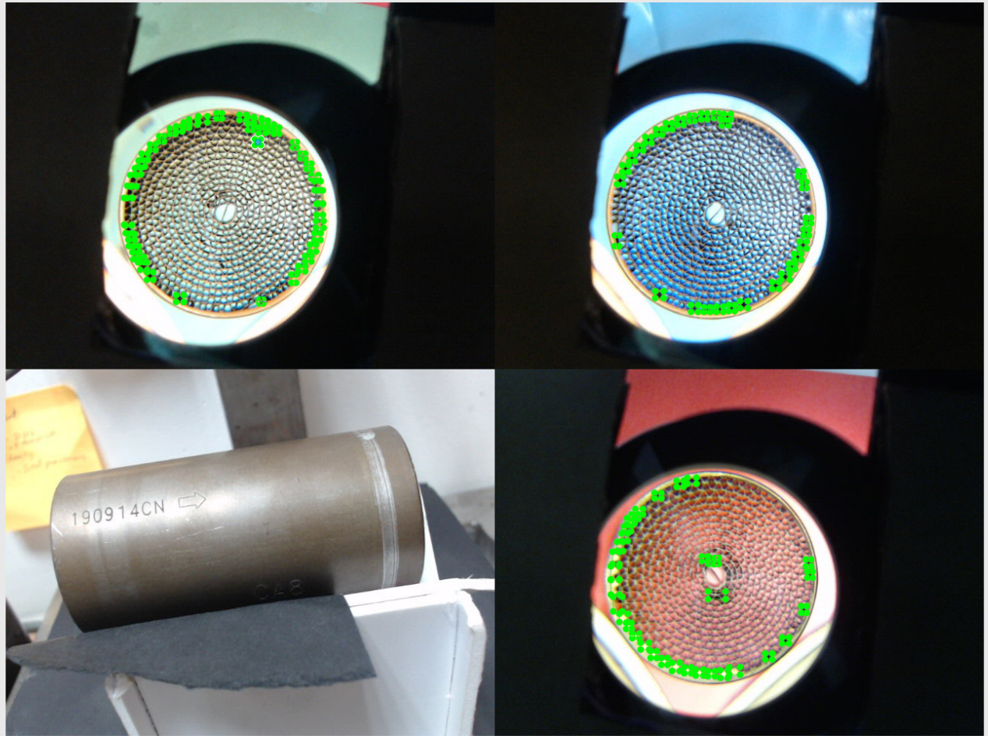

Slide 12
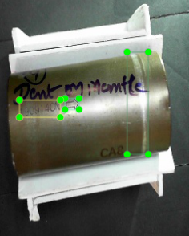
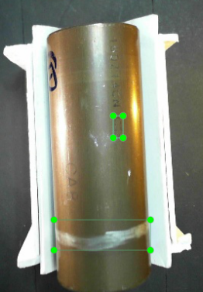
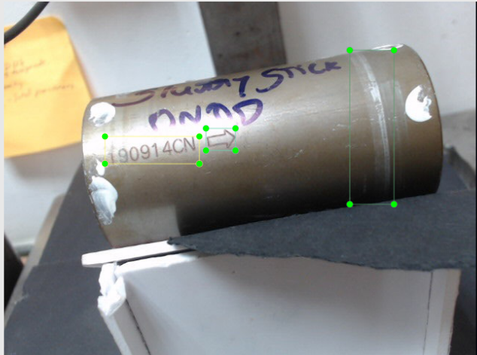
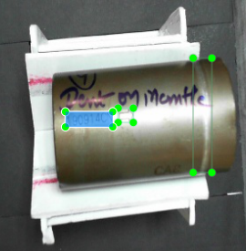

Slide 13
Thank you

