Slide 1
AI and Computer Vision

Slide 2
5 Challenges in Automotive Manufacturing
#1 Quality Assurance
#2 Employee safety
#3 Shortage of skilled labor
#4 Innovation and novelty
#5 Longer cycle time

Slide 3
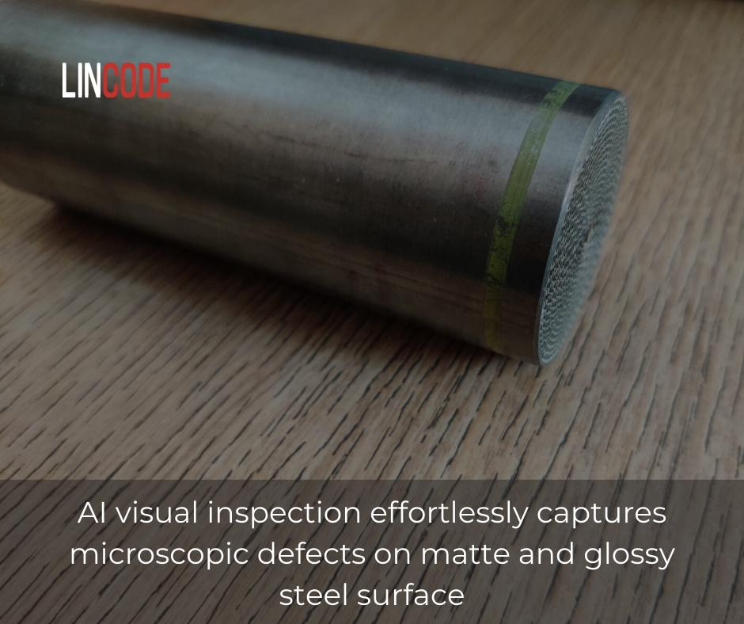

Slide 4
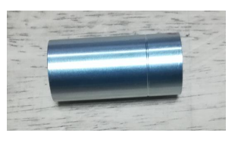
Industry Use Cases
• A manufacturer and supplier of high precision components and assemblies opted for computer Vision solution for steel defect detection. The product to be inspected was steel cylindrical parts and filter pump. Solution accurately identified the following microscopic defects:
✓ Scratch
✓ Dent
✓ White rust
✓ Burr on inner diameter

Slide 5
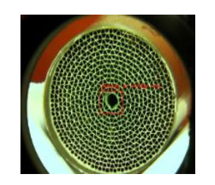
A manufacturer and supplier of Automotive Catalyst products, Motorcycle and General Purpose Engine Products, and Environmental Chemical Products, wanted to inspect the steel of the Air filter present in the silencer.
OCR (optical character recognition), Segmentation, and defect & features identification such as:
✓ Lot mark
✓ Single ring mark
✓ Model numbers
✓ Double ring mark
✓ Mantle dent
✓ Abnormal coating
✓ Slurry stick
✓ Good & bad inner shell
✓ Damaged cell
✓ Presence & absence of coil core

Slide 6
Thank you

