Slide 1
Zomato Dataset Analysis
Zomato Dataset Analysis
• Meerhan Munshi
• Dhanush
• Sachitam Patel
• Piyush Karpe
• Rohan Phalke

Slide 2
Index - Topics Covered
1. Number of Restaurants by City and Country
2. Number of Restaurants Opening by Year, Quarter, Month
3. Count of Restaurants Based on Average Ratings
4. Buckets Based on Average Price
5. Percentage of Restaurants with Table Booking
6. Percentage of Restaurants with Online Delivery
7. Charts Based on Cuisines, City, Ratings

Slide 3
KPI 1: Number of Restaurants by City and Country
📊 Observation:
India dominates the dataset with the highest number of restaurants, indicating Zomato's primary market.
Major cities like Bangalore, Delhi NCR, Mumbai, Hyderabad, and Chennai show the highest concentration of restaurants.
Other countries like UAE, Qatar, South Africa, and Singapore are present, but with comparatively fewer restaurants.
Restaurant presence is heavily urban-centric, with top metro cities holding the lion’s share.
🧠 Inference / Conclusion:
Zomato's operational focus is clearly India-centric, especially in Tier-1 cities.
This urban concentration suggests that Zomato targets locations with high population density, higher internet penetration, and disposable income.
There is potential for expansion into Tier-2 and Tier-3 cities in India as well as a deeper presence in international markets.

Slide 4
KPI 2: Number of Restaurants Opening by Year, Quarter, Month
📊 Observation:
The number of restaurant openings increased steadily year-over-year until a certain peak.
A sharp drop in openings is visible post-2020, likely due to the COVID-19 pandemic.
Quarter 1 and Quarter 4 show slightly higher restaurant opening trends, possibly due to festive seasons or fiscal planning cycles.
🧠 Inference / Conclusion:
The growth trend indicates a rapidly evolving food service industry pre-pandemic.
The post-2020 dip emphasizes the impact of external factors (like lockdowns) on the hospitality sector.
Seasonal trends can help Zomato forecast onboarding new partners and plan marketing strategies for high-growth quarters.

Slide 5
KPI 3: Count of Restaurants Based on Average Ratings
📊 Observation:
Most restaurants fall into the 3.0–4.5 average rating bracket.
Very few restaurants have low ratings (below 2.5) or perfect 5-star ratings.
Cities with more restaurants tend to have a broader range of ratings, reflecting diverse customer experiences.
🧠 Inference / Conclusion:
The bell-curve-shaped rating distribution suggests reliable quality across the majority of listed restaurants.
Consistent moderate-to-high ratings indicate customer satisfaction is generally high.
Restaurants with extremely low or high ratings are rare and could be review outliers or newer/unrated listings.
Zomato can use this insight to highlight top-rated restaurants and support underperformers through feedback tools.

Slide 6
KPI 4: Buckets Based on Average Price
📊 Observation:
A significant number of restaurants fall in the low to medium pricing buckets (e.g., ₹200–₹500 per person).
Very few are in the high-end price range (above ₹800).
Budget-friendly restaurants dominate especially in college areas and working-class localities.
🧠 Inference / Conclusion:
Zomato caters predominantly to a price-sensitive audience, possibly students, office-goers, and families.
There is room to expand premium offerings and tie-ups in upscale neighborhoods or through curated experiences.
Budget segmentation helps in targeted promotions and personalized recommendations based on user spending patterns.

Slide 7
KPI 5: Percentage of Restaurants with Table Booking
📊 Observation:
Only a small percentage of restaurants offer table booking services.
These features are more commonly available in high-end or fine-dining restaurants.
Popular cities like Bangalore, Mumbai, and Delhi have a higher share of table-booking-enabled outlets.
🧠 Inference / Conclusion:
The low adoption rate of table booking suggests it's either underutilized or only relevant to a niche audience.
There is a growth opportunity to promote this feature in mid-range restaurants, especially during peak hours or weekends.
Zomato can explore incentivizing table booking (e.g., discounts or guaranteed seating) to increase usage.

Slide 8
KPI 6: Percentage of Restaurants with Online Delivery
📊 Observation:
A high percentage of restaurants support online delivery, especially post-2020.
This feature is most prevalent in urban and semi-urban areas.
Delivery-enabled restaurants are dominant in cities like Mumbai, Delhi NCR, and Bangalore.
🧠 Inference / Conclusion:
The high adoption shows that online delivery is a core business driver for Zomato.
Restaurants that don’t offer delivery may be missing out on significant revenue potential.
Zomato can use this insight to onboard more restaurants to the delivery ecosystem, especially in regions where this feature is still underutilized.

Slide 9
KPI 7: Charts Based on Cuisines, City, Ratings
📊 Observation:
North Indian, Chinese, South Indian, and Fast Food are the most popular cuisines.
Certain cities have region-specific cuisine preferences (e.g., Kolkata for Bengali food, Hyderabad for Biryani).
Cities with more diverse cuisine options tend to have higher customer ratings.
🧠 Inference / Conclusion:
Zomato serves a diverse palate, indicating strong cultural culinary coverage.
Regional cuisine popularity can be leveraged for hyperlocal promotions.
Zomato can promote lesser-known cuisines in experimental or food festival campaigns to expand taste diversity.

Slide 10
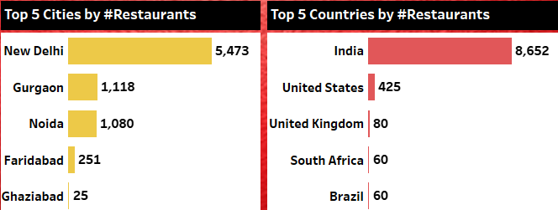
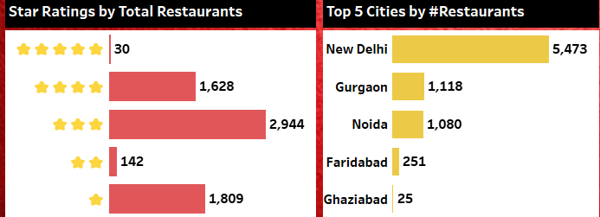
KPI 8: Analysis: City
Analysis: Focus on Indian Market, Especially New Delhi:
Out of the 9,572 restaurants in the dataset, 8,652
(90.39%) are from India, with New Delhi alone accounting for 5,473 restaurants (57.18%). This clearly indicates that our primary focus should be on India, especially cities like New Delhi, Gurgaon, and Noida. Given that the majority of the data comes from these areas, conducting a locality-wise analysis for these cities will provide valuable insights. Actionable strategies based on this analysis will significantly impact overall performance.
Focus on New Delhi and Noida: New Delhi (with the highest number of restaurants) and Noida (third highest) have fewer 5-star rated restaurants compared to other cities, indicating a gap in service quality. This suggests there is room for improvement in restaurant services, and a potential opportunity to bridge the gap between supply and demand. Introducing new cuisines, enhancing online delivery options, and adding table booking features could help elevate the dining experience in these cities.

Slide 11
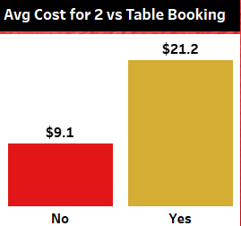
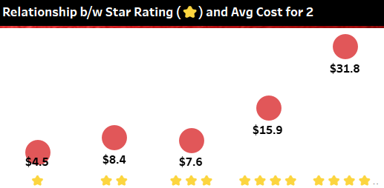
Analysis: Impact of Table Booking on Average Cost
RESTAURANTS WITH TABLE BOOKING HAVE AN AVERAGE COST OF $21 FOR TWO, COMPARED TO $9 FOR THOSE WITHOUT. THIS INDICATES THAT TABLE BOOKING OPTIONS ARE ASSOCIATED WITH MORE PREMIUM DINING EXPERIENCES, WHILE NON-TABLE BOOKING SPOTS ARE MORE BUDGET-FRIENDLY. FOR ZOMATO, PROMOTING TABLE BOOKING COULD ATTRACT HIGHER-SPENDING CUSTOMERS AND BOOST REVENUE, ENHANCING THE PLATFORM’S PREMIUM RESTAURANT OFFERINGS.
Analysis: Correlation Between Star Rating and Average Cost
THE DATA SHOWS THAT AS STAR RATINGS INCREASE FROM 1 TO 5, SO DOES THE AVERAGE COST FOR TWO, SUGGESTING HIGHER-RATED RESTAURANTS CHARGE MORE DUE TO BETTER QUALITY AND AMBIANCE. ZOMATO CAN LEVERAGE THIS BY PROMOTING HIGH-RATED, PREMIUM RESTAURANTS TO ATTRACT PREMIUM CUSTOMERS AND POSITION LOWER-RATED OPTIONS AS BUDGET-FRIENDLY. THIS STRATEGY CAN ENHANCE CUSTOMER SATISFACTION ACROSS DIFFERENT PRICE RANGES.

Slide 12
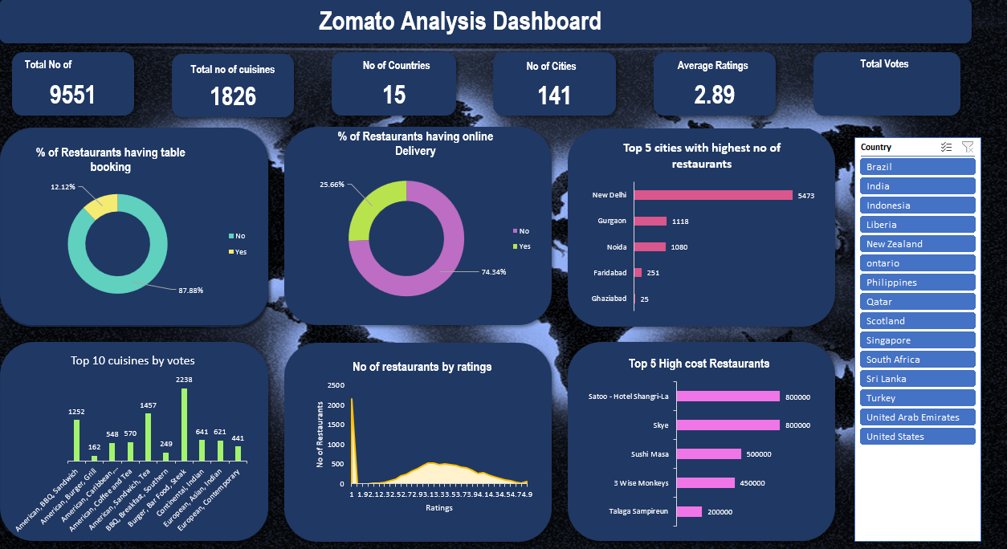
Excel Dashboard Screenshot
[Insert Screenshot Here]

Slide 13
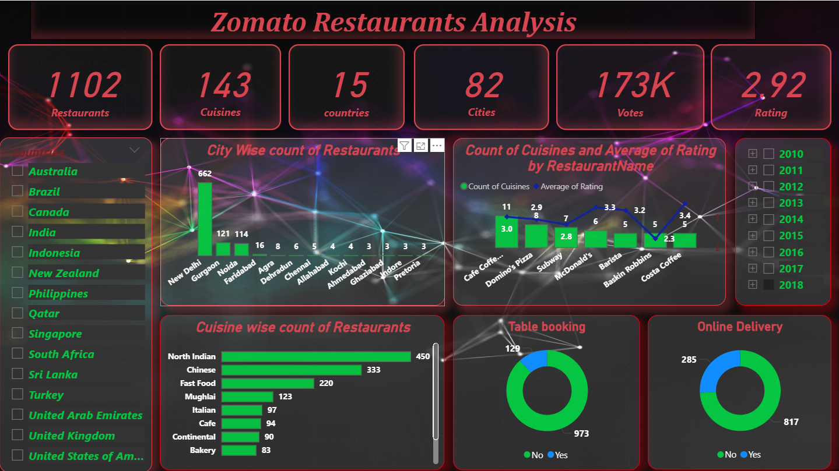
Power BI Dashboard Screenshot
[Insert Screenshot Here]

Slide 14
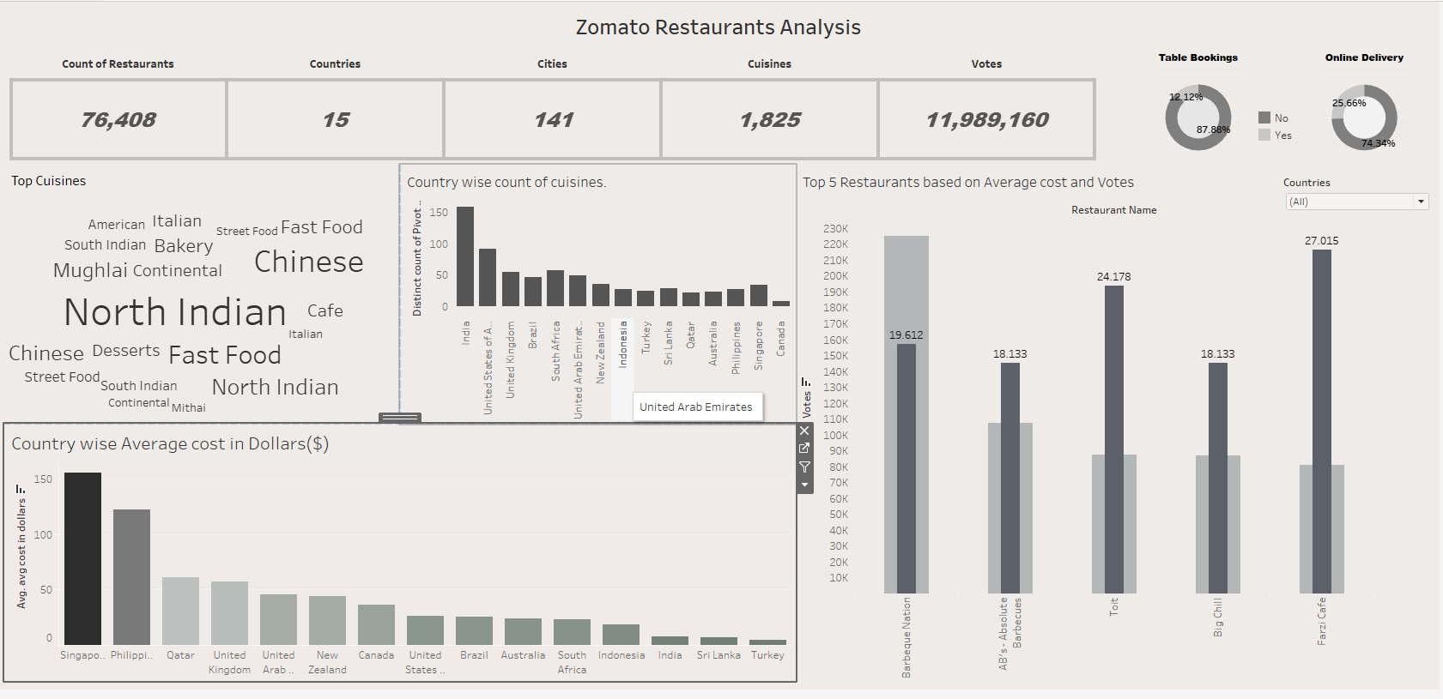
Tableau Dashboard Screenshot
[Insert Screenshot Here]

Slide 15
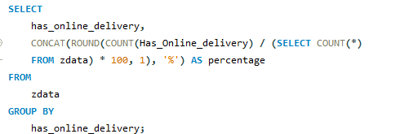
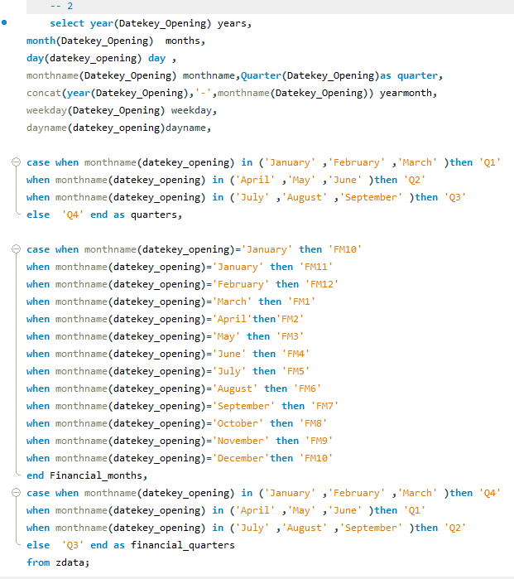
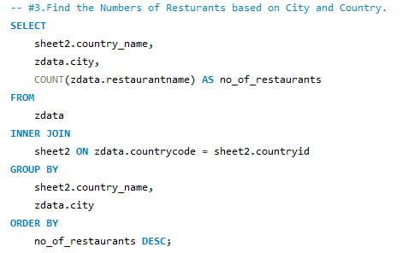
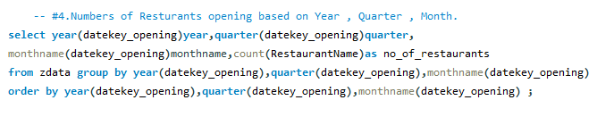
MySQL Query Screenshot

Slide 16
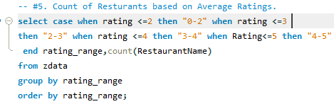
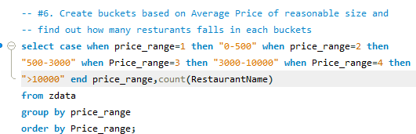
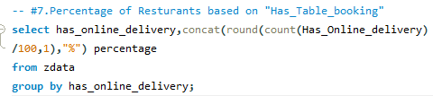

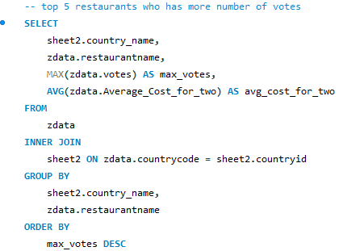
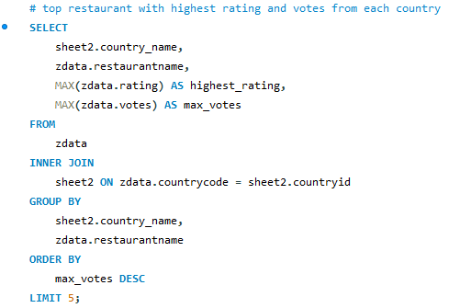
MySQL Query Screenshot

Slide 17
Challenges Faced and Solutions
For stagnant growth in new restaurant openings, we can focus on providing incentives to new restaurants for enlisting in Zomato like lower commission rates for the first two months, priority enlisting in the Zomato App, including separate sections in the app like Newly Added Restaurants etc.
To grow its customer base and revenue, Zomato should incentivize restaurants to adopt table booking and online delivery features, as currently only 12% and 26% of restaurants offer these options, respectively, which limits customer convenience and engagement. Furthermore, only 2% of the low-budget restaurants offer these features and only 6% of the premium restaurants offer online delivery features. These are the first two areas where priority is needed. Also, Shahdara locality (in New Delhi) needs attention where no restaurant offers these 2 features.
Focus on restaurants in New Delhi and Noida as they are under-performing. Also, more emphasis can be given to the Pizza cuisine in New Delhi and Noida as there are no premium restaurants (5 star ratings). Restaurants to focus on: Civil House (4.2 stars), Tossin Pizza (4.1), Napoli Pizza (4.0), PizzaExpress(3.9) and Caffe Tomino (3.9).
To increase new restaurant listings and drive revenue, Zomato should focus on adding more budget-friendly options, as 76.1% of the existing listing restaurants fall within the $1-$10 range, while also implementing targeted marketing strategies to attract affluent customers to premium establishments in specific localities.
Focusing on the localities with the lowest ratings, ranging from 1 star to 2.5 stars and also with a criteria of minimum 50 restaurants in a locality.
Focus on top cuisines which are most popular namely Italian (80 restaurants), Café (70), American (64), Desserts (62), and Pizza (60) and promote more restaurants for the same cuisines as these are highly in demand across the globe.

