Slide 1
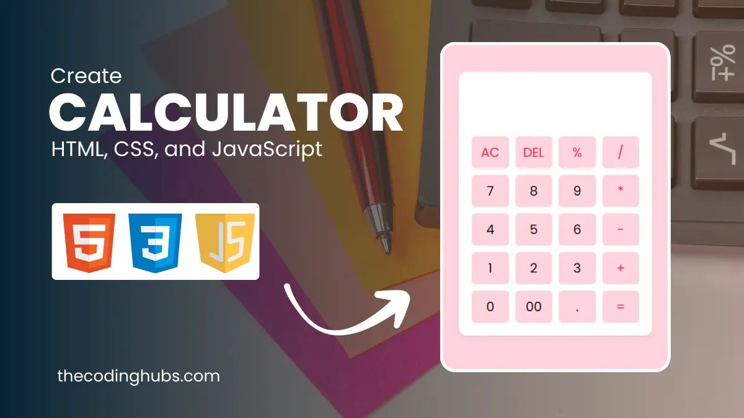
CALCULATOR PROGRAM PROJECT
NAME: DHANUSHYA V ORGANIZATION: Micro IT TOPIC: CALCULTOR PROGRAM PROJECT

Slide 2
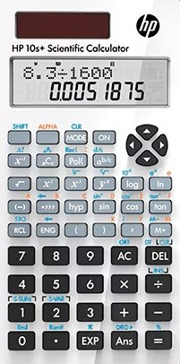
agenda
INTRODUCTION
A calculator is a software tool used to perform arithmetic operations. This project focuses on developing a basic calculator program using Python, which performs operations like addition, subtraction, multiplication, and division.

Slide 3
OBJECTIVES OF THE PROJECT
To understand basic programming concepts.
To learn GUI programming (if applicable).
To apply logic for arithmetic operations.
To implement exception handling and input validation.

Slide 4

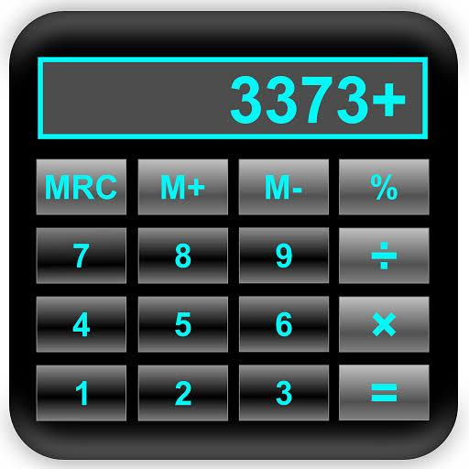
WHAT IS A CALCULATOR?
A calculator is an electronic or software device that performs arithmetic operations on numbers.
It helps users perform quick calculations without manual effort.

Slide 5
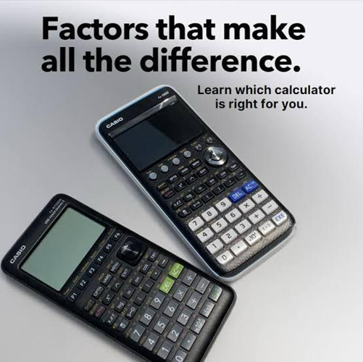
TYPES OF CALCULATORS
Basic Calculator
Scientific Calculator
Graphing Calculator
Financial Calculator

Slide 6
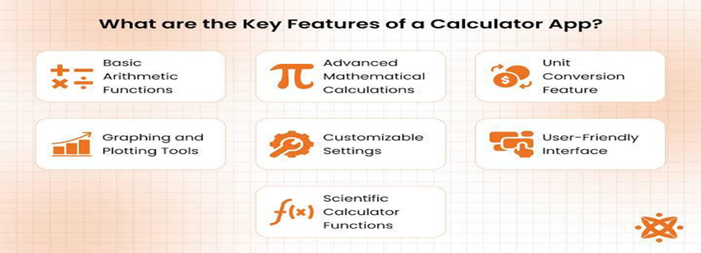
FEATURES OF THE CALCULATOR PROGRAM
Addition, Subtraction, Multiplication, Division
Clear/Reset Function
Input Validation
Error Handling (e.g., divide by zero)

Slide 7
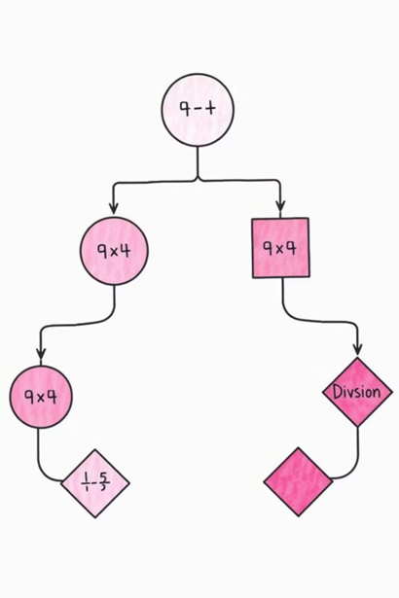
PROGRAMMING TOOLS USED
PYTHON (for programming)
Kinter (for GUI design)
VS Code / IDLE (as IDE)
Basic Math Logic

Slide 8
PROGRAM FLOW / LOGIC
User inputs numbers and selects operation
Perform the selected operation
Display result
Handle errors gracefully
Option to reset and continue

Slide 9
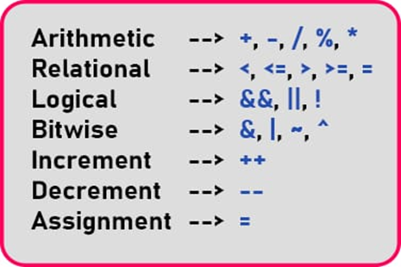
KEY LEARNINGS FROM PROJECT
Learned the basics of programming logic
Understood how GUI applications are built
Gained hands-on experience with Python
Improved problem-solving and debugging skills

Slide 10

CONCLUSION
This project helped me bridge the gap between theory and real programming.
It improved my logical thinking, understanding of code structure, and built my confidence in using Python.

Slide 11
THANK YOU

